Slide 1
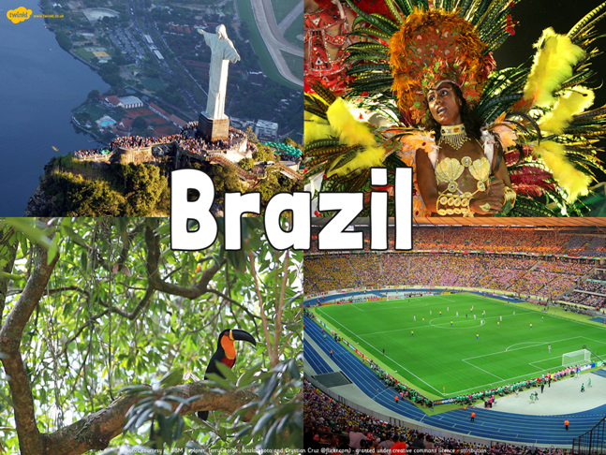
Week 5

Slide 2
Brazil – what do you know?
Name two countries which border Brazil?
Can you name one of the regions of Brazil?
What is the name given to the process of people moving from the countryside to the city?
What is the name given to shanty towns?

Slide 3
Brazil – what do you know?
Name two countries which border Brazil?
  Suriname, Venezuela, Guyana, Paraguay, Argentina, Peru, Colombia, Uruguay, French Guiana, Bolivia
Can you name one of the regions of Brazil?
  Caatinga, Pantanal, Pampas, Amazonias, Mata Atlantica, Cerrado
What is the name given to the process of people moving from the countryside to the city? Urbanization
What is the name given to shanty towns? Favelas

Slide 4
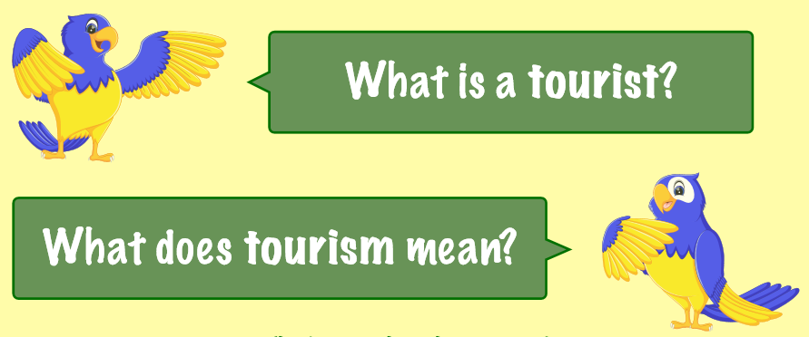
LC: Can I explore Brazil as a tourist destination?

Slide 5
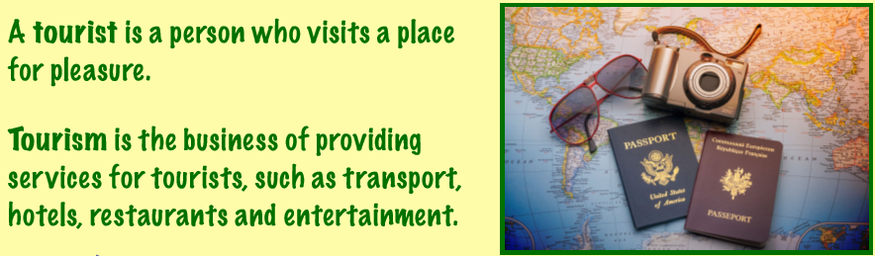

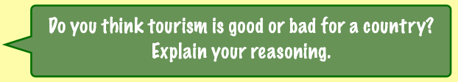

Slide 6


Slide 7
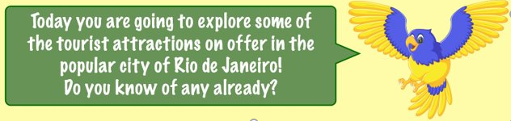
Around 5 and a half million tourists visit Brazil each year. About a third of all foreign visitors are from Europe, with around 150,000 people arriving from the UK.
However, the vast majority of tourists are from other South American countries: Argentina leads the way, with more than one and a half million holidaymakers. The USA holds second place – one in every ten foreign tourists in Brazil is American.

Slide 8
Watch the video – make notes!
https://www.youtube.com/watch?v=mG9Ot8dVmWQ

Slide 9
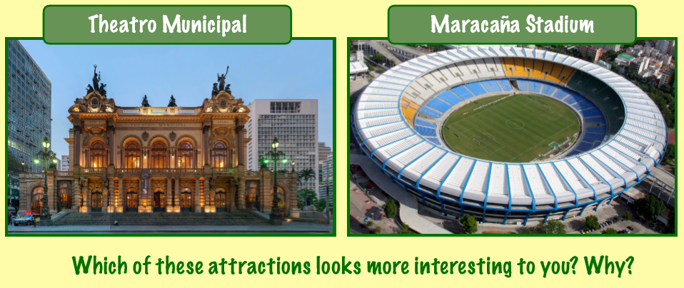

Slide 10
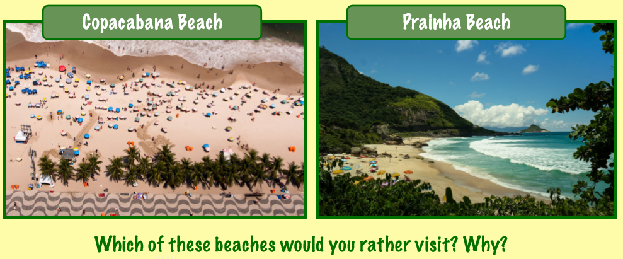

Slide 11
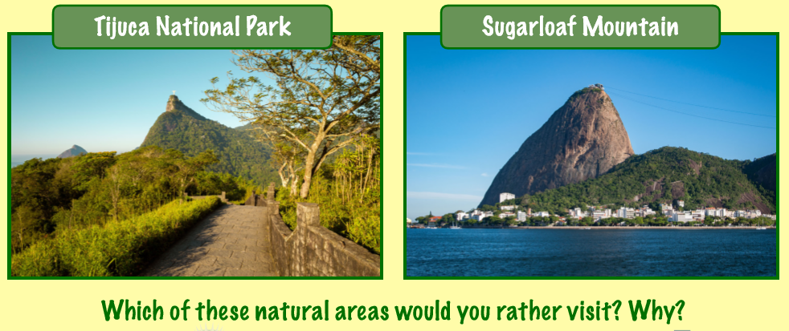

Slide 12
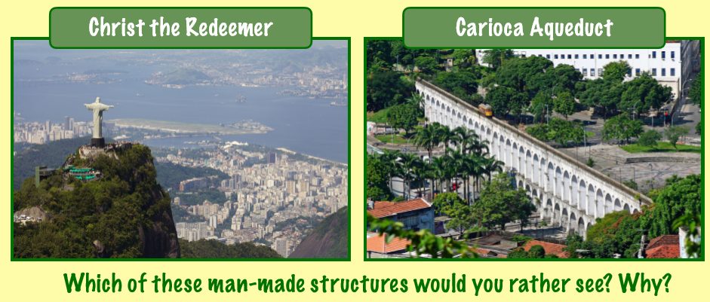

Slide 13

Read through the tourist attraction cards on your table.
Decide on the attraction that you think you would like to visit if you went to Rio.
There are then two tasks for you to choose from.

Slide 14
Task 1
As a member of the Rio de Janeiro tourist information board your task is to attract tourists to visit your city by producing a tourist guide to the city.
Your guide should include the following information:
- The location of the city
- The major human and physical landmarks
- The best places to visit and explore in the city

Slide 15

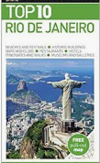
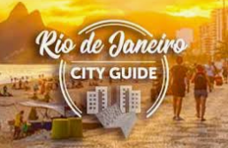

Slide 16
Task 2 – Write a review for Tripadvisor
Read through the tourist information cards.
Decide on your favourite destinations and try to imagine that you have visited them.
Write a Tripadvisor review which would help tourists to decide if they want to visit those locations.

Slide 17


