Slide 1
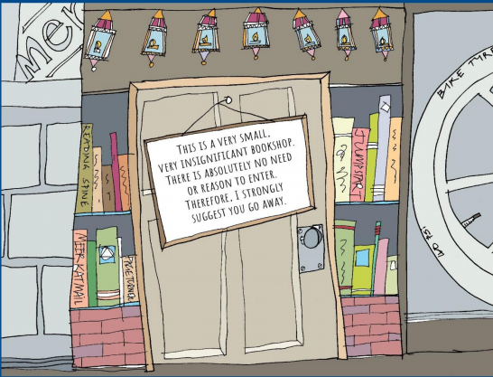

Slide 2

Year 3 and 4 English Home Learning
Week Commencing 29th June 2020

Slide 3
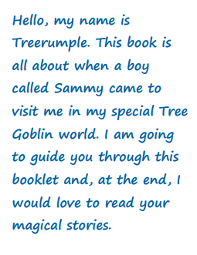
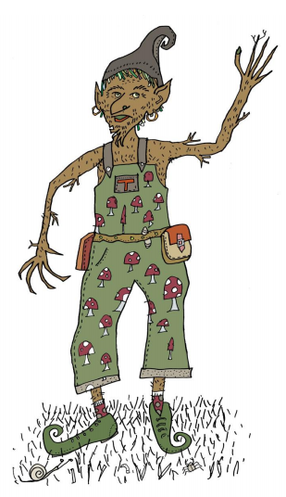

Slide 4
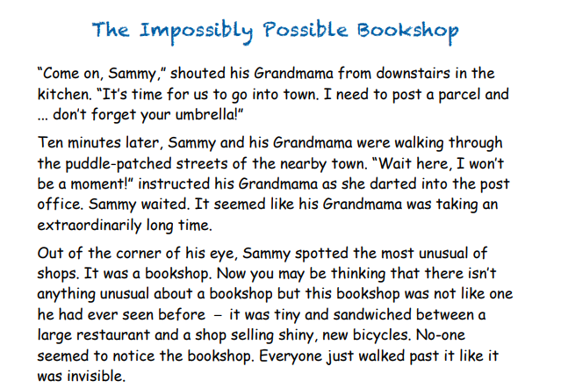

Slide 5
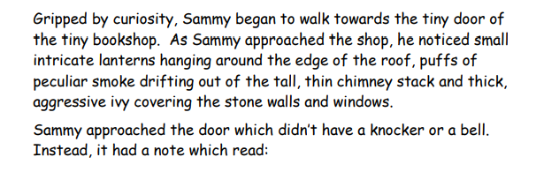
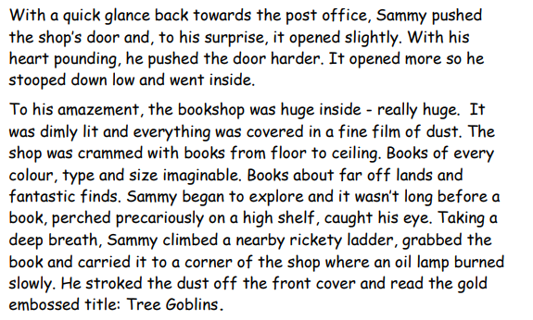

Slide 6
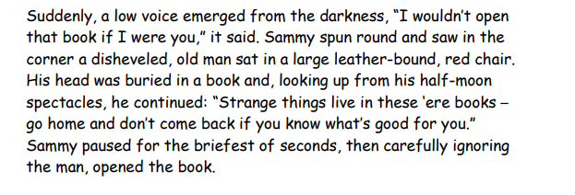
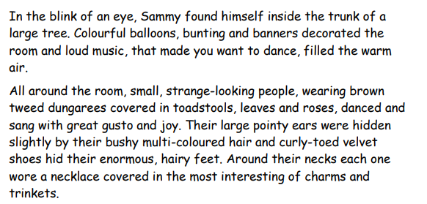

Slide 7
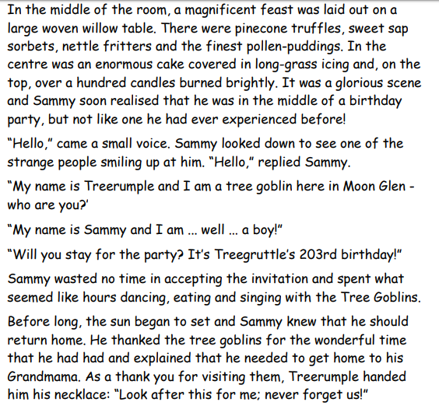

Slide 8
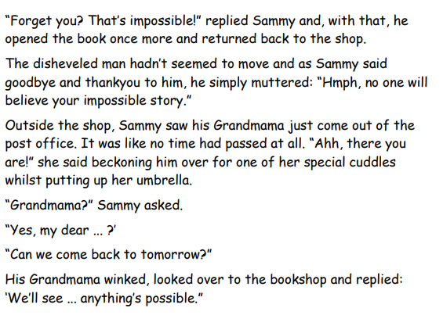
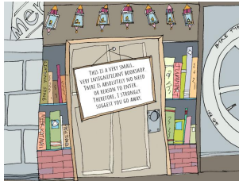

Slide 9
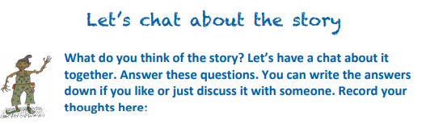
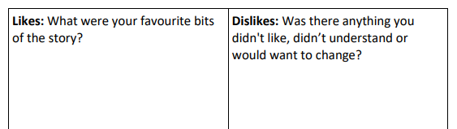
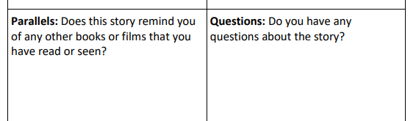
Lesson 1 – L.C Can I be a text detective?

Slide 10
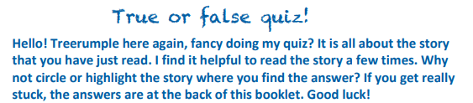
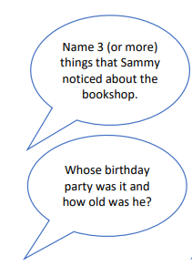
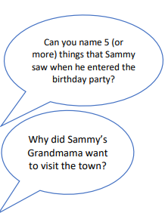
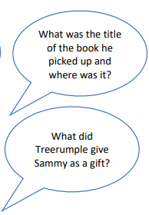

Slide 11
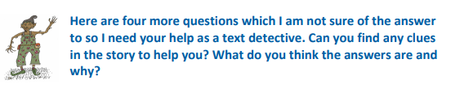





Slide 12

Lesson 2 – L.C Can I show an understanding of new and exciting vocabulary?

Slide 13
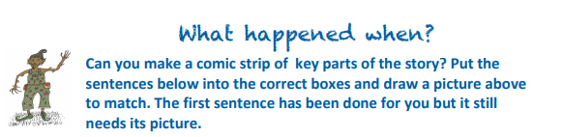
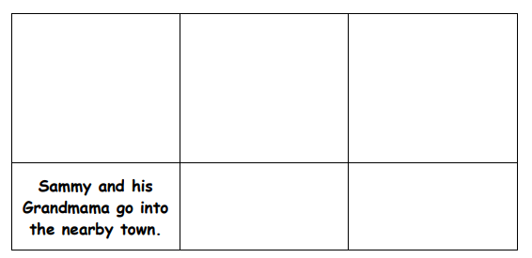
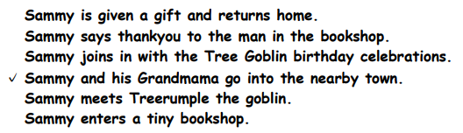
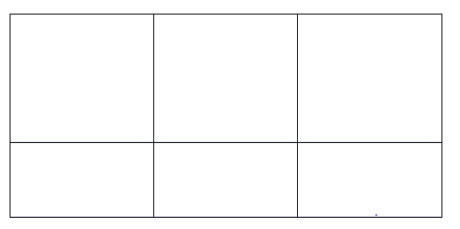
Warm up activity

Slide 14
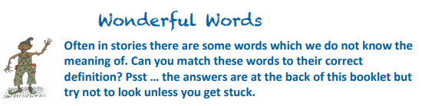
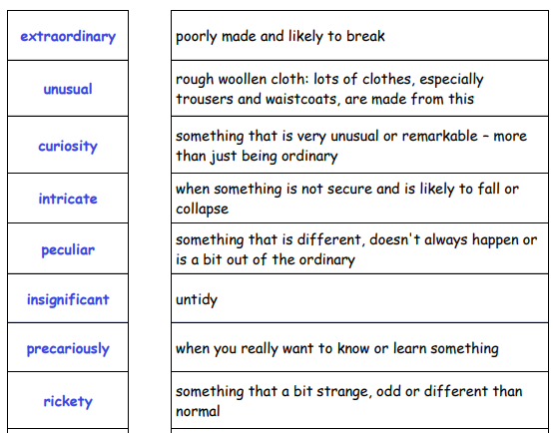
Vocabulary Focus
Activity is over 2 slides. Please move to next slide for more vocabulary and definitions.

Slide 15
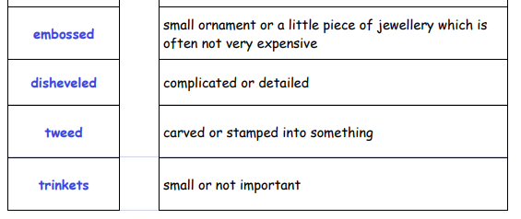

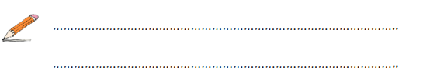

Slide 16
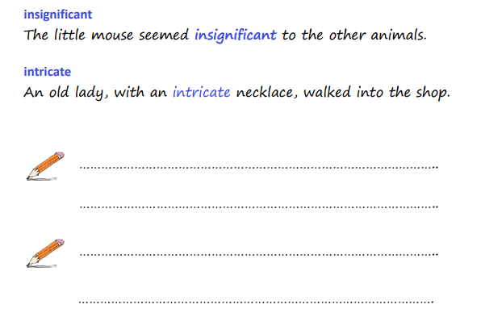

Slide 17

Lesson 3 – L.C Can I begin to create my own goblin character?

Slide 18
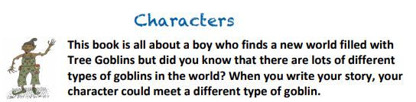


Slide 19
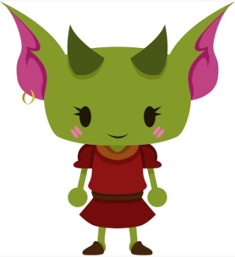
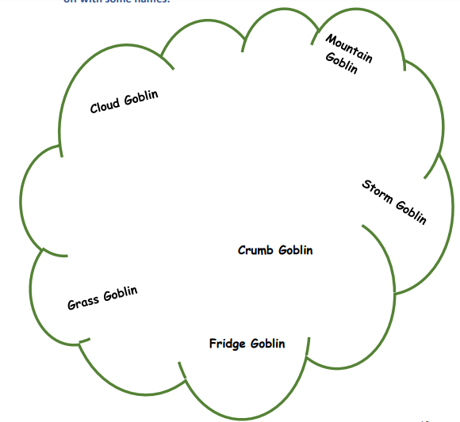
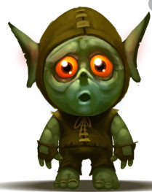
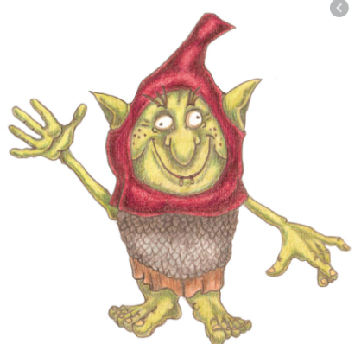

Slide 20
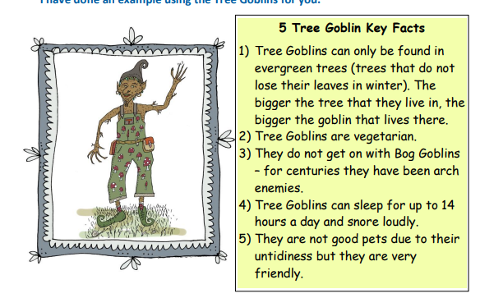

Slide 21

You can print this frame below or you could create your own frame for your 3 goblin designs.

Slide 22


Lesson 4 – L.C. Can I use prepositions in my writing?

Slide 23

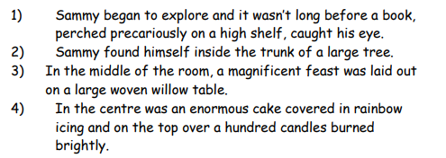
Here are some sentences from the story. Circle all of the prepositions you can find. (Watch out! Some sentences have more than one prepositions.)

Slide 24
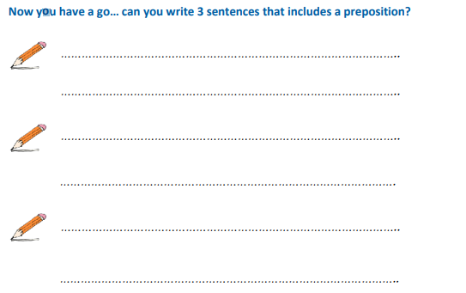

Slide 25
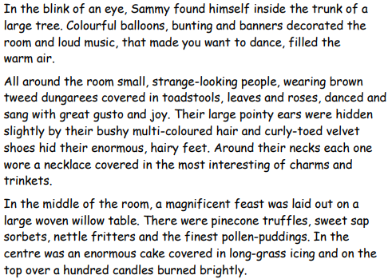
Lesson 5 – L.C Can I begin to create a setting that suits my character?

Slide 26

Using the description of the setting on the previous slide, can you highlight all of the things that Sammy can see?

Slide 27
Think about the goblin you have designed this week.
Can you make a note of what a character might find when they stumble across your goblin’s party? Have a go at drawing it first and labelling it.

Slide 28
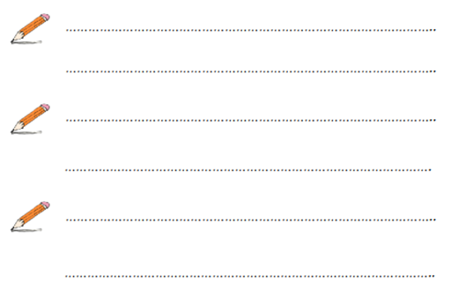
Now, can you write 3 or more sentences to describe your goblin’s party.
When writing your sentences think about,
The senses; what can be seen, smelt, heard etc
Prepositions
Capital letters and full stops
You can use the same sentence starters as the example to help you if you need to.
All around the room.....
In the middle of the room....

