Slide 1


Slide 2

Florence Price
Symphony No. 1 in E minor (3rd mvt)
LC: Can you compose a piece of Music?

Slide 3

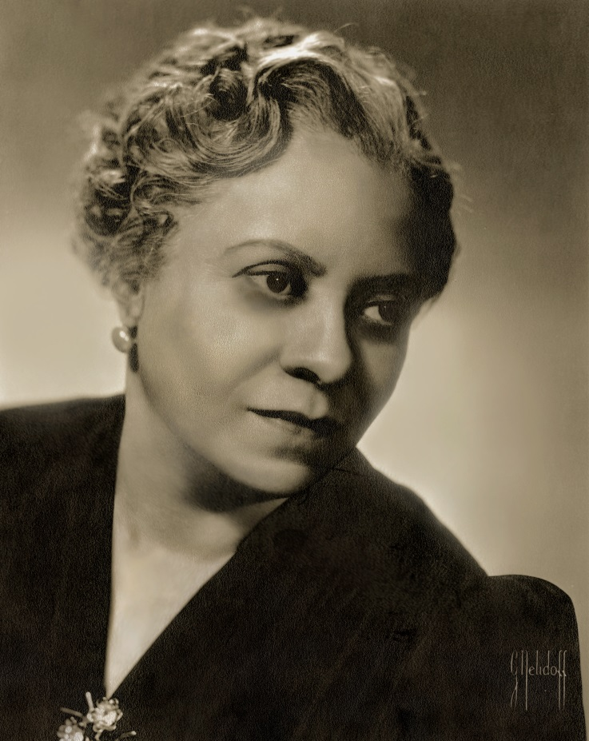
Trailblazer
African-American composer Florence Price overcame much prejudice to become the first black female composer to have her work performed by a major orchestra.

Slide 4
Lesson outcomes
After this lesson, pupils will be able to:
listen and reflect on a piece of orchestral music
create their own piece of music using instruments and voice
learn musical language appropriate to the task

Slide 5
Glossary of music terms
Term | Definition
Coda | a fancy, show-off ending
Ostinato | a repeating (often rhythmic) pattern
Pitched percussion | percussion instruments that can play different pitches – xylophones, glockenspiels, chime bars, etc.
Pulse | the steady ‘beat’ under much music made up of notes of the same length (like a ticking clock)
Rondo | (or Rondeau) a music shape with a recurring theme. The theme is alternated with contrasting ‘episodes’
Unpitched percussion | percussion instruments that can only make a limited number of sounds – drums, shakers, woodblocks, tambourines, etc.

Slide 6

Background – the composer
Florence PRICE
(1887–1953)
African-American composer
First black woman to have a composition played by a major American orchestra
Wrote four symphonies (and many songs and chamber music)

Slide 7
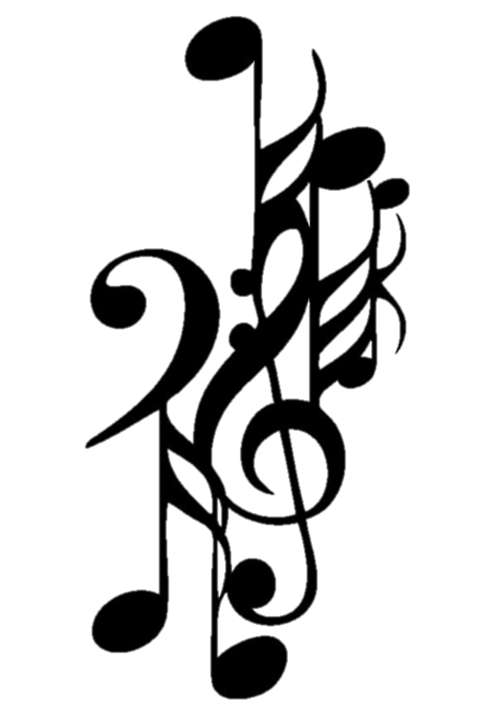
Background – the music
Symphony No. 1 in E minor (3rd mvt)
Her first large-scale orchestral work
Written in 1931-32 and premiered by the Chicago Symphony Orchestra in 1933
Third movement is called ‘Juba Dance’
Also known as the ‘hambone’, or ‘pattin’ juba’, this dance was performed by slaves and featured music provided by their own body percussion
The juba dance is the forerunner to tap dancing

Slide 8
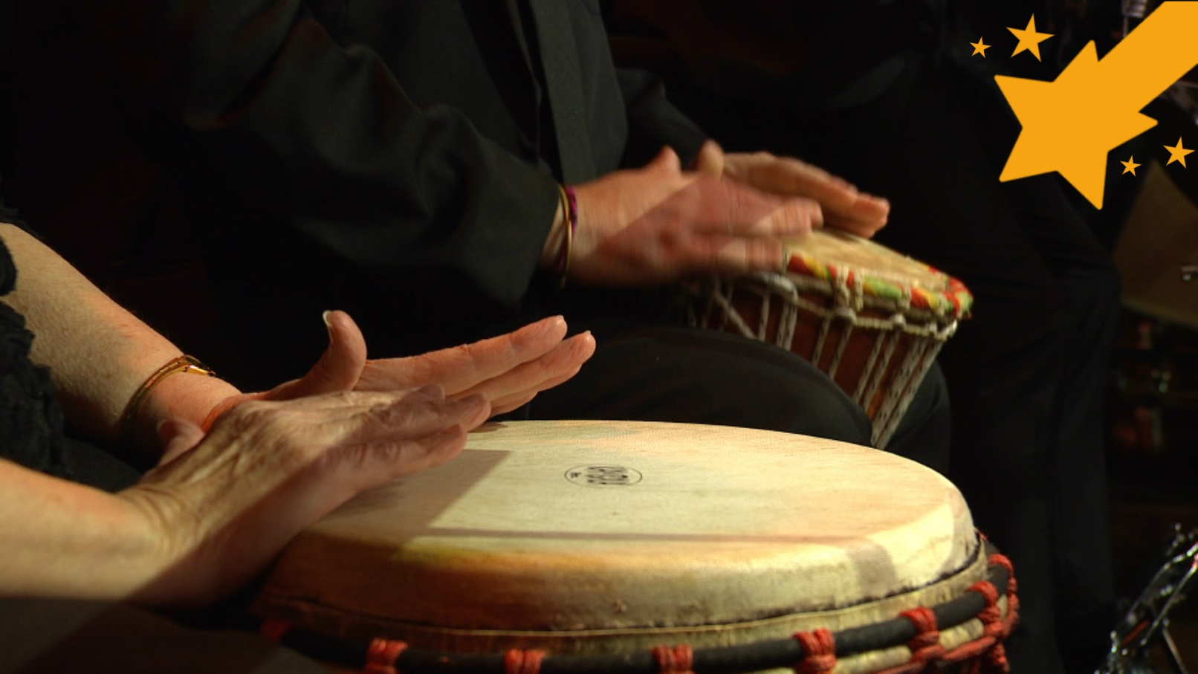

Watch the orchestral performance

Slide 9
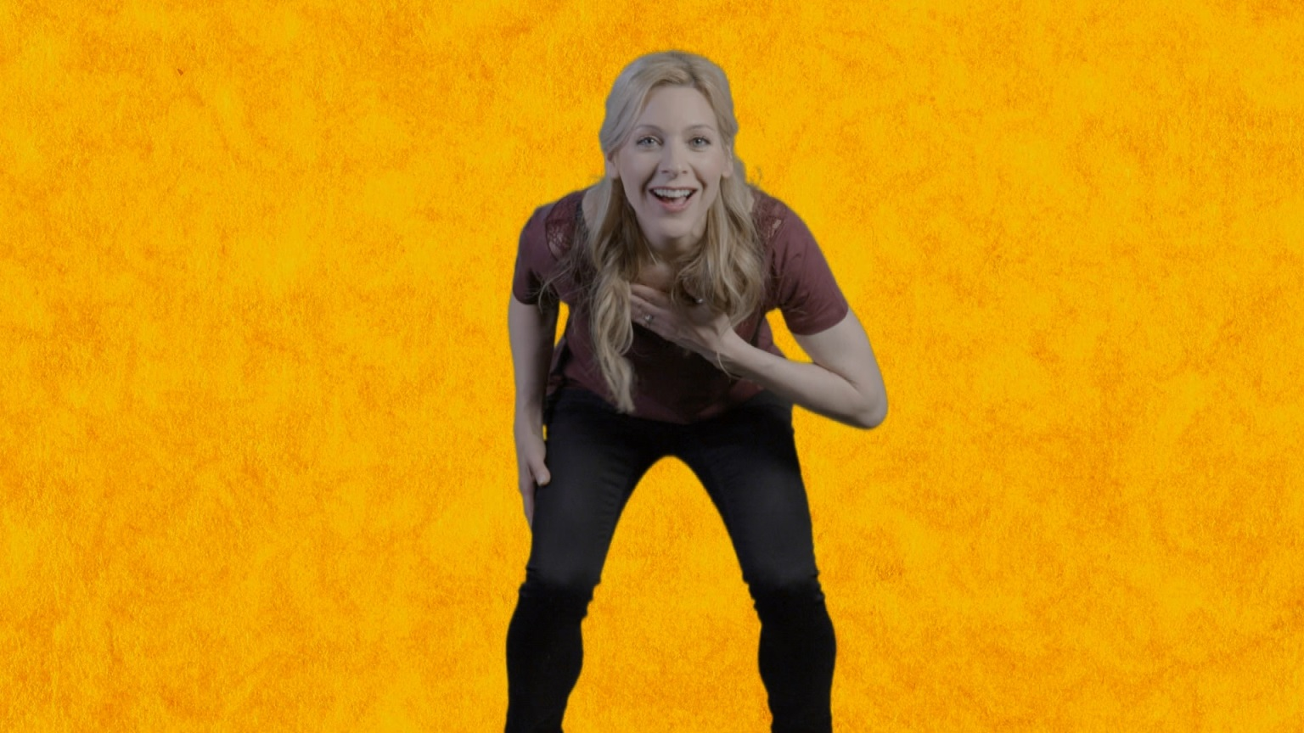
Learn the juba dance!

Slide 10
‘pattin’ juba’ = body percussion

Slide 11

Use body percussion to try out these rhythms.
By playing them over and over you are making an ‘ostinato’

Slide 12
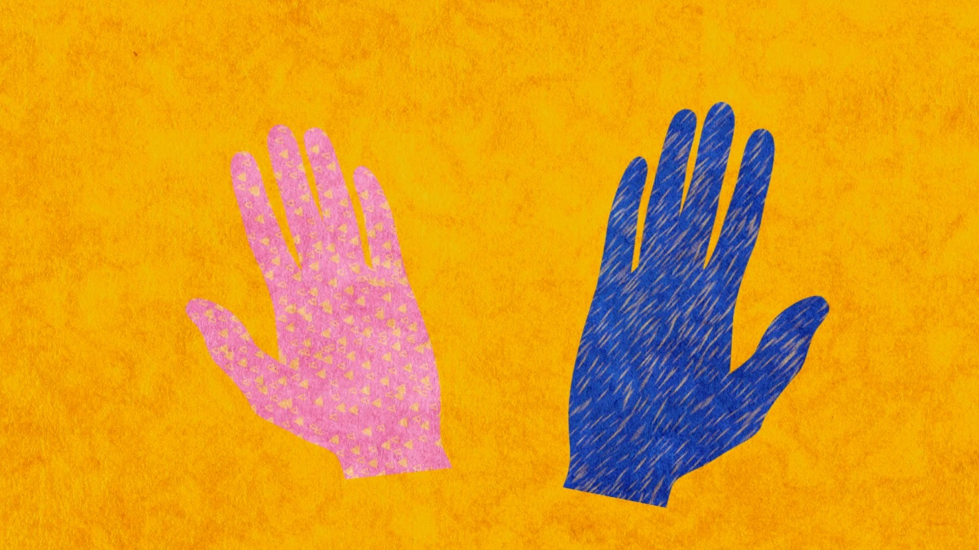
Warm up with some body percussion!

Slide 13
The ‘walking circle’ is the pulse of the piece. It is an ‘um-pah’ pulse

Slide 14
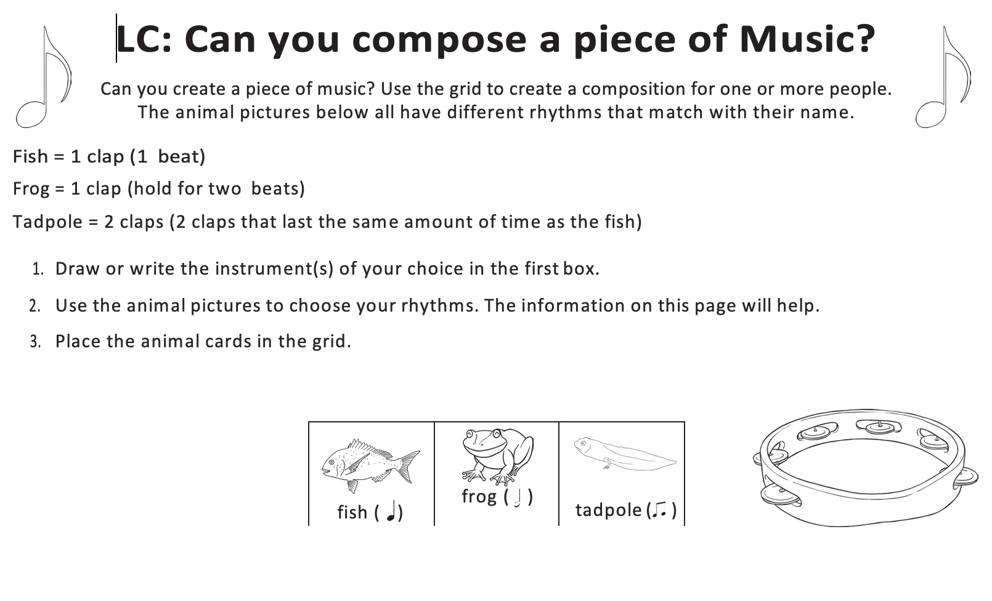
Activity - Rhythm

Slide 15
Taking it further – cross-curricular activities
MUSIC: Florence Price wrote four symphonies. In each one, the third movement is a ‘juba dance’. Her tastes and skills increased the more she wrote so these juba dances are very different to each other. Compare and contrast them, which is the best and which one are you going to dance to next?
RESEARCH: The juba dance developed into tap dancing largely because of a very famous African-American dancer called ‘Master Juba’. Tap dancing then grew into street dancing. Research Master Juba’s story and the history of these dance styles or have a go at tap dancing!
LITERACY: Florence was from a wealthy African-American family but she grew up in very difficult times when the American South was segregated and there were strict laws for how black people should behave. This affected her everyday life; she would have been banned from ‘whites only’ places and unable to travel around freely. Imagine how that must have felt and write a letter in her voice.

