Slide 1
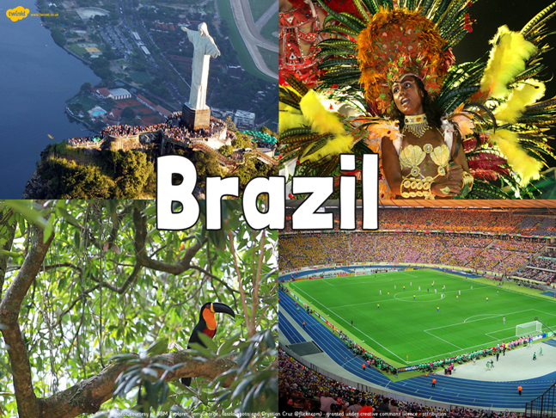
Week 5

Slide 2
Brazil – what do you know?
Name two countries which border Brazil?
Can you name the continent which Brazil is part of?
What is the capital city?
What is the name given to shanty towns which are built on the outskirts of cities in Brazil?

Slide 3
Brazil – what do you know?
Name two countries which border Brazil?
  Suriname, Guyana, French Guiana, Uruguay, Paraguay, Bolivia, Colombia, Argentina, Venezuela, Peru
Can you name the continent which Brazil is part of? South America
What is the capital city? Brasilia
What is the name given to shanty towns which are built on the outskirts of cities in Brazil? Favelas

Slide 4
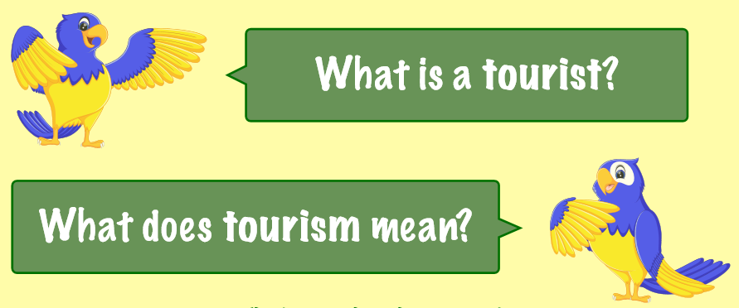
LC: Can I explore Brazil as a tourist destination?

Slide 5
Watch this video – is this somewhere you would like to visit on holiday?
https://www.youtube.com/watch?v=gYy1RITRN9s

Slide 6
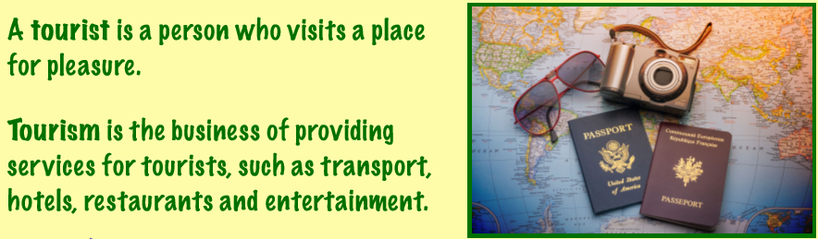

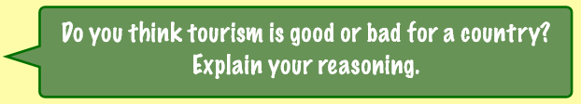

Slide 7


Slide 8
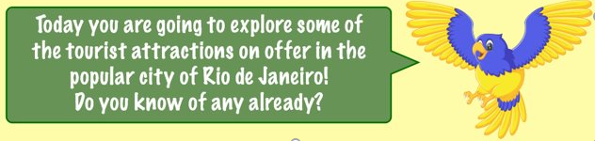
Around 5 and a half million tourists visit Brazil each year. About a third of all foreign visitors are from Europe, with around 150,000 people arriving from the UK.
However, the vast majority of tourists are from other South American countries: Argentina leads the way, with more than one and a half million holidaymakers. The USA holds second place – one in every ten foreign tourists in Brazil is American.

Slide 9
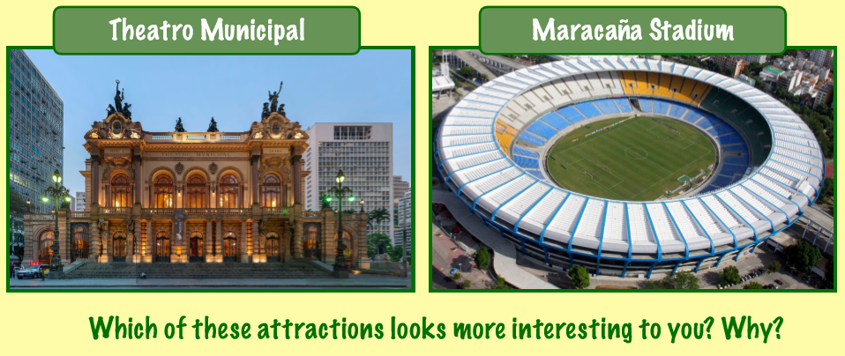

Slide 10
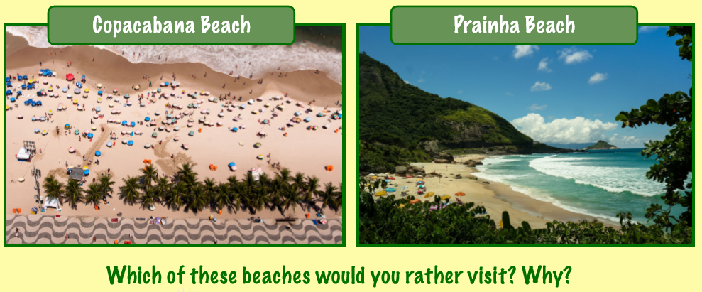

Slide 11
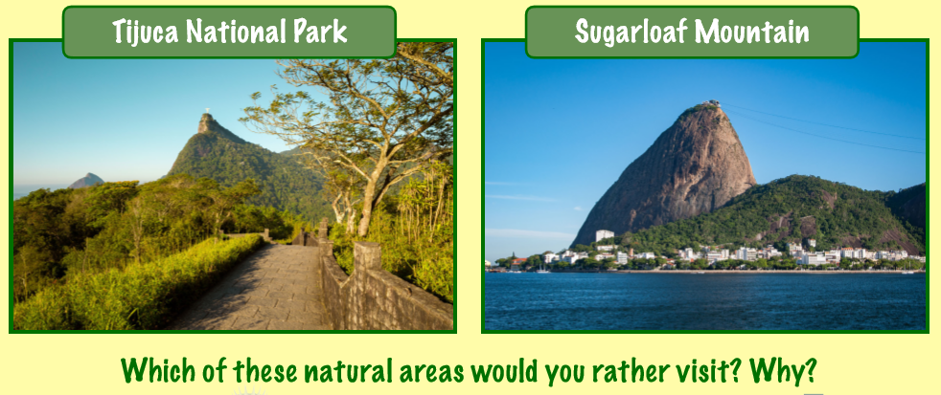

Slide 12
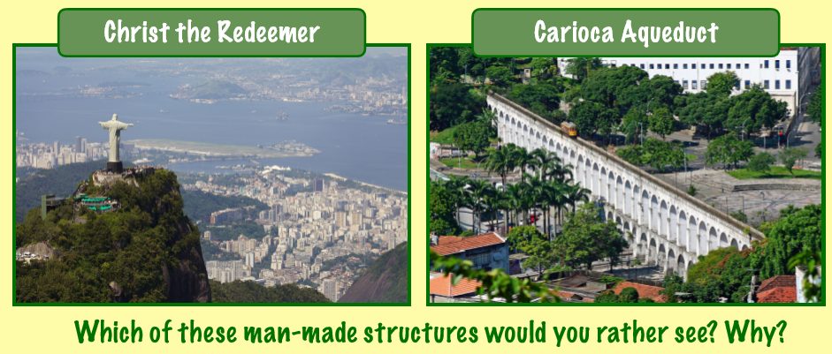

Slide 13
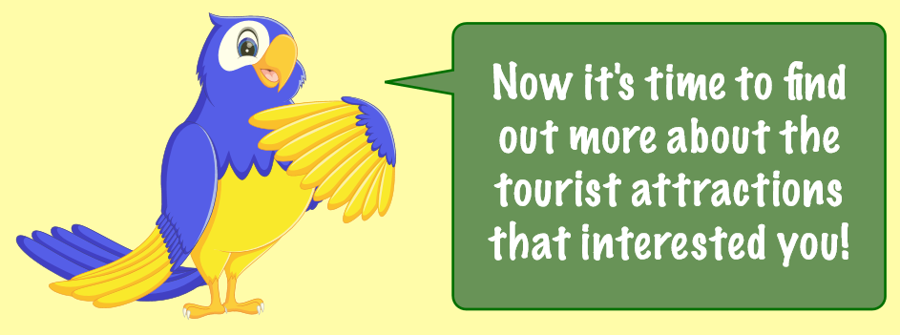
Read through the tourist attraction cards on your table.
Decide on the attraction that you think you would like to visit if you went to Rio.
There are then two tasks for you to choose from.

Slide 14
Task 1 – Write a review for Tripadvisor
Read through the tourist information cards.
Decide on your favourite destinations and try to imagine that you have visited them.
Write a Tripadvisor review which would help tourists to decide if they want to visit those locations.

Slide 15
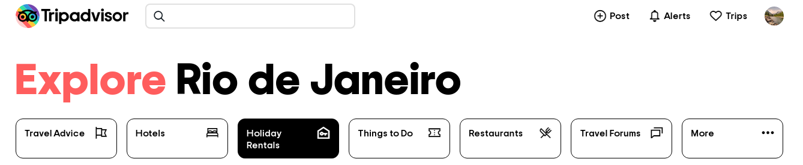
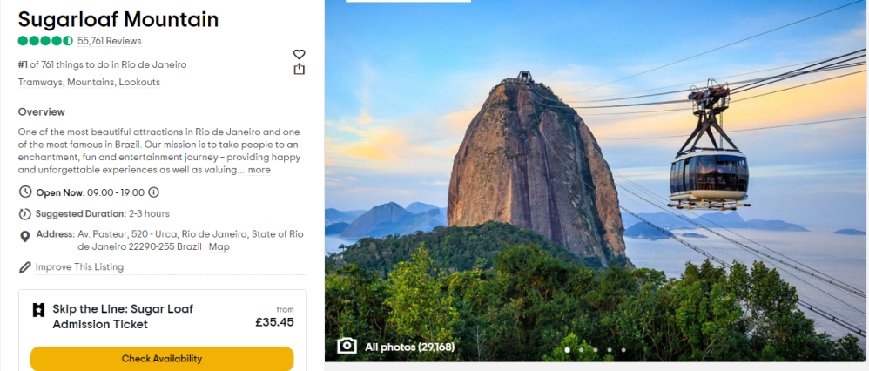
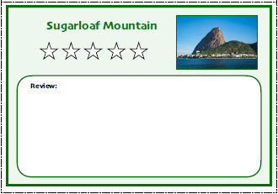
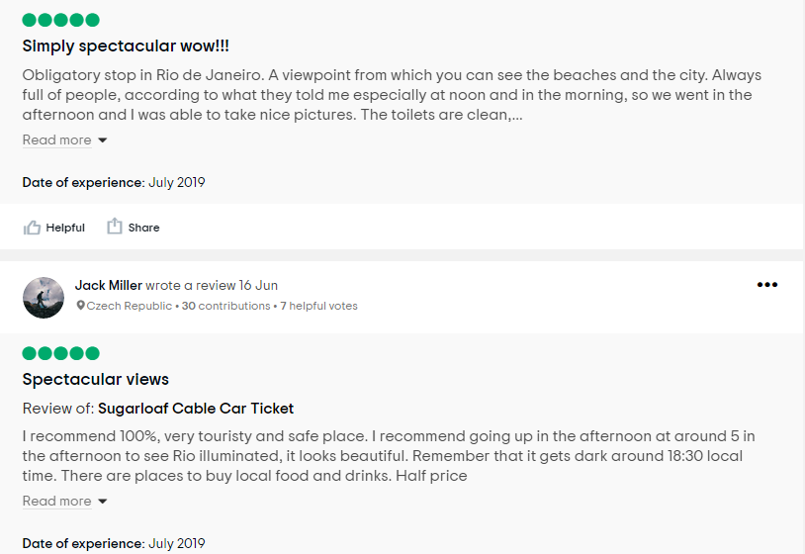

Slide 16
Task 2 – Write a postcard home
Imagine you have been on holiday to Rio de Janeiro
Write a postcard home describing what you have done / favourite places that you have visited.
Can you describe the climate?

Slide 17



