Slide 1
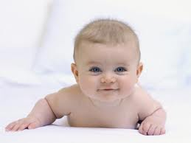

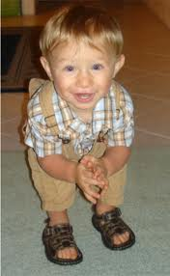
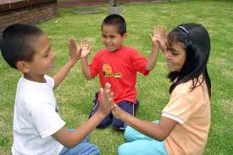
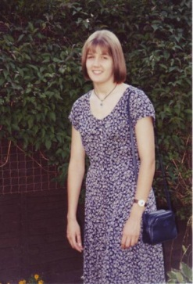
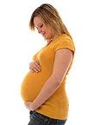
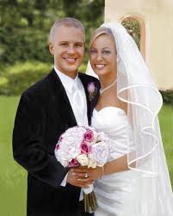
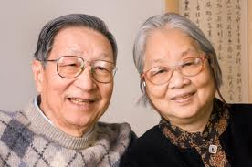
How do humans change and grow?

Slide 2
How do humans change and grow?
In this lesson we will look at the different stages of growth and development.
We will be able to recognise, name and order these different stages of growth and state some of the key facts about each stage.
https://www.bbc.co.uk/bitesize/clips/z4tmhyc

Slide 3
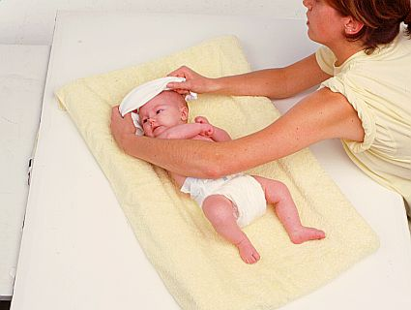
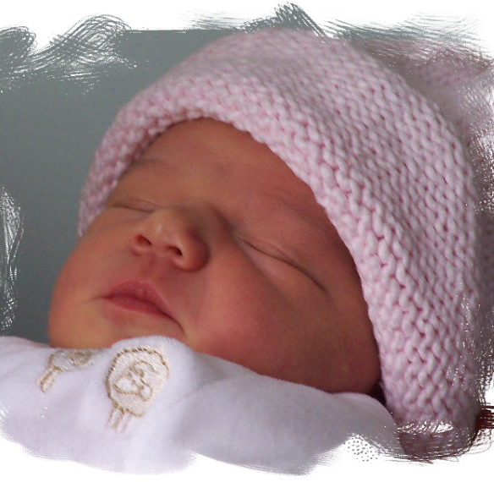
Babies
Babies can do nothing for themselves when they are first born.
They need a parent to do everything for them

Slide 4
Babies
What does a parent do
to take care of a baby?

Slide 5
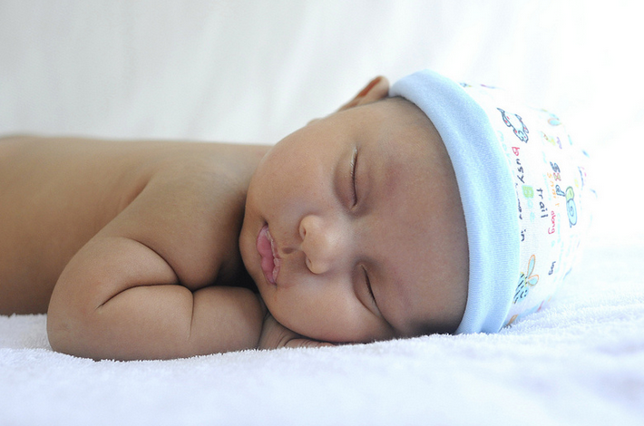
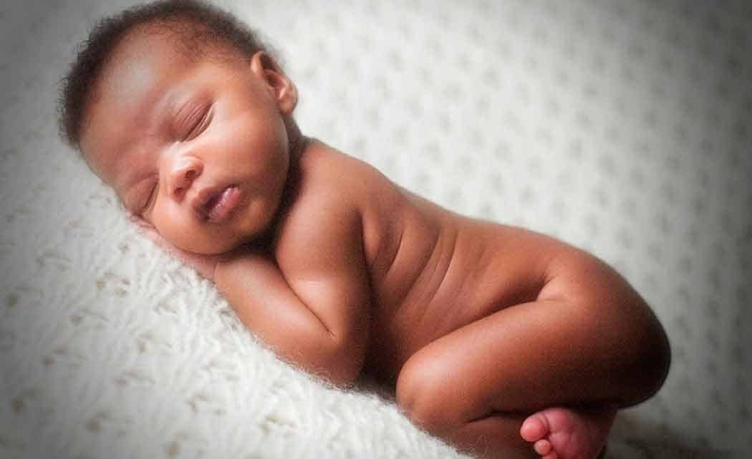
Babies
What does a parent do to take care of a baby?
Feed the baby milk.
Keep the baby clean and healthy by changing its nappy and bathing it.
Make sure the baby is warm and comfortable.
Play with the baby.
Give the baby lots of love.

Slide 6
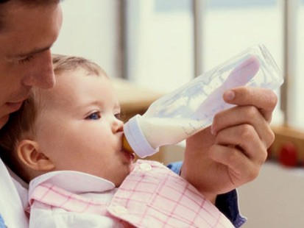
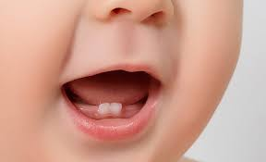
Babies
Babies drink milk.
This is because they have no teeth.
As they get older they start to grow milk teeth.

Slide 7
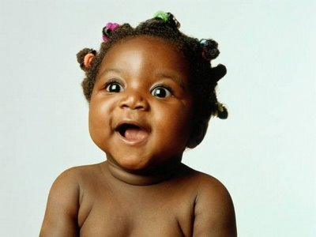
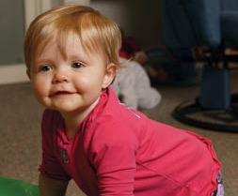
Toddlers
As babies grow they turn into toddlers.
At about 12-18 months (1- 1 ½ years old).
A toddler is a child who is just learning to walk and talk - they are a bit wobbly on their feet!

Slide 8
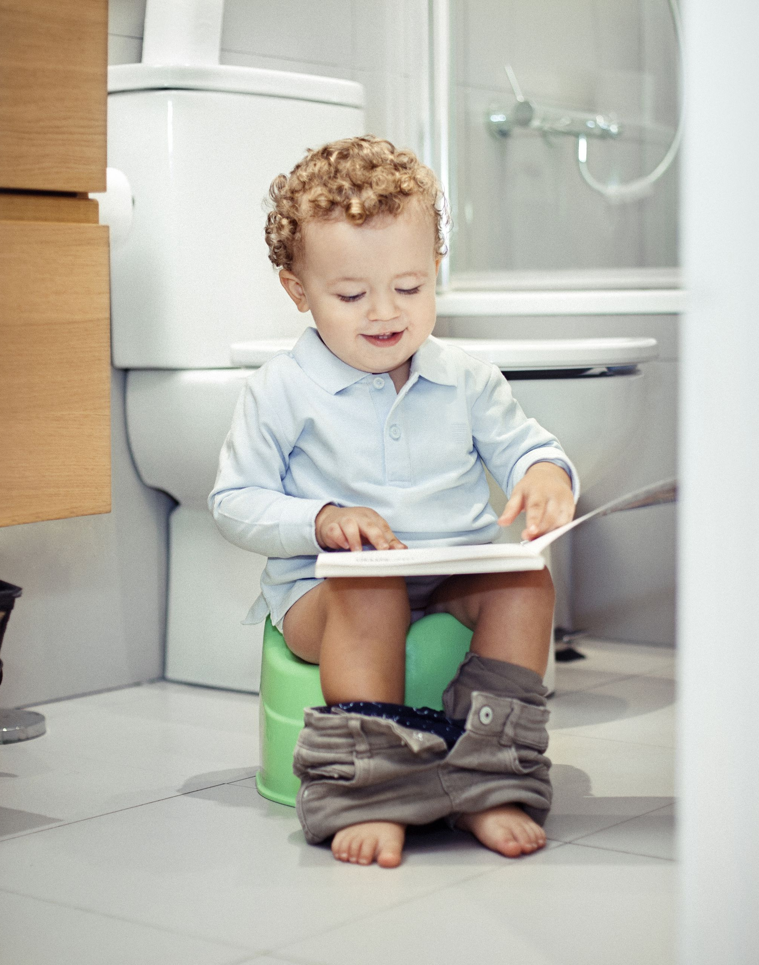
Toddlers
Toddlers start to be more independent of their parents.
They start trying to do things for themselves and develop lots of new skills such as holding the spoon when feeding or building a tower of bricks.

Slide 9
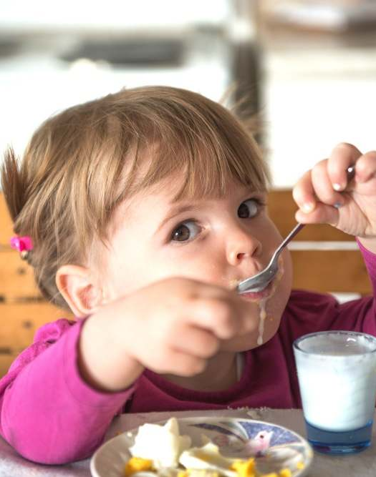
Toddlers
They stop drinking just milk and start to try lots of different food.
Toddlers grow and develop muscles to help them move around.

Slide 10
Toddlers
What does a parent have to do to their house to take care of a toddler?

Slide 11
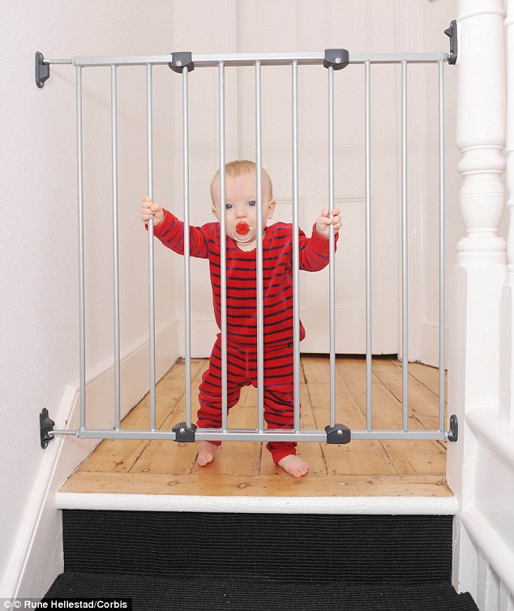
Toddlers
What does a parent have to do to their house to take care of a toddler?
Fit a stair gate to stop accidents when the toddler wants to go exploring.
Cover all plug sockets so a toddler can’t stick things into them.
Buy toys that are safe to play with.

Slide 12
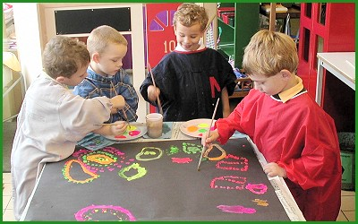
Children
Children are aged 3-12.
In the UK, children go to school.
Children learn to do things for themselves.
Think about the things you can do now that you couldn’t do in Reception.
What things can the older children do better than you?

Slide 13
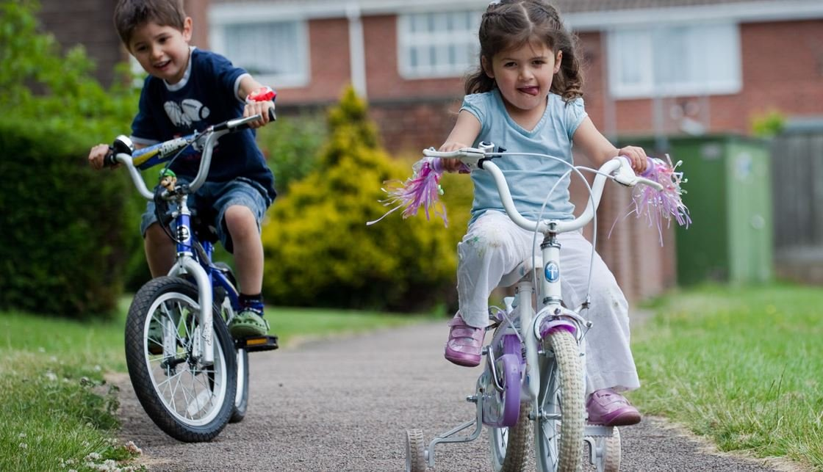
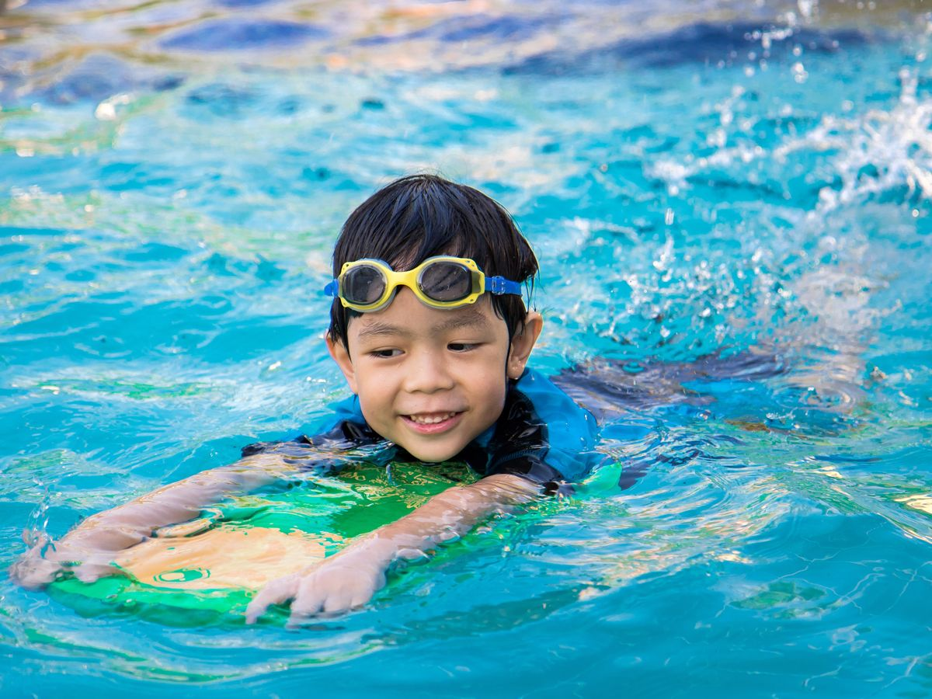
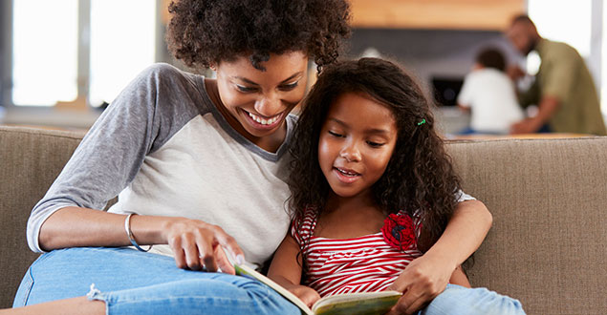
Children
This is the stage of life you are at now!
During these years you learn lots of new skills such as reading and writing, counting, kicking a ball, swimming and riding a bike.
You have lots of new experiences like starting school, going on a sleepover or getting a pet.
You try different foods and develop tastes you like and dislike.
You grow, both in body size and weight.

Slide 14
Children
What changes are happening to you at the moment?

Slide 15
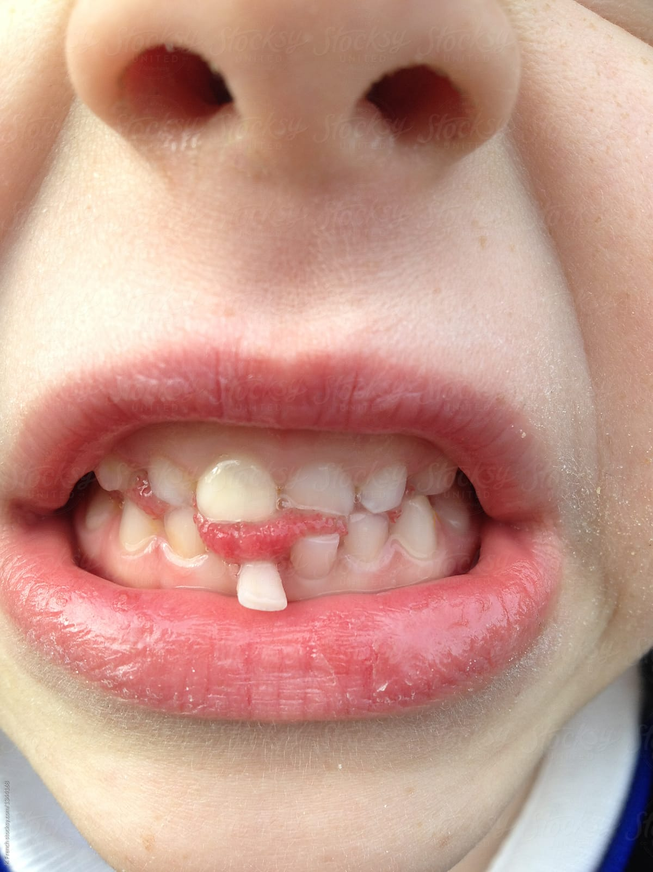
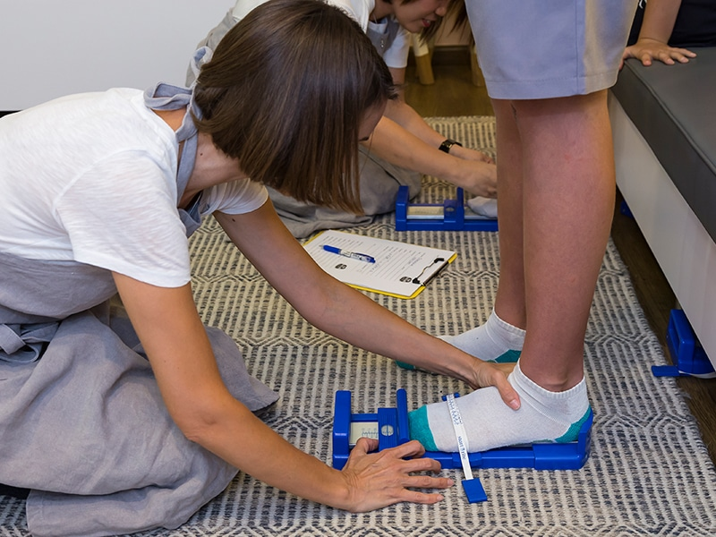
Children
What changes are happening
to you at the moment?
Wobbly tooth.
New shoes because your feet have grown.
Starting to go to play at a friend’s
house without mum or dad being there.
Going to bed later.

Slide 16
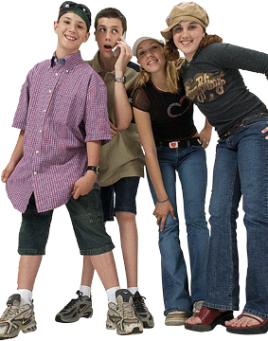
Teenagers
As children grow, they become teenagers.
Children start to become teenagers when they are 13.
This is the time when a child starts to turn into an adult.
They finish being a teenager the day
they turn 20.

Slide 17
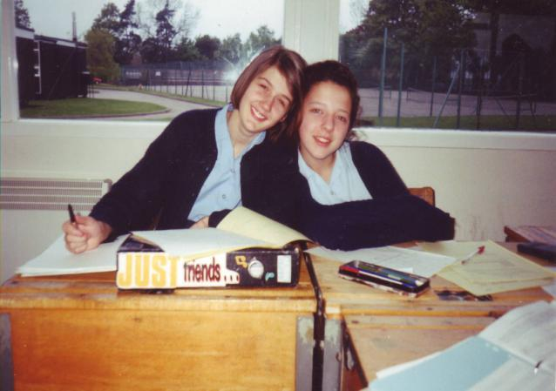
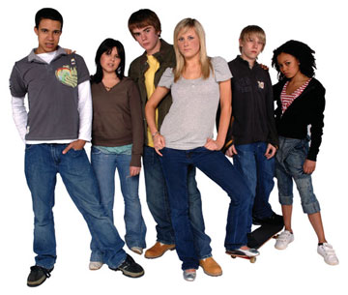
Teenagers
All the time they are teenagers their bodies are changing …. fast!
Teenagers eat lots!!! This is because they are growing and changing a lot.
They can get spots and their hair changes.
They can sometimes be a bit grumpy! This is because new hormones are growing and changing in their body.

Slide 18
Teenager
How can you tell someone is a teenager?

Slide 19
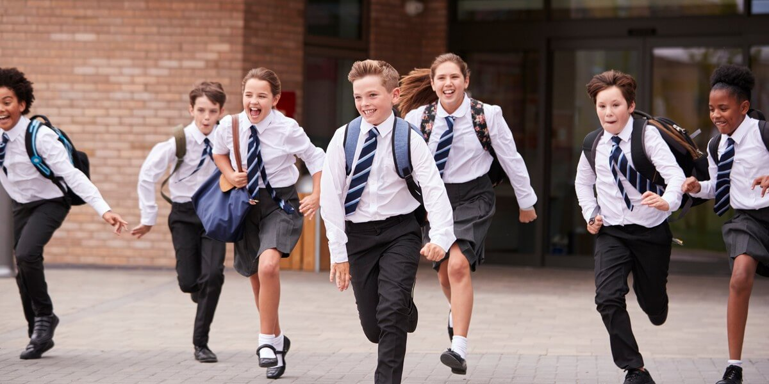

Teenager
How can you tell someone is a teenager?
Taller than a child.
Often out without a parent to look after them.
Might have spots.

Slide 20
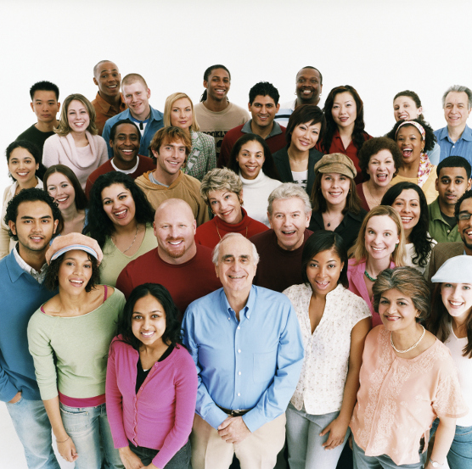
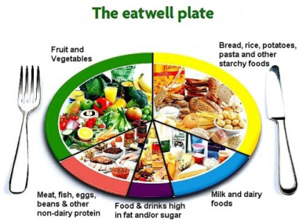
Adults
Adults are mature and fully grown – they have stopped growing.
Adults can do things for, and by, themselves.
It is important continue to eat healthily and exercise to keep their body working well.

Slide 21

Adults
When a person becomes an adult, they usually start work.
Why do you think they need a job?
What jobs do some of the adults you know do?
What job might you like to do when you are an adult?

Slide 22
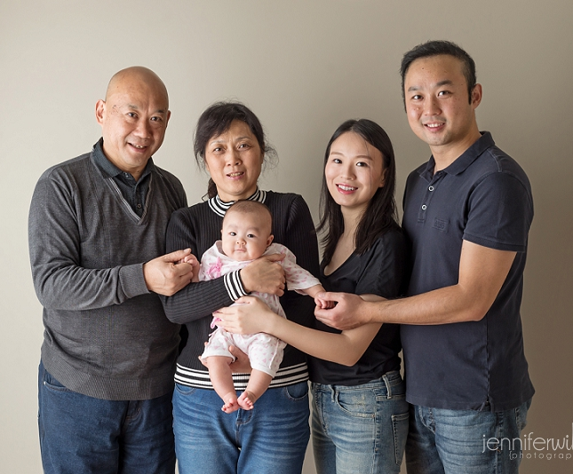
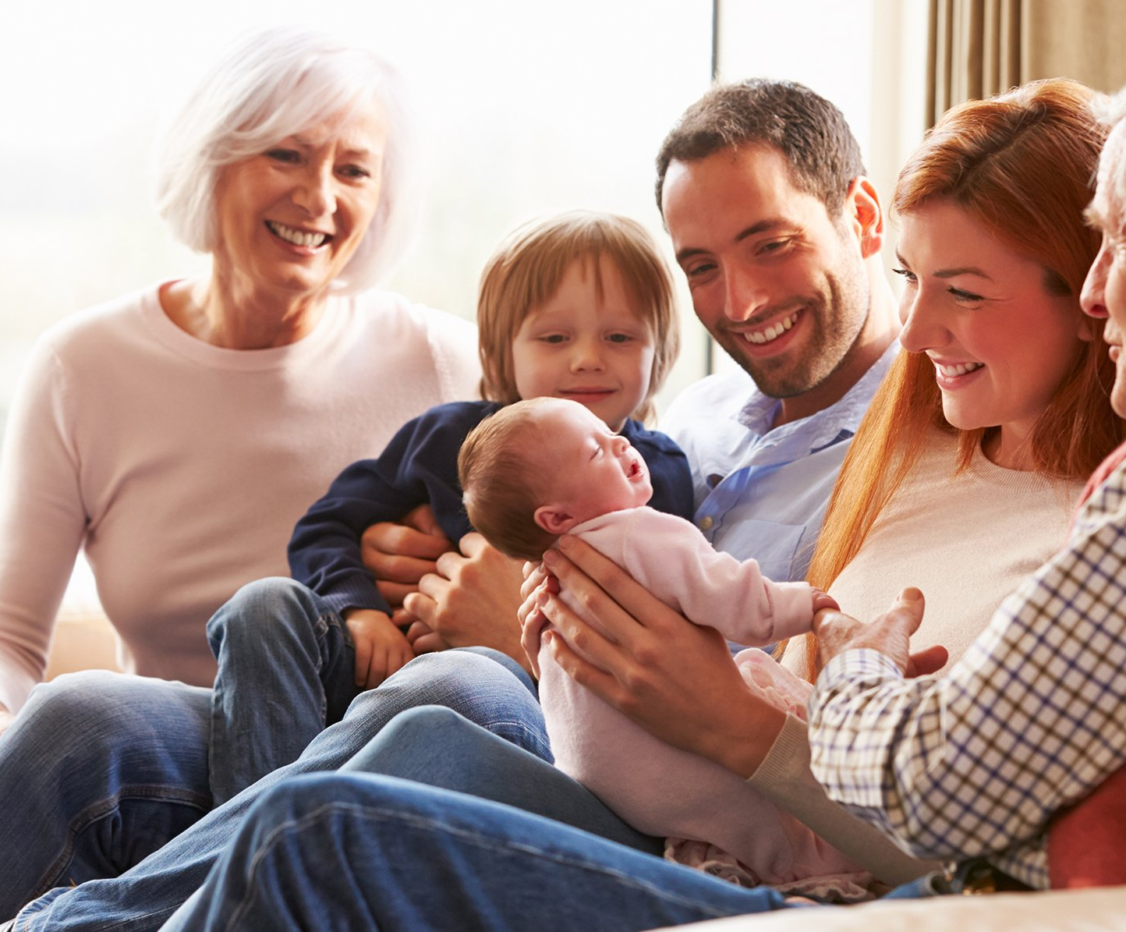
Adults
They can have babies of their own!
Adults can become parents…
…and then grandparents!

Slide 23
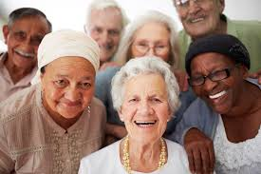
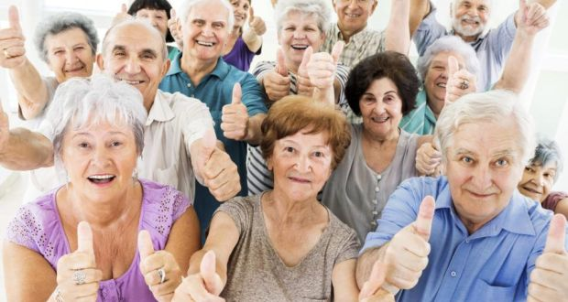
Elderly
Adults continue to age throughout their lives. You are classed as elderly after the age of 60, but many adults of this age don’t feel old!

Slide 24
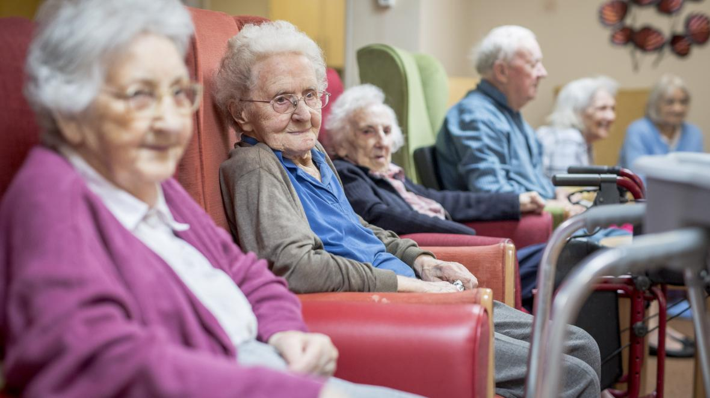
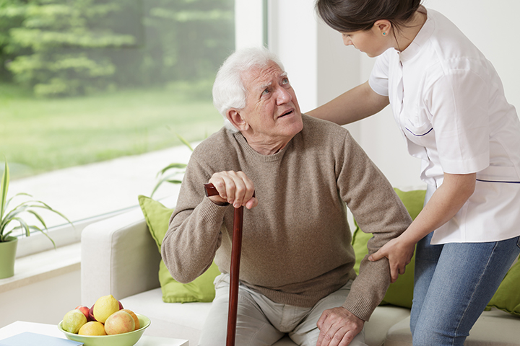
Elderly
Elderly people begin to slow down as their body ages.
Their skin goes softer and becomes wrinkly & their hair goes grey and often becomes thinner.
Their eyes stop working as well and often need glasses.
Joints and muscles can ache more.
They shrink! Just a bit, but their bones are not being remade as they were when they were younger.

Slide 25
Activity:
Can you make a timeline to show how
a human changes from a baby to elderly?
Go back through the slides to remind yourself of the different stages of human growth and what these stages are called (there should be 6!).
Draw a picture to match each stage and write the name of the stage. Alternatively, you can try to find appropriate pictures in magazines. You can use the attached grid split into sections to help you.
Place these pictures in the correct order.
WELL DONE! You have produced a timeline.
Challenge:
Can you add the age range for each stage of growth?
Can you add a caption to summarise the main things that happen at each stage?

