Slide 1
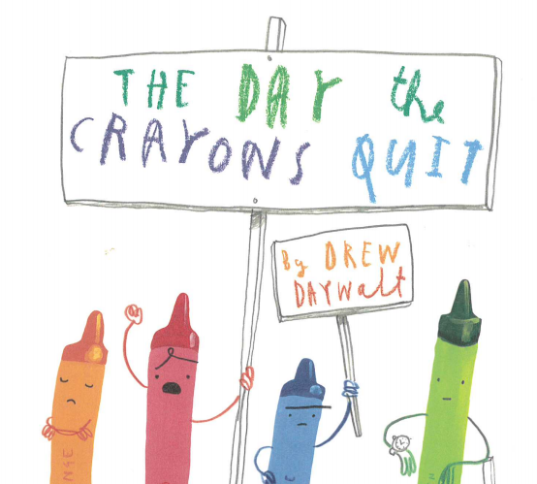
Week 2

Slide 2
A copy of the PowerPoint story and link have been included again if you need them to support your learning.
Read
‘The Day The Crayons Quit’ (separate Power Point )
You may also wish to watch this:
https://www.youtube.com/watch?v=489micE6eHU

Slide 3
Lesson 1

Slide 4
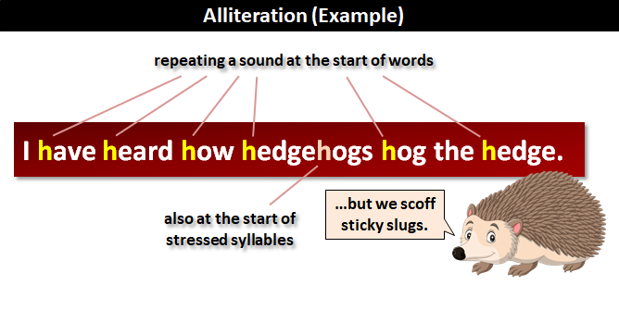
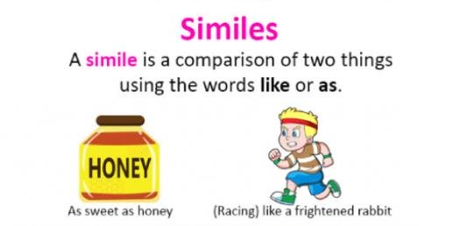
Using similes and alliteration
Lesson 1
Can you remember what similes and alliteration are from our previous lessons?

Slide 5
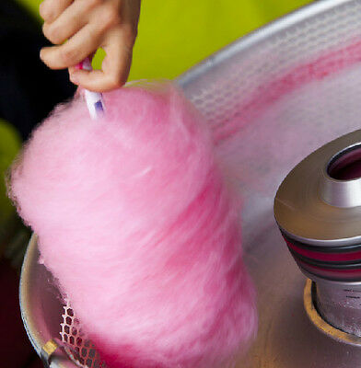

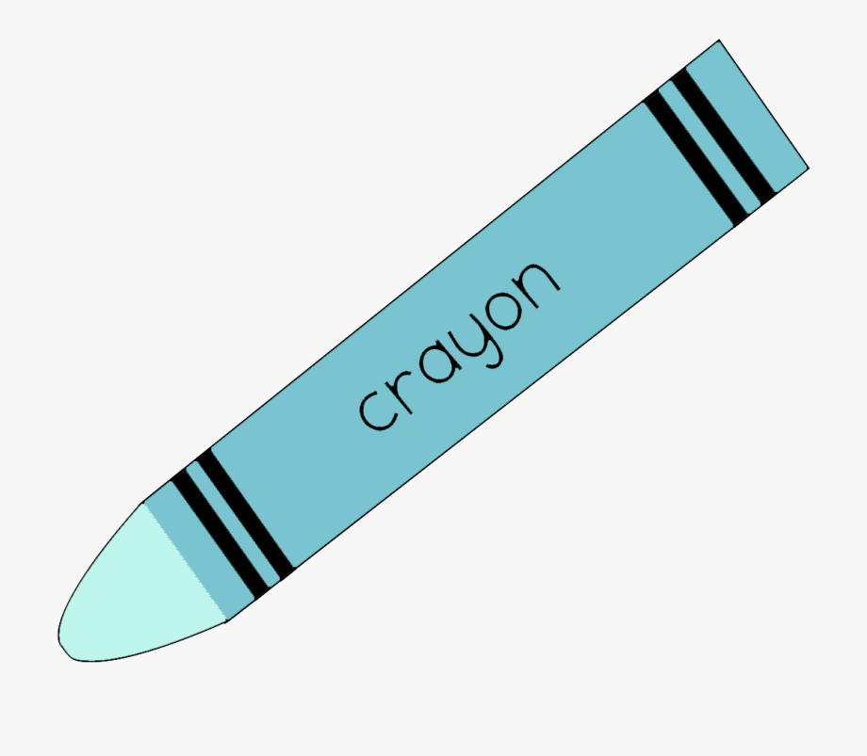

Lesson 1
Activity 1: Can you write some sentences about
some of the crayons using a simile?
As blue as the sky on
a clear summer’s day.
Pink like soft
candy floss.

Slide 6
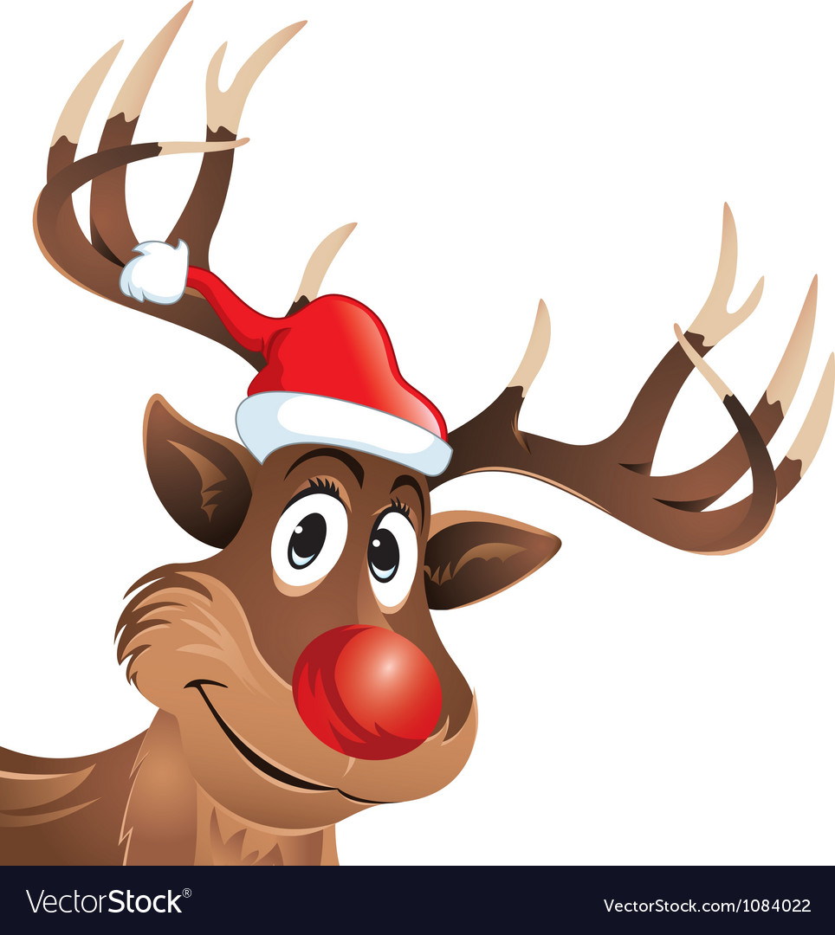

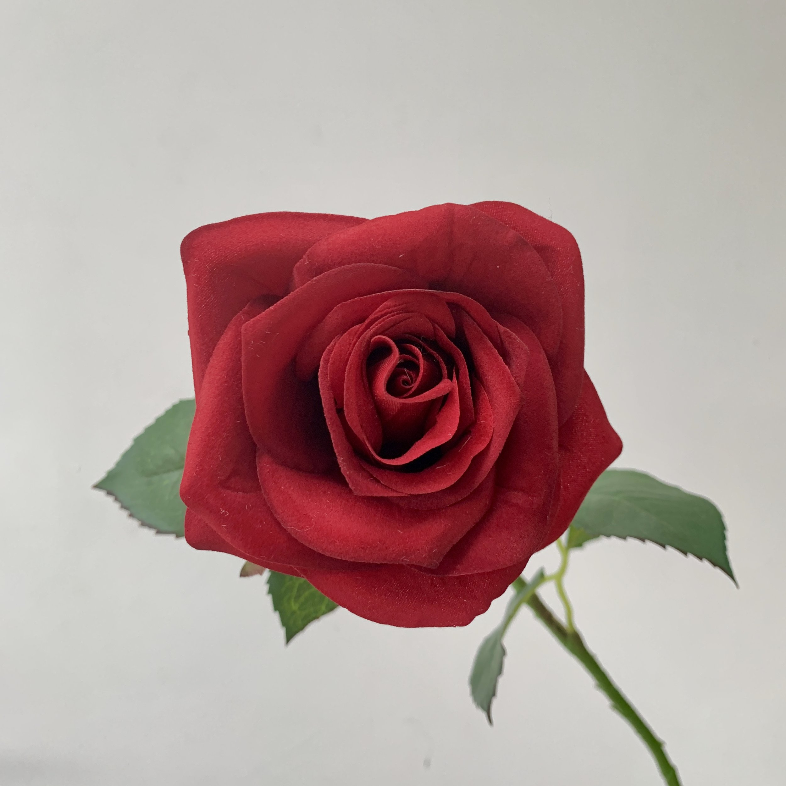

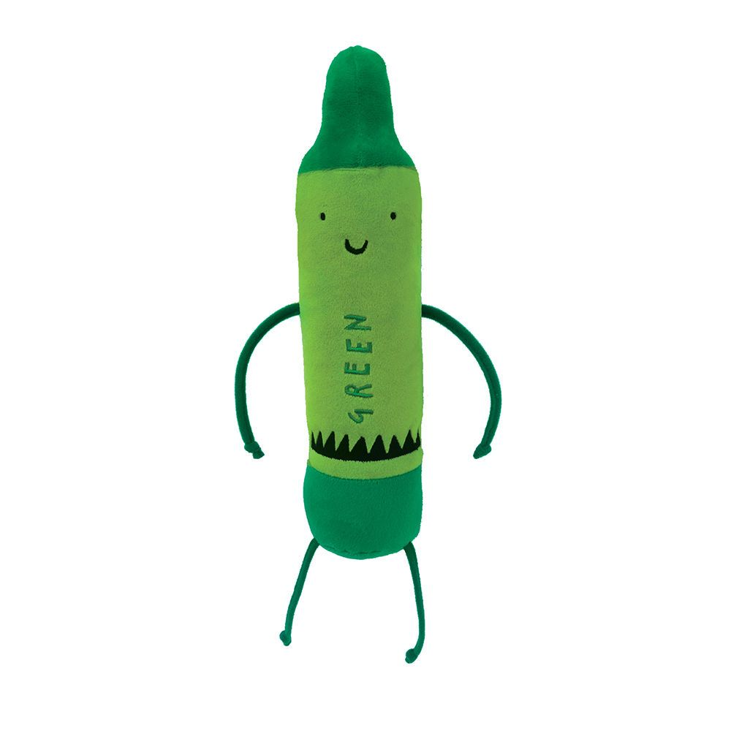
Lesson 1
Activity 2: Can you write some sentences about
some of the crayons using alliteration?
The red crayon was ready and raring to write about roses, reindeers noses and raspberries.
Good old green gets ready to go giving grass, green leaves and geckos their glow.

Slide 7
Lesson 2

Slide 8
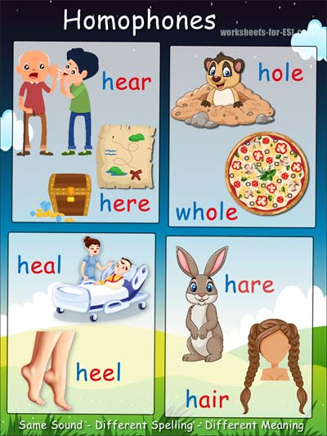
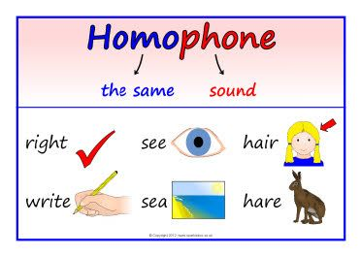
What is a homophone?
Lesson 2
A homophone is a word that sounds the same as another word or words, but has a different meaning or spelling.

Slide 9
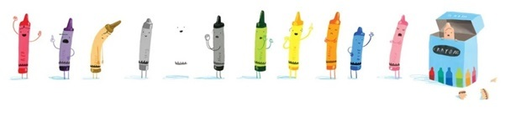
Lesson 2
Activity 1: Ask someone to print and muddle the homophone cards (attached).
Can you match the different homophones? Read the sentences so that you recognise the different spellings and understand the different meanings. Can you say some sentences of your own that match the homophone?
Maybe you could use these cards to play a game of snap or pairs?
Activity 2: Are there any colours in the book that you think could be spelt a different way and have a different meaning but sound the same? Can you find any other words in the book?
This activity is a little tricky so you may need a little help identifying some of these as you read back through the text.

Slide 10
Lesson 3

Slide 11
Can you use speech bubbles to show what the crayon ‘characters’ might be saying?
Lesson 3

Slide 12
Lesson 3
Let’s have a quick reminder about some of our characters with these quick ‘Who Am I?’
I feel so empty Duncan.
You cannot even see me if I don’t have a black outline. Who am I?

Slide 13

Lesson 3
You guessed it!
I’m White Crayon.

Slide 14
Lesson 3
Duncan, I love my workload. You use me to colour dinosaurs and trees and frogs.
Who am I?

Slide 15
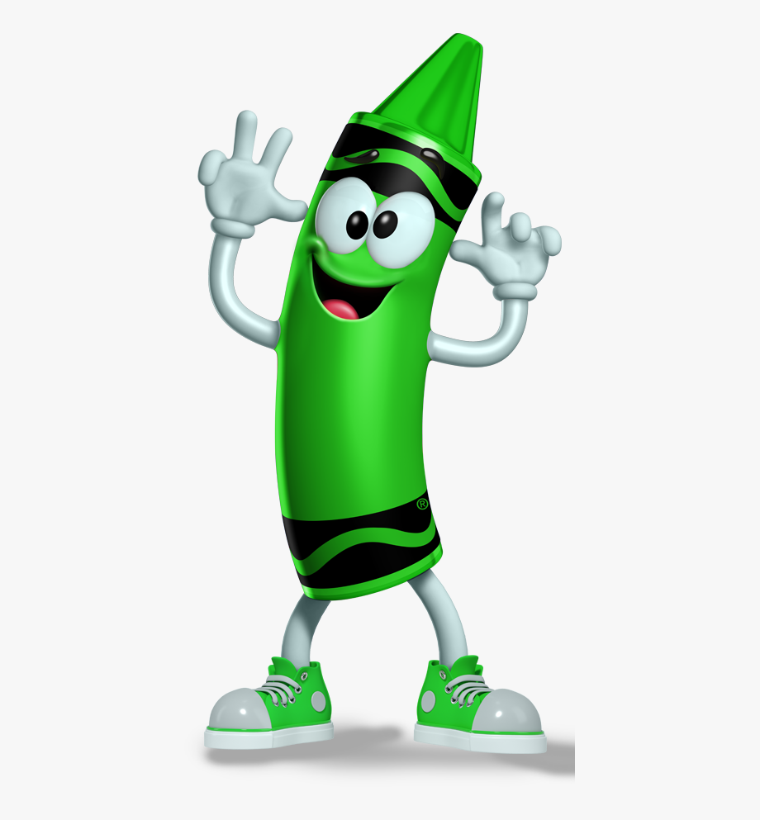
Lesson 3
That’s right!
It’s me, Green Crayon.

Slide 16
Lesson 3
“I’m not speaking to yellow crayon. Can you tell him I am the real colour of the sun? Who am I?”
I’m not speaking to Yellow Crayon. Can you tell him I am the real colour of the sun? Who am I?

Slide 17
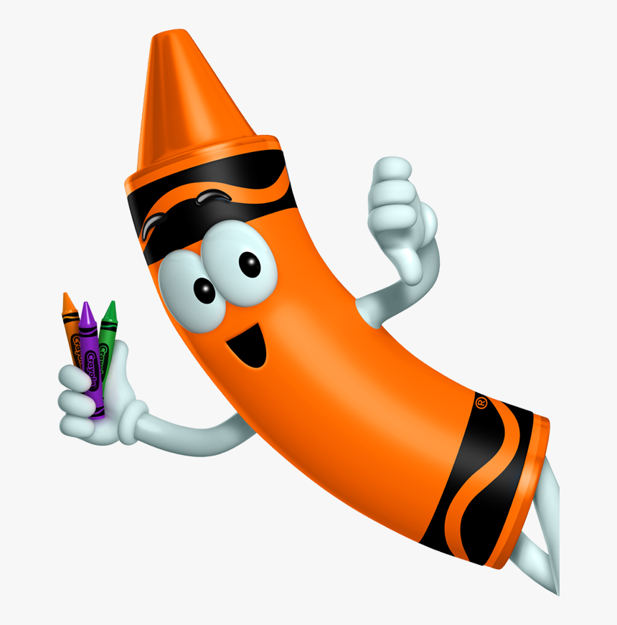
Lesson 3
You guessed correctly.
I am Orange Crayon.

Slide 18
Lesson 3
“I’m not speaking to yellow crayon. Can you tell him I am the real colour of the sun? Who am I?”
Duncan I need your help! I’m naked and can’t leave the crayon box. Who am I?

Slide 19
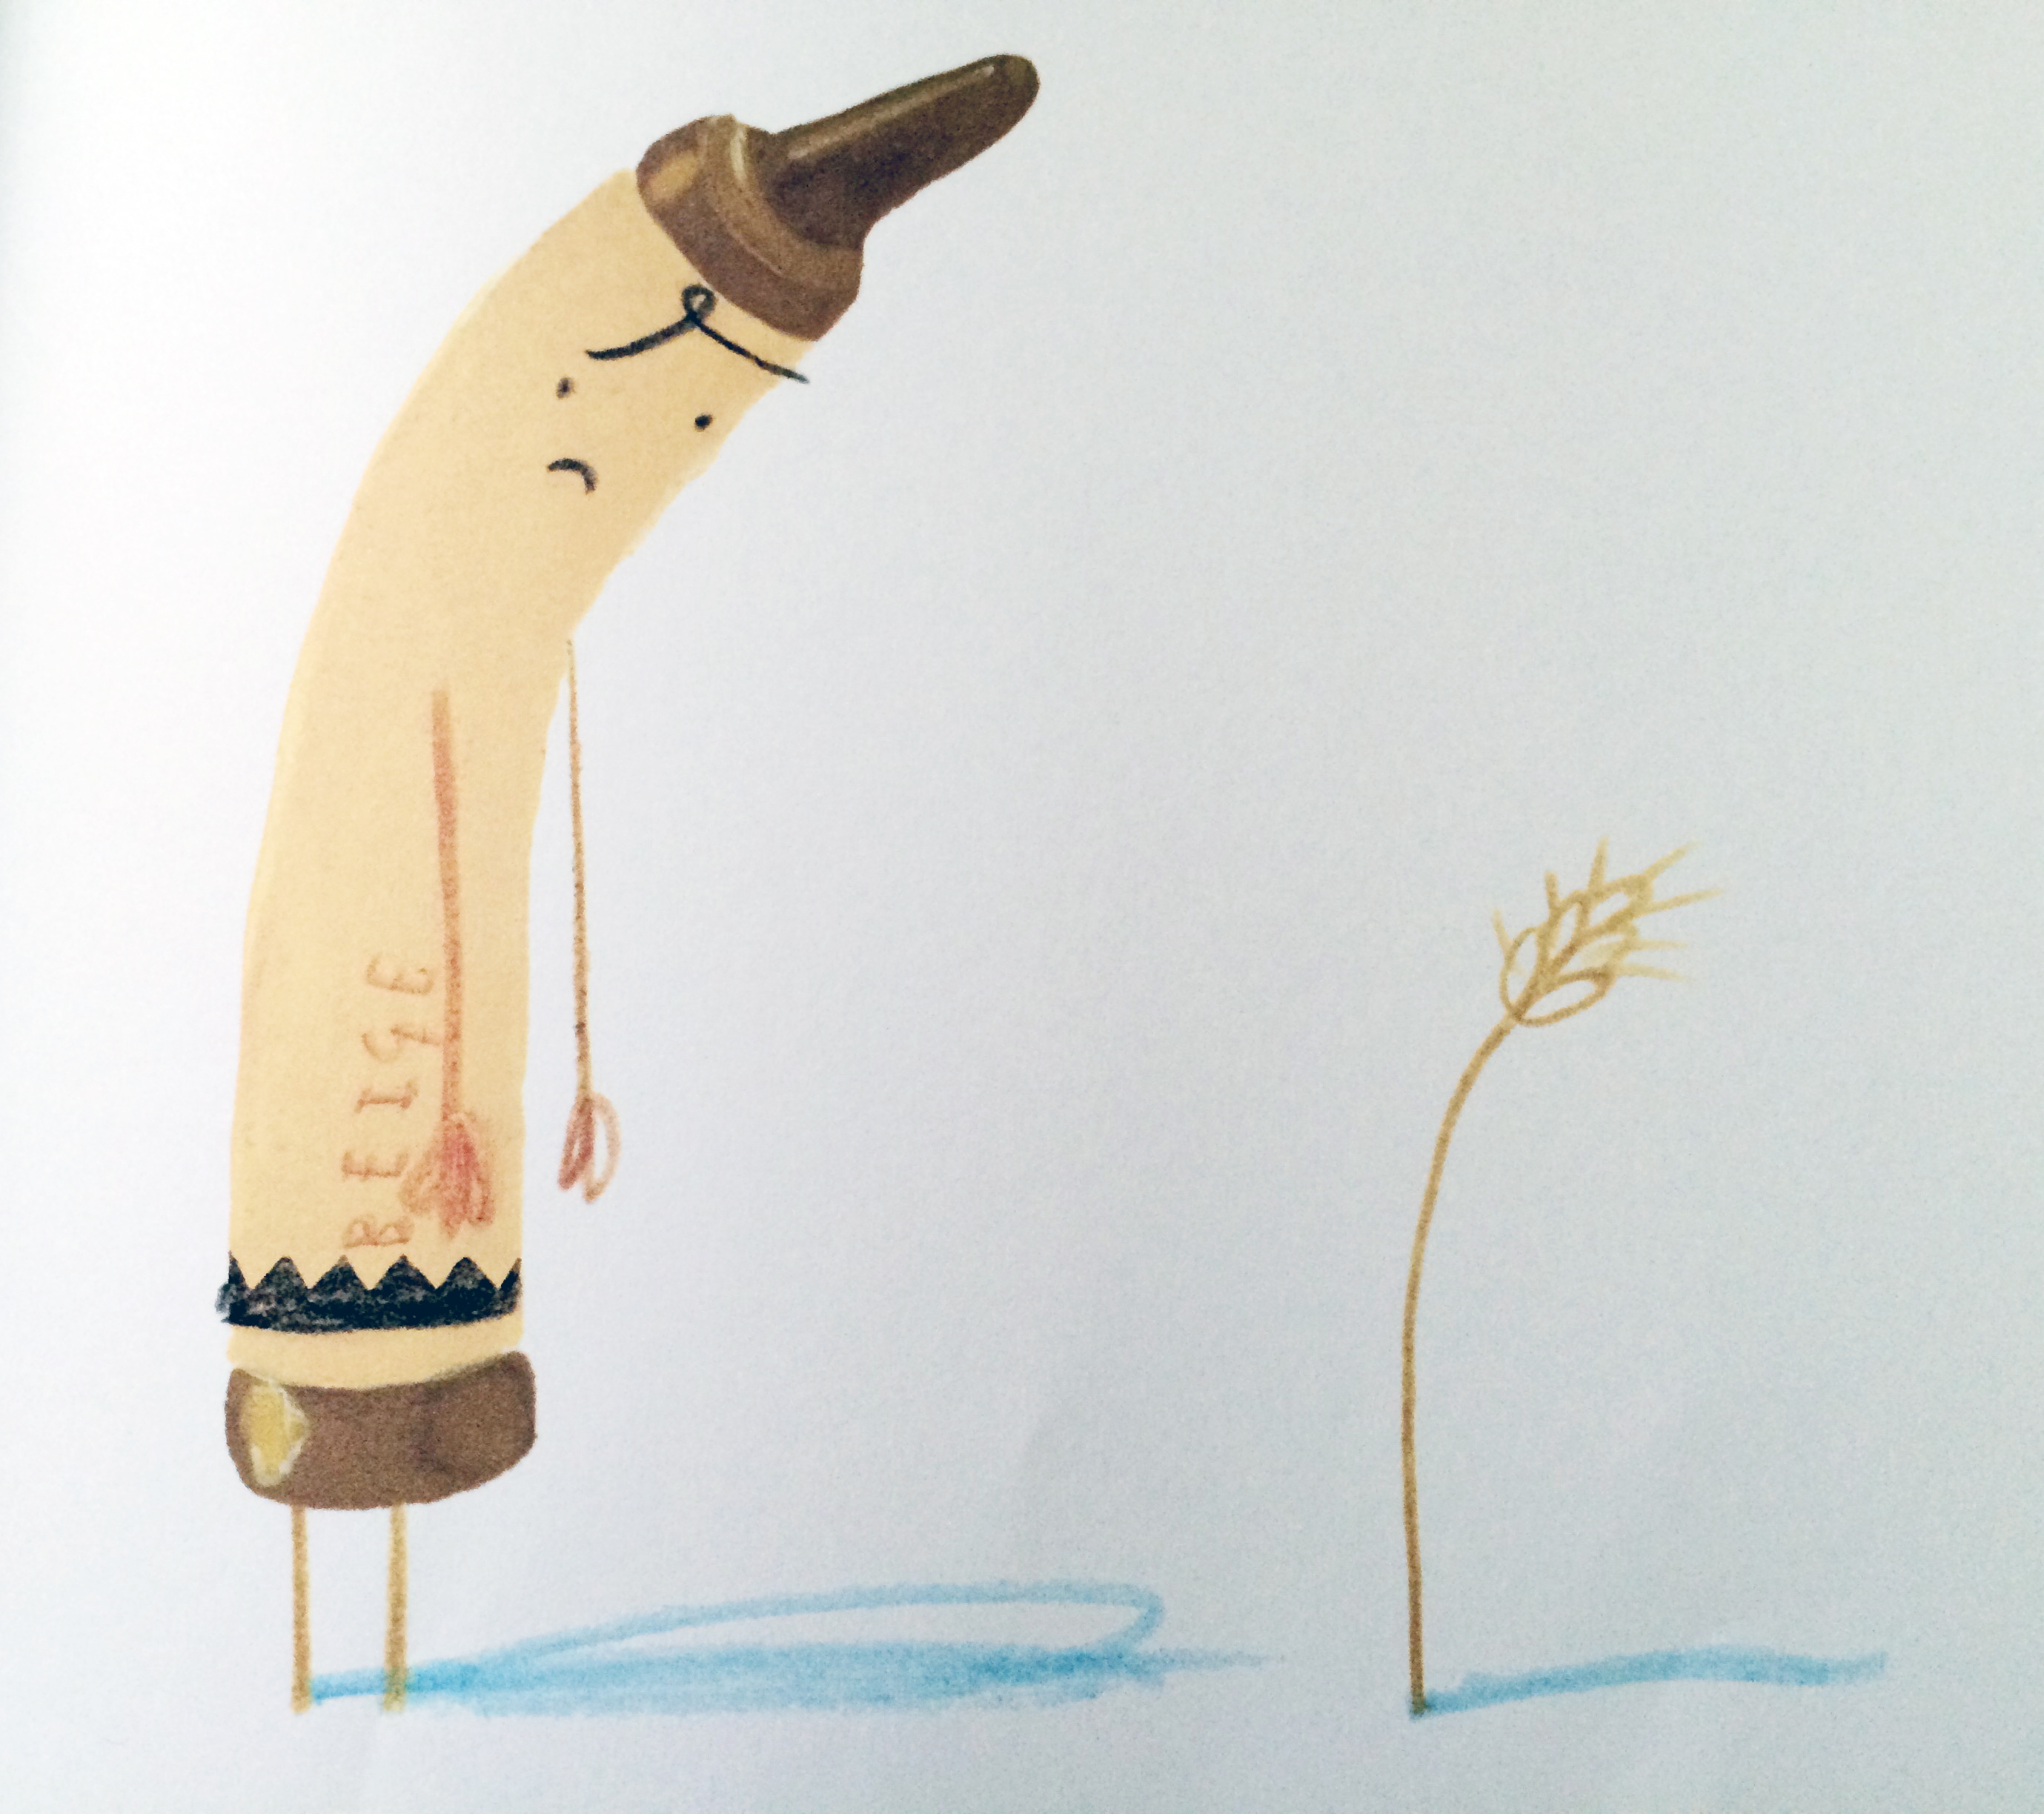
Lesson 3
“I’m not speaking to yellow crayon. Can you tell him I am the real colour of the sun? Who am I?”
Yes it’s me.
Beige Crayon.

Slide 20
Lesson 3
“I’m not speaking to yellow crayon. Can you tell him I am the real colour of the sun? Who am I?”
I’m glad I have been your favourite colour for such a long time, but there is not much of me left. Give me a break. Who am I?

Slide 21
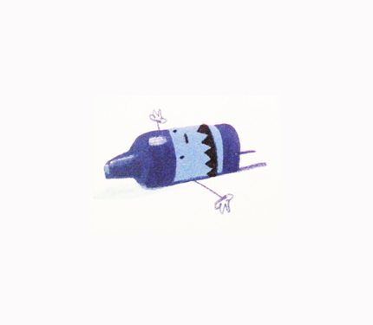
Lesson 3
Yes it’s me, or what’s left of me! Stubby little Blue Crayon.

Slide 22
Lesson 3
“I’m not speaking to yellow crayon. Can you tell him I am the real colour of the sun? Who am I?”
You use me all year long to colour fruits and even holidays. I need a rest. Who am I?

Slide 23
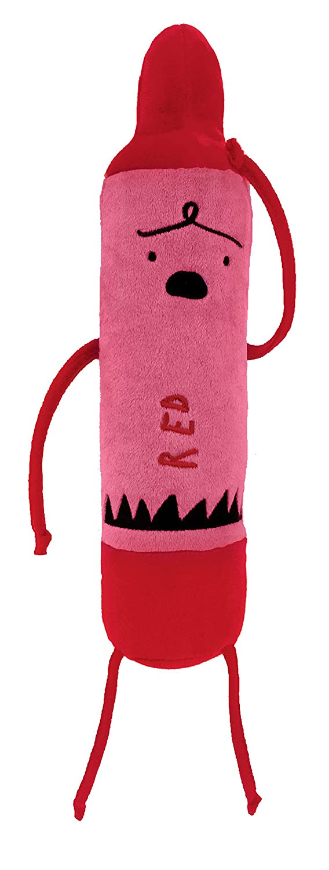
Lesson 3
You got it in one! It’s me your tired, overworked and exhausted Red Crayon.

Slide 24
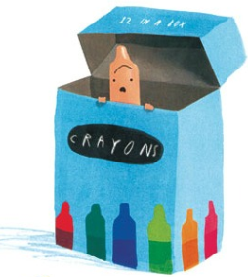
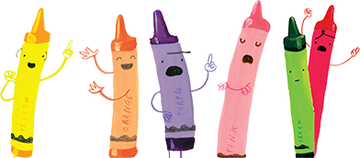
Activity:
What do you think the different crayons are saying?
Complete one of the attached speech bubble sheets OR draw some crayons of your own and complete some speech bubbles for them.
Lesson 3
----
----
_________________________________________________________________________________________________________
_________________________________________________________________________________________________________
________________________________________________________________________________________________________________
----
----
_________________________________________________________________
----
______________________________________________________________________________
----
_________________________________________________________________________________________________________
----
____________________________________________________________________________________

Slide 25
Lesson 4

Slide 26
Can you add relevant powerful verbs (for said) and adverbs (-ly words) to match the speech in your speech bubbles?
Lesson 4

Slide 27
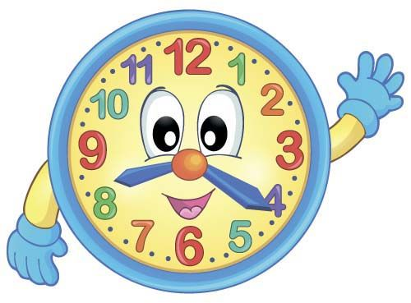
Time Challenge:
How many different words can you remember that mean the same as ‘said’ but might help to explain ‘how’ the speech is said?
You have 2 minutes to write down as many as you can think of. We have given you 3 to start you off!
3…2…1…GO!
whispered
cheered
moaned
Lesson 4

Slide 28
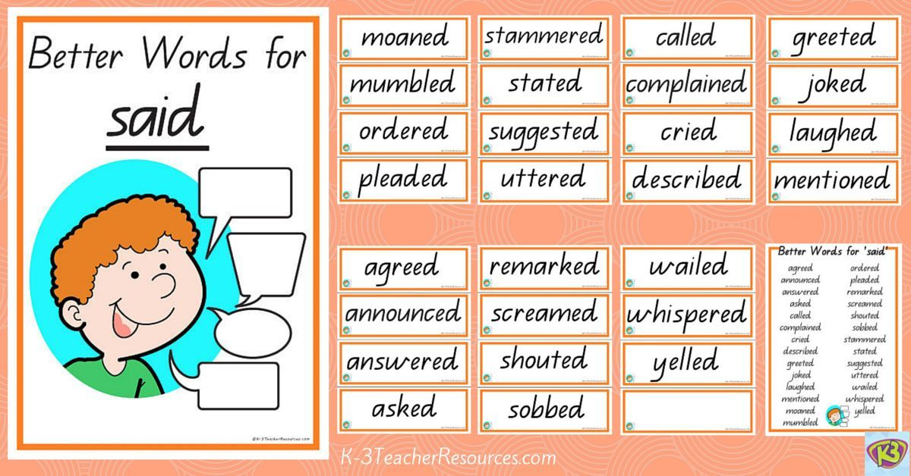
Lesson 4

Slide 29
Lesson 4
Time Challenge:
How many –ly adverbs can you think of?
Write down as many as you can think of in 2 minutes.
We have given you a couple to start you off!
3…2…1…GO!
loudly
quietly
excitedly

Slide 30
Lesson 4
Activity: Return to the speech bubbles you completed yesterday. Can you write down a ‘said’ verb and adverb to match the speech in the bubble? Try to think carefully about what the crayon is actually saying and how they might be saying it. Do you think the crayon is happy and would be singing cheerfully or are they more likely to be moaning grumpily?
“I’m not speaking to yellow crayon. Can you tell him I am tI always feel like I come second to brown crayon
and it’s just not fair.
verb: sobbed adverb: disappointedly

Slide 31
Lesson 5

Slide 32
Can you turn your speech bubbles, said verbs and adverbs into direct speech?
Lesson 5
I am absolutely exhausted and overworked. I never seem to get a day off!
Well at least you don’t feel invisible like me!

Slide 33
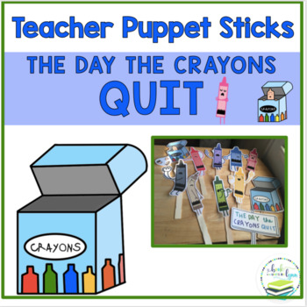
Alternative Year 1 work
Lesson 5
Direct speech can be a little tricky so Year 1 may wish to just make some crayon puppets and role play speaking the speech bubbles from the previous lesson and hold further conversations that the crayons may have with one another.
The crayon puppets may also like to talk to you and you could pretend to be Duncan from the story.
Also attached is a ‘Duncan Thought Bubble’ sheet. Thought bubbles are similar to speech bubbles. They are just speech that stays in you head as thoughts

Slide 34
Lesson 5
What is direct speech?
Direct Speech is spoken language written down as if it were a real overheard conversation.
Words such as ‘he said’, ‘she asked’ and ‘Red Crayon shouted’ show who is speaking to who.
The purpose of direct speech:
Direct speech is used a lot in stories. It makes the characters believable and convincing.
What the characters say and how they speak tells the reader a lot about them.

Slide 35
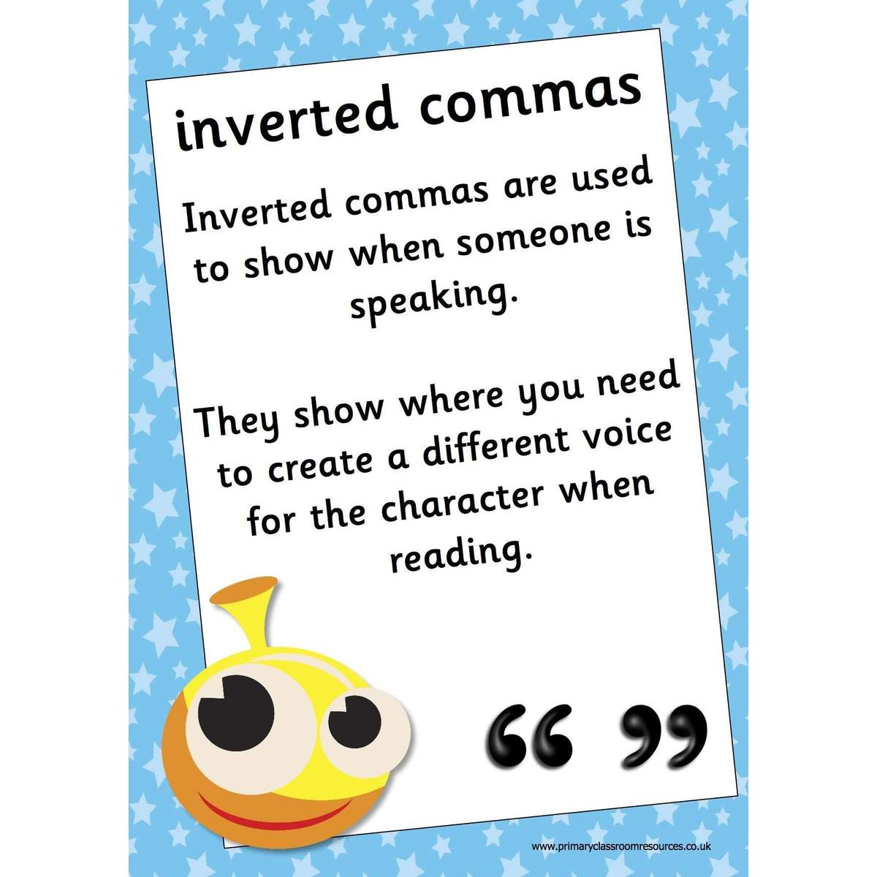

Direct Speech has its own special kind of punctuation.
Lesson 5
Inverted Commas
(speech marks)
only go around the spoken words.

Slide 36
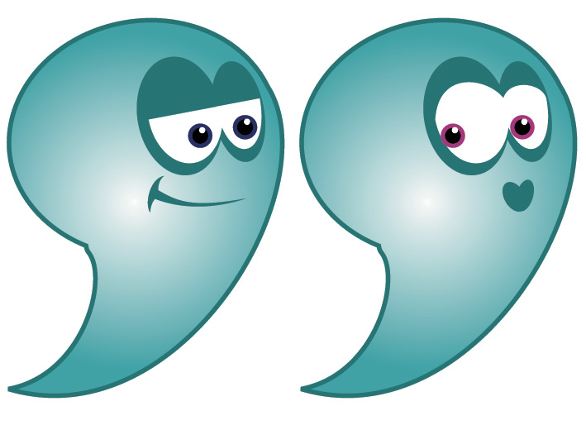
Lesson 5
I am absolutely exhausted and overworked. I never seem to get a day off!
“ I am absolutely exhausted and overworked. I never seem to get the day off!” said Red Crayon.
What Red Crayon has actually said goes inside the inverted commas.
We then write who has said it.

Slide 37
Lesson 5
I am absolutely exhausted and overworked. I never seem to get a day off!
“ I am absolutely exhausted and overworked. I never seem to get the day off!” said Red Crayon.
Remember all the work we did on powerful verbs for said and –ly adverbs?
“ I am absolutely exhausted and overworked. I never seem to get the day off!” gasped Red Crayon wearily.

Slide 38
Lesson 5
I love colouring in all the grass, leaves and frogs!
“ love colouring in all the grass, leaves and frogs!” exclaimed Green Crayon proudly.

Slide 39
Activity: Have a go at writing some direct speech sentences.
You may wish to use your previous speech bubble, ‘said’ and adverb work to support you.
Stick or finger puppets are also an excellent way to practise speech and help you to become clear about which words the crayons are actually saying (these are the words you need to write in the speech marks).
Change your voice to say the words of the crayon’s speech. Think about what you are saying and how you say these words. This will help you to decide on your better ‘said’ word and adverb.
Lesson 5

Slide 40
Year 2 extension work: Can you write a conversation?
Lesson 5
Writing a conversation is where you put a few pieces of direct speech together.
Each time someone new starts to speak, you start a new line.
You may choose to have a conversation between 2 different crayons or maybe one of the crayons is speaking to Duncan.
This is quite a tricky thing to do in Year 2 but a good challenge.

Slide 41
End

