Slide 2
To be aware of and be able to recognise different types of sentences.

Slide 3

Statements
1
Statements are sentences which tell you a fact, opinion or idea.
Example:
A rainbow has 7 colours.
They are beautiful to look at.

Slide 4
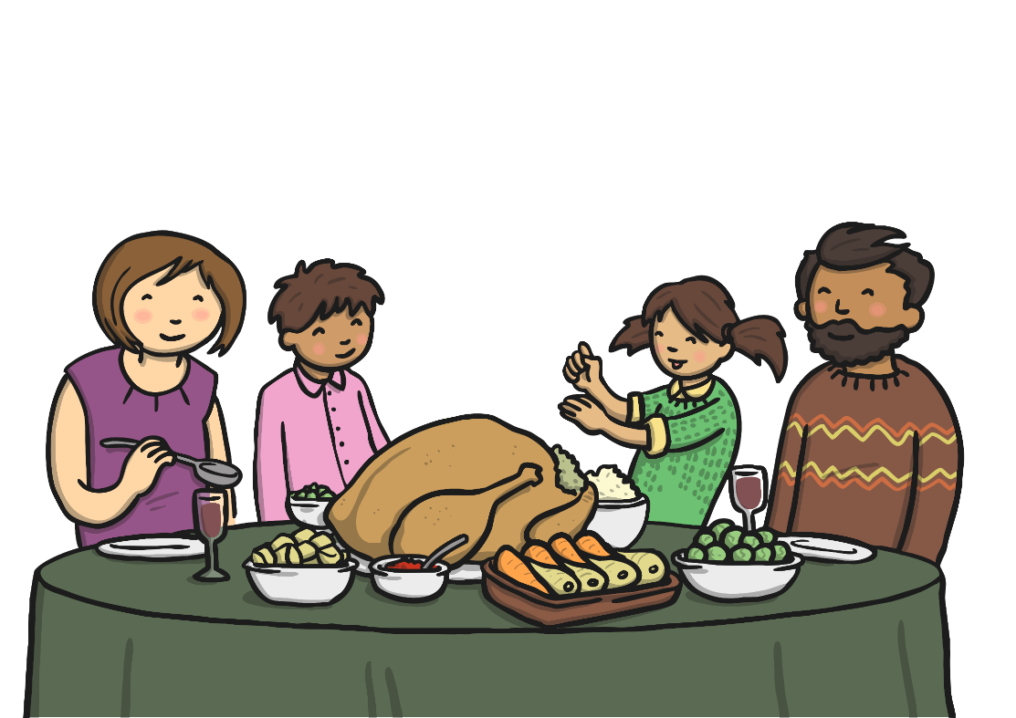
Questions
2
Questions are sentences that ask you something.
They usually end with a question mark.
Example:
What did you have for dinner?

Slide 5


Commands
3
Commands give an instruction. They start with an imperative (bossy) verb and they tell people what to do.
They can often be urgent or angry and can be very short.
Example:
Stop it.
Come here.
Turn it over.
Press the button.

Slide 6

Exclamations
4
An exclamation is used when someone is surprised.
It always starts with ‘How’ or ‘What’ and contains a noun
and a verb.
Example:
What big feet you have!
How beautiful the waether is today!

Slide 7
To be aware of and be able to recognise different types of sentences.

