Slide 1
Y6 English 1.6.20

Slide 2
Reading
L.C. Can I answer retrieval, inference and choice questions?

Slide 3
The following extract is from the prologue of The Snow-Walker's Son by Catherine Fisher.
The door was the last one in the corridor.
As the flames flickered over it, they showed it was barred; a hefty iron chain hung across it, and
the mud floor beneath was red with rust that had flaked off in the long years of locking and
unlocking. The keeper hung his lantern on a nail, took the key from a dirty string around his neck,
and fitted it into the keyhole. Then he looked behind him.
'Get on with it!' the big man growled. 'Let me see what she keeps in there!'
The keeper grinned; he knew fear when he heard it. With both hands he turned the key, then
tugged out the red chain in a shower of rust and pushed the door. It opened, just a fraction.
Darkness and a damp smell oozed through the black slit. He stepped well back, handed the
stranger the lantern, and jerked his head. He had no tongue to speak with; she'd made sure he
kept her secrets.
The stranger hesitated; a draught moved his hair and he gazed back up the stone passageway as if
he longed suddenly for warmth and light. And from what I've heard, the keeper thought, you
won't be seeing much of those ever again.
Then the man held up the lantern and pushed the door. The keeper watched his face intently in
the red glow, and his great hand, as it clutched a luck-stone that swung at his neck. The man went
in, slowly.
The door closed.

Slide 4
Questions
The door was the last one in the corridor.
1. What is the significance of the word ‘last’?
Can you think of any other contexts where the world last has such a
significant meaning? e.g. the last chance.
2. How does this opening line set the mood of the story? What are your
immediate impressions?
As the flames flickered over it, they showed it was barred; a hefty iron
chain hung across it, and the mud floor beneath was red with rust that
had flaked off in the long years of locking and unlocking.
3. What does this description suggest to you as a reader?

Slide 5
Questions
4. .......as it clutched a luck-stone that swung at his neck.
Why do you think the stranger clutched the luck-stone?
5. Why did the keeper jerk his head?
6. Why do you think the stranger hesitated?

Slide 6
Questions
7. Why has Fisher described the iron chain as being ‘hefty’? What could the significance of this word be in the context of the story?
Darkness and a damp smell oozed through the black slit.
8. How does this make you feel as a reader? What is the relevance of both darkness and a damp smell? Do these surprise you; if so, why?
What I love about this prologue is the way that Catherine Fisher hooks
the reader in and builds immediate tension.
9. Make a list of all of the ways she captures the reader’s interest, e.g. The
ambiguous reference to the characters (the keeper/the stranger/she).
Make sure you find examples in the text to support your point.

Slide 7
Vocabulary
Use a dictionary to write a definition of the following words.
1. intently
2. lantern
3. draught
4. oozed
5. clutched
6. slit
Write a sentence using each word.

Slide 8
Writing
L.C. Can I write a poem?

Slide 9
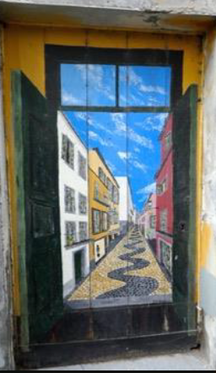
Writing
Have you ever looked at a door
and wondered what might be on
the other side? Where may it lead?
What may be hiding within? At first
glance, a door is just a piece of wood,
glass or metal that is opened and closed
so that people can get in and out of a
room, a vehicle or a space. But in the
hands of an author, a door represents
a world of possibility, a world where
things are not only hidden but often
closed off and restricted.

Slide 10
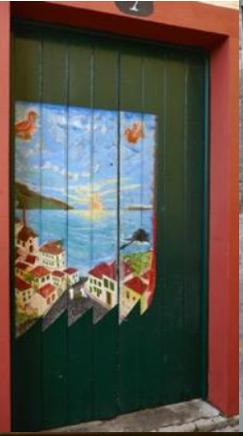
Lockdown
The world is in lockdown, shut
behind doors for our own safety.
Each of our experiences will be
very different, but at the heart
of the matter is the fact that we
are, in a sense, being locked away.
We long for the day when the
doors are open once again and
life returns to normality.
But how do you feel?

Slide 11
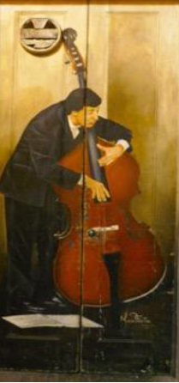
Lockdown
Before we start, draw on your own personal
experience of the situation you find yourself in.
How are you feeling and what is running
through your mind?
Let the words burst out of you in whatever form
they decide to take.
After all, what better stimulus to write about
now than a sense of being locked in and the
desire for the doors to be open again.
You might want to jot down a few thoughts now.

Slide 12
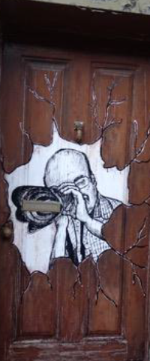
Being creative
In order to open up our minds to the world
of possibility, it is important that we allow
ourselves time to think creatively. The poet
Ted Hughes tells us that, when writing, we
have to allow our minds to wander and
explore the world of possibility. We must
not worry about what comes out or fear that
it may be wrong. The joy of writing is that it
allows us to explore our thoughts, or
interests, our imagination. This activity
is designed to let you lose your inhibitions
and explore the world of possibility.

Slide 13
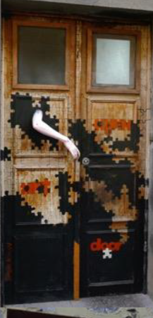
Read the example.
A door is …
A door is a barrier between can and can’t,
Sometimes opened in intrigue,
Often slammed shut in defiance.
A door is hope, an escape from reality,
An escape to happiness,
A hidden sanctuary.
A door is protection, it locks and encases,
It bars and isolates,
It secludes and forgets.
A door is a portal to an imaginary world,
A passage to the unknown,
To journeys unexplored.
A door is magic, conjuring possibility,
Endless passageways and avenues,
In the labyrinth of our mind.
A door is the end, locked and secure,
Waiting for the prisoners,
To break out from their cells.

Slide 14
Tips
Remember – do not overthink this – let the ideas run free.
In the example, it begins by thinking what a door may represent (e.g. a barrier, hope, protection, a portal, magic, the end).
To get the initial idea, ask yourself: what is a door like? Once you have the simile, turn it into the metaphor by saying that the door is that.
e.g. A door is like a barrier (simile)
A door is a barrier (metaphor)
Then extend the metaphor with some added detail. Do not worry if some ideas are abstract or if some are more literal. Let your mind run free!

Slide 15
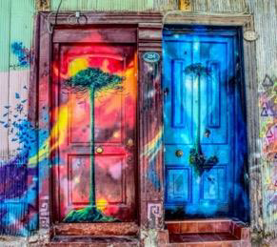
Starting to write
Begin with the simple opening:
A door is …
This could be a repeating phrase that is revisited through the poem.
Then let your imagination run wild and free. Whatever pops into your head, jot it down. Don’t worry about spelling, punctuation, grammar or sentence construction. Just focus on the words that spill out of you and find themselves assembled on the page.

Slide 16
Word Bank
portal
barrier
possibility
hope
protection
seclusion
isolation
reality
secrecy
invisible
prison
labyrinth
maze
escape
confusion
passages
avenues
travel
freedom
locked
unlimited
ajar
exploration
darkness
beauty
journey

Slide 17
Editing your writing
A door is …
Use a dictionary to check your spellings.
Use a thesaurus to choose the most powerful verbs and adjectives.
Have you used a simile?
Have you used a metaphor?

Slide 18
Grammar
L.C. Can I use idioms?

Slide 19
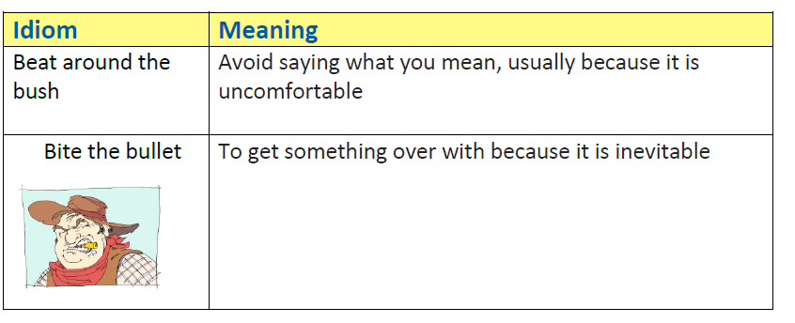
Grammar
An idiom is a common word or phrase which means something different from its literal meaning but can be understood because of its popular use.

Slide 20
Below is a list of idioms about doors.
Can you work out or find out what they mean?
as one door closes another opens
beat a path to somebody’s door
close/shut the door on something
foot in the door

Slide 21
Below is a list of idioms about doors.
Can you work out or find out what they mean?
early doors
keep the wolf from the door
knocking on heaven’s door
lay something at somebody’s door
leave the door open
never darken my door again
show somebody the door
slam the door in somebody’s face

Slide 22
Artistic challenge
Can you turn your favourite door idiom into a poster? Think about the meaning and how this could be represented through your design.

Slide 23
Spelling
L.C. Can I build words from roots using prefixes and suffixes?

Slide 24
Find the meaning of the root and where it came from by using a dictionary.
cyclo
chrono
tract
dict
script
fac
port
struct

Slide 25
Build as many words as you can by adding prefixes and suffixes to the root.
Prefix | Root | Suffix
 | cyclo
 | chrono
 | tract
 | dict
 | script
 | fac
 | port
 | struct

Slide 26
Quiz time!
If the prefix inter- means between, the portion
of time between acts of play or during a concert
is called an…
  a. interstate
  intermission
  international
  internal

Slide 27
If the prefix crede- means to believe, if you can
believe someone, then that person has good…
a credibility
b counterfeit
c cycle
d credit

Slide 28
If the prefix dict- means speak, a person’s
manner of speaking is called…
a. dictate
b. diction
c. dictionary
d. prescription

Slide 29
If the prefix tract- means to drag, draw, the act
of drawing or pulling a thing is known as…
a. traction
b. attractive
c. tractor
d. incredulous

Slide 30
If the root script means to write, a doctor’s
hand-written instruction for the preparation of
medicine is known as a…
a manuscript
b demagogue
c prescription
d television

Slide 31
If the suffix -cede means to go, to yield, to
receive more in return than you thought you
would, then your expectations are...
a. exceeded
b. proceed
c. succeed
d. preceded

Slide 32
If the suffix -dict means speak, when a person
on a jury speaks and gives a truthful decision or
judgment, the person is stating the...
a. dictionary
b. predict
c. verdict
d. diction

Slide 33
If the prefix tele- means distance, from afar,
communication over a distance by cable, telegraph or
telephone lines is known as...
a. contrary
b. telecommunication
c. television
d. incredulous

Slide 34
If the root demo means people, a widespread
occurrence of a disease within a group of people
is called an...
a. democracy
b. external
c. demographic
d. epidemic

Slide 35
If the prefix vita- means life, a compilation of several organic compounds essential for living organisms are known as...
a. vitality
b. autograph
c. benefit
d. vitamins

