Slide 1
Which warm-up activity will increase heart rate the most?
Working scientifically

Slide 2
Different warm-ups
There are many different ways athletes warm up before sports to avoid injury and to prepare their bodies. You may wish to test some of these exercises:
  Gentle jogging
  Sprints
  Passing drills
  Lunges
  Giant leaps

Slide 3

You should plan an experiment to discover which activity will increase the heart rate most
Our heart rate is the number of times our heart beats per minute.
To record this we must first find our pulse. Then count the number of times we can feel the pulse in 15 seconds and multiply by 4 to get beats per minute

Slide 4
You should plan an experiment to discover which activity will increase the heart rate most
You will need to plan your experiment, this should include:
  A research question ‘Which warm-up activity will increase heart rate the most?’
  A prediction
  An equipment list
  A method, including the steps you shall take to ensure a fair test
  Your results (this could be a table or a line graph)
  Finally, a conclusion to summarise your findings.

Slide 5
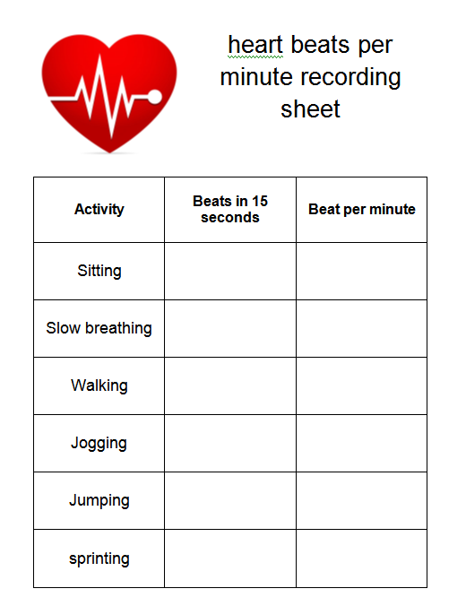
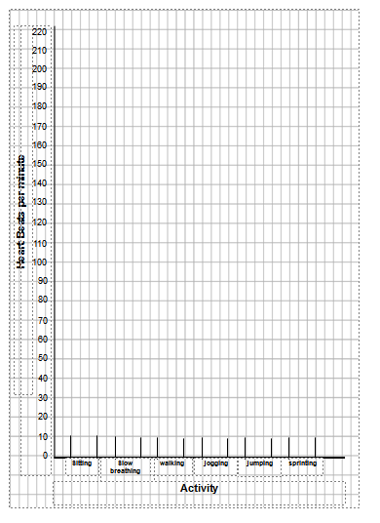
You may use a table like this to produce a line graph.

