Slide 1
Y5 English 1.6.20

Slide 2
Reading
L.C. Can I use vocabulary in context?

Slide 3
Read the story.
One Chance
Outside, the evening was cold and wet. A squally wind howled,
rattling the roof tiles and shaking the window frames of 13
Wager Road. Inside, shabby curtains were drawn, a humble fire
crackled and a couple sat in silence. Jack stretched out on the
tired couch with an amused smile, turning the page of his
favourite novel. Sarah scowled, silently seething. She scanned
the room, noticing the worn-out furniture, peeling paint and, in
her opinion, a pointless, idle husband. She deserved so much
more than this.

Slide 4
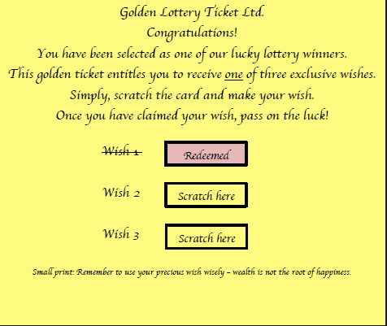
Suddenly, the letterbox jangled and there was a solitary but decisive knock on the door. Hope, the Labrador, barked. Sarah pulled back the curtain and watched as a hooded figure slipped silently away up the road. Puzzled, she stared down at a golden card that had appeared, glinting on the frayed doormat.
Tentatively, she gathered it up and read it out loud:

Slide 5

Predict.
What next? We’ve stopped at an interesting part
of the story. Summarise in your home learning
book what you think could happen next.

Slide 6
Now let’s find out how close your predictions were. Read on!
Sarah gasped. This is just what she was looking for – another chance. Maybe
lose the idle husband as well, she thought, shaking her head.
“I am going to give this a go. I am thinking lots of money to buy expensive
clothes and maybe you can finally sort this house out,” she said to Jack,
Rummaging desperately in the drawer for a coin.
“Utter nonsense,” muttered Jack, glancing up from his book and taking in the
room. “I love this old house and you just the way you are. Even if all that did
come true, there’ll be a catch. No one gets something for nothing. Just throw
it away.”
Sarah stopped and nodded sullenly. He was right. She made to throw the
ticket on the fire, but something stopped her. Furtively, she stashed it in her
pocket.

Slide 7
Later that evening, as Jack slept, Sarah retrieved the ticket and
greedily scratched ‘Wish 2’, dreaming of immense riches or,
to be precise, £100,000. Outside, a squally wind howled.
Inside, nothing happened. Bitterly, she tossed the ticket
into the bin.
The next day, the wind died down to a cool, whispering
breeze. Jack prepared for his early morning walk with Hope.
Pulling his woollen hat firmly down over his ears, he called out
to Sarah that he wouldn’t be out long and left. Sarah scowled.
She could barely respond.

Slide 8
Eight hours passed and Sarah began to worry – where were Jack and Hope?
Shaking with fear, she dialled 999, hoping for the best but fearing the worst.
A massive search was launched but there was no sign. Jack and Hope had
simply vanished. Sarah was distraught. Deep down she worried if their
disappearance had anything to do the golden ticket.
Days later, as the wind whipped up again, a woman in a black cloak knocked
at the door. She told Sarah she had been sent to offer some compensation for
her sad loss. Sarah was feeling desperate so asked, “How much?”
“Shall we say… £100,000?”
Shocked, Sarah recalled the greedy sum she had wished for. Could it be true?
Had her selfish wish actually been granted? Quickly, she raced outside and
rummaged desperately through the bin, trying to locate the discarded ticket.
With sickening dread, she smoothed out the crumpled ticket and gasped in
horror.

Slide 9
It was true. The second wish had been redeemed.
Sarah leaned against the bin for support, her head spinning, her
thoughts in turmoil.
Then she gathered herself together. There was still one final wish left
.… Could she use it to try and bring Jack and Hope back? She needed a
coin, quick.
Just then, without warning, the squally wind howled and snatched the
ticket from her hand. It spiralled, higher and higher like autumn
leaves in a storm and then, like the mysterious woman herself, it was
gone. Sarah cried out of helpless pain.
Inside, the shabby curtains were drawn and a humble fire crackled.

Slide 10
Dictionary work
Have a look back at the story. All of the words below are in
bold. See if you can work out what they mean from the context
of the story and jot your ideas down here.
If you are stuck, there is a list of matching words below to help
you. If you are still stuck, you could use a dictionary or the web.
squally | redeemed | howled
shabby | solitary | distraught
humble | rummage | compensation
scowled | sullenly | discarded
seething | stashed | turmoil
tentatively | immense

Slide 11
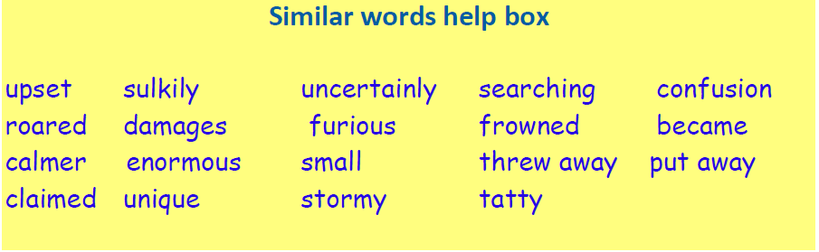

Slide 12
Writing
“Be careful what you wish for, you may receive it,” by anonymous.
Have you ever thought about what this means?
The underlying moral of the wishing tale is often played out in
real life. Every week many people dream of winning the lottery –
they make a wish. Someone then wins a huge sum of money.
While this might seem like great news, the story often leads to
misery and unhappiness.
The sudden win changes lives. Friends and family may be lost.
The ‘winner ’may lose a sense of purpose as they no longer have
to go to work.

Slide 13
Writing
This moral message is one that has been used
many, many times in stories across the world. It
was first thought to have been used in Aesop’s
Fables.
Aesop was a slave and storyteller believed to
have lived in ancient Greece.

Slide 14
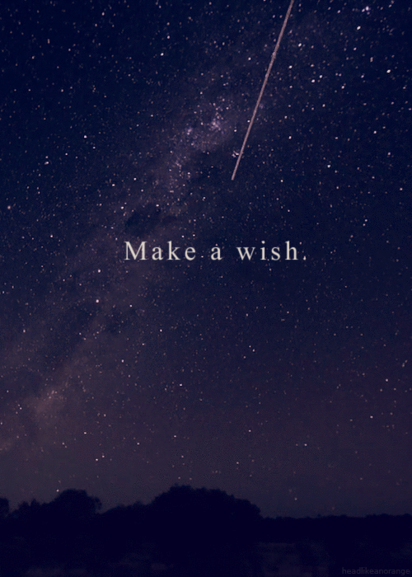
Just one wish!
If you had just one chance to make a wish, what
would you wish for?
For example:
a new car
a new pet
a yacht
a new skill

Slide 15
The downside........
For example:
I wish I had a bright red sports’ car. I could drive at
immense speed and win many great races.
However, I am too young to drive.
I wish I had a small, brown Dachshund. I could take
it for long, leisurely walks in the countryside.
However, I have already got a cat and they might
not get on with each other.

Slide 16
Your turn.
I wish...............................................................
........................................................................
However, ..........................................................
I wish ...............................................................
........................................................................
However, ..........................................................

Slide 17
Now try to be a little more magical. Anything is possible!
For example: I wish I was in Hogwarts and
befriended Hermione. I could learn some
magical spells, play Quidditch and soar high on
my enchanted broom.
However, I might let them all know what
happens in the story and ruin it for everyone.

Slide 18
Your turn.
I wish...............................................................
........................................................................
However, ..........................................................
I wish ...............................................................
........................................................................
However, ..........................................................

Slide 19
Poem
Do you remember how, in Snow White, the wicked Queen
used a mirror that always told the truth? The following
poem is about what happens when different characters
look into a mirror that shows what you wish for.
Make a list of people who might look into the wishing
mirror and think about what they would wish to see.
For example: a teacher, a sailor, a superhero, an
astronaut, a pirate, a dragon hunter and a writer.

Slide 20

The Mirror of Wishes
The teacher looked into the mirror
And saw a class of hard-working children.
A sailor looked into the mirror
And saw the still waters of the Atlantic.
Batman looked into the mirror
And saw a crime free day in Gotham City.
An astronaut looked into the mirror
And saw his capsule landing in the sea.
A pirate looked into the mirror
And saw where a treasure chest lay buried.
A dragon hunter looked into the mirror
And saw the location of a dragon’s cave.
A writer looked into the mirror
And saw stories waiting to be told.

Slide 21
Your turn
As you can see, the poet has written each idea
using the same pattern, based on two lines.
Copy his pattern but use your own characters
and ideas about what they might wish for.
Write your poem in your home learning book.

Slide 22
The Mirror of Despair
On the wall, there is also the mirror of despair! This
always shows what you fear most of all happening.
Either make a new list of people who might look
into the mirror of despair and think about what
they would most fear to see or write about the
same characters to find out what they might most
fear. Once again, the poet has written each idea
using the same pattern.

Slide 23
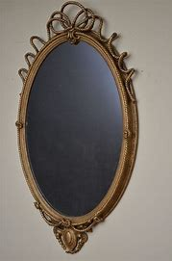
The Mirror of Despair
The teacher looked into the mirror
And saw children throwing paper airplanes.
A sailor looked into the mirror
And saw a tsunami approaching.
Superman looked into the mirror
And saw he was wearing a pair of kryptonite tights!
An astronaut looked into the mirror
And saw an asteroid as big as Bristol approaching
A pirate looked into the mirror
And saw sharks gathering beneath the plank.
A dragon hunter looked into the mirror
And saw that he had picked up a plastic sword by mistake.
A writer looked into the mirror
And saw a library burst into flames.

Slide 24
Your turn
As you can see, the poet has written each idea
using the same pattern, based on two lines.
Copy his pattern but use your own characters
and ideas about what they might wish for.
Write your poem in your home learning book.

Slide 25
Grammar
In stories, one character often speaks and
another replies. This helps move the story along
and should tell the reader something about the
characters. We need to make sure we lay out the
speech clearly and punctuate the way that they
speak so that the reader knows:
• what’s said • who said it • how they said it.

Slide 26
There are some golden rules for writing speech:
1) Put inverted commas (“ ”) around what is actually said.
2) Begin a new line (paragraph) for every new speaker.
3) Always begin a new piece of speech with a capital letter.
4) Always put some punctuation at the end of the speech – . , ! or ?
5) To make it interesting, tell us how the words were spoken.

Slide 27
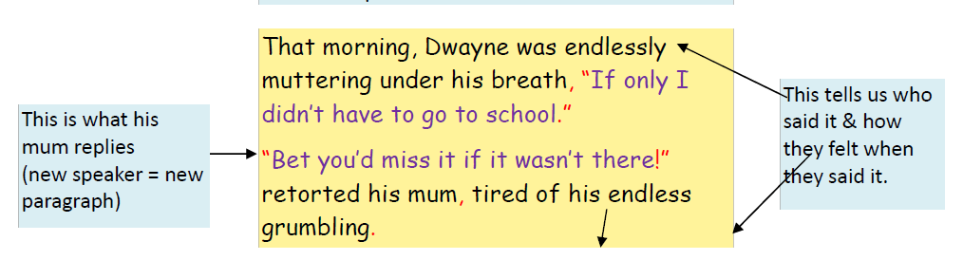
Writing speech in a story is very similar to a comic strip
except this time you have to use words to paint the
picture of how the speaker is feeling and how they
react to what someone else has said.
Look at the example below:

Slide 28
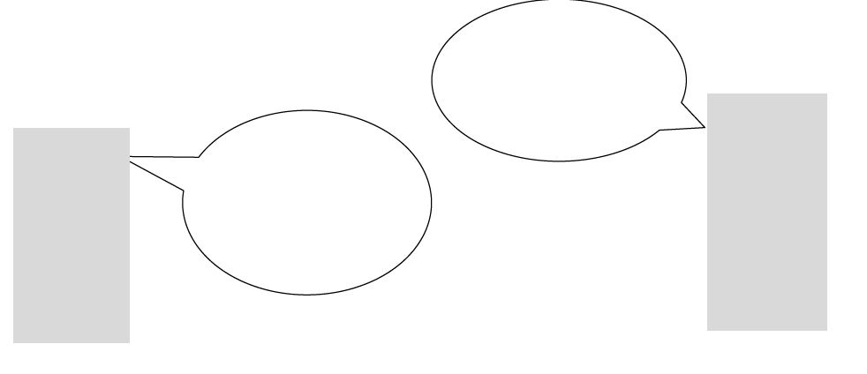
Rules of speech
The inverted commas go around what is said.
The first word of speech has a capital letter.
The last word spoken has punctuation after it, inside the
inverted commas.
Now it’s your turn. Use the characters from the story. Make
Sarah wish something and Jack react. Let the reader
know how each character feels. Write what they say into the
speech bubbles and draw an image to show how each speaker
feels.

Slide 29
Writing task
Now turn your cartoon into a short dialogue
from the wishing story. Use the words you select
help the reader picture the scene.
Write it in your home learning book.

Slide 30
Spelling
L.C. Can I use a dictionary to check words referring to the first three or four letters?

Slide 31
Put these words in dictionary order.
relevant
revelation
referee
restaurant
revolution
reflex
remonstrate
readjust
reflection

Slide 32
Put these words in dictionary order.
profession
programme
pronunciation
prototype
popularity
prosecute
proposition
prospective
production

