Slide 1
English week commencing June 1
Year 3 and Year 4

Slide 2
The King of The Fishes
The story we are going to look at is ‘The King of the Fishes’. This traditional story has been passed around the world by many people which means that there are many different versions of the story out there.

Slide 3
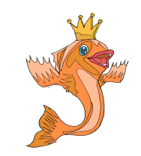
The King of The Fishes
Looking at the picture. What do you think the story will be about?
Write your predictions in your books.

Slide 4
The King of The Fishes
Our story is Pie Corbett’s version. You can listen to a recording of the story here:
https://soundcloud.com/talkforwriting/fishes/s-v410Lk1dxJy

Slide 5
The King of The Fishes
Once upon a time there was a poor fisherman called Li. Every day, he went down to the sea to fish. There he stood on the rocks and threw the nets into the icy waters and waited. When he pulled the nets in, he would take any fish back to the market and sell them. One day, he caught a huge fish. It had silver scales that glittered in the sunlight, blood–red fins and a golden crown. It was so beautiful that Li stood, amazed, staring at the fish as it thrashed about in the net. Suddenly Li felt guilty. It was so beautiful, and surely it must have a family… So, he scooped it up out of the net and set it free. Li stood watching as the fish swam out to sea. Then, to his amazement, it turned and spoke to him. I wonder what you will like about the story. What will surprise you? What will it remind you of? “Li, you have saved the King of the Fishes. I grant you one wish. When the moon is high in the sky, come back here and tell me your heart’s desire.’ With a flick of his fin, the King of the Fishes was gone. Immediately, Li hurried home, wondering what on earth he should wish for. There were so many things that his family needed.

Slide 6
The King of The Fishes
First, he asked his elderly father. “Father, if you had one wish, what would it be?” There was a silence and then his father spoke, ‘Why son, I would wish for new eyes, for I am blind and will never see again.’ Next, he asked his mother. “Mother, if you had one wish, what would it be?” His mother thought for a minute and then said, “Why son, I would wish for money, for the roof needs mending and the winter winds whip through the house and make my bones shiver so.” Finally, he asked his beautiful wife. “Wife, if you had one wish, what would it be?” There was a silence and then his wife whispered, “Why Li, I would wish for a baby, for who will care for us when we are old? Yes, nothing would be more precious than a child.” Poor Li could not make up his mind – they needed the money certainly, but his father was blind and that was a terrible thing. However, he also knew that a child would bring joy to them all. All evening, Li paced up and down trying to decide what the wish should be. Suddenly, he stopped pacing and grinned. Yes, he had it! He rushed out of the house, through the forest and down to the sea. The moon was high in the sky and so it was time to talk to the King of the Fishes. Li ran down onto the rocks and stood there with the foam crashing about him. He could see the moon’s reflection on the waves, and then came the King of the Fishes. “What do you wish for Li?” called the King in a high, silvery voice. “I wish for my father to see our son in a cradle made of gold,” shouted Li. There was a silence and the great fish disappeared. The waves stilled and Li could see the stars like silvery freckles in the dark night sky. Then out of the darkness he heard a noise, drifting down through the forest. It was a baby crying…

Slide 7
The King of The Fishes
1. What did you like about the story?
2. What surprised you?
3. What did it remind you of?
Here are some examples children have written about before....Let’s share those ideas now! 1. I loved the part when Li chose to put the fish back in the water because it told me that he was a kind man. 2. The final wish surprised me because it was so clever! 3. This story reminded me of Aladdin because they are both wishing tales. Tip: The word because might help you extend your ideas.

Slide 8
LC: Can I comment on a story?
Now we’d like you to write your comments in your English books.
Toolkit:
Answer these 3 questions:
1. What did you like about the story?
2. What surprised you?
3. What did it remind you of?
Year 4: Use conjunctions, and but, so yet, because, if, when to extend your answer.

Slide 9
Lesson 2: LC: Can I study a story extract and answer questions?
Go back over the story and underline or highlight any words that you don’t know.
Ask an adult to help you find the meaning or look in a dictionary online.

Slide 10
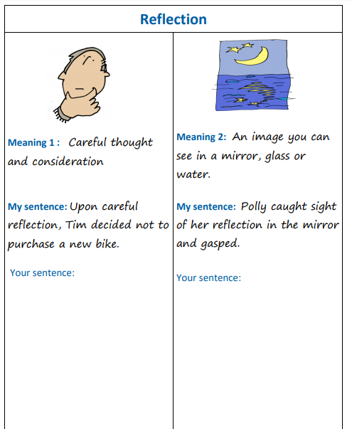
Focus on Key Vocabulary.
Reflection

Slide 11
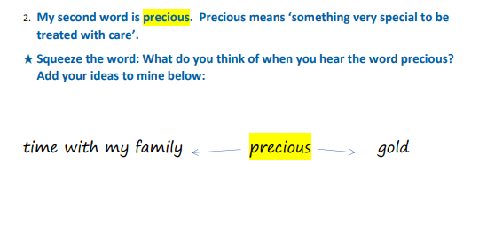
Focus on Key Vocabulary.
Precious

Slide 12
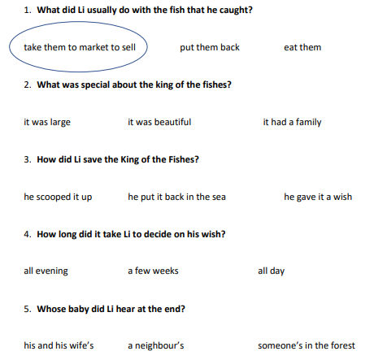

Slide 13
If you had 3 wishes what would you wish for? Record them in your English book
Toolkit:
3 wishes you would like granted
Year 4: Use conjunctions, and but, so yet, because, if, when to extend your answer.
Top Tips: Here are some answers other children have written. They may give you some ideas. 1. I wish I could fly because I would love to visit a different country every week. 2. I wish that the rich people in the world would share their money so that no one was homeless or hungry. 3. I wish for a magic wardrobe which would mean that I could create any outfit I fancied.

Slide 14
Lesson 3: LC: Can I create expanded noun phrases?

Slide 15
In this sentence from The King of the Fishes, the writer has picked three parts of the fish to describe in detail.
It had silver scales that glittered in the sunlight, blood–red fins and a golden crown.

Slide 16
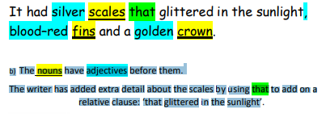

Slide 17
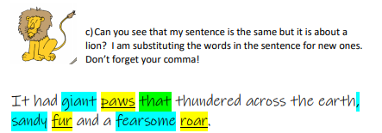

Slide 18
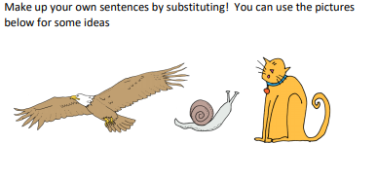
Lesson 3: LC: Can I create expanded noun phrases?

Slide 19
Lesson 4: LC: Can I use fronted adverbials?
The writer of our story uses ‘fronted adverbials’ to tell the reader where, when or how something is happening.
Two examples: Immediately, Li hurried home, wondering what on earth he should wish for. Suddenly, he stopped pacing and grinned.
These fronted adverbials – immediately and suddenly – have a similar meaning: ‘to do something very fast, without waiting.’ ‘Suddenly’ also makes the reader feel as though it has been a surprise; something unexpected.

Slide 20
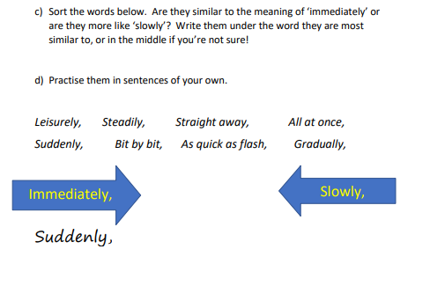
Lesson 4: LC: Can I use fronted adverbials?

Slide 21
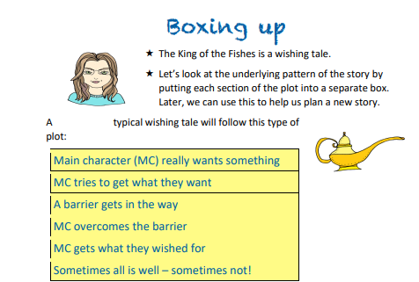
Lesson 5: Can I create my own character innovation?

Slide 22
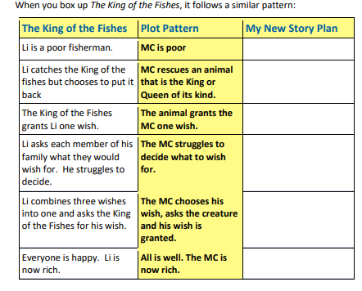
Lesson 5: Can I create my own character innovation?

Slide 23
Lesson 5: Can I create my own character innovation?
In your story, your main character will need to rescue a King or a Queen of a species. Here’s a chance to get creative. Pick an animal and draw or describe what the King or Queen of its kind would look like. You could use paper and coloured pens or pencils.
Think about:
What does your character look like?
Where do they live?
What are their character traits?
Next week, we will then be able to create your own version of the story.

