Slide 1
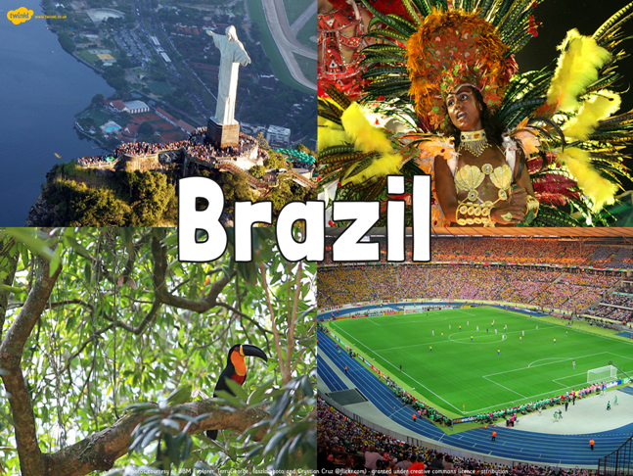

Slide 2
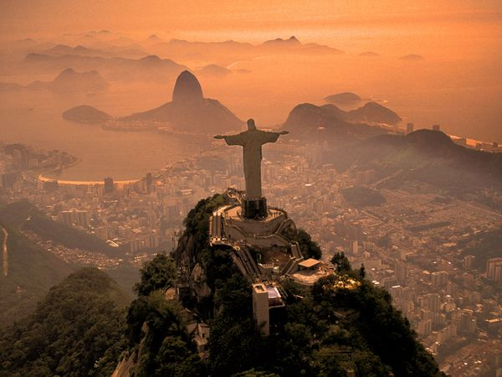
School / Home Learning
Following on from the work you have done on the Rainforests, we are now going to zoom in on the country of Brazil.
This week, we will look at the human and physical aspects which make up this fascinating country.

Slide 3
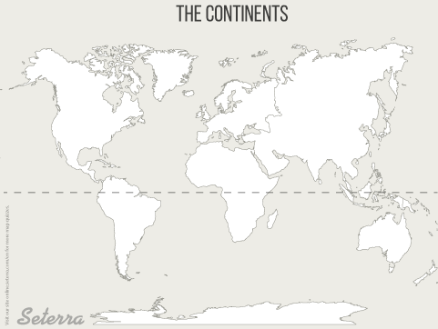
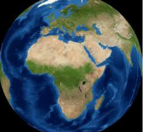
Our world – what do you know?
How many continents are there?
  Can you name them?

Slide 4
Brazil
Which continent is Brazil part of?
What do you think it would be like to live there? Can you add two sentences in your book / home learning book before you go any further in the lesson.
Now watch the video:
What do you think now about Brazil?
https://www.youtube.com/watch?v=GaTxZG3fxYI

Slide 5
Google Earth or use an Atlas
Let’s locate Brazil.
If you are at home, practise zooming in and out.
Can you discover which countries in South America share a border with Brazil? There are 10 in total.
Can you identify the main cities of Brazil?
What ocean borders Brazil’s coastline?
There is a blank map of South America for you to print off and label or you can just record these in your books.

Slide 6
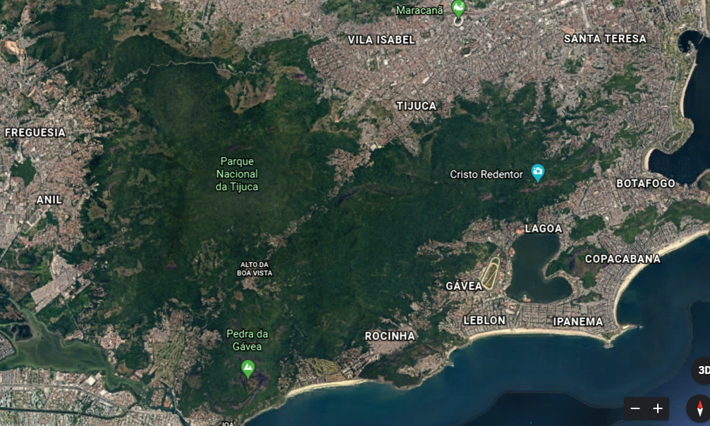
Maps show many different things
This is Rio de Janeiro – this image from Google Earth shows human and physical features. What can you spot?

Slide 7
Write a definition in your books of:
A human feature:
A physical feature:

Slide 8
You may have written something like this:
A human feature:
A physical feature:
A man-made feature in the environment. For example: buildings, bridges, tunnels, railroad tracks, dams, monuments, piers, cultivated land.
Natural landforms and bodies of water. For example: cliffs, rivers, waterfalls, caves, mountains.

Slide 9
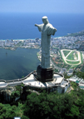
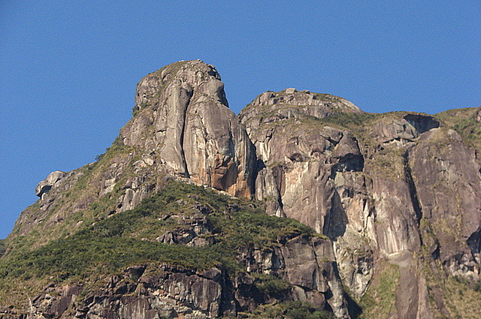
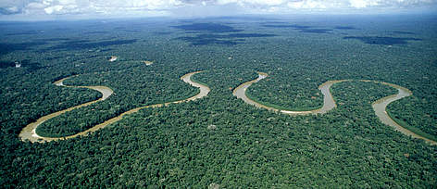
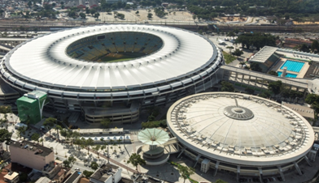
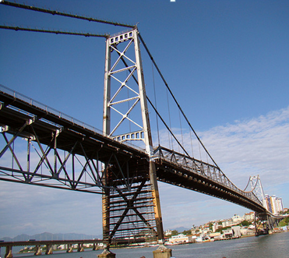
Human or Physical?
Human –
Christ the Redeemer Statue
Physical –
The Serro do Mar
Physical - The Amazon Rainforest
Human - The Hercilio Luz Bridge
The Maracana Stadium

Slide 10
Geographical Regions of Brazil
There are six major ecosystems in Brazil known as:
Tropical rainforest (Amazonia),
The Cerrado (tropical savannah grasslands),
The Pantanal (wetlands),
The Pampas (grasslands),
The Caatinga (semi-arid forest),
The Mata Atlantica (coastal forest).
Using the map and information sheet, locate the different ecosystems found in Brazil. Read the information carefully as there is going to be a quiz next!

Slide 11
Quiz time!
If I went swimming off the coast of Brazil, what ocean would I be swimming in?
Name 3 large cities in Brazil.
Name the river that flows through Brazil?
Can you name 2 of the 6 geographical regions you’ve just read about?
What is a human feature (give an example) and what is a physical feature (give an example).

Slide 12
Answers! How many did you get right?
If I went swimming off the coast of Brazil, what ocean would I be swimming in? (South) Atlantic
Name 3 large cities in Brazil. Rio de Janeiro, Sao Paulo, Salvador, Manaus, Fortaleza, Belo Horizonte
Name the river that flows through Brazil? The Amazon
Can you name 2 of the 6 geographical regions you’ve just read about? Caatinga, Cerrado, Pantanal, Mata Atlantica, Pampas, Amazon Rainforest
What is a human feature (give an example) and what is a physical feature (give an example). Human = manmade eg. Christ the Redeemer statue Physical = natural – eg Amazon River

