Slide 1
Anna Meredith
Connect It
Primary classroom lesson plan
LC: Can you create your own music patterns?

Slide 2
Lesson outcomes
After this lesson, pupils will be able to:
• Listen and reflect on a piece of orchestral music.
Develop their listening ear.
• Learn musical language appropriate to the task.
Recognise patterns in the music.

Slide 3
Glossary of music terms
Term | Definition
Canon | everyone performs the same material but begins at different times (also known as a ‘round’)
Motif | a small musical idea
Orchestrate | choose which instruments perform which parts of the music
Pitched percussion | percussion instruments that can play different pitches – xylophones, glockenspiels, chime bars etc.
Pulse | the steady ‘beat’ under much music made up of notes of the same length (like a ticking clock)
Unpitched percussion | percussion instruments that can only make a limited number of sounds – drums, shakers woodblocks, tambourine etc.

Slide 4
Lesson 1
Watching and listening and doing!
Notes:
Listen and watch the full performance.
Curriculum link: Appreciate and understand a wide range of high-quality live and recorded music drawn from different traditions and from great composers and musicians
Develop an understanding of the history of music

Slide 5

Background – the composer
Anna Meredith (b. 1978)
British composer and performer
Born in London, grew up in Scotland, studied in York and at Royal College of Music

Slide 6

Background – the music
Connect It
    Written in 2014 especially for BBC Ten Pieces.
    Doesn’t contain any instruments at all, just body percussion and vocal sounds

Slide 7
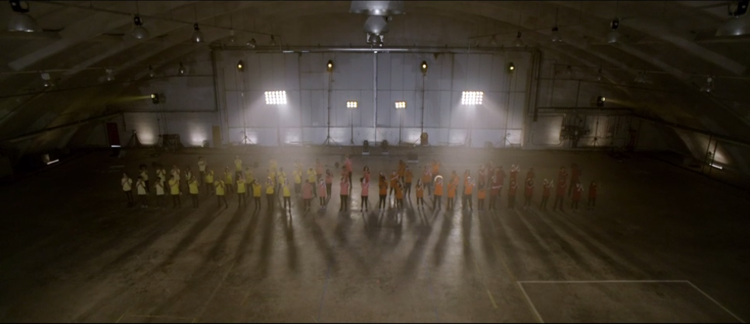
Watch the orchestral performance
https://www.bbc.co.uk/programmes/p02b5cqg
Notes:
Perform each pattern four times back-to-back before moving onto the next one. You might like to choose someone to play a steady pulse as you do this, or just stand and count the patterns out loud.
Decide on your favourite version (canon, wave, altogether) and write it down.

Slide 8
Learn these four patterns:
Notes:
Practise performing each pattern four times.
Activity: Create your own music patterns.

Slide 9
Taking it further – cross-curricular activities
ART: Make a graphic score of your new piece by inventing symbols for all of the new motifs.
LISTENING: Have a listen to Kerry Andrew’s ‘No Place Like’
https://www.bbc.co.uk/programmes/p05dtp73

