Slide 1
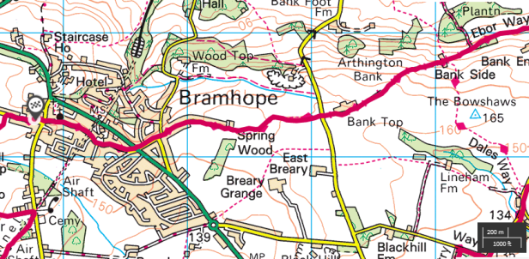
Map Skills Lesson One:
An Introduction to Maps
Maps and plans are representations of space in two dimensions and flat images.
This week, your main activity involves creating a plan of your bedroom, thinking about the relative position of different objects in the room, and representing 3-D space in a 2-D diagram.

Slide 2


What do the maps and globe feel and look like?
Is the map flat and smooth?
Is the Earth flat?
Why are maps useful?
How are maps and globes different?
What 3-D shape is the globe?

Slide 3
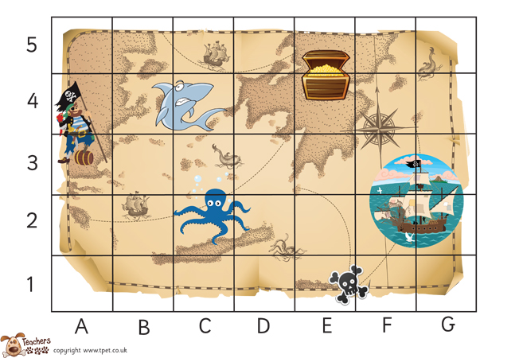
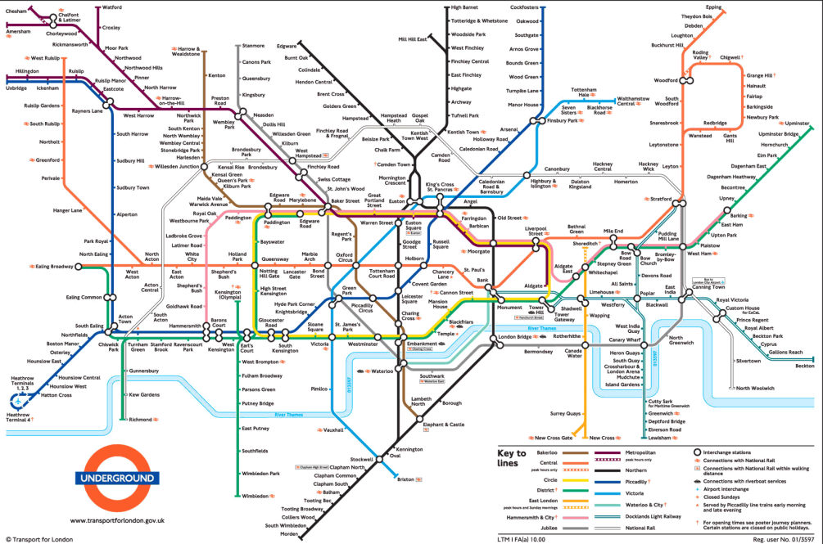
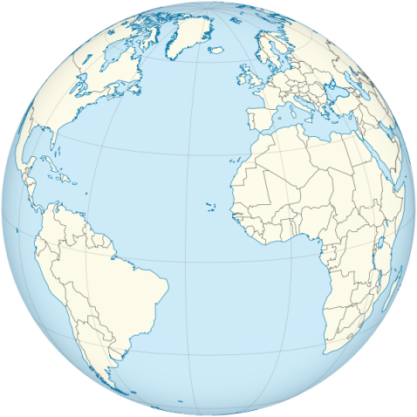
Look at a range of maps, plans and globes
Have you seen maps like this before?
Where have you seen them?

Slide 4
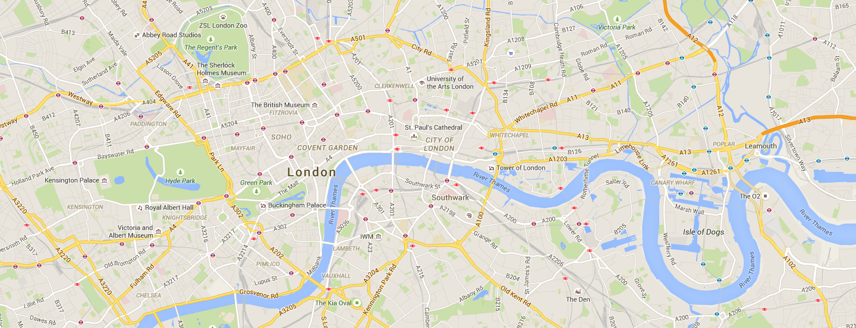
Map of London
What can you see on this map?
Source: google maps

Slide 5
What do people use maps for?
Maps are 2-D drawings of our world from above or a ‘bird’s eye view’.
They help us find our way around and show where different places are in relation to each other (distance and direction).
Maps can show small or large areas: from room plans to world maps.
Introduction to maps – BBC
https://www.bbc.co.uk/teach/class-clips-video/geography-ks1--ks2-maps/zdwhpg8

Slide 6
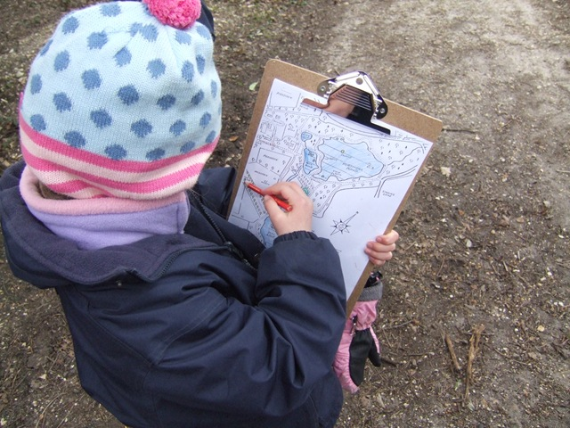
What is this person doing?

Slide 7
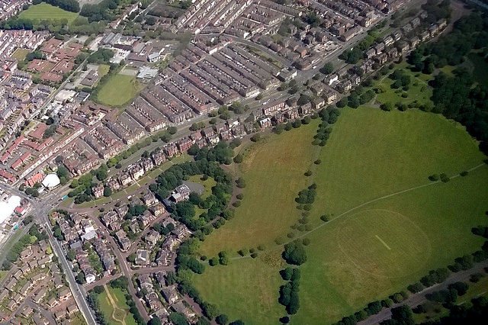
The world from above: a bird’s eye view
Project 365 #200: 190715 You Can See...© Pete, Flickr

Slide 8
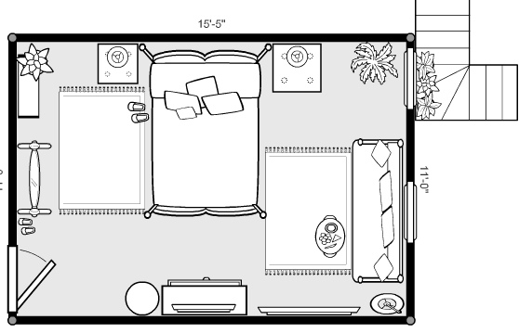
Floor plans are a view from above
Mynextbedroom © Elif Altinbasak,Flickr

Slide 9
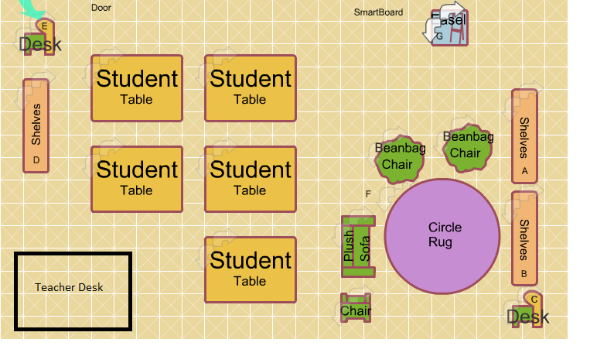
What can you see on this classroom plan?
How would our classroom look from above?

Slide 10
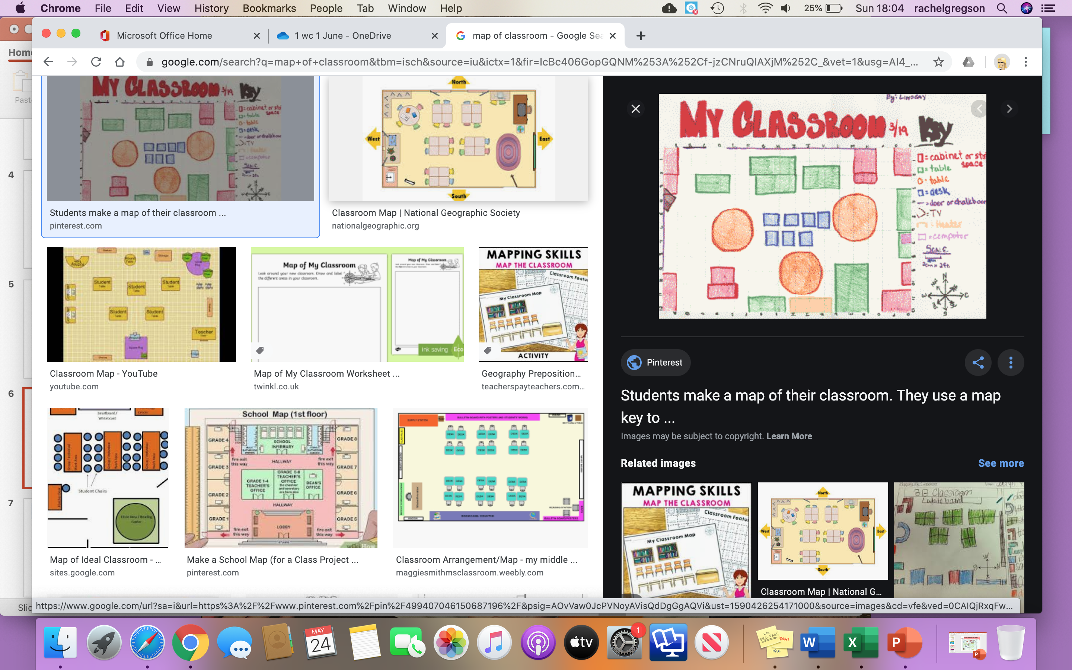
What does this map show?
Use the key to help you.

Slide 11
LC: Can you create a plan of your bedroom?
Main Activity
Draw a plan of your bedroom
Think about your bedroom.
Try and draw what objects would look like from above, or from a ‘bird’s eye view’.
Try and put everything in the right position.
Decide if you are going to label the objects or use a key
Challenge: Can you draw a plan of other rooms in your house? Or maybe you’d like to plan your dream bedroom.

