Slide 1
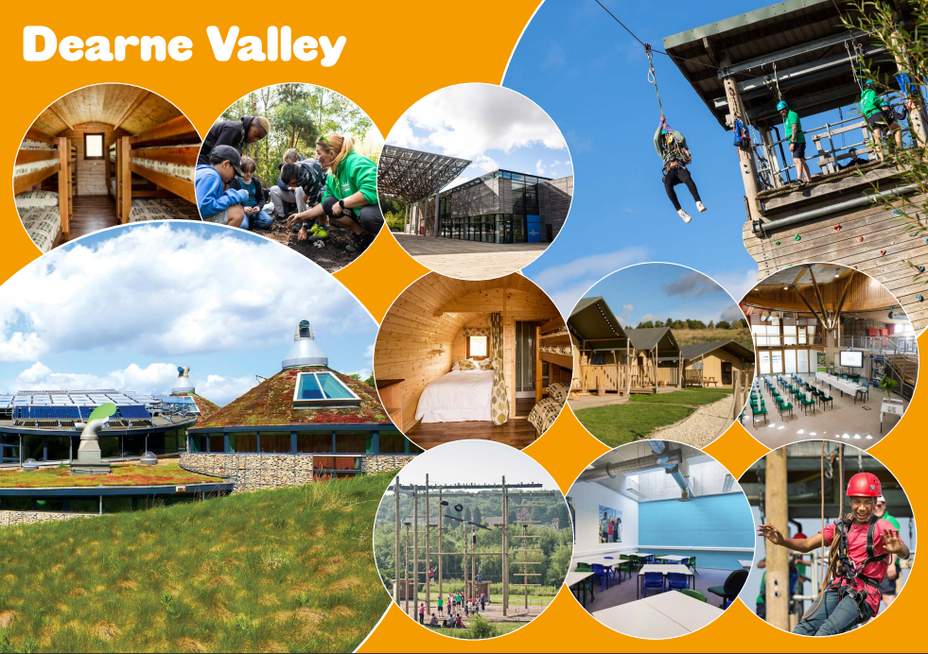

Y6 Residential at Dearne Valley
Wednesday 3rd June – Friday 5th June 2026

Slide 2
https://www.youtube.com/watch?v=3eTgB3OwB-0&t=5s
Formerly the Earth Centre, one of the millennium commission projects, Dearne Valley was transformed into a state-of-the-art activity centre in 2012. Dearne Valley is the most environmentally sustainable centre, complete with one of Europe’s largest solar panels and an on-site water treatment plant.
With fantastic indoor and outdoor activity facilities surrounded by the beautiful countryside of South Yorkshire, a purpose-built water sports lake and access to the adjacent River Don, Dearne Valley offers something for everyone.

Slide 3
Why do we take pupils on residentials?
to encourage independence
to develop team building and collaboration
to be given the opportunity to lead activities
to make memories
to step out of comfort zones
to support each other

Slide 4
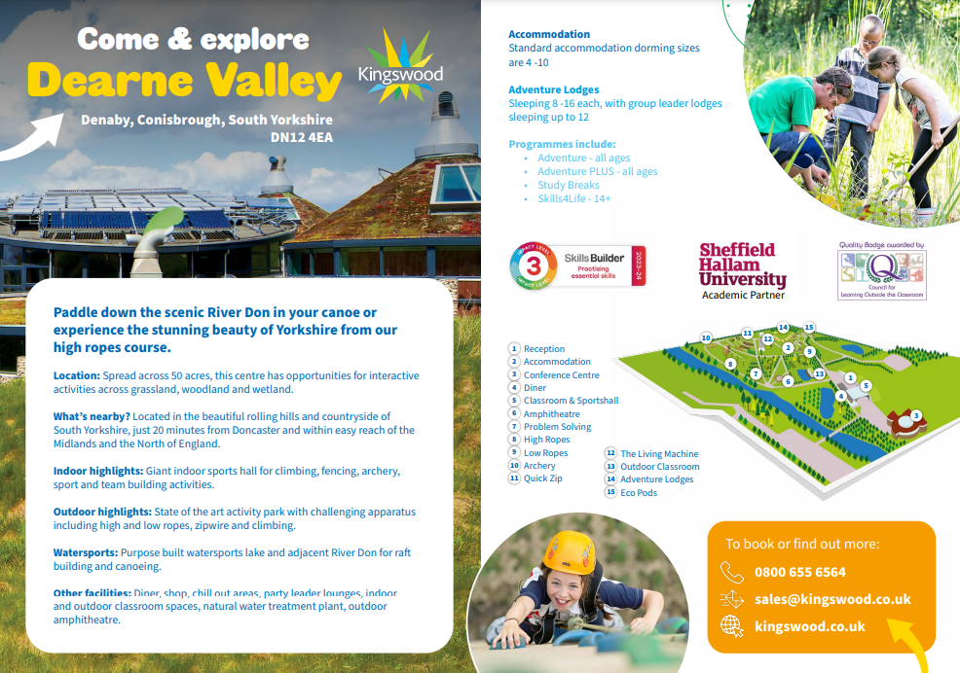

Slide 5
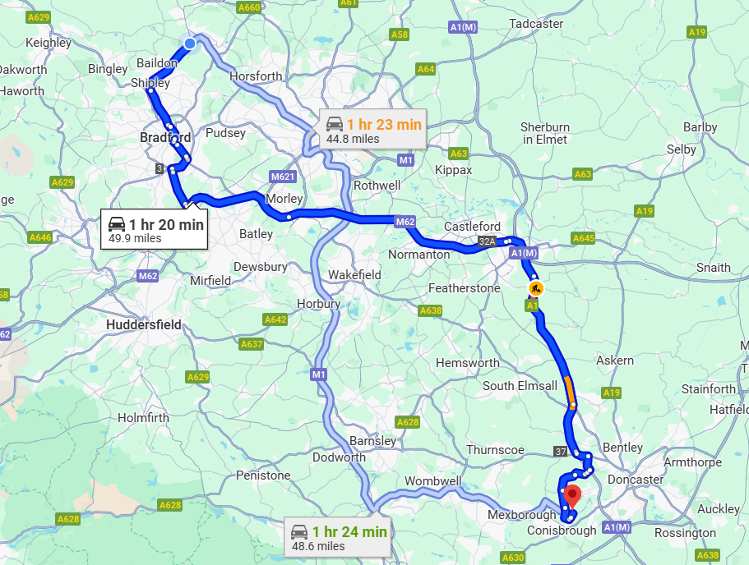
Where is it?

Slide 6
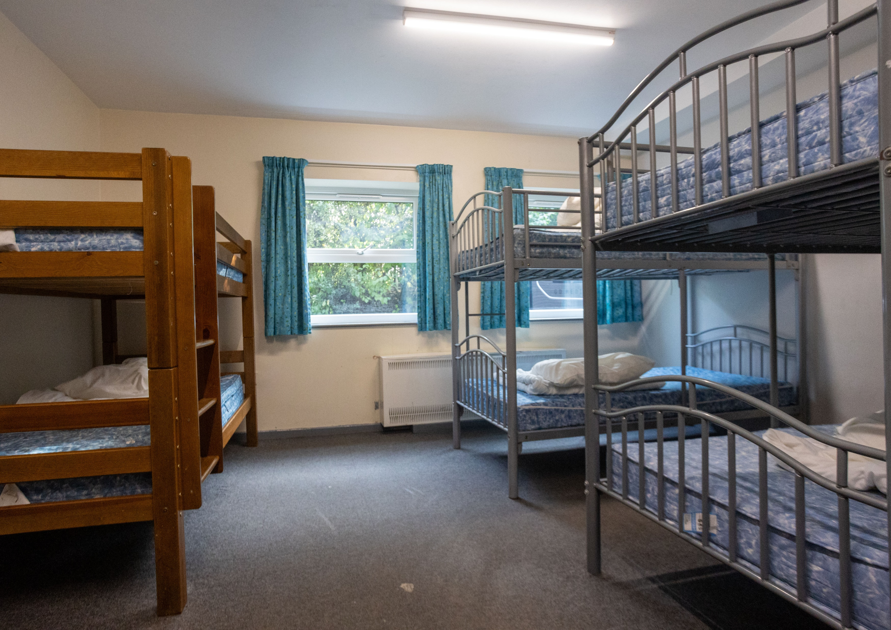
Accommodation
Dearne Valley has standard dormitory-style accommodation. Rooms range from 4 to 16-bed dormitories, some en-suite, with gender-separated bathroom and shower facilities and party leader rooms close by.
Sheets are provided for all guests but your child will need a sleeping bag and a pillow.

Slide 7
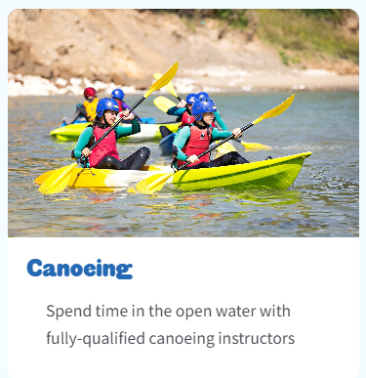
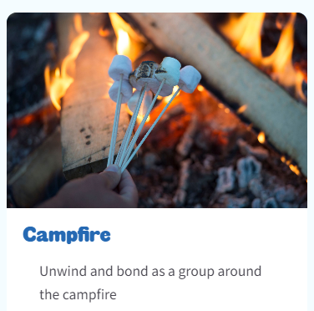
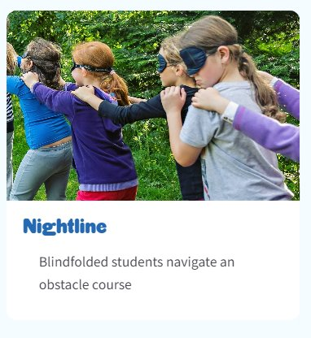
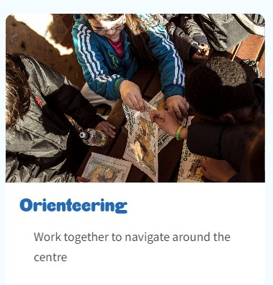
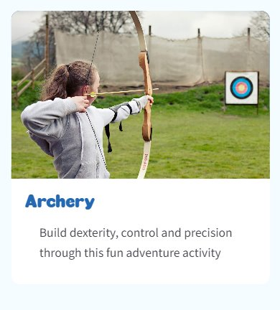
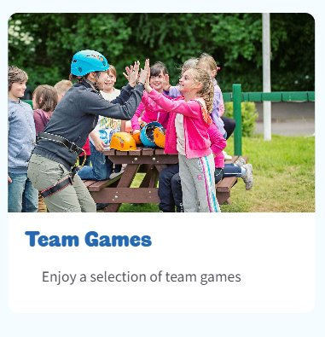

Slide 8

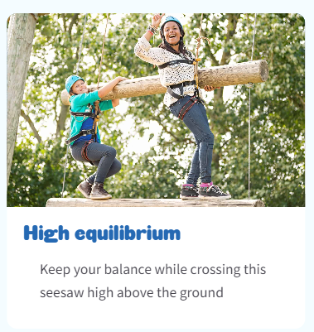
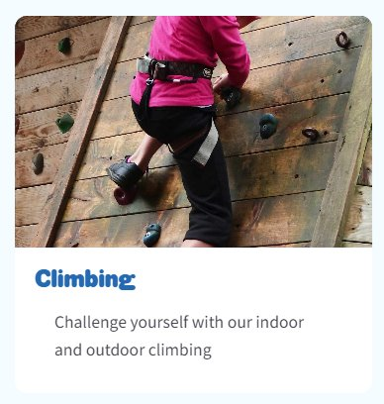

Slide 9
Important information
On Wednesday 3rd June arrive at lunchtime, and we will bring a packed lunch with us
On Friday, 5th June 2026, depart at 13:30 so the last meal at Dearne Valley is lunch.

Slide 10

Example menu
All dietary requirements will be catered for.
There are places to refill water bottles and a juice trolley for an on-the-go refreshment between sessions.

Slide 11
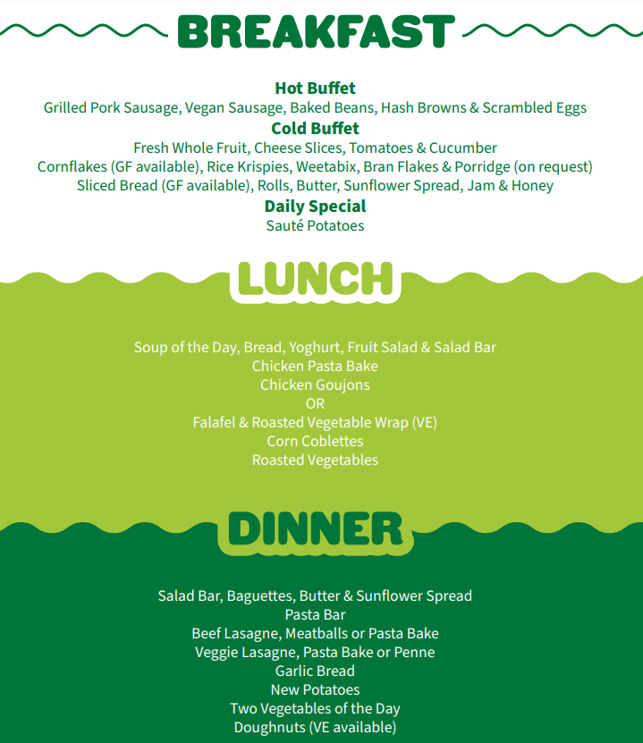
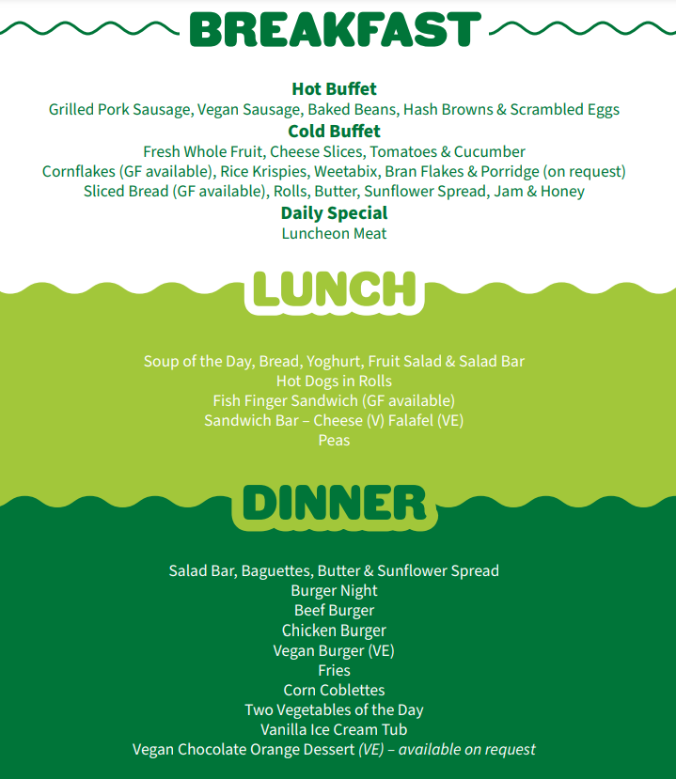

Slide 12
Kit list Please note that most activities require long sleeves.
Two bath towels and a toiletries bag containing: toothbrush, toothpaste, soap, hairbrush, shampoo and shower gel etc.
Night clothes, socks and underwear
Four t-shirts and two jumpers/sweatshirts
Three pairs of trousers/tracksuit bottoms
Clothes for the evening activities
Waterproof jacket (and trousers if you have them)
Sturdy shoes or wellingtons (even in summer) and two pairs of trainers (one old pair)
Bin bag for dirty clothes
Water bottle
Hat and sunscreen
Small day bag
£2 for the site shop
Sleeping bag and pillow

Slide 13
What not to bring!
Please do not bring mobile phones, smart watches, cameras, electronic games, expensive or much cherished jewellery, expensive favourite clothing/shoes. Kingswood will not accept liability for the loss or damage of any personal property that your child may bring.
In case of lost property please put your child’s name on all items of clothing!

Slide 14
Medicines
In line with our medical policy, ONLY prescribed medication will be allowed.
The exceptions are travel sickness and hay fever tablets, which must be in the original packaging.
It must be handed into the office a week before the residential and a medical form must be completed.

Slide 15
Forms
Please complete the EV1 and return by March 13th.
Please complete the Bramhope medical form if necessary.
Dormitory forms will also be completed, and pupils will be guaranteed at least one friend.

