Slide 1


What is 'Change One Thing?'

Slide 2
What does the evidence tell us about screentime?
Technology is addictive
Too much screentime can affect your sleep
Too much screentime can cause arguments
Too much screentime can stop you doing other things –'opportunity cost'
Too much screentime can sometimes make you feel lonely and less confident

Slide 3
What are adults at home doing about it?
Setting rules about how often and how much
Controlling how often and how much
Making sure tablets and phones stay downstairs
Controlling what you can access
Checking your devices
Trying to use their phones less
Trying to get you to do other things and get off your devices

Slide 4

So..this year we are running a family challenge...
Can you and an adult at home come off your screen and do something TOGETHER?

Slide 5
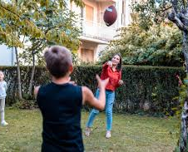
Get Moving and get outdoors
Exercise: Go for a walk or a bike ride.
Explore: Walk around your neighborhood, visit a park, library, art gallery or museum.
Play: Play with your pets, jump on a trampoline, or play an outdoor game like catch!

Slide 6
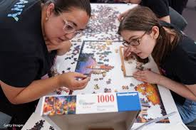
Be creative and learn
Crafts: Knit, crochet, draw, paint or try origami
Music: Make a playlist, play the piano or learn a dance.
Skills: Practice a language, learn a new recipe or try a new sport.
Puzzles: Do a crossword or a jigsaw puzzle

Slide 7

Get organised
Tidy Up: Clean a drawer, de-clutter your wardrobe and visit the charity shop
Plan: Write a shopping list, plan a meal or organize your photos.
Sort: Organize your desk, your books or your bedroom

Slide 8
Relax and re-charge
Read: A book, a magazine or listen to an audiobook
Self-Care: Have a hot chocolate or go for a walk..
Mindfulness: practice deep breathing or find a good view

Slide 9
Connect with someone
Talk: Call a friend or family member or have a phone-free chat.
See a friend: Play a game cook together or volunteer.
Write: Send a letter or postcard to someone you don't see very often

Slide 10

The challenge is for you and an adult to come off your screens and do something together instead!
Please send us a photo...

