Slide 1
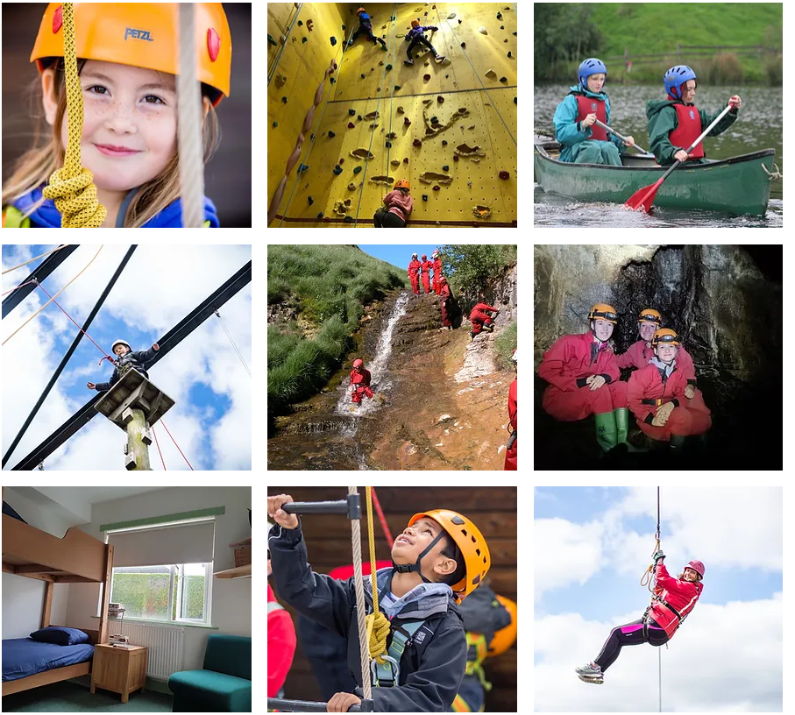
High Adventure Outdoor Education Centre
Monday 23rd - Wednesday 25th March 2026

Slide 2

Why High Adventure?
Owned and run by former teachers.
Offer a high quality experience reflected by a 90% rebook rate.
They have the Learning Outside of the Classroom Award.
Designated Group Leader, home-cooked meals, bedding & waterproofs provided and comfortable indoor accommodation.

Slide 3
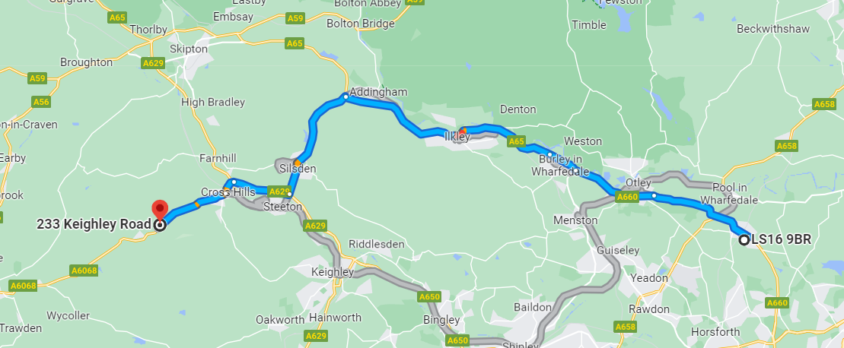
​
​
Where is High Adventure?
233 Keighley Road,
Cowling,
North Yorkshire, BD22 0AA.

Slide 4
Why do we take pupils on residentials?
encourage independence
team building
opportunities to lead activities
make memories
step out of their comfort zone
support each other

Slide 5
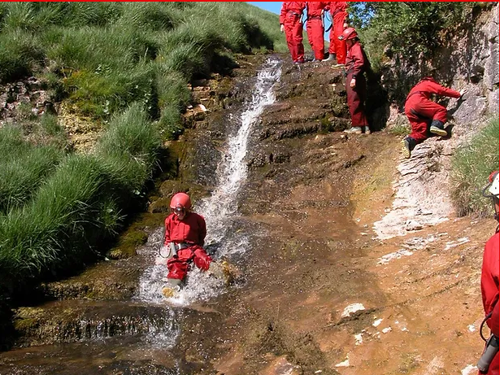
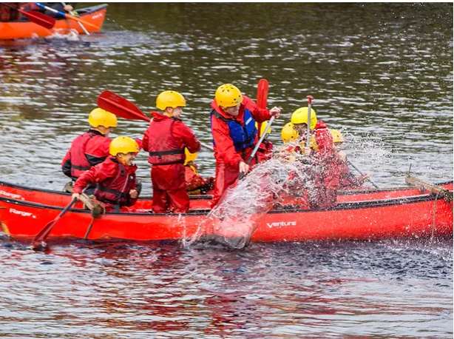
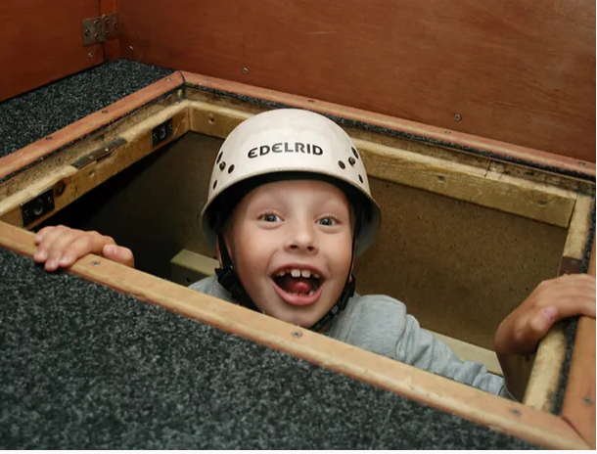
Possible Activities
Stream scrambling
Canoeing
Hiking
High ropes
Labyrinth

Slide 6
Sample Menu
Day 1
Lunch: pupils to bring their own packed lunches
Evening meal: sausage and mash, ice cream roll
Day 2
Breakfast: cereal, fruit juice, toast, beans, porridge
Lunch: make your own packed lunch - sandwiches, fruit, sweet treat, crisps
Evening meal: bolognese / macaroni cheese, garlic bread, grated cheese, cup cake
Day 3
Breakfast: cereal, fruit juice, toast, beans, porridge
Lunch: make your own packed lunch - sandwiches, fruit, sweet treat and crisps
Pupils must bring their own lunch box, reusable water bottle and mug.
All dietary requirements will be catered for.

Slide 7
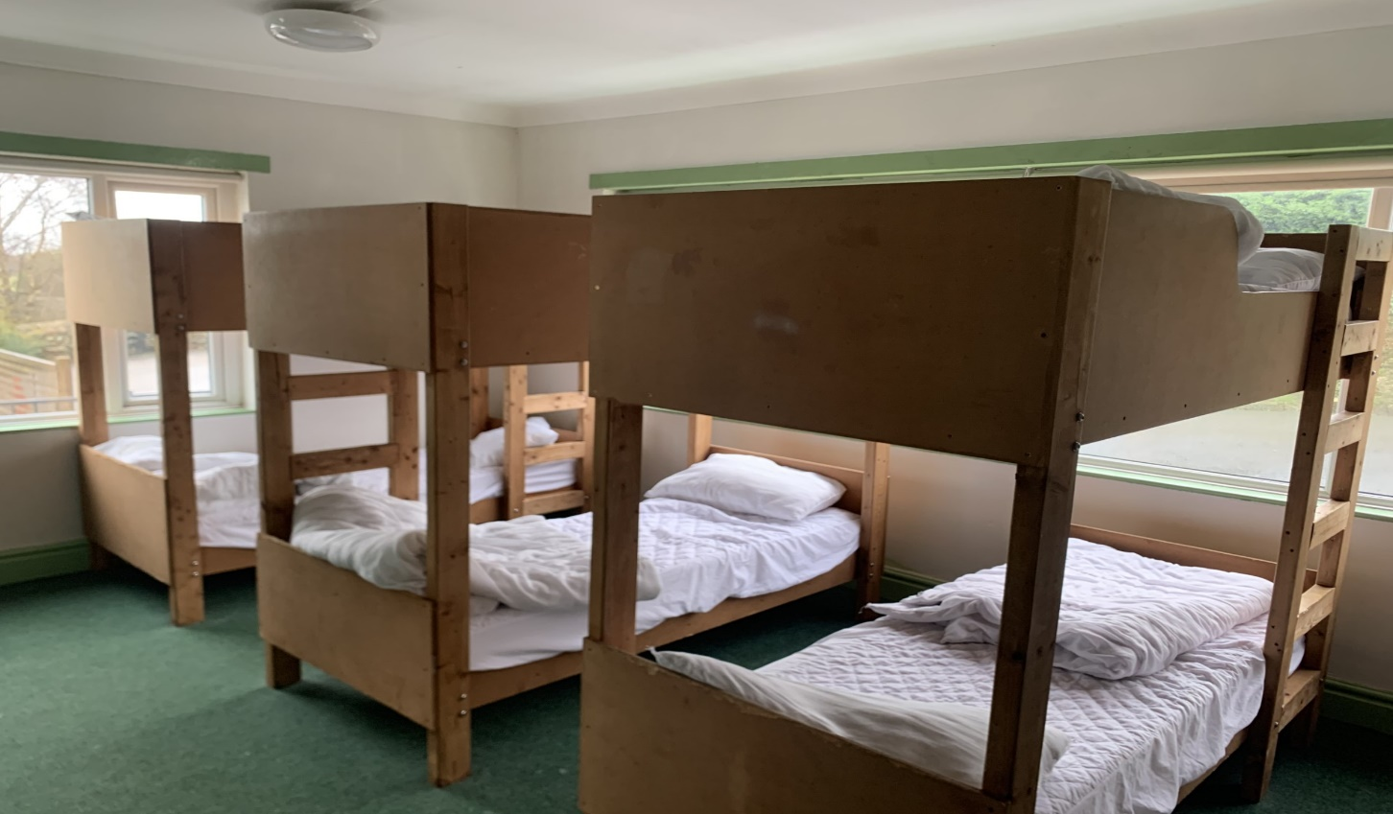
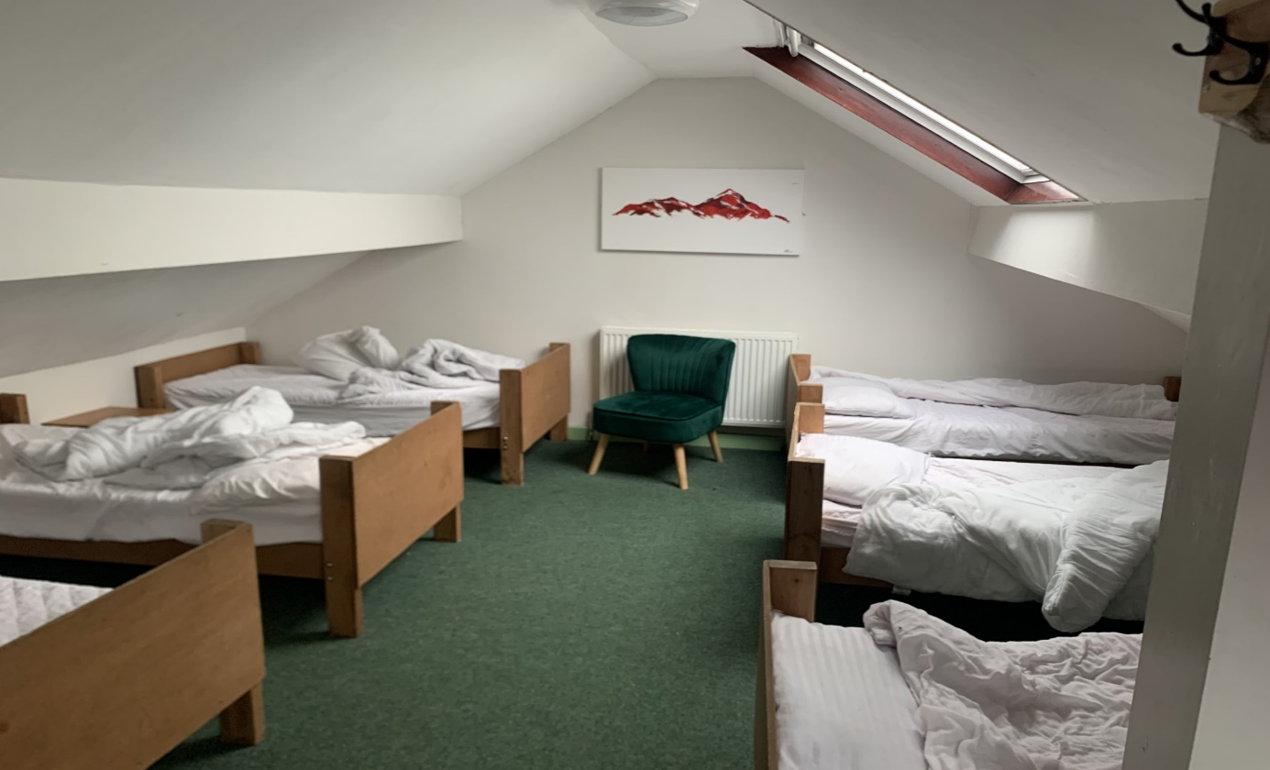
Organisation
Dormitory style rooms
We are in the larger building, split over 2 floors, not shared by other school groups.
Room to socialize and relax.

Slide 8
Organisation
There will be approximately 12-14 pupils in an activity group with a High Adventure Leader and member of BPS staff.
There is a tuck shop so pupils can bring up to £2 to spend. Please hand to staff before departure.
No electronics including mobile phones, fitbits and Smart watches are permitted.

Slide 9
Organisation
The pupils will need a packed lunch as we eat as soon as we arrive at High Adventure.
It needs to be packed separately and taken onto the coach as we eat before we get our luggage.
Packed lunch will be provided for those pupils who are on school dinners.
Bring walking shoes/boots for the hike.

Slide 10
Kit list (will be provided) - please label items!
2/3 T-shirts
2/3 Sweatshirts/hoodies
2/3 Trousers - Tracksuit bottoms or similar (NO JEANS)
Socks & underwear (bring plenty)
Warm jacket
2 x Large towels
Pyjamas/similar
Indoor footwear - trainers
2 pairs of outdoor footwear (that will get wet/dirty)
Comfortable indoor clothes

Slide 11
Kit list
Comfortable clothing – think layers!
Indoor shoes / slippers
Waterproofs (see note below*)
Toiletry bag – shampoo, soap, toothpaste, toothbrush
Re-usable drinks bottle and a mug
Lunch box – to take lunch on Monday and with you on activities
Small rucksack / day bag
Gloves and hat – it can be cold
Sun cream – it may be sunny in March (!)
Bin bags / carrier bags for wet clothes
Torch & batteries (optional)
Teddy (optional)
Books, small games for room (no electronics)
Please make sure:
*Waterproofs (including wellies) can also be provided by High Adventure so don't worry if you don't have any.
All clothing must be labelled.
Bedding is provided by High Adventure.

Slide 12
Medicines
In line with our medical policy, ONLY prescribed medication will be allowed.
The exception is travel sickness tablets, which must be in the original packaging.
It must be handed into the office a week before the residential and a medical form must be completed.

Slide 13
Forms
Please complete the Bramhope medical form if necessary.
Dormitory forms will also be completed and pupils will be guaranteed at least one friend.

Slide 14
FAQs from pupils
Will I need any money? Yes-£2 in a named envelope. ​
Can I take a teddy? Yes.​
Can I share a dorm with my friends? You will be guaranteed to be able to share with at least 1 friend. ​
Can I take sweets? No - you won’t be hungry!​
Do we wear our own clothes? Yes and to travel in.​
Can I take a phone? No. Please do not bring electrical equipment or technology on to camp, to avoid the risk of expensive items being lost or damaged.​
Can I wear earrings? No​ - please wait to get ears pierced until after the residential if your child will not be able to remove them.

Slide 15
Any questions?
https://www.highadventure.co.uk/

