Slide 1

Welcome meeting
September 2025

Slide 2
Aims of today’s meetings
Share our celebrations and our challenges
Share our priorities for this year
Build relationships with class teachers
Find out how best to help your child
Share our strengths
Find out about the ‘Great to wait’ campaign

Slide 3

Our vision is ‘to teach children to become readers, writers, and mathematicians. To inspire children to begin to think and act as artists, geographers, musicians, scientists, designers, historians, linguists, sportsmen and women.’

Slide 4
Our vision is reflected in our school motto.
Bigger school-same values…
We work hard so that all children feel a part of Bramhope Primary and are inclusive to others (Belong).
We emphasise achievement through effort (Be Your Best).
We provide opportunities for children to become kind, responsible citizens, and leaders of the future (Be Bramhope).

Slide 5

Our school strengths

Slide 6
Children enjoy coming to school. Our frequent pupil surveys demonstrate that the majority of pupils feel safe, enjoy school, and have positive attitudes to learning. Safeguarding is embedded in the culture of the school. The LA conducted a full safeguarding audit in March 2023. The report concluded It is clear from the evidence presented that Safeguarding and well-being of children is a priority for the school. The schools safeguarding arrangements evidence some areas of exemplary practice which the safeguarding team and the school should be proud of. We know our children. We assess regularly, teachers have clear 'next steps' for every child and pastoral care is excellent. Pupils and families receive additional support from class teachers, our Pastoral leader and outside agencies. In our most recent pupil voice 100% of pupils confirmed that 'The adults in school care about me'. We have clear values. For example, behaviour is excellent. We have a clear, consistent behaviour policy which is built on Restorative practice. OFSTED Inspectors stated that Pupils’ behaviour is exemplary. All, including the youngest, listen well and respond quickly to prompts. Bullying is not tolerated. Pupils know that they have a responsibility to report unsafe or unkind behaviour. They are confident that adults will take action to help. Parents seek to be involved in their child’s learning. They support their child to establish a routine with home learning (spellings and times tables) and read regularly (to and with) We have an active school community The PTA helps strengthen and support our school by planning inclusive events and raising money to enhance the curriculum. We have an excellent learning environment for our children. New spaces this holiday We have a rich curriculum. Subject leaders are passionate and ambitious for their subjects and make the most of our fantastic site. For example, we currently have gold Quality Marks for history and P.E, a GILT award for science and have just been recognized for our work in Geography.
Spiritual…

Slide 7
We have high expectations and emphasize achievement through effort. Every child is encouraged to ‘Be Your Best’. Our teachers want every child to attain at least the expected level for their age in Reading, Writing and Maths. Our academic results are very strong. The 2025 attainment outcomes (Y6) exceeded national results in reading, writing, maths and the combined score. Results show that children have an excellent start in Reception (85% made GLD in 2025) The teaching of phonics and early reading is also excellent; in 2025, 97% of Y1 pupils reached the expected standard in phonics. Finally, in 2025, 80% of Y4 pupils scored 20 or more in their multiplication test We have excellent support for children with additional learning needs. In April 2023, an external SEN audit stated Leaders communicate inclusivity at the heart of their vision. Inclusivity is demonstrated through practice within the classroom. All children are included within lessons and differentiation of task is evident. Pupils receive support and intervention where appropriate. This was still the case when we were inspected by OFSTED ‘…teachers are well equipped to adapt teaching and secure success for all. Those who need additional support are quickly identified.’ We seek to find and develop pupils’ talents. Enrichment activities form part of our personal development and well- being curriculum and are available to all. In addition, we have built a broad ECA programme for all children which includes provision for extra sport, music and drama. We provide leadership training and opportunities for all children and help them develop the skills they will need to stand out in the future. We are both supported and challenged by the Cluster, The Trust and the DfE.
Spiritual…

Slide 8
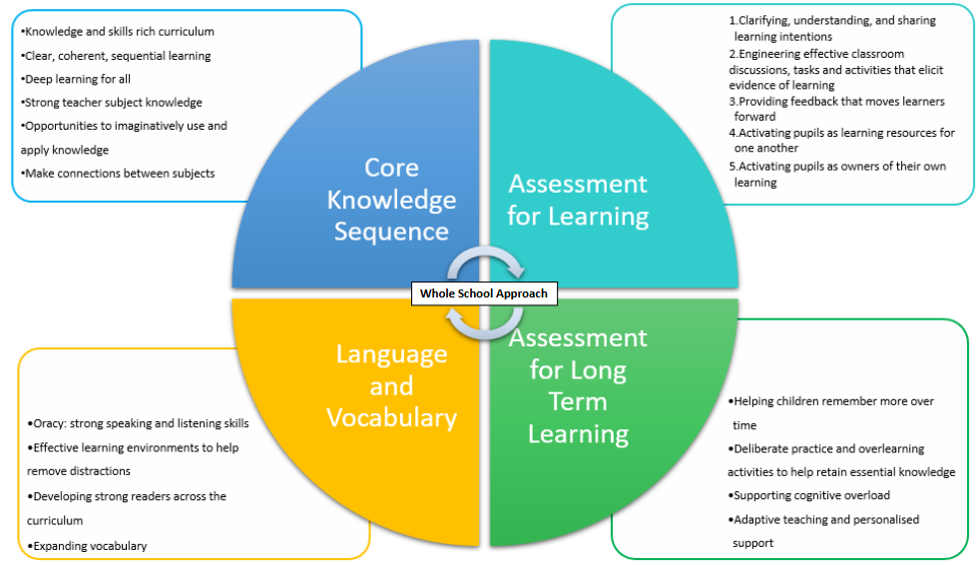
How is our curriculum organised?

Slide 9
How is our curriculum organised?
National Curriculum
Statutory document set out by the Department for Education.
Sets out the programmes of study and attainment targets for all subjects at all 4 key stages (primary and secondary).
Long Term Plans
Maps out the learning across the school for each subject.
Knowledge Overviews
Clear sequence of learning through a subject from Reception to Year 6.
Short term plans
Used where appropriate to detail specific elements of the lesson
All local-authority-maintained schools in England must teach these programmes of study. Academies can choose to adopt the national curriculum.
Contains clear end points for each year group.
Provides a detailed map of what units will be taught including when and how they will be taught.
Progression of knowledge and skills for each subject.

Slide 10
Which subjects are taught at Bramhope?
Mathematics
Science
Computing
English:
Phonics
Reading
Writing
History
Geography
Spanish
RE
Personal, Social, Health Education (PSHE)
Art and Design
Design and Technology
Music
Physical Education

Slide 11
Celebrations for the academic year 2024-2025
    Clear curriculum intent. The curriculum has a clear rationale for the ‘why’. It is well sequenced and responsive to need. Children know the small steps of learning and know they will come back to previous learning each lesson.
    The knowledge overviews are strong.
    There is a reflective approach to the curriculum, which is a highly effective part of the school’s culture.
    Subject leaders demonstrate commitment, strength and passion for their subject. Leaders ‘think hard about what’s going to work for us here’. Staff value CPD in history, PE, English and maths.
    Early reading is strong. Fidelity to the scheme with skills and routines used elsewhere in the curriculum E.g., magnet eyes; Fred talk. Younger children read well.
    High quality reading curriculum. Reading and writing curriculum linked with a clear progression model.
    High standards of written work. Handwriting is being taught; some SEND pupils have additional handwriting support.
    Subjects have strong links to expert organisations: Historical association, NCETM, PSHE association.
    Dialogic talk: strong use of talk partners; no hand culture. Sophisticated use of talk evident in lessons. Debate is part of the class culture.
    Evidence of AfL- live marking and feedback and responsive teaching.
    Pre/post assessments, assessing not just facts but terminology and concepts.
    Writing big write assessments are best fit. The assessment documents are sequential. High quality moderation both internal and external.
    Staff are aware of the need for the school to continue to support PP/SEND whilst retaining high expectations as numbers of pupils grow.
‘Outstanding’ Ofsted Judgement in Quality of Education

Slide 12
Celebrations for the academic year 2024-2025
    Personalised curriculum with time taken to do it well.
    The curriculum gives the children what they need.
    There are clearly defined learning sequences; pupils understand what comes next in their learning.
    Leaders continue to tweak improvements in their subject but still retain excellent practices.
    The reading and writing sequences are exceptional, including the way it links with grammar.
    Presentation is exceptional in final pieces of writing.
    Dialogic talk principles are exceptional.
    Children are interested in learning. The concepts they are learning are deep which results in deep learning.
    Pupils are well-prepared for future learning.
    High aspirations for all pupils.
    Children have a sense they are expected to do well. There is no dumbing down.
What makes Bramhope 'exceptional'?

Slide 13
Evidenced based drivers for this year’s SIP
5 newly recruited staff, 2 Early Careers Teachers and 4 teachers moving to new year groups.
Feedback from the school’s Ofsted inspection, November 2024.
Monitoring highlights the need for further refinement of our curriculum intent, including inclusion and diversity.
Monitoring highlights the need for further refinement of curriculum implementation: consistency in delivering our quality first teaching model; alignment to curriculum planning, and strategies to embed inclusive practice.
Enhancements to SEND provision, including tracking and assessment.
DfE Writing Framework 2025; new RSE curriculum to prepare for September 2026.
Ofsted Research Reviews 2025: ‘Best Start in Life’ ; ‘Strong Foundations’ and New Ofsted Framework from November 2025.
DfE Curriculum Review final report and recommendations expected Autumn 2025.

Slide 14
School improvement priorities for 2024-2025
Continue to enhance our QFT model to ensure the quality of teaching is consistently good or better and further develop staff confidence and expertise with SEND
Review the school’s teaching and learning policy, ensuring that all staff understand the core principles for our quality first teaching model. Create new shared principles document to show how this will be implemented within each year group. This will link to each area of the school’s QFT model.
All staff have read updated policies for:
1) Teaching and learning 2) Curriculum 3) Assessment 4) Marking and Feedback
Finalise curriculum intent documents for: D&T, music and PSHE

Slide 15
School improvement for 2024-2025
Continue to enhance our QFT model to ensure the quality of teaching is consistently good or better and further develop staff confidence and expertise with SEND
Ensure that the school meets the requirements of the DfE’s Writing Framework.
Ensure that all teaching staff show fidelity to the Nelson handwriting scheme.
Staff completing the ECT 1 and ECT2 programmes pass their respective assessments.

Slide 16
School improvement for 2024-2025
Continue to enhance our QFT model to ensure the quality of teaching is consistently good or better and further develop staff confidence and expertise with SEND
Implement the IASEND assessment programme for pupils working pre-key stage.
Implement any changes to curriculum/ teaching and learning/ assessment principles following an audit of the ‘Strong Foundations’ document.
Implement any changes to curriculum/ teaching and learning/ assessment principles following an audit of the ‘Best Start in Life’ document.
Work towards national Inclusion Quality Mark (2 year programme).

Slide 17

Other priorities for this year…

Slide 18
Review our behaviour matrix and policy Embed our learning behaviours Review Y6 pupil leadership opportunities Increase the variety of playground games Launch our healthy food guidance Adapt PSHE sessions to include personalised, class-based scenarios Trial a new assembly schedule Plan our first ‘One World Week’ focusing on celebrating the culture, music, food and traditions from our diverse community Trial more active involvement of pupils in charity work Create a ‘where are they now?’ display Work towards an Inclusion Quality mark Launch our new parent communication policy Familiarise ourselves with the new Ofsted framework
Spiritual…

Slide 19
Parent communication policy
Our expectations remain the same-our communication is respectful, timely and demonstrates an appreciation that everyone is working in the best interests of your child.
However, there are some key changes which we are introducing to improve consistency, streamline communication and improve staff well-being:
Written communication
All communications should be addressed to the appropriate member of staff
Non urgent communication should be done via email
Staff will only respond to non-urgent communication between 8:30am and 4:30pm
Part time staff have no obligation to respond on their non- working days
Staff will seek to acknowledge all emails within 2 working days and to respond in full within 3 working days.
Telephone conversations
Urgent communication (family emergencies and safeguarding and welfare) should be
done by telephone, via the office
Face to face meetings
Meetings will typically be held for half an hour maximum
We aim for most meetings to end by 4:30pm latest.

