Slide 1

Bramhope Primary School

Slide 2
School Buildings
EYFS/Key Stage 1
Early Years
Key Stage 1 (Years 1 and 2)
Main Hall
Mrs Colbourn’s Office
Main Office
Pastoral Office
Key Stage 2
Years 3-6
Small Hall
Library
Learning Hub

Slide 3
Year 2 Staff
Year 1 Class Teachers
Miss Driscoll (1D)
Miss Parker (1P)
KS1 Support Assistants
Mrs Pugal - Year 1
Class Teachers
Mrs Schofield (2S)
Miss Beaumont (2B)
Monday PM
Mrs Reynard (2B)
Mrs Stenton (2S)
Year 2 Support Assistants
Miss Smith
Miss Sanna
Mr Knight

Slide 4
Safeguarding
  All Bramhope staff are committed to the protection, safety and promotion of the welfare of all pupils.​
  Any safeguarding concerns or questions about your child's welfare please contact the safeguarding team, who are able to offer support and advice.
  The school Safeguarding and Child Protection policies can be found on the website.
Mr Richard Street (DSL) and Mrs Caroline Judd (DDSL)

Slide 5
Behaviour and Attitudes
Be safe​
Positive ​
Show respect

Slide 6
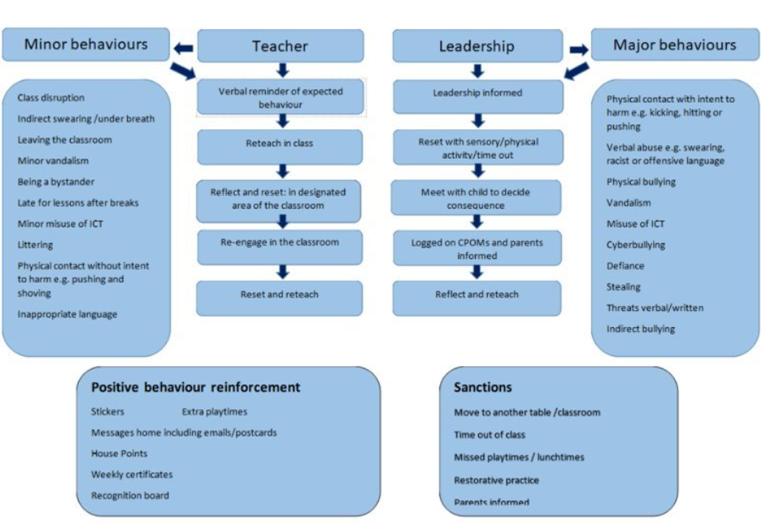
KS1 Behaviour Matrix

Slide 7
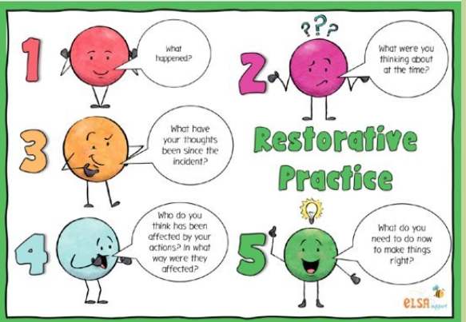
Restorative Practice

Slide 8
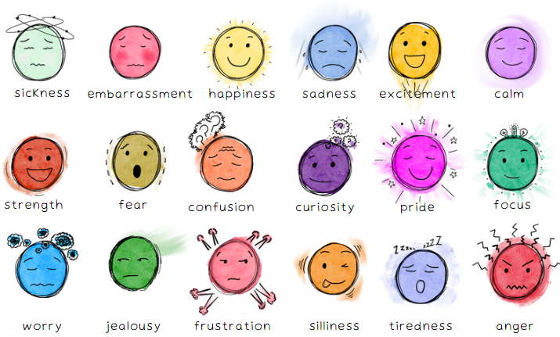
SEMH/Journaling

Slide 9


SEMH/Journaling

Slide 10
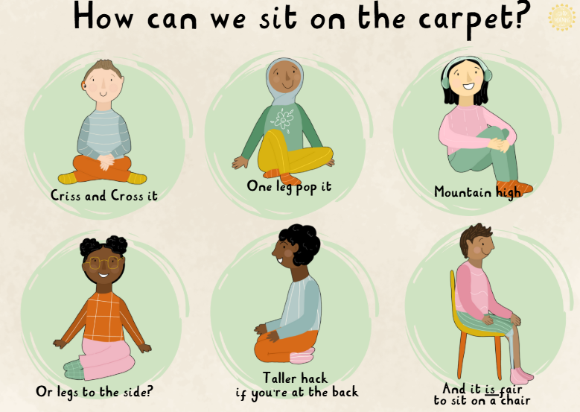
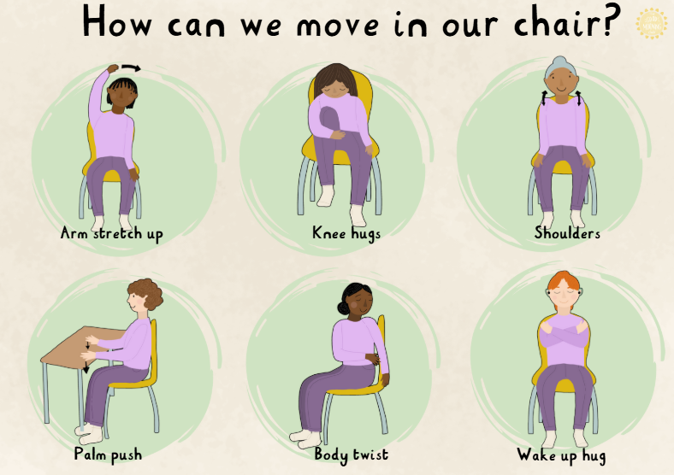
Flexible seating

Slide 11
Pastoral Care
Targeted individual support
Support and advice to parents
Intervention Groups
Support and advice to teachers and other staff
We provide support and guidance to pupils and their families, helping them to address any social, emotional and/or behavioural needs. This may include: building confidence & self-esteem, developing social skills, coping with bereavement and other life events, new pupil induction & transition between key stages.​

Slide 12
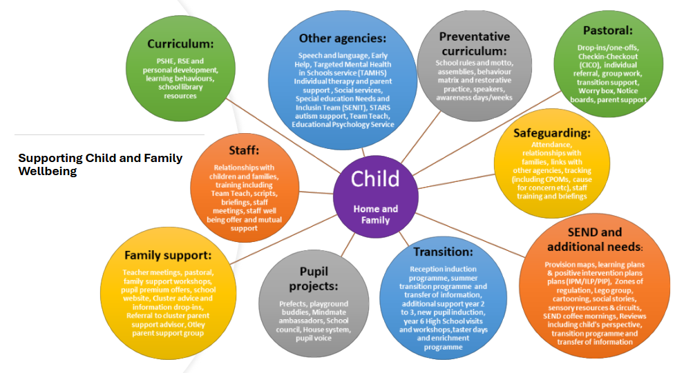
Pastoral Care

Slide 13
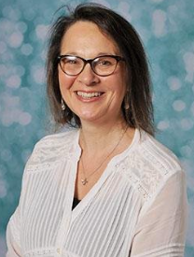
Pastoral support
  At Bramhope we recognise that positive social, emotional and mental health is fundamental to the healthy development and educational achievement of children. ​
  We work closely with other adults and external agencies to identify and break down barriers to learning, helping children to stay motivated and "Be Their Best".​
​Mrs Caroline Judd​
Pastoral Lead​
Deputy Designated Safeguarding lead​
​
pastoral@bramhopeprimaryschool.co.uk

Slide 14
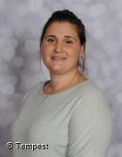
SENDCo
  Special Educational Needs and Disabilities Co-Ordinator​
  Responsible for coordinating provisions across the school and liaising with external agencies. ​
  In the first instance, a discussion with your child’s class teacher is incredibly beneficial.​
  The SENDCo can become involved when the provision needed is beyond what can be delivered in the classroom alone and a specific special educational need is identified.​
  Parents and children are always involved in discussions.​
Ms House
SENDCo and Year 4 Class Teacher
send@bramhopeprimaryschool.co.uk

Slide 15


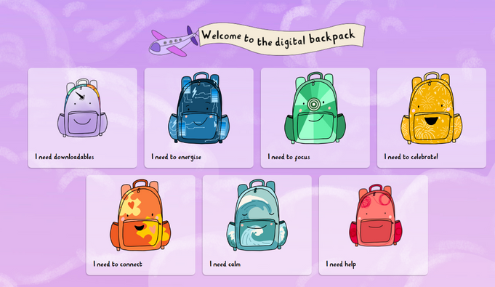
Quality First Teaching
For example:
  Visual time table
  Whole class movement breaks
  Concrete resources
  Word mats
  Worked examples
  Letter formation
  Clear step-by-step instruction
  Visual learning

Slide 16
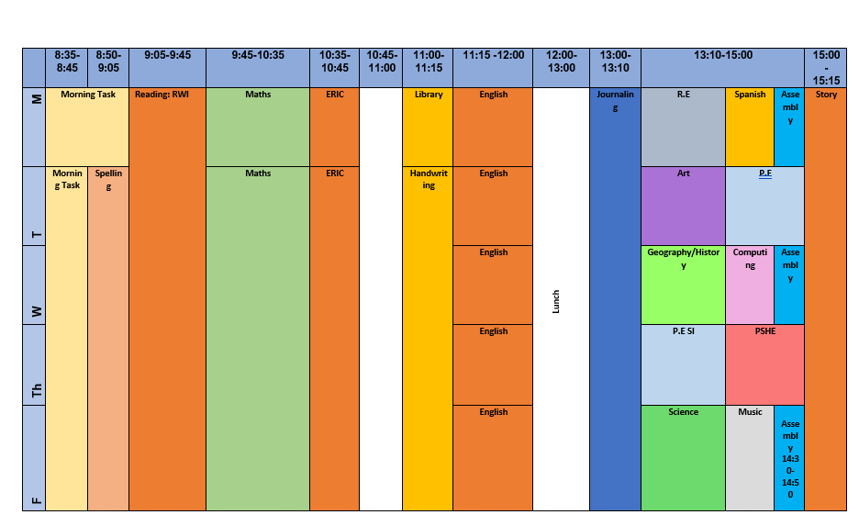
2B Weekly Timetable

Slide 17
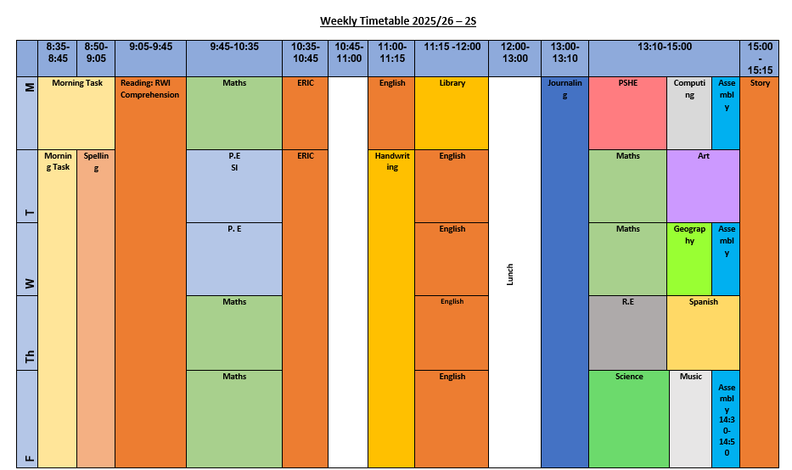
2S Weekly Timetable

Slide 18
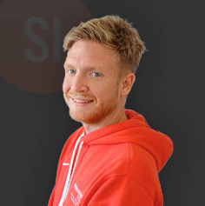
Physical Education
  Each class has two sessions for PE each week. Children should come to school wearing their PE kits on Tuesday and Thursday
  One session is taught by Sporting Influence and the other by the class teacher. ​
  Please can all children have their hair tied up. If they have their ears pierced, the children will have to take them out.
Mr Nick Crooks​

Slide 19
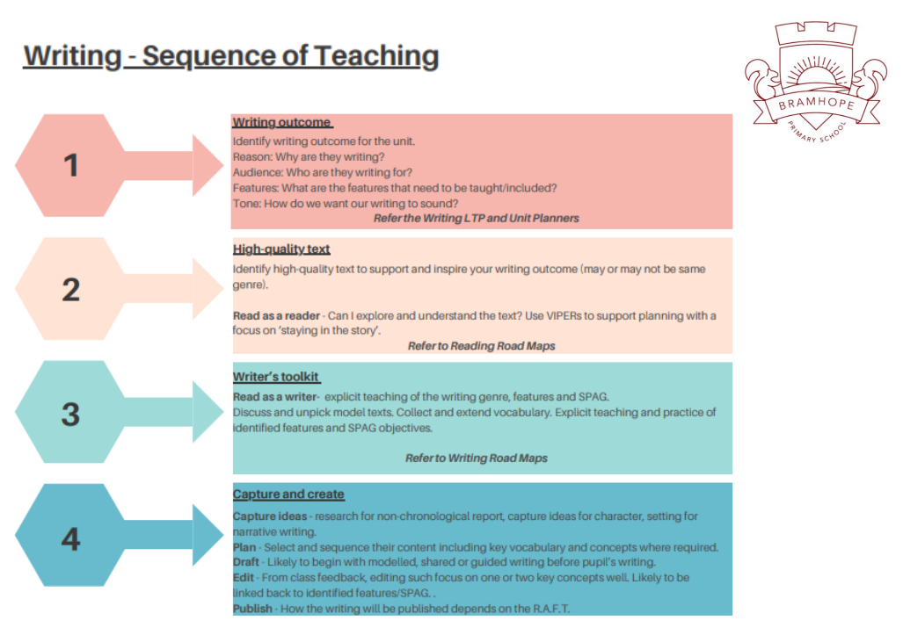
English
​Lessons will consist of:​
Spelling​
Phonics​
Punctuation and grammar​
Handwriting practice following the Nelson Handwriting Scheme ​
Reading​
During the academic year, lessons will focus on different authors and types of text. ​
We have carefully chosen texts to engage and inspire our children to read and write with immersion and enjoyment.

Slide 20
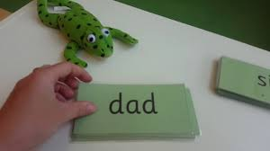
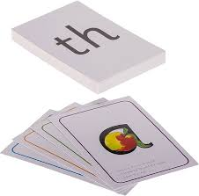


Read Write Inc. Phonics
Learning new sounds and revisiting previously taught sounds
Practicing reading words containing sounds to boost using phonics as a strategy, to work towards reading at a glance.
Reading their core storybook with focused feedback from their teacher to support swift progress and boost confidence.
Protected storytime sessions to share high quality stories that immerse and inspire.​

Slide 21
Read Write Inc. Phonics
We group children by their current challenge point. ​
  Teach to the group’s challenge level.​
  Re-assess all children every 6 weeks.​
  If a child has been assessed at the same level, we will look at the gaps or area of the assessment (for example speedy reading or gaps in sound knowledge) focus on those, and reassess in 2-3 weeks.​
  If necessary, additional fast track tutoring will be put in place to bridge any gaps quickly.
  Assessments are completed every 6 weeks by the class teacher.

Slide 22
Where to next after Grey group?
  Read Write Inc. Comprehension is for children in Year 2 who have completed Read Write Inc. Phonics. ​
  Once children can comfortably read grey books with fluency, independent and in the moment comprehension and accuracy, they can be assessed to start the comprehension scheme.
  The teacher introduces the first text by posing 'The Big Question' – the key to comprehending the story. Children learn the meanings of potentially unfamiliar words, read the text, answer questions, discuss the story, and compose written responses.​
  A second text shares a common theme with the story but is much shorter. It provides a great jumping off point to develop children’s vocabulary, grammar, punctuation and composition.

Slide 23
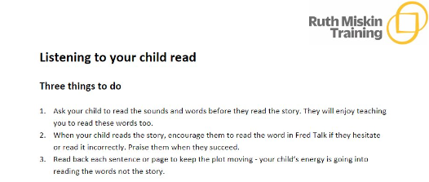
Listening to your child read tips!
There is an English workshop on the 8th October - details in parent pack

Slide 24
Spellings
New spellings every Friday based on weekly spelling lessons.
Directly linked to learning covered in the week.
Every half term we will have a spelling challenge on the Year 2 Common Exception Words.

Slide 25
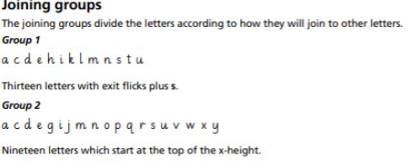
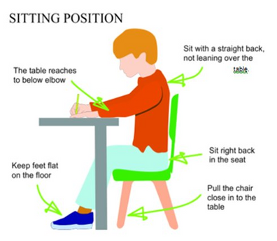
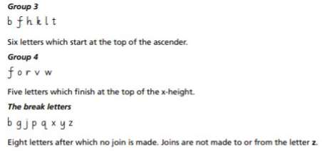
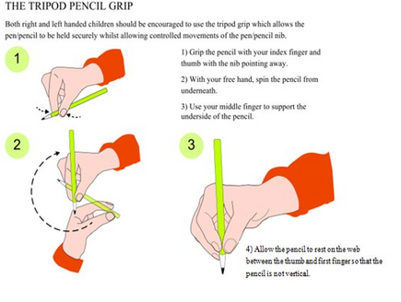
Nelson Handwriting Scheme
Year 2 Handwriting Expectations:​
Handwriting​
Pupils should be taught to:​
• form lower-case letters of the correct size relative to one another​
• start using some of the diagonal and horizontal strokes needed ​
to join letters and understand which letters, when adjacent to one ​
another, are best left unjoined​
• write capital letters and digits of the correct size, orientation and ​
relationship to one another and to lower-case letters​
• use spacing between words that reflects the size of the letters

Slide 26

Maths
Your child's log in will remain the same for Mathletics, here you will find activities based on the units of work we cover in Year 2. This helps to cover retrieval and recall or prior learning.​
​
We will set work based on the unit of learning we have just completed.
  5 a day
  Reasoning discussions
  Concrete and Pictorial
  Number formation

Slide 27
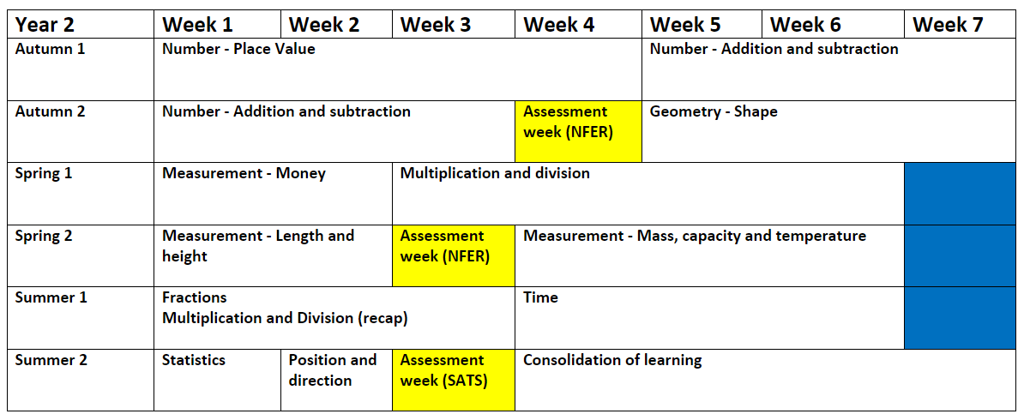
Maths

Slide 28
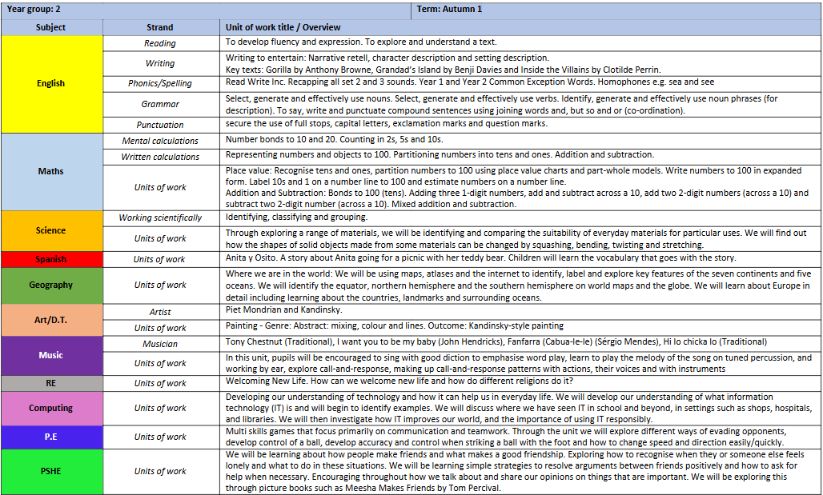
Curriculum Overview

Slide 29
Assessment
Informal assessment: eg weekly spelling challenges.​
  These are opportunities for us to assess children's knowledge and understanding in the moment, and as such adjust teaching and support accordingly.​
Formal assessment: ​
  Termly NFER assessments in reading and maths. These are standardised assessments.​
  Termly checking of common exception word knowledge for your child’s current year. ​
  Children's phonic progress will be checked every 6 weeks by your child's class teacher. This informs which progress group is right for their current challenge point, and informs whether any supporting intervention is needed to ensure they do not fall behind. ​
  Writing assessment every half term. ​
  We have opted into the SATs (Summer Term)

Slide 30
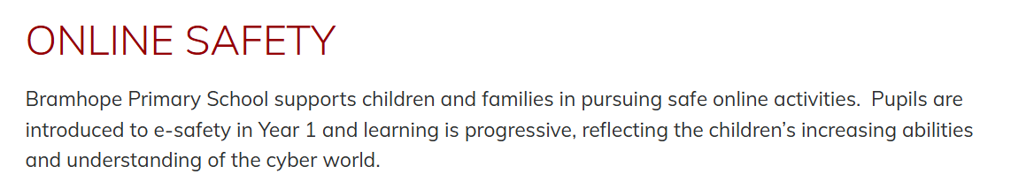

E-Safety

Slide 31
Home Learning
Reading
  Home reading books returned every Thursday.
  Please have in bag daily.
  Child will bring home:
    Library book
    Phonics book(s)
  Bookflix!
  Please read for pleasure at home!
Spelling
  Weekly spelling challenges in class.
  Spelling books returned on Friday for spelling challenge and new spellings!
  We complete a half termly assessment of the common exception words for the year group, of which there is a full copy for you to take home this evening.
Maths
  Each child has their own Mathletics log in.
  We will assign tasks each Monday which will reflect their current learning.

Slide 32
Assemblies
Monday 14:45 Mrs Colbourn ‘Big Think’ Assembly
Wednesday 14:45 Mr Street Assembly
Friday 14:30 Celebration Assembly with Miss Parker

Slide 33


Lunchtimes
Year 2
  12:00 - 12:10 Year 2 on KS1 Playground
  12:10 onwards lunch in hall / playground when finished!
  Hutchisons are the catering company providing lunches.​
  Please choose what they would like to eat on each day, and your child will then confirm their choice before they are served.

Slide 34
Playtimes
  Outdoor play (snack/milk) – 10:45-11:00​
  Flexible afternoon play/break​
  Children’s water bottles are available as and when children feel like they require it, and we do provide regular ‘nudges’ to drink during the course of the school day.
  Movement break/sensory rest throughout the school day.

Slide 35
Communication channels
  When entering or leaving school (on the door!)
  Emails - via admin team or class emails
    2S@bramhopeprimaryschool.co.uk
    2B@bramhopeprimaryschool.co.uk
    admin@bramhopeprimaryschool.co.uk
  Arrange an appointment
  Absences/lateness/sickness please report to school office
  Please inform the school office for pick up arrangements

Slide 36
Key messages
  Coats ​
  Water Bottles​
  Reading books and reading records on a Thursday​
  Spelling Books on a Friday​
  No toys, pencil cases or jewellery please
  Please do not bring birthday sweets into school.
  Names in any clothing likely to be removed (coats, jumpers etc)​
  Healthy fruit or snack can be brought in from home – nothing containing nuts please. ​
    Fruit, veg, rice cakes etc, and no juice.
  8:45 doors close, please take child to the office.
  Inform office regarding pick up arrangement. .

Slide 37
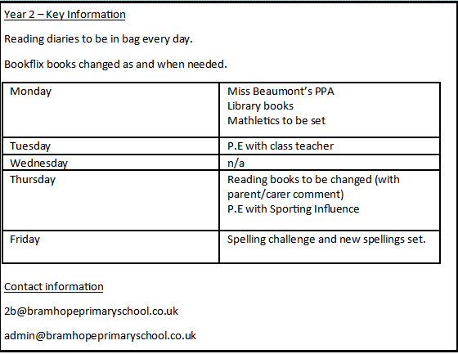
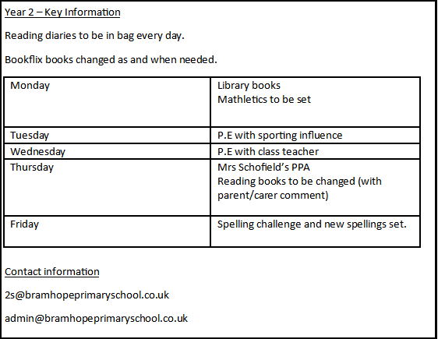

Slide 38

Any questions?

