Slide 1

Welcome to Year 5

Slide 2
Year 5 Teaching Team
Class Teacher 5DH: Mrs Drakard (Mon-Tue) Mrs Hurst (Wed-Fri)
Class Teachers 5SL: Mrs Stewart (Mon-Wed) Mrs Lawson (Thu-Fri
Mr Chapman – Year 5 support Weds- Fri
Mrs Reynard: PPA cover 5SL (Tuesday pm) & Fri AM
Mrs Reynard: PPA cover 5DH (Tuesday am) & Fri PM

Slide 3
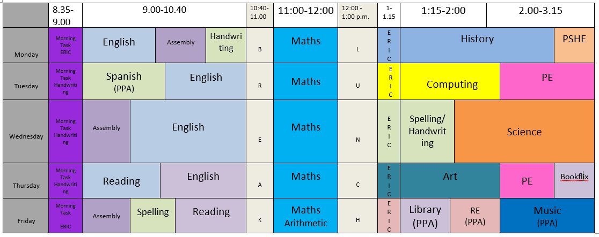
5DH Time table 2025/26

Slide 4
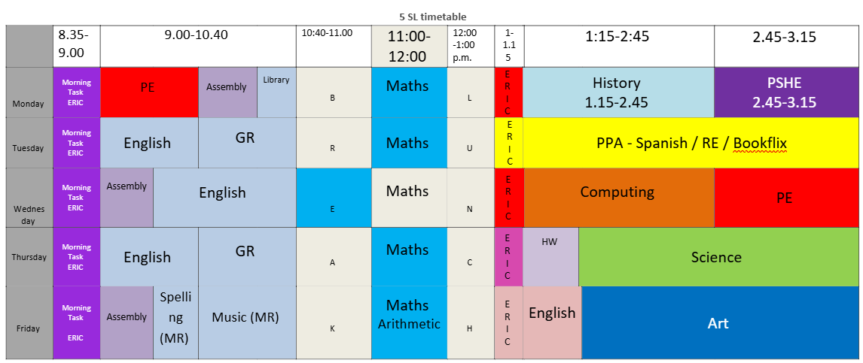
5SL Time table 2025/26
5SL Time table 2025/26

Slide 5

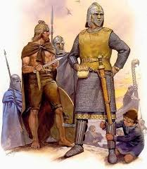

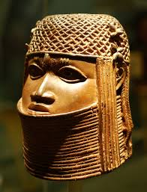

Our curriculum is led by our science / history / geography units and our English texts often support these areas.
Autumn – Space / Anglo Saxon and Vikings
Autumn 2 – Materials / Anglo Saxon and Vikings
Spring 1 – Materials / Natural Resources
Spring 2 – Forces / Spain (Catalonia region)
Summer 1 – Forces / Kingdom of Benin
Summer 2 – Living Things /Settlements

Slide 6
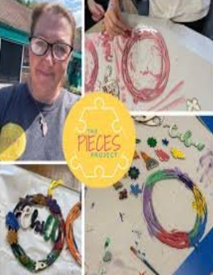
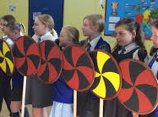
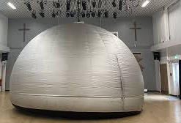
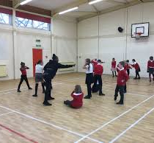
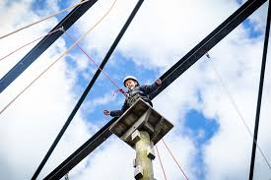
Curriculum enrichment
Wonderdome (October 24)
The Pieces Project (Teamwork) - 22/9
Viking workshop (date tbc)
High Adventure Residential
23-25 March 2025 (separate meeting)
Kingdom of Benin drama workshop – date tbc – after Easter holiday

Slide 7
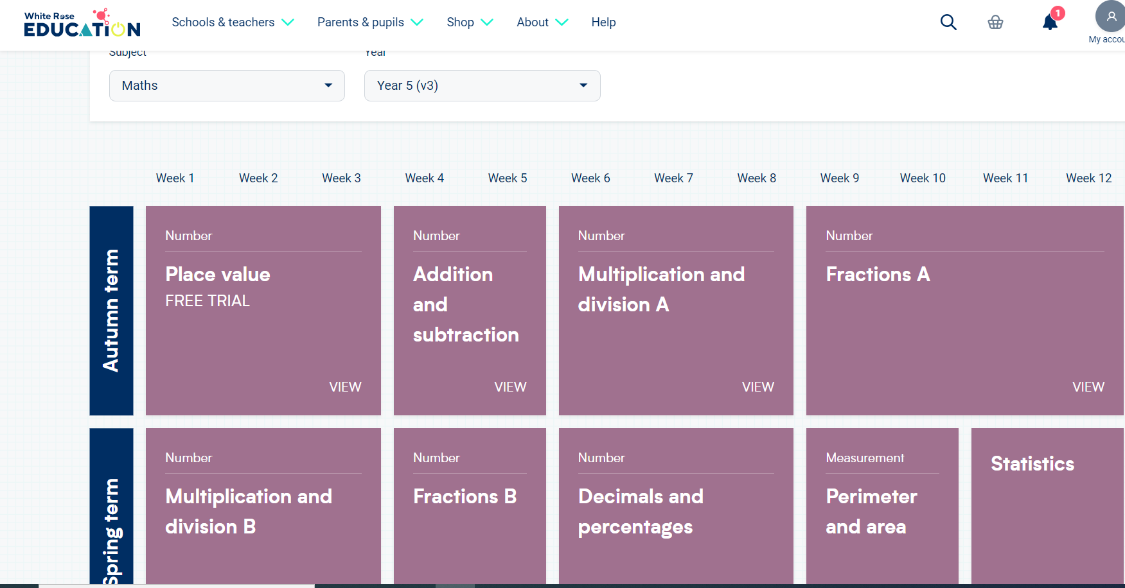
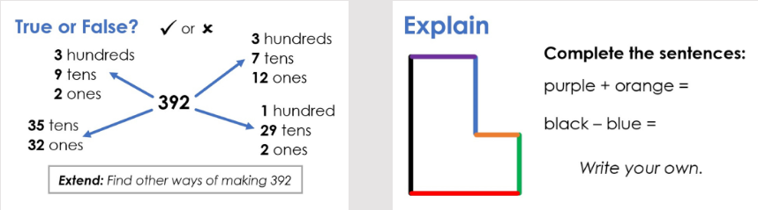

Maths in Year 5
Sets based on NFER scores and teacher judgements.
Targeted support.
White Rose scheme of learning supplement with additional resources e.g I see reasoning, NCETM.

Slide 8
Homework for Year 5
Reading – up to 20 mins per day recommended. Books given out at school (scheme, free choice, Bookflix) should be brought to school each day. Reading should be recorded in the reading diary which will be checked on a Wednesday.
Maths – homework will be set on Mathletics on a Friday to be completed by the following Friday. We suggest logging on to TTRS little and often to refresh multiplication facts and continue to learn any that are not secure.
Spellings – 10 spellings* will be taught and sent home on a Friday for the children to learn and be tested the following Friday.
*sometimes spellings are differentiated with agreement by teacher/parent.
Key skills (SPAG) / Reading challenge – sent home on Friday to be handed by the following Friday.

Slide 9
Helping your child
Please keep reading to your child and listen to them read, even if you think they are fluent readers.
Websites – www.lovereading.co.uk
Times tables practice to support multiplication/division/fractions.
Speak to us if any issues with home learning.

Slide 10
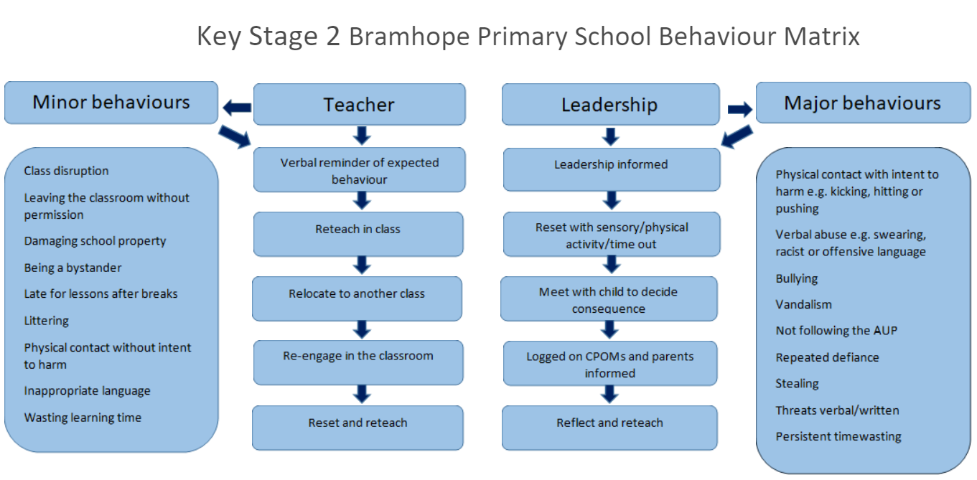
* – sometimes reasonable adjustments are made to take into account the needs of individual children. Where this happens, these are agreed with parents.

Slide 11
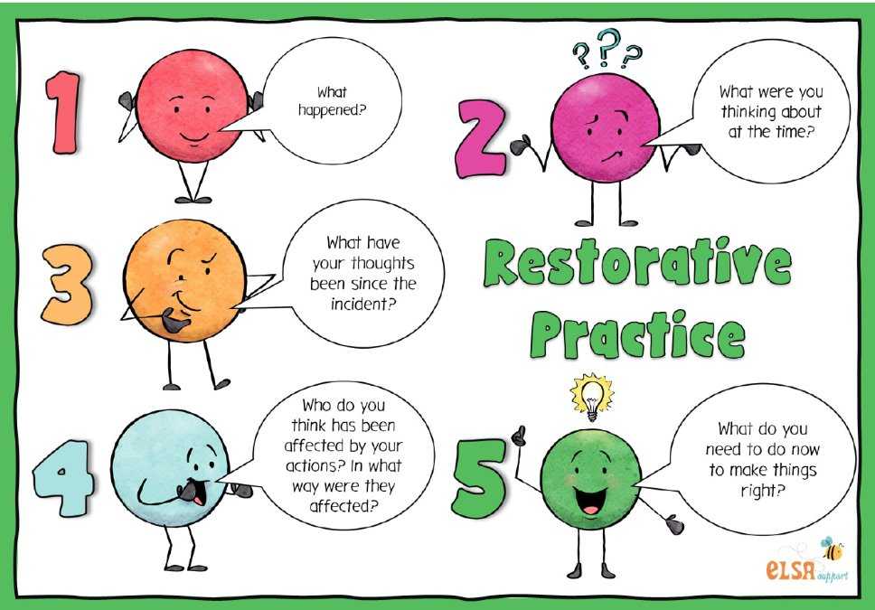
Restorative practice approach.
What is it?
When can we use it?
Why is it useful?
Does it always work?

Slide 12
Uniform reminder
Black shoes – no trainers unless PE day.
Earrings – small studs, no hoops – must be removed for PE (or taped)
School jumper/cardigan.
PE tops – school PE top / or plain black.
Please name your child's uniform!
Uniform accommodations need to be agreed with Mrs Colbourn.

Slide 13
Any questions?

