Slide 1

KS2 Curriculum Evening
Thursday 25th September

Slide 2
Y6 Team
Class teachers
Mr. McKeown and Mrs. Laws
PPA cover
Mrs. Reynard and Mrs. Stenton

Slide 3

Safeguarding
All Bramhope staff are committed to the protection, safety and promotion of the welfare of all pupils.
Any safeguarding concerns or questions about your child's welfare please contact the safeguarding team, who are able to offer support and advice.
Mr Richard Street (DSL) and Mrs Caroline Judd (DDSL)
The school Safeguarding and child protection policies can be found on the website.

Slide 4
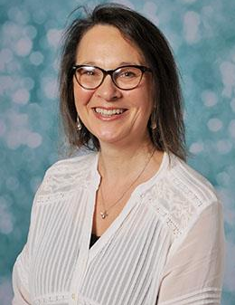
Pastoral Team
At Bramhope we recognise that positive social, emotional and mental health is fundamental to the healthy development and educational achievement of children.
We work closely with other adults and external agencies to identify and break down barriers to learning, helping children to stay motivated and "Be Their Best".
Mrs. Caroline Judd
pastoral@bramhopeprimaryschool.co.uk

Slide 5

We provide support and guidance to pupils and their families, helping them to address any social, emotional and/or behavioural needs. This may include: building confidence & self-esteem, developing social skills, coping with bereavement and other life events, new pupil induction & transition between key stages.
Support is provided through:
Intervention groups
Targeted individual support
Support and advice to parents including signposting to other services
Support and advice to the class teachers and other staff

Slide 6
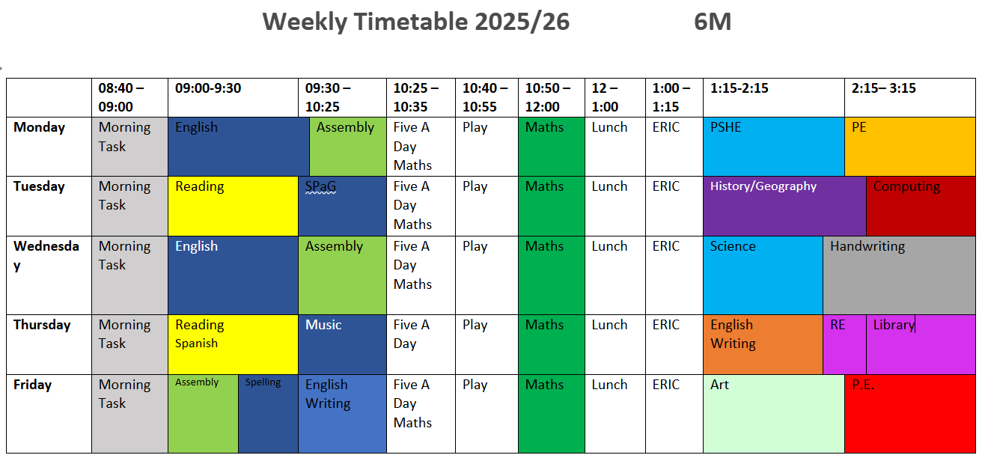

Slide 7
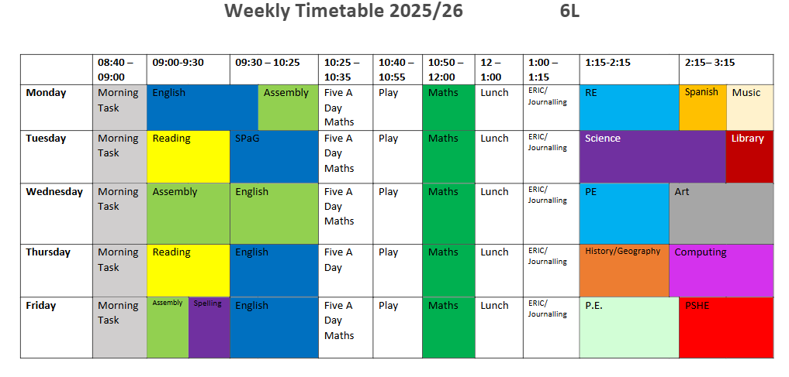
Timetable for 6L

Slide 8
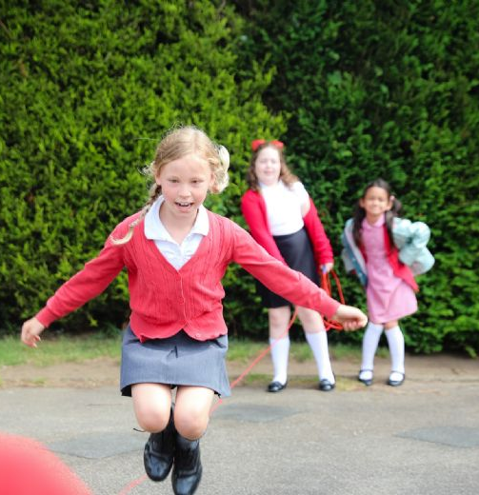
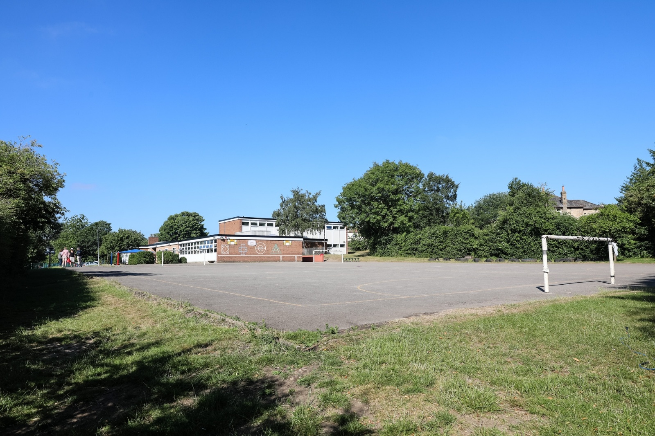
Playtimes and lunchtimes
Y56 play together at morning break and as a Key Stage 2 on both front playgrounds. It is an opportunity to play with friends who are not in their class. Play equipment is available such as bats, balls and skipping ropes.

Slide 9
Behaviour expectations
A positive school ethos is encouraged so children form good relationships with adults and their peers.
Our school values are promoted - Belong - Be Your Best – Be Bramhope
Our expectations - Be Safe, Positive, Show Respect
Classes display and enforce the behaviour matrix and the school rules.
Failure to complete work to a satisfactory level may mean a child missing part of playtime to complete or make improvements
Modifications to the behaviour policy are made in some instances for children with special educational needs.
·

Slide 10
Behaviour expectations
We promote a culture of good behaviour where children should not always expect a reward but behave well because it is the right thing to do.
Verbal praise is awarded daily, by all staff
House points for behaviour which goes 'above and beyond'
Children have the chance to earn weekly certificates from teachers in recognition of efforts and / or achievements
Termly Head Teachers' Award (nominated by teaching staff) for children who have stood out at representing our school values – Belong, Be Your Best, Be Bramhope
·

Slide 11
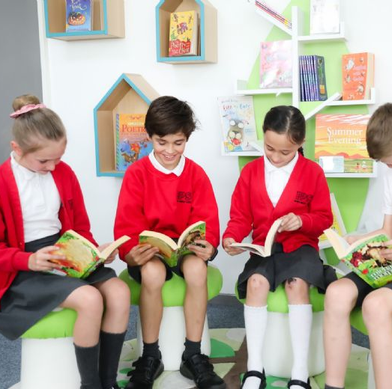
School Uniform and belongings
PE kit is to be worn on PE days.
Trainers are not to be worn in school when not doing PE.
Earrings must be taken out for P.E. or taped up.
Apple watches/other devices with cameras cannot be worn in school.
Mobile phones must be signed into the office before school.

Slide 12

Houses
Bronte
Burton
Hepworth
Wilberforce
Children can earn house points for “above and beyond”
Year 6 children will be appointed as House Captains as well as other prefect roles!

Slide 13
Assessment
Teacher assessment is ongoing through observation and marking.
Children are given feedback verbally or in written form and then given time to respond.
Formal assessments (SATs) take place once a term in reading, SPaG and maths.
Writing is also assessed by class teachers every half term.
Y6 complete end of Key Stage 2 assessments in May : otherwise known as SATs!

Slide 14
Home Learning
Reading
We recommend up to 20 minutes a day of reading. This includes reading a range of texts, discussing vocabulary, asking and answering questions and being read to. We encourage all children to read a range of texts including fiction, non-fiction and poetry as well as a range of authors.
Maths
Mathletics will be set weekly every Friday to be completed by the following Friday. This will be linked to the topics taught in maths during the week. It is also expected that all children access Times Tables Rockstars at least once a week. All children are expected to know their times tables up to 12 x 12 by the end of Y4.

Slide 15
Home Learning
Spellings
Each week, your child will be given 10 spellings to learn. The spellings may be linked to patterns taught in school or include some of the KS2 statutory common exception words. It is also important that your child understands the meaning of the words in order to use them in context.
Key Skills/Reading Challenge
Key Skills homework and Reading Challenges will be set on alternate Fridays. Key Skills will focus on punctuation and grammar. Reading Challenges will be book-related activities such as trying a new author, reading a book set in the past, reading comprehensions or learning a poem to perform.

Slide 16

Reading
The more children practise reading, the easier and more enjoyable it will become. Through reading sessions in school and together with your support with reading regularly at home, we help the children to become confident and fluent readers. Our aim is to inspire children to read a range of genres and authors and for them to develop a love for reading. We have implemented a new whole school reading programme called Bookflix.
Guided Reading
We have timetabled reading sessions each week where we give children opportunity to practice their fluency and develop their reading comprehension skills. In these sessions, children read a wide range of texts and extracts to learn how to retrieve key pieces of information, summarise what they have read and to make inferences using evidence from the text. Children are given lots of opportunity to discuss what they have read, their understanding and their opinions about a text. They are also taught specific skills to enable them to pinpoint key information and answer reading comprehension questions.

Slide 17

Home readers and how to help at home
Your child will have a home reader which they have chosen in school. We encourage children to read other genres and 'real texts' like magazines, news reports, online texts alongside their home reader.
To support your child at home:
- Practise reading regularly (quiet reading and reading aloud)
- Support with decoding unfamiliar words and explaining the meaning of new vocabulary
- Regularly check your child's understanding of what they have read – Can you tell me about that chapter? Character? Why do you think that happened? What do you think might happen next?
​
Stuck for ideas? https://www.lovereading4kids.co.uk/

Slide 18
Maths
We follow a mastery approach with fluency, problem solving and reasoning being a part of all our lessons.
To be competent in mathematics, pupils need to
develop the three forms of knowledge:
Fluency (Factual) I know that…….
Problem Solving (Procedural) I know how …….
Reasoning (Conceptual) I know why…….
Mathematical fluency is the ability to quickly and accurately recall mathematical facts and concepts.

Slide 19
Learning Times Tables
Expectations
Y2 To recall and use multiplication and division facts for the 2, 5 and 10, multiplication tables, including recognising odd and even numbers.
Y3 To recall and use multiplication and division facts for the 3, 4 and 8 multiplication tables.
Y4 To recall and use multiplication and division facts up to 12 x 12.
Y4 are tested in June 2025 as part of the government multiplication check.
Y5/6 should be fluent in written methods for all four operations, including long multiplication and division, and in working with fractions, decimals and percentages.

Slide 20
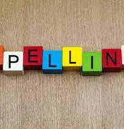
Spellings
How to help
Practise little and often.
5 minutes each day is much more productive than once a week.
Make sure your child knows the meaning of the word and can give you some synonyms of the word.
Practise in different ways

Slide 21
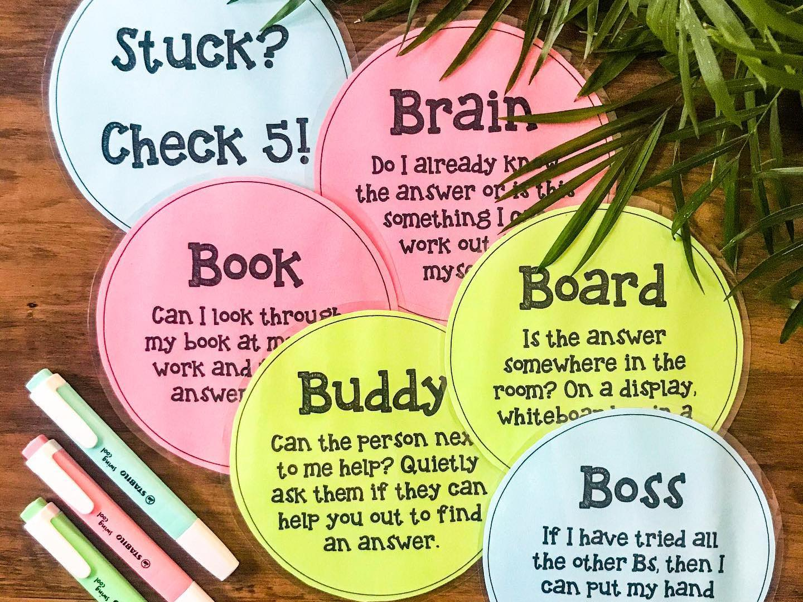

Resilience
How you can support your child at home to become resilient.
Strategies we use in school to build independence and resilience.

Slide 22


Online Safety
Acceptable Use Policy and access to school computers.
Wide-ranging digital literacy content.
Online safety evening for parents held in November each year.
Any safeguarding concerns to be taken to our designated safeguarding leads in school. (Mr Street and Mrs Judd)

Slide 23
What’s coming up:
Parents' evenings
These will be face to face meetings with your child's class teacher and will focus on how your child is settling into their new year group.
Termly reports
Your child's first termly report will be sent by email in December. This will focus on your child's academic strengths and areas to improve.

Slide 24
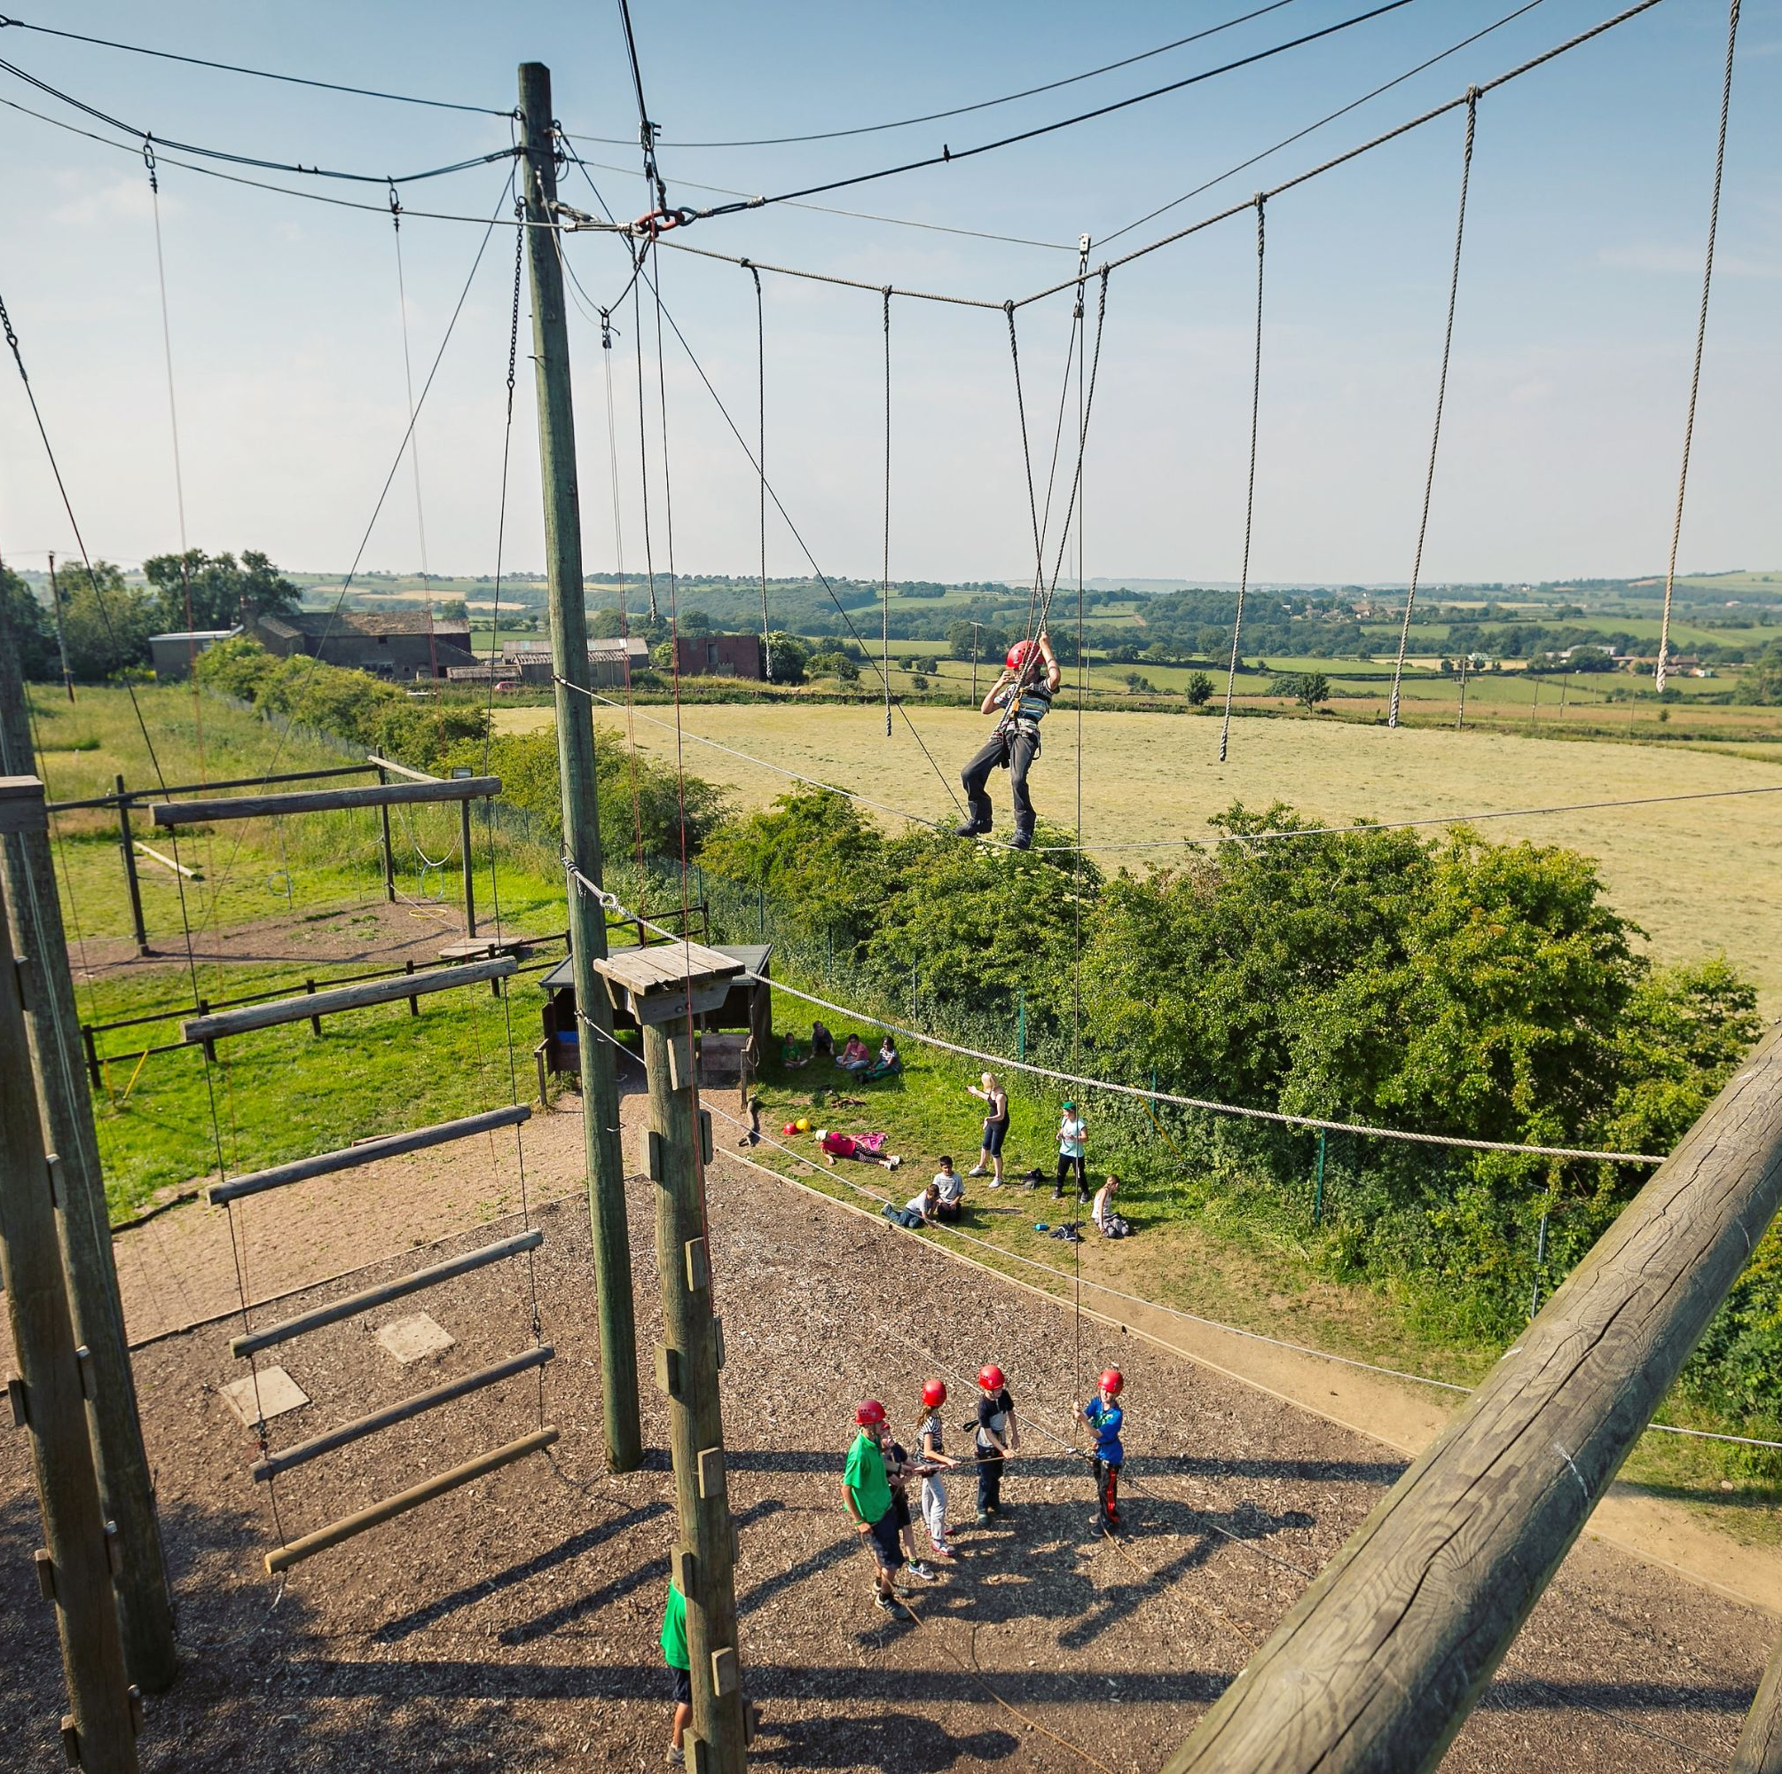
What’s coming up:
Bikeability in November
Year 6 Residential - This academic year we will be visiting Kingswood Dearne Valley on Wednesday 3rd June- Friday 5th June 2026.

Slide 25
How to contact us
Leave a message with the office – 0113 2671222
Leave a message on the gate during drop off
School playground at end of day

Slide 26

Any questions?

