Slide 1

Bramhope Primary School

Slide 2
School Buildings
EYFS/Key Stage 1
Early Years
Key Stage 1 (Years 1 and 2)
Main Hall
Mrs Colbourn’s Office
Main Office
Pastoral Office
Key Stage 2
Years 3-6
Small Hall
Library
Learning Hub

Slide 3
Year 3 and 4 Staff
Year 3
Mrs Rathmell (3R)
Miss Maull (3M)
Year 2 Support Staff
Mrs Bi
Mrs Rattenpal
Year 4
Miss Mansfield (4M)
Mrs House (4HM Mon/Tues)
Mrs McNaboe (4HM Wed/Thurs/Fri)
Year 4 Support Staff
Mr Brogden
Miss Sromova
Miss Wilson

Slide 4
Safeguarding
  All Bramhope staff are committed to the protection, safety and promotion of the welfare of all pupils.​
  Any safeguarding concerns or questions about your child's welfare please contact the safeguarding team, who are able to offer support and advice.
  The school Safeguarding and Child Protection policies can be found on the website.
Mr Richard Street (DSL) and Mrs Caroline Judd (DDSL)

Slide 5
Behaviour and Attitudes
Be safe​
Positive ​
Show respect

Slide 6
Behaviour and Attitudes
new matrix

Slide 7
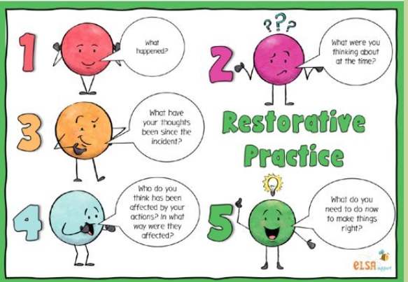
Restorative Practice

Slide 8




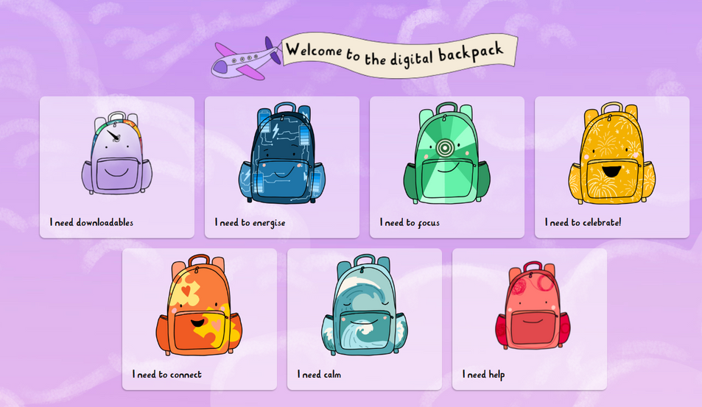
SEMH/Journaling

Slide 9


SEMH/Journaling

Slide 10

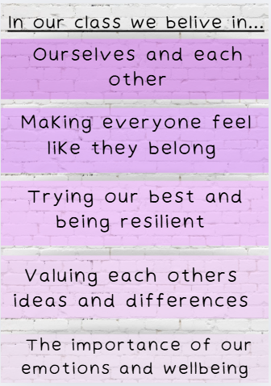
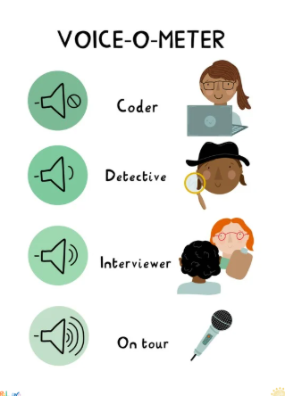
Classroom routines

Slide 11
Pastoral Care
Targeted individual support
Support and advice to parents
Intervention Groups
Support and advice to teachers and other staff
We provide support and guidance to pupils and their families, helping them to address any social, emotional and/or behavioural needs. This may include: building confidence & self-esteem, developing social skills, coping with bereavement and other life events, new pupil induction & transition between key stages.​

Slide 12
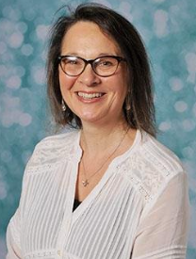
Pastoral support
  At Bramhope we recognise that positive social, emotional and mental health is fundamental to the healthy development and educational achievement of children. ​
  We work closely with other adults and external agencies to identify and break down barriers to learning, helping children to stay motivated and "Be Their Best".​
​Mrs Caroline Judd​
Pastoral Lead​
Deputy Designated Safeguarding lead​
​
pastoral@bramhopeprimaryschool.co.uk

Slide 13
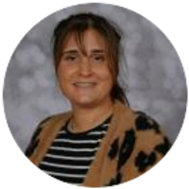
SENDCo
  Special Educational Needs and Disabilities Co-Ordinator​
  Responsible for coordinating provisions across the school and liaising with external agencies. ​
  In the first instance, a discussion with your child’s class teacher is incredibly beneficial.​
  The SENDCo can become involved when the provision needed is beyond what can be delivered in the classroom alone and a specific special educational need is identified.​
  Parents and children are always involved in discussions.​
Ms House
SENDCo and Year 4 Class Teacher
send@bramhopeprimaryschool.co.uk

Slide 14


Quality First Teaching
For example:
  Visual time table
  Whole class movement breaks
  Concrete resources
  Word mats
  Worked examples
  Letter formation
  Clear step-by-step instruction
  Visual learning

Slide 15
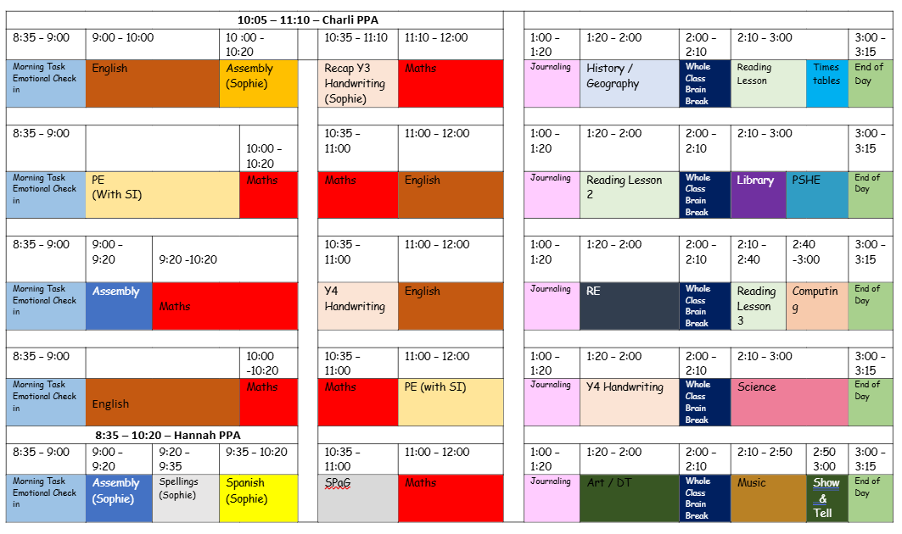
4HM Weekly Timetable

Slide 16
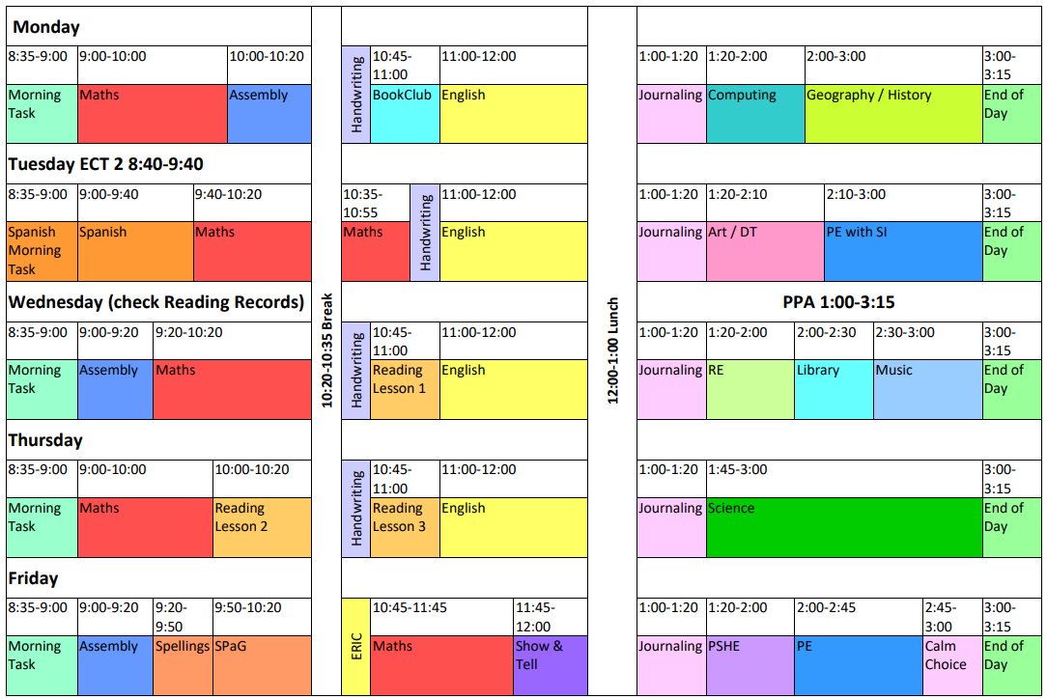
4M Weekly Timetable

Slide 17
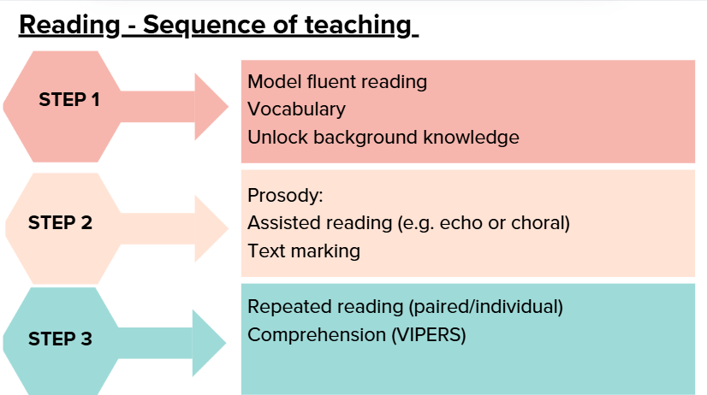
Reading

Slide 18

Reading at home
Reading plays a very important role in all of our learning. As well as developing a love of reading, our aim is to continue to develop accuracy, automaticity and prosody within reading which supports and strengthens comprehension. All pupils have a reading record to record their reading at home and school. Pupils will select an age/stage appropriate reading book from school. They are able to change their book as and when needed, ideally once a week but we appreciate some books may need longer. While pupils may often read independently at this stage, we ask that parents/carers continue to listen to your child read aloud on a regular basis. We kindly ask for a minimum of one parent/carer comment in your child’s reading record per week (more welcome). The parent/carer comment should communicate pages read and a brief description of your child’s reading. As well as one parent/carer comment per week, pupils may wish to record their own comments including pages read and a reflection of what they have read. Reading records will be collected and checked on Wednesdays. Reading records and books should be brought to school every day, to enable school staff to utilise every opportunity to read one-to-one with pupils.
Changing books: As and when needed (ideally once per week)
Parent/carer comment: Minimum of one comment per week
Reading records will be checked on: Wednesdays

Slide 19
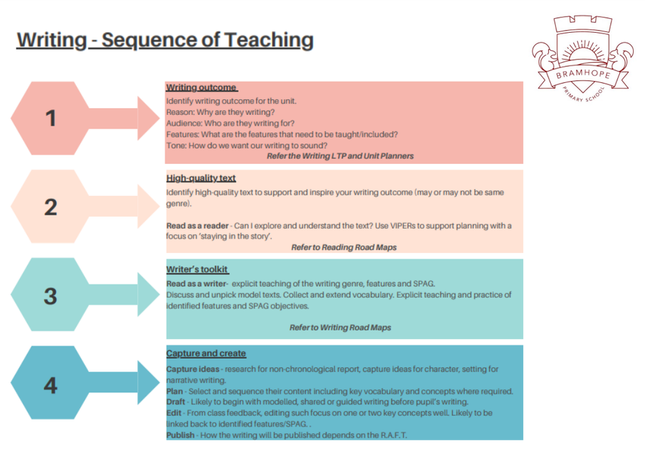
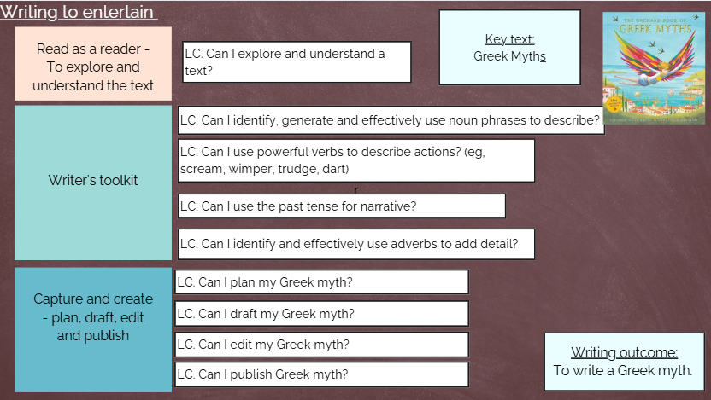
English

Slide 20
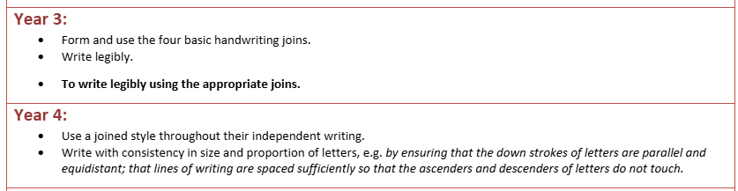
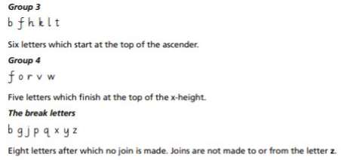
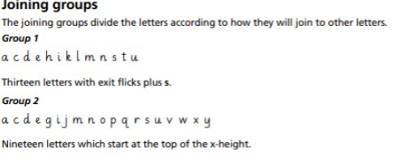
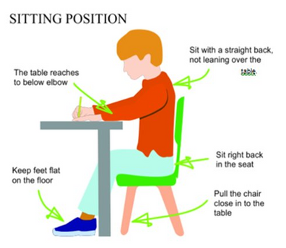
Handwriting

Slide 21
Spelling
A new list of spelling words will be added to pupils spelling books each week. These spellings will be in line with our focus spelling lessons/rule that week. We will complete a ‘spelling challenge’ of the focus rule/spelling words on Friday morning. This spelling challenge will be completed on the page next to the spelling list so you are able to see your child’s completed spelling challenge. Please practise the focus spellings at home regularly. Spellings can be practised using a range of strategies such as ‘Look, Say, Cover, Write, Check’, ‘Rainbow Writing’ and ‘Have a go’. Please practise spellings in an alternative books/writing resources to reserve the pages in this spelling books for the spelling list and spelling challenge. Please ensure spelling books are in school on Friday.

Slide 22
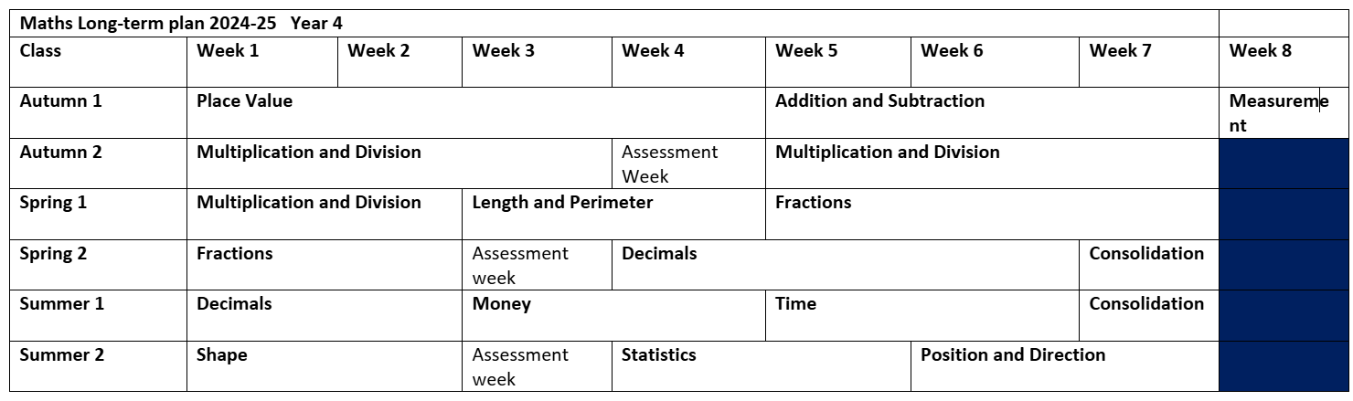
Maths

Slide 23


Maths at home
Mathletics will be set weekly every Wednesday to be completed by the following Wednesday. This will be linked to the topics taught in maths during the week. Log in details will be provided during the curriculum evening.
Each week, pupils will be set a 20 minute session on TT Rockstars (garage). Pupils will be able to access the other activities and games once the initial 20 minute has been completed. Log in details will be provided during the curriculum evening.

Slide 25
Assessment
Informal assessment: eg weekly spelling challenges.​
  These are opportunities for us to assess children's knowledge and understanding in the moment, and as such adjust teaching and support accordingly.​
Formal assessment: ​
  Termly NFER assessments in reading and maths. These are standardised assessments.​
  Termly checking of common exception word knowledge for your child’s current year. ​
  Timetable check
  Writing assessment per term. ​
  We have opted into the SATs (Summer Term)

Slide 26


Physical Education
  Each class has two sessions for PE each week. Children should come to school wearing their PE kits on Tuesday and Thursday 4HM and Tuesday and Friday 4M
  One session is taught by Sporting Influence and the other by the class teacher. ​
  Please can all children have their hair tied up. If they have their ears pierced, the children will have to take them out.
Mr Chris Doey
Mr Nick Crooks

Slide 27
Assemblies
Monday 10:00 Mrs Colbourn ‘Big Think’ Assembly
Wednesday 8:55 Mr Street Assembly
Friday 8.55 Celebration Assembly Mr McKeown and Mrs Rathmell

Slide 28
Enrichments/trips
Pieces Project- Year 4 Team Building - 22nd/23rd September
Murton Park - Roman Day - 1st December Price TBC
Road Safety Pedestrian Training - January 22nd

Slide 29

Lunchtimes
At Bramhope, our school meals are provided by our private caterers, Hutchison. Menus are changed termly and are designed to meet the School Food standards which specify which types of food should be served at school and how often. If you would like to read more about the School Food Standards.
Most parents opt for their child to have a school lunch, and we currently serve approximately 340 meals a day. Menus are on the school website; meals can be ordered in advance and cost £2.60 per day. There is always a sandwich option available as well as a vegetarian option.

Slide 30
Lunchtimes
Packed lunches
Our aims
In school, we teach all children what is meant by a balanced diet and how this can affect their health. Our aim is that all children:
· Learn what we mean by food groups
· Know which foods belong in which food group
· Understand whether their own diet is generally healthy and balanced
· Understand the direct link between diet and physical and dental health
· Make informed choices about their own meals and packed lunches rather than feeling that there are some foods that they should never eat
· Challenge themselves to try something new or make small changes if necessary
Our approach
We teach children about a balanced diet through science lessons, PSHE lessons and school assemblies.
· One portion of fresh fruit such as apples, bananas or grapes
· One portion of vegetables such as cucumber, carrot sticks or tomatoes
· A type of starchy food such as bread, rice, pasta, noodles or crackers
· A type of milk and dairy food such as cheese or yoghurt
· A source of protein such as tuna, egg, chicken or beans
· No more than one high sugar/high fat ‘treat’ such as a cookie, crisps or cereal bar- please do not send any chocolate bars or sweets
· A bottle filled with fresh water-please do not send juice
Whilst we do not ‘police’ packed lunches, we will speak with you or your child if they need to be reminded about our strict ‘no nuts’ policy and encourage them to make healthy choices wherever possible.

Slide 31
Playtimes
  Outdoor play (snack/milk) – 10:20-10.35​​
  Children’s water bottles are available as and when children feel like they require it, and we do provide regular ‘nudges’ to drink during the course of the school day.
  Movement break/sensory rest throughout the school day.

Slide 32
Communication channels
Emails - via admin team or class emails
    4HM@bramhopeprimaryschool.co.uk
    4M@bramhopeprimaryschool.co.uk
    admin@bramhopeprimaryschool.co.uk
  Arrange an appointment
  Absences/lateness/sickness please report to school office
  Please inform the school office for pick up arrangements

Slide 33
Key messages
  Coats ​
  Water Bottles​
  Reading books and reading records in bag everyday (checked on Wednesday)​
  Spelling Books on a Friday​
  No toys, or jewellery please
  Names in any clothing likely to be removed (coats, jumpers etc)​
  Healthy fruit or snack can be brought in from home – nothing containing nuts please. ​
    Fruit, veg, rice cakes etc, and no juice.

Slide 34

Any questions?

