Slide 1


Bramhope Primary School
Reception classes 2025-2026
Classes: RF and RH

Slide 2
Welcome and introductions Mrs. Colbourn
Our curriculum Mr. Street
Reception information Mrs. Freer and Mrs. Herring
- Classes
- Transition and key dates
- What to expect
Pastoral support and speech and language Mrs. Judd
Frequently asked questions Mrs. Freer, Mrs. Herring, Mr. Street
School meals Hutchison catering
PTA welcome Emma Gibbons
Optional visit to the classroom – pre-loved uniform

Slide 3
Our curriculum: what is the big picture?
We follow the Early Years Statutory framework set by the Department for Education: 17 areas.
We teach a broad and balanced curriculum that is inclusive of all children.
Early Years is not seen as a separate entity. It provides an essential first step to a child’s journey at Bramhope.
Whilst the structure of the Early Years framework is different to the National Curriculum (starting in year 1), there is a clear pathway from one framework to the next.
We are continually improving our QFT (Quality First Teaching) model. Teachers work closely together, improving their pedagogy using evidence-based research.
Focus areas for the quality of education this year have included:
  Embedding the main principles of dialogic talk.
  Developing knowledge sentences to help children summarise the key information they need to remember.
  Further developing our reading and writing curriculum
  Re-developing our art and design curriculum
  Further developing our provision for pupils with special educational needs
  Curriculum experiences: trips and visitors.
For more information, go to https://www.bramhopeprimary.co.uk/page/?title=Curriculum%3A+Learning+in+School+%26amp%3B+Home&pid=7

Slide 4
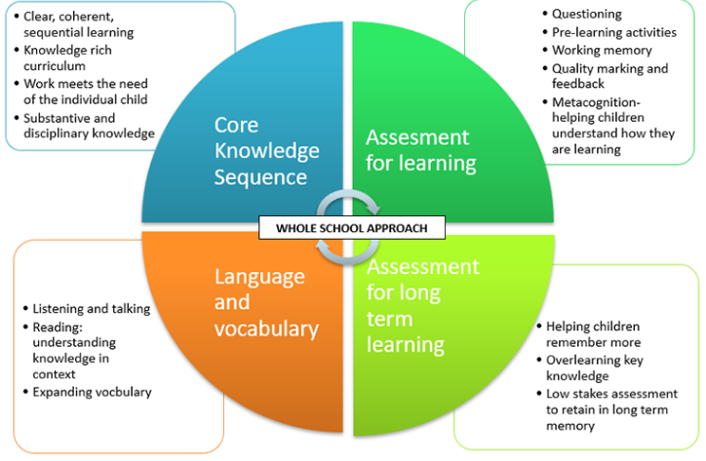
Curriculum Overview

Slide 5
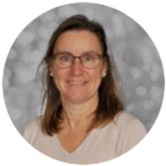
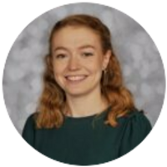
The Reception Teachers
Mrs Freer
Mrs Herring
Supported by three Teaching Assistants

Slide 6
Classes
Children are coming from 24 different settings.
What do we consider when we put the children into their classes?
gender
date of birth
SEND (Special educational needs) or other additional needs
EAL (English as an additional language)
split the largest group from Cliffe House
put children coming alone together
We try to put children together with one other child they know, for example when there are two children coming from the same setting.

Slide 7
Transition
1:1 appointment with your child's key worker. Tuesday 24th June. You should have your appointment, if not contact the office and they will make an appointment for you.
This informal, 10-minute meeting provides a valuable opportunity for you to tell us about your child’s personality and interests. It also provides you with an opportunity to discuss any personal information about your child and to share any confidential information you may have.
Stay and play Tuesday 1st July and Thursday 3rd July.
An informal session for you and your child to spend time in the classroom and the outdoor area. You and your child are welcome to drop in at any point between 3:45 and 4:45pm

Slide 8
Key dates for next academic year:
Monday 1st and Tuesday 2nd September Staff training (school closed)
Wednesday 3rd September 9:30am–11:30am (Mrs Freer's class only in school) and 1:00-3pm (Mrs Herring's class only in school)
Thursday 4th September 10:00am-2:00pm (RF and RH in school – both classes)
Friday 5th September First full school day for all reception children
Additional EYFS Staff Training (school closed to reception pupils only. Date TBC)
First week
In the first week the children will be getting to know their surroundings, each other and the adults. They will begin to get to know the rules and routines. Support and teaching will be provided around making friends. They will settle into their class bases before mixing across the year group.

Slide 9

First Term
Develop the 3 prime areas of learning; PSED, PD and CAL
Children will be able to independently choose their own resources during their child-initiated play.
Independence will be promoted, and children will be encouraged to ask 3 friends for help if they need it before asking an adult.
Phonics
We will begin our phonics programme Read Write Inc in the first couple of weeks, after settling in and working on listening skills.
Initially children will be given flash cards to learn their sounds at home.
They will be given reading books when they are ready.
Maths
Short, whole class maths lessons

Slide 10

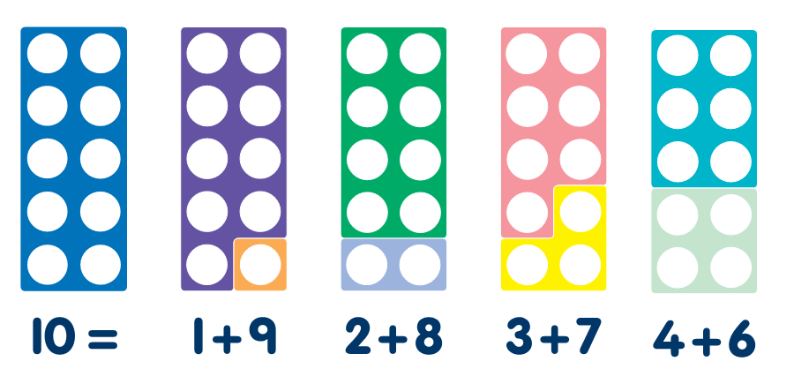
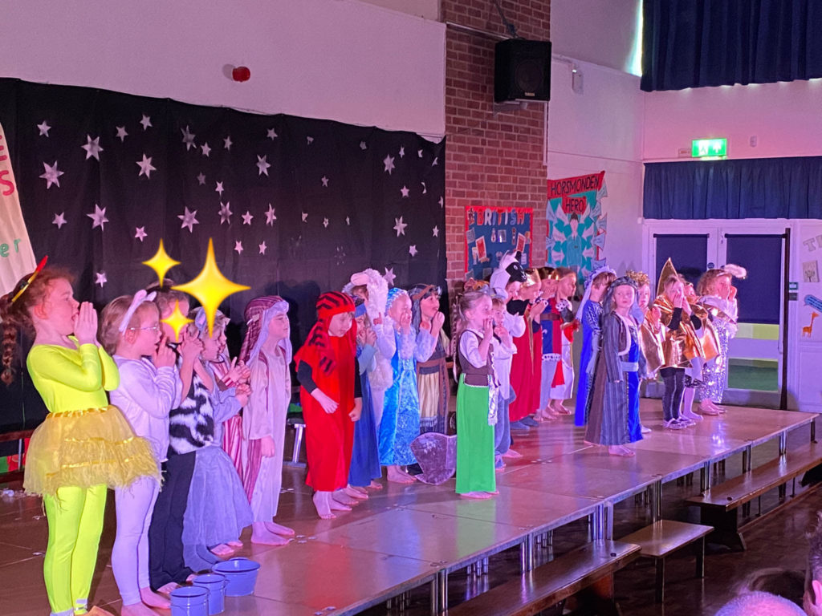
By the end of the First year
Children are now:
able to present and perform in front of their class
read their own book bag books
write simple sentences
show a good understanding of the composition of numbers to 10, including double facts and using a wide range of mathematical language.
problem solving in different contexts
able to confidently make new friends and independently use their skills around the classroom.

Slide 11
What can you do to help?
Mrs Judd Pastoral lead/DDSL/Speech and Language
Avoid starting discussions too early in the summer
Clear and positive morning routine
Recognise that worries are normal
Share key information
Regular attendance from the outset
Expect tiredness
Friendships are often broad groups
              If you are worried talk to us!

Slide 12
Seeking Support at Bramhope
Class teachers ongoing support in class and for parents
School Website signposts range of online support and information services
Discussion with parents and pastoral referral agreed
Teacher or parents complete a short form
Children added to school pastoral register
4-6 sessions over the course of one half term
Discussion with parents
Referral on to TAMHs for access to school therapists or parent support. Targeted services which are offered through the school cluster (OPBC)

Slide 13
Frequently Asked Questions

Slide 14

How much communication will I get about my child's day?
Adjustments to communication
There will be less communication than nursery.
Communication with us
We are available on the door morning and evening. Email us to arrange a meeting if you would like a private conversation.
We will let you know important information, for example, if your child isn't eating their lunch.

Slide 15
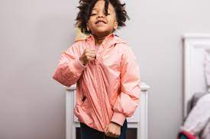
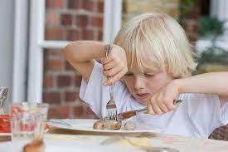
How do I prepare my child for September?
Label all clothes that will be brought to school.
Teach your child to put their coats and shoes on independently.
Teach and encourage your child to use cutlery. The fork stays still and the knife moves. At school the food is not chopped up, for example, it comes as a piece of chicken or a jacket potato.
Encourage your child to open a yogurt pot
Practice zipping and unclipping school bags.
Teach your child to wipe their bottom and change their clothing.

Slide 16
How do I prepare my child for September? continued
Learn to recognise their name (they will be needing this for their lunch order)
Play listening games to develop their attention and listening skills.
Talk about how to be friendly, model: Can I play? , Yes you can play! Can I have that toy when you've finished?

Slide 17
Does my child get a snack?
We provide milk and a variety of fruit so there is no need to bring in snacks from home. However, if children would like to bring their own piece of fruit in their bag they can.
Please bring a water bottle each day with fresh water in it.

Slide 18
Do all children eat school dinners?
Most children eat school dinners. It's free. It's healthy. It's an opportunity for your child to try new food. There are 4 choices each day. Parent are encouraged to order the children's lunch in advance so that the children know what to expect.
We are a healthy, nut free school so if your child brings in a packed lunch, please don't send in nuts, chocolate or sweets.

Slide 19
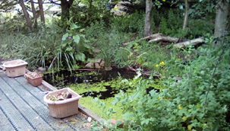
Does my child need to bring wellies?
Please bring a pair of wellies to keep in school. These will be used for outdoor learning in the school garden and in the outdoor provision during the week when it is wet.
You can leave them on the silver welly racks outside the reception doors. Feel free to take them home at weekends if you wish.

Slide 20
Do I need to bring a spare change of clothes?
Please send in a spare change of clothes (not just underwear) and a plastic bag for the children to put wet or dirty clothes in. These will be kept in their lockers for when they are needed.
There are a range of reasons why your child may need to get changed.
Please make sure that all clothes are labelled.

Slide 21
Can my child bring in their toys?
Please don't bring in toys from home as they may well get lost or broken.

Slide 22

When will PE be?
We will confirm the PE day at the beginning of term.
Children should come in their PE kit and black or white trainers.
Please remove all jewellery and tie back long hair with soft hair bands. This includes earrings.

Slide 23
Is there before and after school clubs?
Kingfishers is the breakfast and after school club.
It is across the playground from the reception classrooms.
Many children attend in the morning and the evening.
Staff at Kingfishers drop the children off in the morning and collect them from the classroom at the end of the school day.

Slide 24




What are house groups?
Our four house groups:
Bronte (Blue)
Wilberforce (Yellow)
Burton (Green)
Hepworth (Red)
You can buy your house t-shirt and water bottles online and collect them from the office.
Children will be allocated to their houses after a couple of weeks when the children are settled. If they have a sibling we will put them in the same house group.

Slide 25
Where do I pick up and drop off my children?
Come to the Reception class doors.
Please inform us at the door in the morning or contact the office during the day if your child is going home with somebody different.
We won't let your child go with anyone else unless you inform us.

Slide 26
What is the reception baseline?
A few years ago, the government introduced a new reception baseline assessment, which will be used to track your child's progress throughout school.
This takes place in the first six weeks of school and involves a literacy and a maths task.

Slide 27
Do the children use computers and ipads in school?
Technology is a big challenge for schools and families and many of our children have lots of opportunities to use technology outside of school.
In EYFS we are keen to give our child other learning opportunities.
Children only use Ipads occasionally in EYFS to support their learning. For example if they want to look for a picture to support art work or junk modelling.
Internet safety is an important part of our curriculum to prepare the children for the digital world.
We introduce the concept of programming, for example beebots.

Slide 28
What if my child has special education needs or I think they may have special educational needs?
We use information from parents, nurseries and the local authority to inform us of identified SEND. We work with all stakeholders to ensure that the transition to EYFS is as smooth as possible. This may involve additional meetings and visits to nursery settings.
If you have questions or concerns regarding potential SEND, please speak to your child's class teacher in the first instance.
The school SENDco is Mrs House.
For more information, go to:
https://www.bramhopeprimary.co.uk/page/?title=SEND+%28Special+Educational+Needs+and+Disability%29&pid=72

Slide 29
How does the school support children in receipt of pupil premium funding?
Pupil Premium is additional Government funding given to schools to raise the attainment of disadvantaged pupils and close the gap between them and their peers.
Pupil premium funding is allocated to eligible schools based on the number of:
  pupils who are recorded as eligible for free school meals, or have been recorded as eligible in the past 6 years (referred to as Ever 6 FSM)
  children previously looked after by a local authority or other state care, including children adopted from state care or equivalent from outside England and Wales
Pupil premium is not a personal budget for individual pupils, and schools do not have to spend pupil premium so that it solely benefits pupils who meet the funding criteria. It can be used:
  to support other pupils with identified needs, such as those who have or have had a social worker, or who act as a carer
  for whole class interventions which will also benefit non-disadvantaged pupils
Your child may be eligible for Pupil Premium if you receive any of the following: Income Support. income-based Jobseeker's Allowance. income-related Employment and Support Allowance. If you think you may be eligible, please contact the school office.
For more information go to: https://www.bramhopeprimary.co.uk/page/?title=Pupil+%26amp%3B+PE+Premium&pid=59

Slide 30
When will I find out more information about the curriculum?
In the autumn term we will invite you to attend workshops for reading, writing and maths.
Each half term you will receive a parent pack informing you about what your child is learning.

Slide 31
Thank you for listening.
Any Questions?

