Slide 1

Maths’ curriculum evening
3.12.24

Slide 2
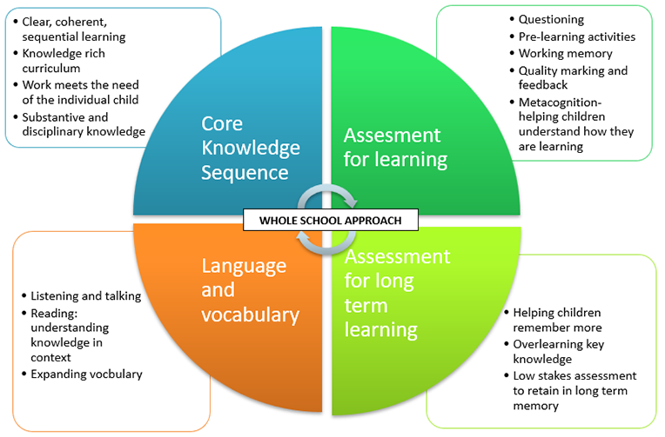
How is our curriculum organised?

Slide 3
Click here for the maths long term plans
Click here for the whole school progression of maths curriculum
Click here for the addition and subtraction calculation policy
Click here for the multiplication and division calculation policy
Click here for White Rose Maths

Slide 4
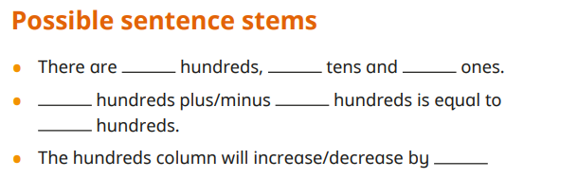
Principles of dialogic talk: listening and talking
Mathematical language and vocabulary:
  Opportunities for talk embedded within each unit
  Stem sentences to support mathematical vocabulary
  I see reasoning resources (I See Reasoning)

Slide 5
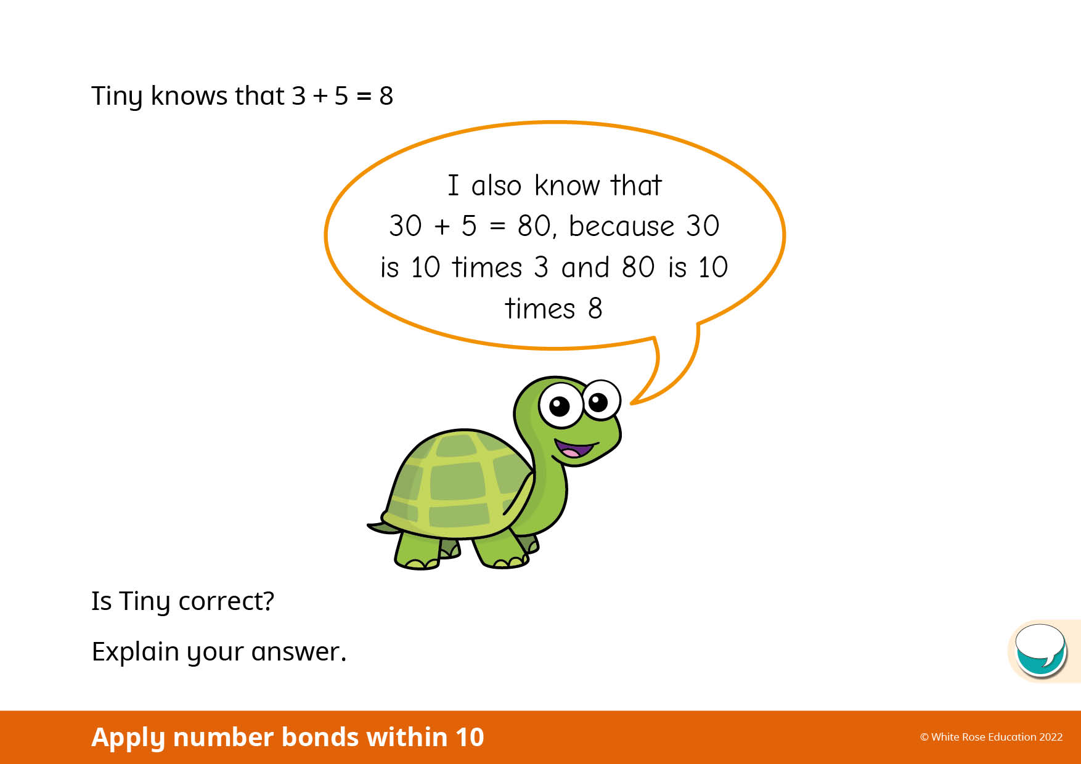
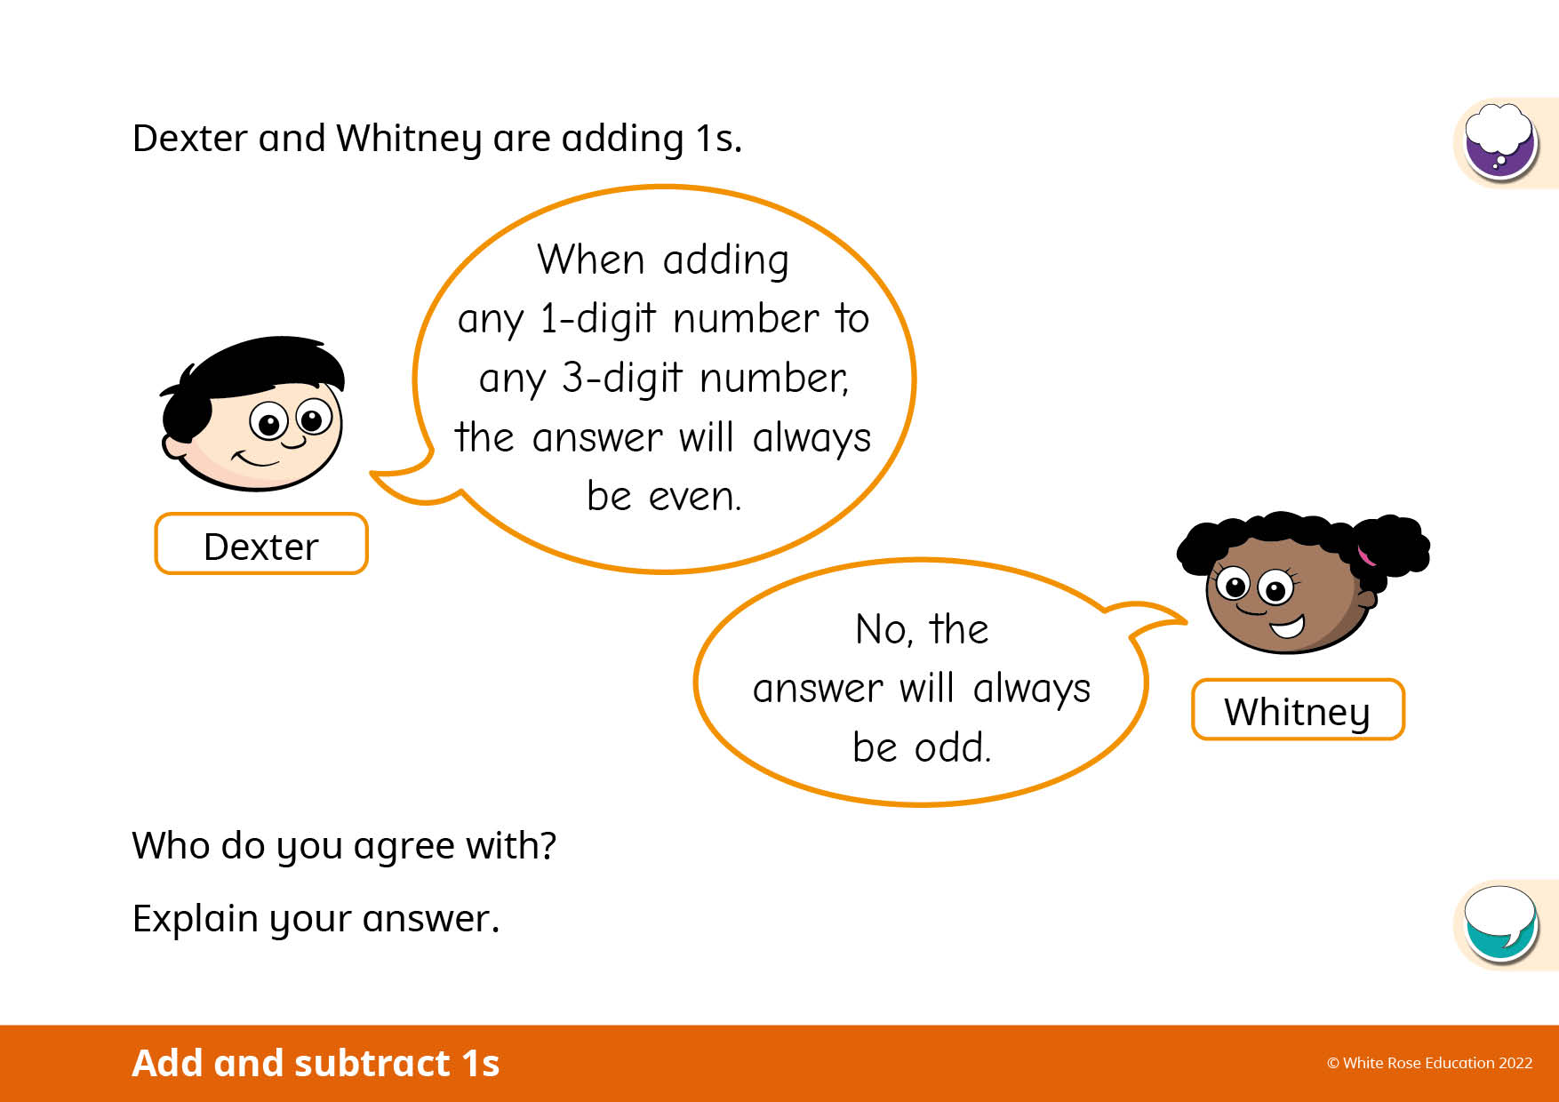

Slide 6
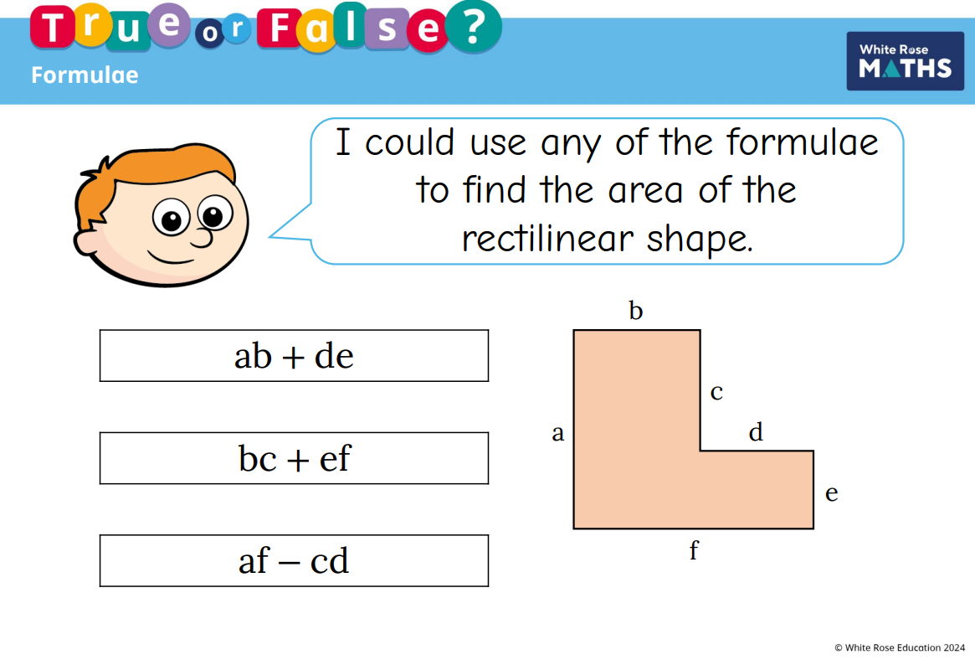
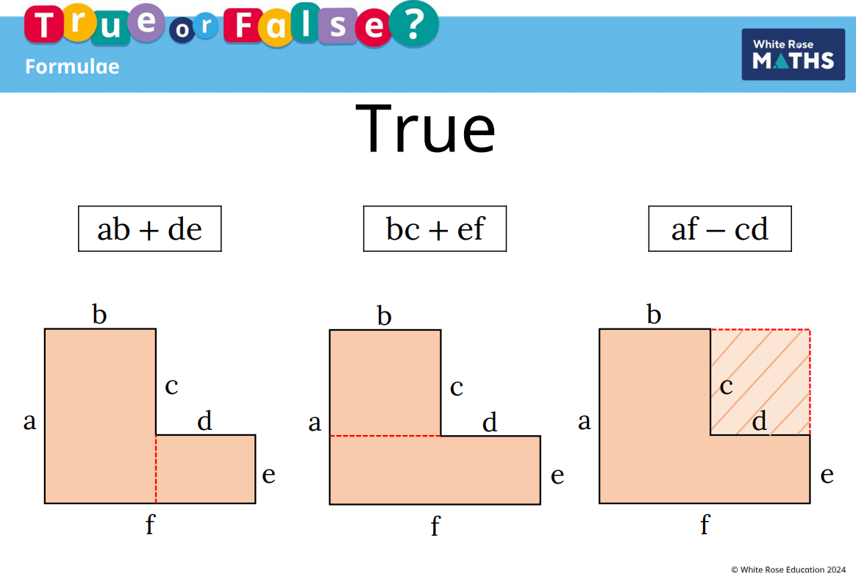

Slide 7
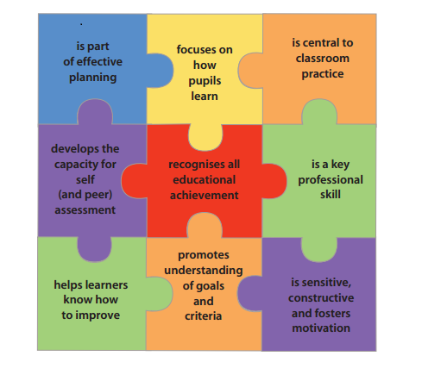
Clarifying, understanding, and sharing learning intentions
Engineering effective classroom discussions, tasks and activities that elicit evidence of learning
Providing feedback that moves learners forward
Activating students as learning resources for one another
Activating students as owners of their own learning

Slide 8
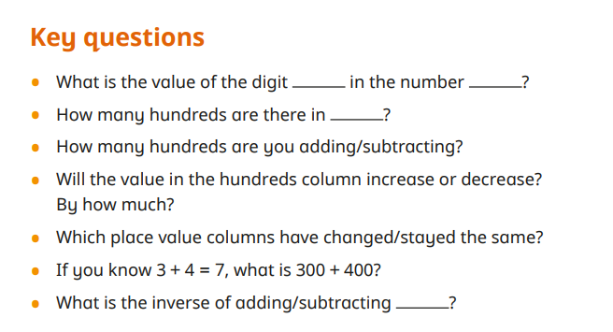
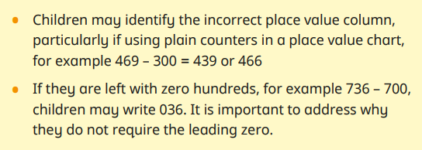

Slide 9
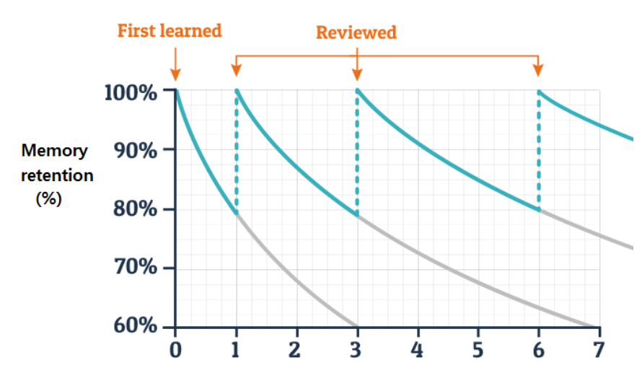

Slide 10
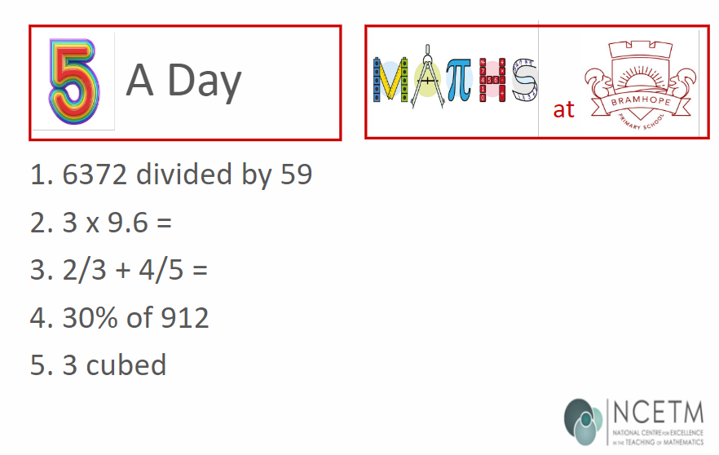
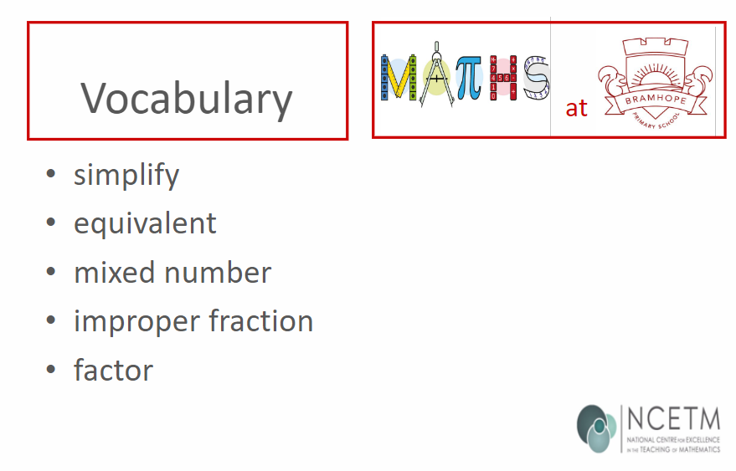
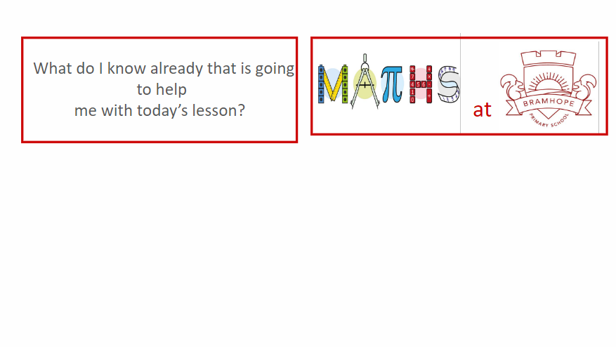

Slide 11
Aims
To share our maths’ vision and ethos
To understand fluency, reasoning and problem-solving
To share our scheme of learning
To understand the CPA approach
To explain the calculation policy through the strand of multiplication
To understand what maths looks like in the classroom
To explain assessment including the multiplication check
To understand how we support and challenge pupils
To share the importance of Mathletics
How to support your child at home

Slide 12
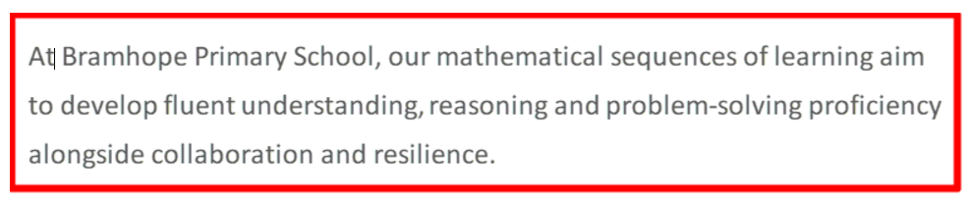
Our maths’ vision

Slide 13
Our maths ethos
All pupils can achieve, and we have high expectations for all
Mistakes are the first attempt in learning
We use dialogic talk in every maths lesson
Follow the White Rose scheme while taking into account the needs of our pupils
Keep up-to-date with the latest training and information from maths network meetings
Teach a balance of fluency, reasoning and problem-solving to all pupils

Slide 14
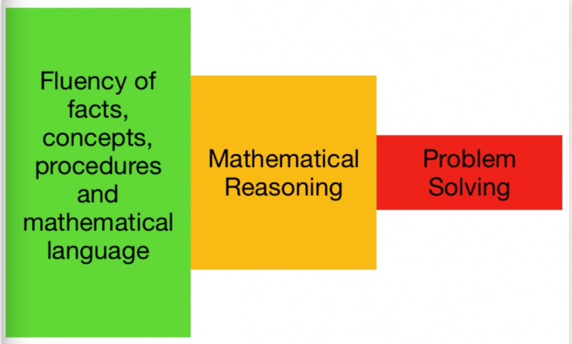

Slide 15
Fluency
Fluency is the ability to recall and apply knowledge rapidly and accurately.
It is the quick recall of facts and procedures.
It is the flexibility and fluidity to understand the structure of maths.
It is the ability to recognise relationships and make connections in maths.
I know that ………… 2 + 4 = 6​
I know that I can use a column method to find the sum …… 12 + 14 = ?​

Slide 16
Reasoning
Reasoning is asking pupils to explain their mathematical thinking.
We reason mathematically by following a line of enquiry, conjecturing relationships and generalisations, and developing an argument, justification or proof using mathematical language.
I know when…​ 12 + 14 = ?​
If I know 2 + 4 = 6, and my two addends have increased by 10 then my answer will increase by two tens/20. ​

Slide 17
Without doing the calculations, decide whether the answers to the following would be between 500 and 550.
3 × 149
500 × 1.21
Half of 1,073
93 × 6
4,000 ÷ 9
220 ÷ 0.42

Slide 18
Without doing the calculations, decide whether the answers to the following would be between 500 and 550.
3 × 149 = 447​
500 × 1.21 = 605​
Half of 1,073 = 536.5​
93 × 6 = 558​
4,000 ÷ 9 = 444.44​
220 ÷ 0.42 = 523.8​

Slide 19
What skills did you use when answering the question?​
​
Record them on a post-it.​
​
What language did you use when discussing it?​

Slide 20
What did you do?​
Representing – analyse, record, do, check, confirm​
Enquiring – plan, decide, organise, interpret, reason, justify​
Reasoning – create, deduce, apply, explore, predict, hypothesise, test​
Communicating – explain methods and solutions, choices, decisions, reasoning​

Slide 21
Did you use any mathematical language?
It could/could not be because…​
It will/won’t work because…​
It would only work if…​
So…​
I know that…..​
I know how …..​
I know when…​
If I ……….
Approximately………

Slide 22
Reasoning prompts
What’s the same, what’s different?​
What do you notice?​
Always, sometimes, never​
Odd one out
Convince me
Justify
Prove it
What else do you know?​
Another, another, another​
Give a non-example​

Slide 23
What’s the same, what’s different?
4 and 40
5 and 9
9 and 18
Multiples of 3 and multiples of 6
0.5, 50%, 4 : 8, 1 : 2
Square numbers and numbers that are not square

Slide 24
Convince me/how do we know that…
All angles in a triangle always add up to 180°
The next whole number after 119 will be 120
Co-ordinates are useful for identifying points
An odd number plus an odd number always equals an even number
The area of a rectangle divided by the length gives the width

Slide 25
Always, sometimes, never
The picture on a pictogram represents one piece of data.
If the answer is in cm², you are measuring area.
The diagonals of a quadrilateral bisect each other.
Angles on a straight line add to 180˚.
Multiples in the 5x table will end in 5.

Slide 26
Collaboration
Find the value of 9,999 + 999 + 99 + 9 + 5
By asking pupils to think, pair, share turns this from a simple question into a reasoning activity.

Slide 27
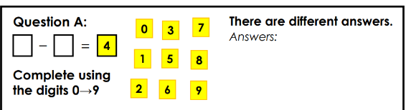
Problem-solving
Problem solving is when pupils apply their knowledge to solve problems in varied contexts.
It is when we can solve problems by applying maths knowledge to a variety of routine and non-routine problems with increasing sophistication, including breaking down problems into a series of simpler steps and persevering in seeking solutions.

Slide 28
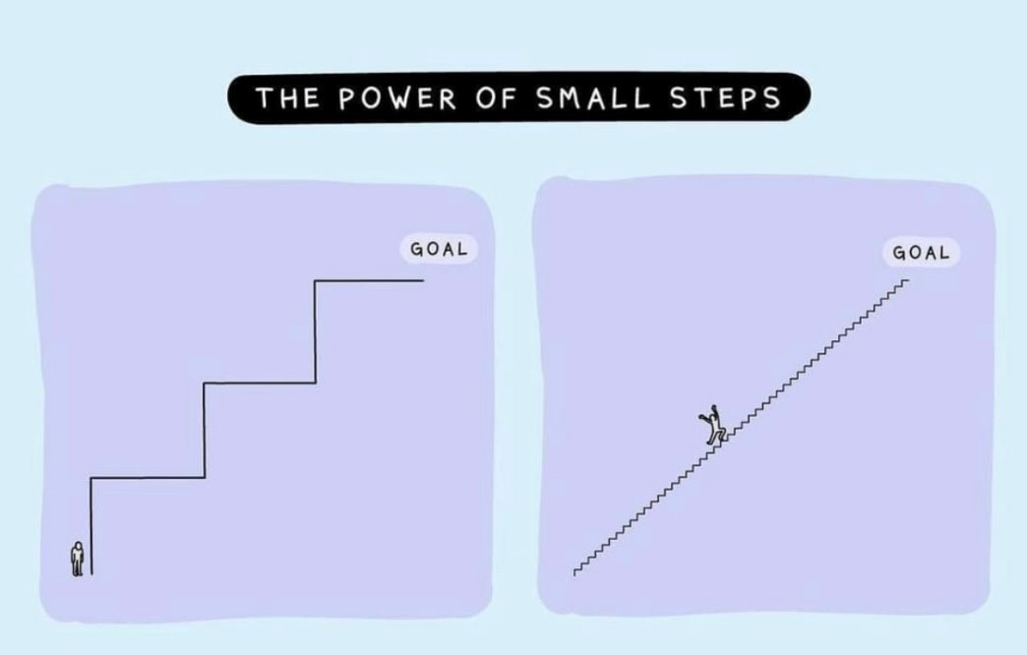
Our scheme
We use the White Rose Maths
scheme from EYFS to Year 6.
It covers the National Curriculum
and breaks the learning into small steps.
It also includes fluency, reasoning
and problem-solving within the lesson.
We also use the progression documents
from the NCETM (National Centre of
Excellence for Teaching Maths) so that we
can see what the pupils have been taught in
the previous year.

Slide 29
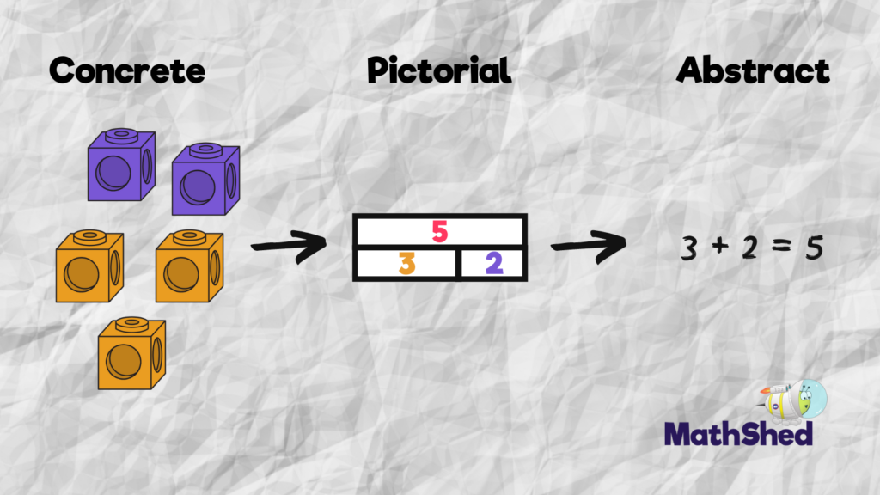
CPA approach
The concrete, pictorial, abstract approach (or CPA method) is a process of using “concrete” equipment to represent numbers (including fractions) and operations, such as addition, subtraction, division and multiplication, followed by a pictorial representation to represent the equipment or derived structures (like bar and part-whole models), before moving on to the “abstract” digits and various other symbols used in mathematics.

Slide 30
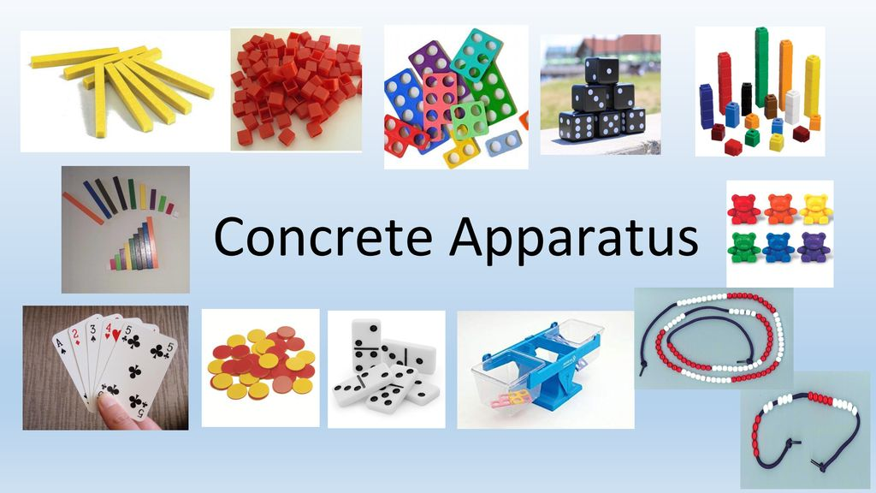
Examples are:
Numicon
Base 10
Cuisenaire rods
Multilink
Place value counters and grids
Bead strings
Ten frames
Number lines

Slide 31
Calculation policy
We use the White Rose calculation policy for addition, subtraction, multiplication and division.

Slide 32
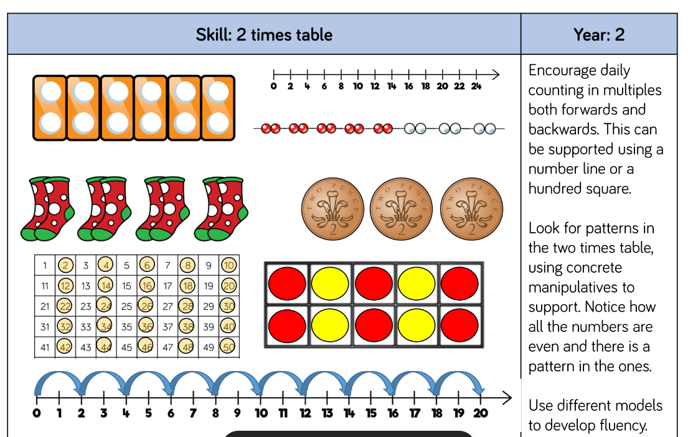
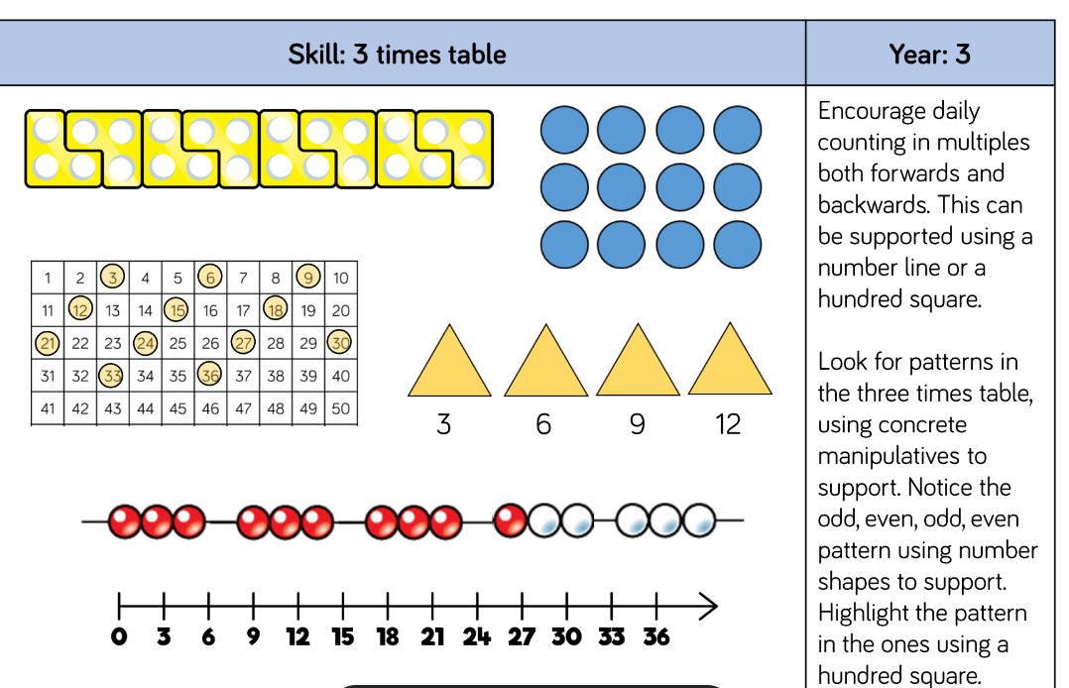
Policy example in multiplication

Slide 33
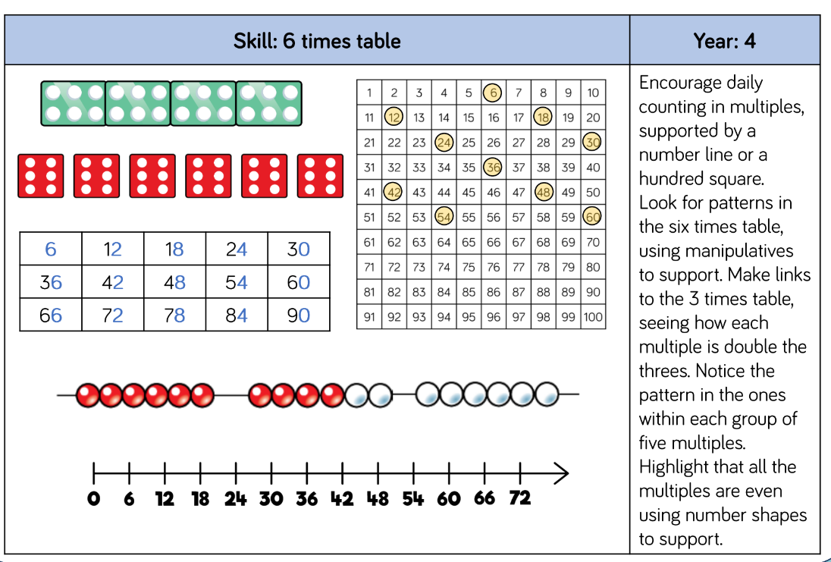
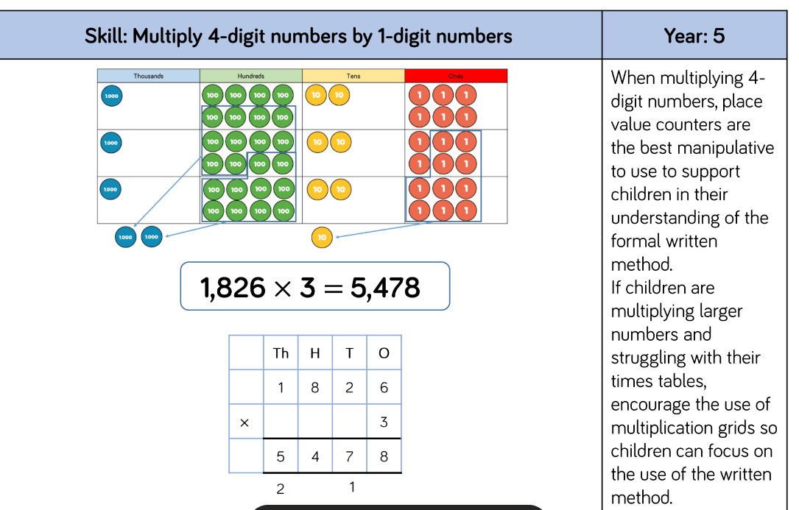
Policy example in multiplication

Slide 34
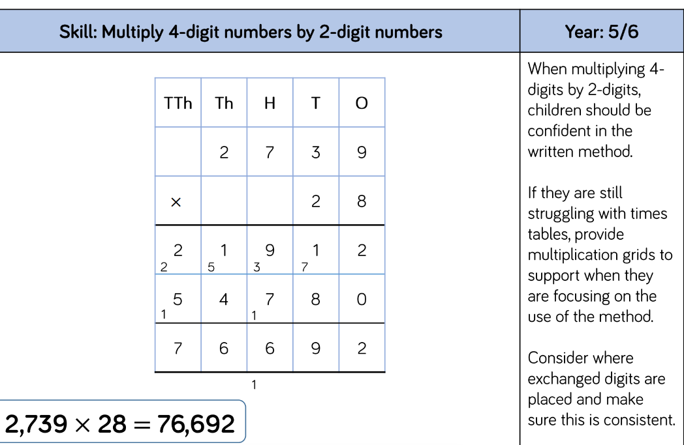
Policy example in multiplication

Slide 35
What does maths look like in EYFS?
Learning through play.
Outdoor activities.
Counting, counting and more counting!
Pattern spotting
Number recognition and ordering to 10.
Learning numbers bond up to 10.
Shape recognition, 2D and 3D.
Addition and subtraction using single digit numbers.

Slide 36
What does Maths look like in Year 1?
Number bonds to 10 and within 10.
Compose numbers to 10 from 2 parts, and partition numbers to 10 into parts, including recognising odd and even numbers.
To read time to O'clock and Half Past.
To double numbers to 10.
Count forwards and backwards in multiples of 2, 5 and 10.
Read, write and interpret equations containing +, - and = symbols.
Recognise common 2D and 3D shapes presented in different orientations, and know that rectangles, triangles, cuboids and pyramids are not always similar to one another.
Count within 100, forwards and backwards, starting with any number.

Slide 37
What does Maths look like in Year 2?
Add and subtract within 100 by applying one-digit addition and subtraction facts. To add and subtract any 2 two-digit numbers.
Practical learning using a variety of resources.
To read the time to the nearest five minutes
Recognise the place value of each digit in two-digit numbers.
To describe the properties of 2D and 3D shapes and compare shapes by their properties
Recognise the subtraction structure of ‘difference’ and answer questions such as “How many more…?”.
Secure fluency in addition and subtraction facts within 10.

Slide 38
What does Maths look like in Year 3?
To use choose strategies to help answer questions such as partitioning, number lines, counting on, counting back, bar models and eventually formal methods such as the column method.
Consistently use the correct number formation (0-9).
To recognise the place value of each digit in a three-digit number (hundreds, tens and ones).
To read and write numbers up to 1,000
To identify angles greater than or less than a right angle
To add and subtract mentally and scaling these by 10 e.g. 6 + 3 = 9, 60 + 30 = 90.
To understand the inverse relationship between add and subtract
To solve number and practical problems, including reasoning using number knowledge.
To recall my 2, 5, 10, 3, 4 and 8 times tables and related division facts.

Slide 39
What does Maths look like in Year 4?
Find the perimeter of regular and irregular polygons
Convert mixed numbers to improper fractions and vice versa
Solve addition and subtraction two-step deciding which operations and methods to use and why
Have a secure understanding of number: confidently identifying the value of each digit in a 4 digit number E.g. 2378 the 3 represents 300.
Recognise common groups of equivalent fractions and finding the corresponding decimal.
To solve practical and number problems using reasoning to justify answers.
To confidently and securely know times tables facts, including the inverse up to 12x12
Multiply two-digit and three-digit numbers by a one-digit number using formal written layout

Slide 40
What does Maths look like in Year 5?
Measure angles in degrees (°) and draw angles of a given size.
Recognise the place value of each digit in numbers with up to 2 decimal places
Secure understanding of fractions including simplifying, equivalent fractions and calculating with fractions (+ - and x by integers)
To use the formal written methods for all four operations (addition, subtraction, division and multiplication)
Convert between units of measure e.g. grams to kilograms
Rapid and accurate recall of ALL times tables and related division facts
To solve number problems using reasoning to justify my answers and to prove and disprove.
Find non-unit fractions of quantities.
Draw upon a variety of mental maths strategies to support arithmetic skills

Slide 41
What does Maths look like in Year 6?
Rapid and accurate recall of ALL times tables
Draw, compose and decompose shapes according to given properties, including dimensions, angles and area
Find equivalent fractions, decimals and percentages
Solve problems involving ratio relationships
Solve multi-step word problems
Recognise the place value of each digit in numbers up to 10 million, including decimal fractions
Algebra
To consolidate the formal written methods and use alongside efficient mental strategies
Use common factors and multiples to simplify fractions. To securely use all four operations when calculating with fractions (+ - x ÷)
Working with numbers beyond 6 and 7 digits
Systematic and methodical workings
Draw upon a variety of mental maths strategies to support arithmetic skills

Slide 42
Assessment
We assess pupils through observations, how they answer questions, marking, pupil voice, interventions, tracking data, monitor Mathletics and self-assessment.
We also use:
Baseline assessments for EYFS
NFER for Y1 in Spring and Summer
NFER for Y2 in Autumn and Spring
NFER every term​ for Y3, Y4 and Y5.
SATs papers every term for Y6
White Rose end of unit assessment​s
RockStars daily​ in Key Stage 2
Multiplication Check for Y4

Slide 43
What is the multiplication tables check?
The purpose of the check is to determine whether your Y4 child can fluently recall their times tables up to 12.
It is an on-screen check consisting of 25 times table questions, which takes place in June. Your child will be able to answer 3 practice questions before taking the actual check. They will then have 6 seconds to answer each question.

Slide 44
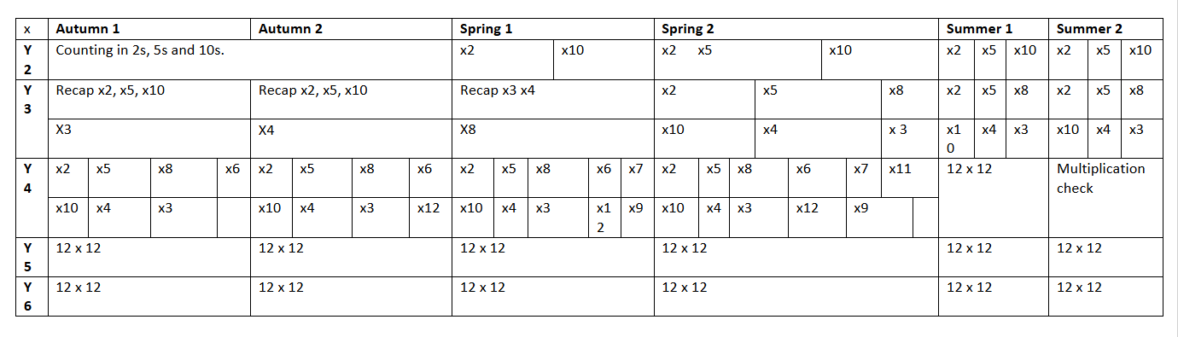
Our multiplication timetable

Slide 45
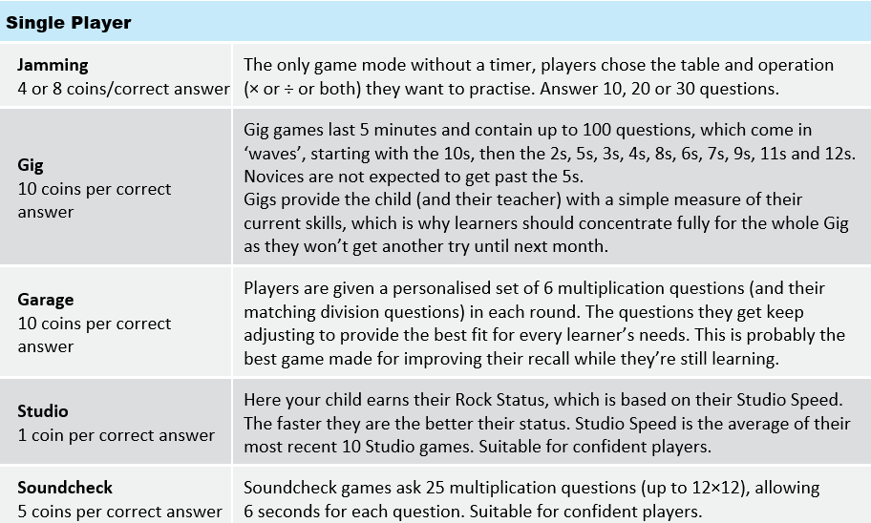
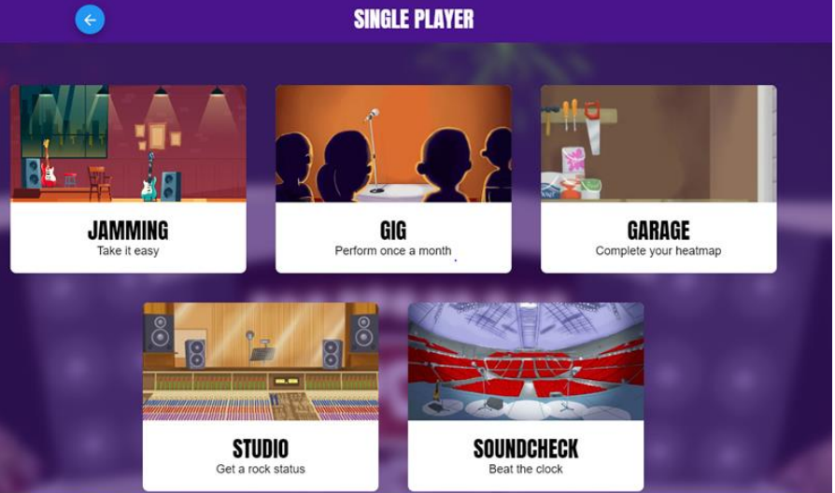
How to practise multiplication tables on Times Table Rockstars. https://www.youtube.com/watch?v=-ZxZbRVvbYM

Slide 46
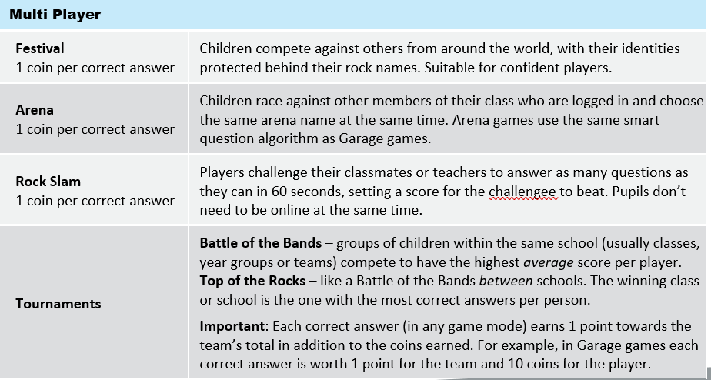
How to practise multiplication tables on Times Table Rockstars

Slide 47
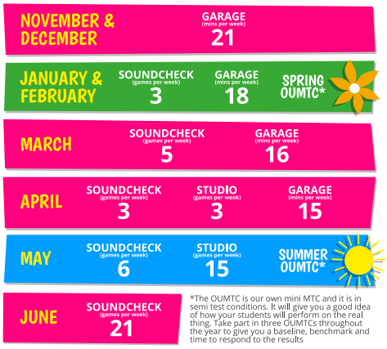
How to practise multiplication tables
Times Table Rockstars

Slide 48
How we support SEND pupils
By having high expectations
By providing reasonable adjustments to meet individual need
Use the CPA approach
Personalise the learning
Make the steps even smaller
Use the progression documents to track back
Collaboration with peers
Possible intervention

Slide 49
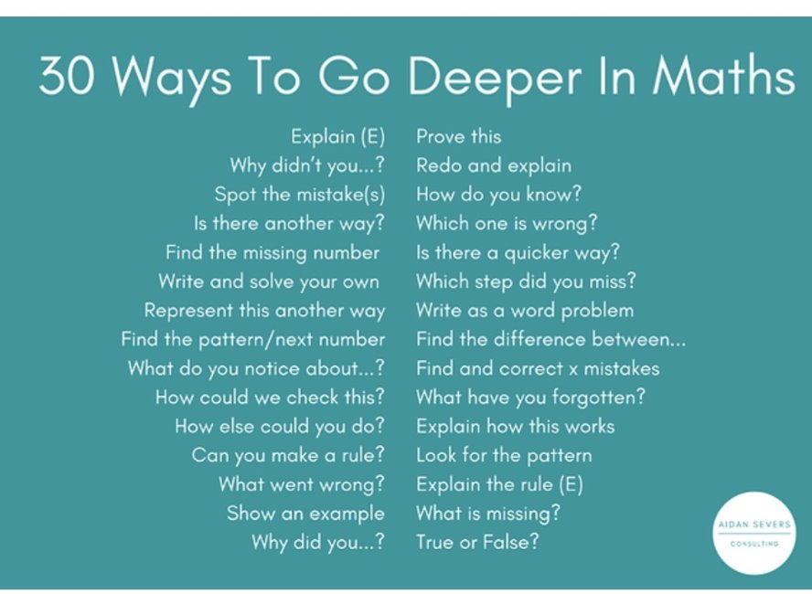
How we challenge pupils in school
We ask them to:
access maths problems presented in a wide range of different, complex ways;​
be able to justify and prove their reasoning;​
ask their own mathematical questions and follow their own lines of enquiry when exploring an open-ended maths problem.

Slide 50
Examples of curriculum links
Geography
Measurements such as temperatures, distances such as lengths of rivers and heights of mountains and grid references
History
Timelines and durations of historical periods
Science
Presenting and interpret data in tables, charts and graphs, identifying patterns and measuring.

Slide 51
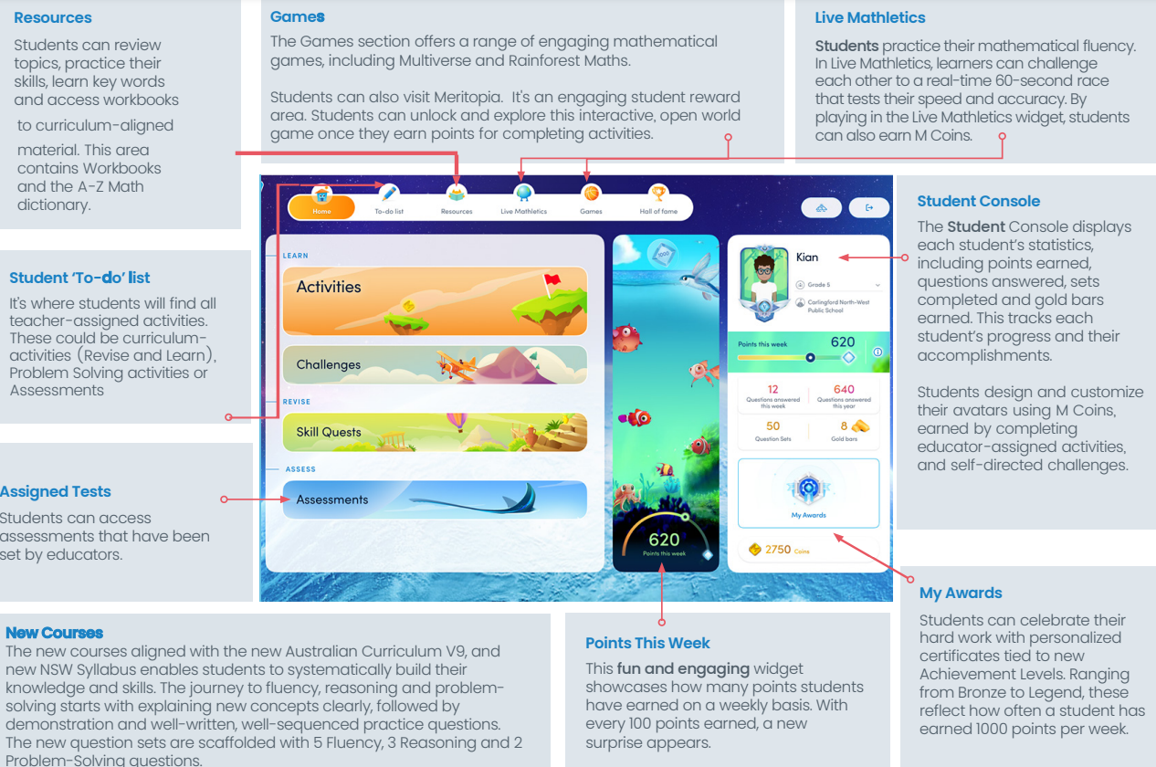

Slide 52
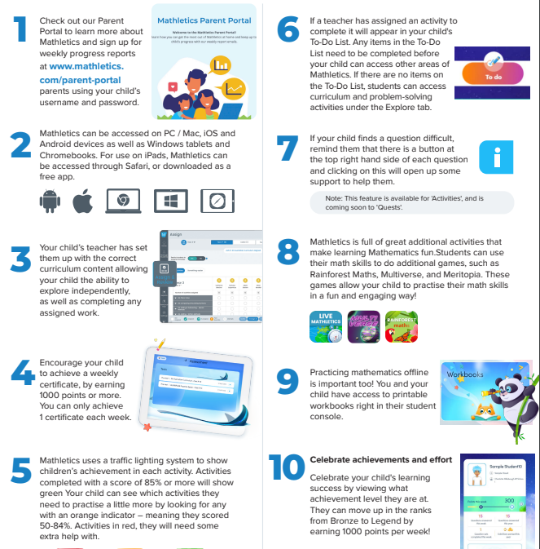
Top Ten Tips for using Mathletics to support your child’s learning at home.

Slide 53
How to support your child at home.
Positive attitude to the maths learning.
Use everyday opportunities to practise maths skills.
Praise the process and not just a correct answer.
Find the logic in what they are saying!
No “wrong” strategy (if it gets the right answer!) • BUT some strategies more helpful than others!
Use powerful questions when exploring maths problems. • Praise deep thinking skills rather than speed.
Embrace the mistakes!

Slide 54
Practical ways to support your child at home.
Practise number bonds to different amounts e.g. 10, 20, 50, 100.
Using practical resources.
Counting in different amounts e.g. 2s, 5s, 8s.
Recognising coins, making different amounts and finding change.
Looking at shapes in the real world and discussing properties.
Cooking- weighing and measuring different ingredients.
Relating time to daily routines and telling the time – analogue and digital.
Sitting with your child each week whilst completing homework for discussion.
Count as you go up/downstairs – count in 2s, 3s, 4s etc. It doesn’t have to be 1 step!
Set them open challenges, such as: The answer is 18, what is the question?

Slide 55
Any questions?
Please add them to a post-it.

