Slide 1

Bramhope Primary School
Maths

Slide 2
Our aim
For children to develop positive attitudes and interests in mathematics, look for patterns and relationships, spot connections, ‘have a go’, talk to adults and peers about what they notice and not be afraid of making mistakes.

Slide 3

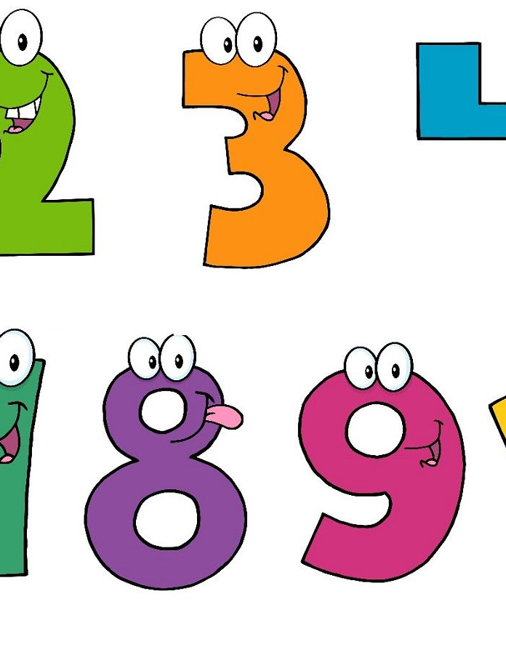
Skills In mathematics
Count confidently and develop a deep understanding of the numbers to 10.
Use manipulatives to develop understanding.
Develop and use correct mathematical vocabulary.
Develop reasoning skills across all areas of mathematics including shape, space and measures.
How do you know?
How did you work that out?
Can you explain that to me?

Slide 4
Mathematics early learning goals
Number
Have a deep understanding of number to 10, including the composition of each number;
Subitise (recognise quantities without counting) up to 5;
Automatically recall (without reference to rhymes, counting or other aids) number bonds up to 5 (including subtraction facts) and some number bonds to 10, including double facts.
Numerical Patterns
Verbally count beyond 20, recognising the pattern of the counting system;
Compare quantities up to 10 in different contexts, recognising when one quantity is greater than, less than or the same as the other quantity;
Explore and represent patterns within numbers up to 10, including evens and odds, double facts and how quantities can be distributed equally.
Our maths curriculum is broader than these learning goals, including learning about shape and measure (length, weight and capacity).

Slide 5
What if my child is very confident with number already?
You may feel that your child can already count to 10 and therefore understands everything there is to know about counting to 10. But have you considered:
They may just know the numbers by rote?
They may not have grasped the 5 ness of 5.
They may not understand the numbers within numbers e.g. that 5 is made up of 3 and 2, 4 and 1?

Slide 6


What schemes do we use to teach maths?
NCETM mastering number
A programme that we are using to develop number sense.
White Rose Maths
White Rose maths is used in addition to this to give a broad and balanced curriculum.

Slide 7
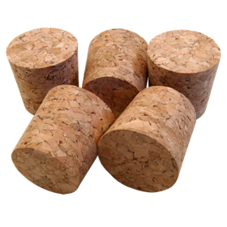
Perceptual subitising is instantly recognising an amount without counting. Usually up to around 5 in an irregular pattern.

Slide 8
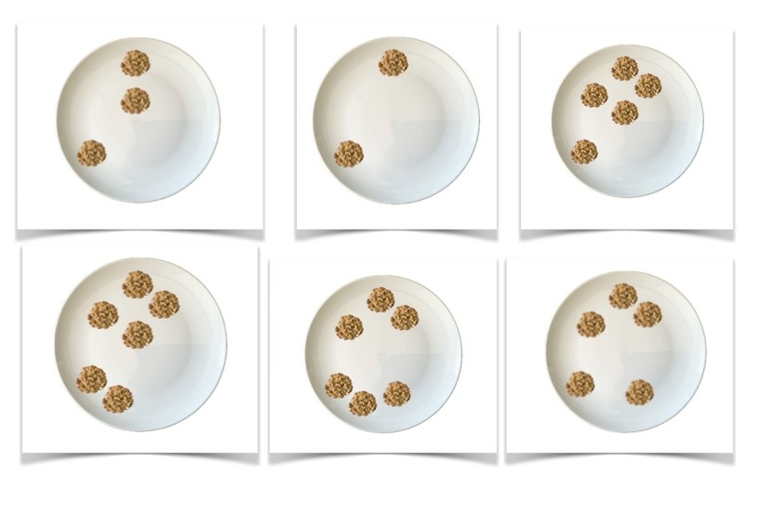
Conceptual subitising is instantly recognising a number by seeing groups and adding them together.
You know this is 6 because 4 and 2 makes 6.
You might see 2 and 2 and 2 and know that makes 6.

Slide 9
What can you see and how do you see it?

Slide 10
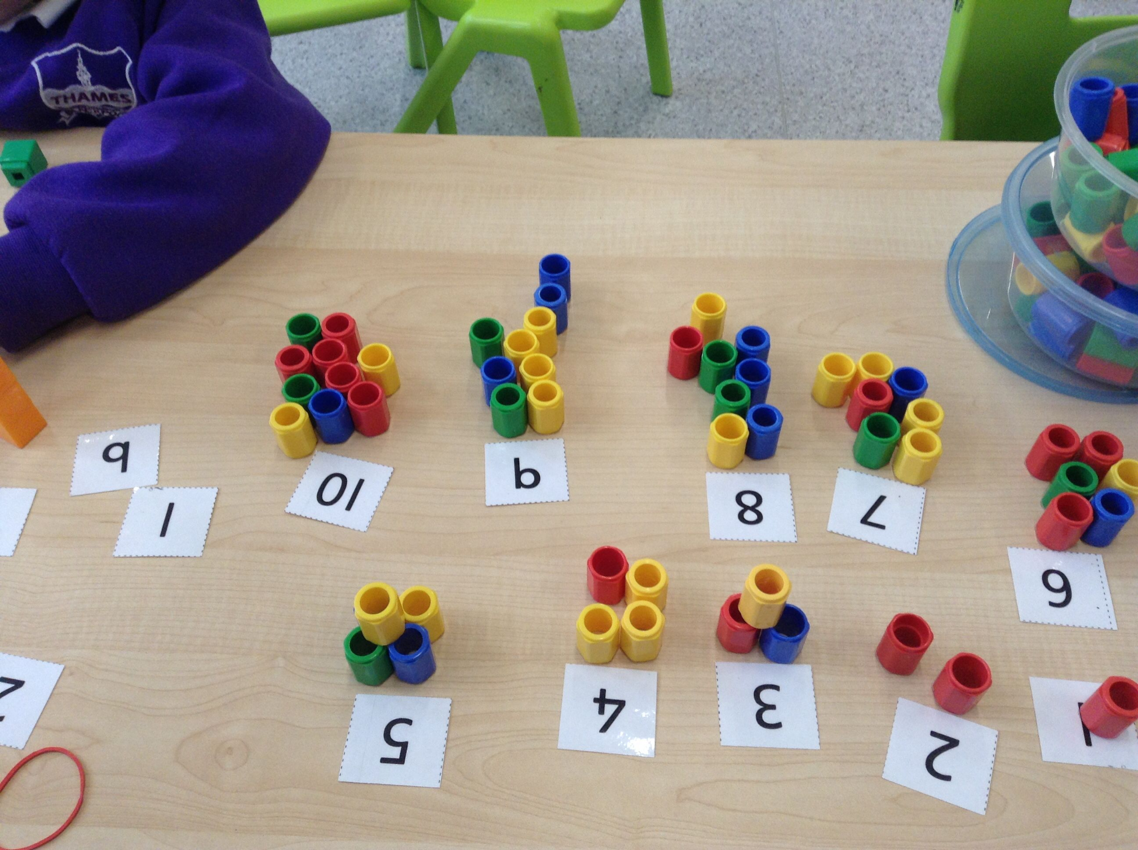
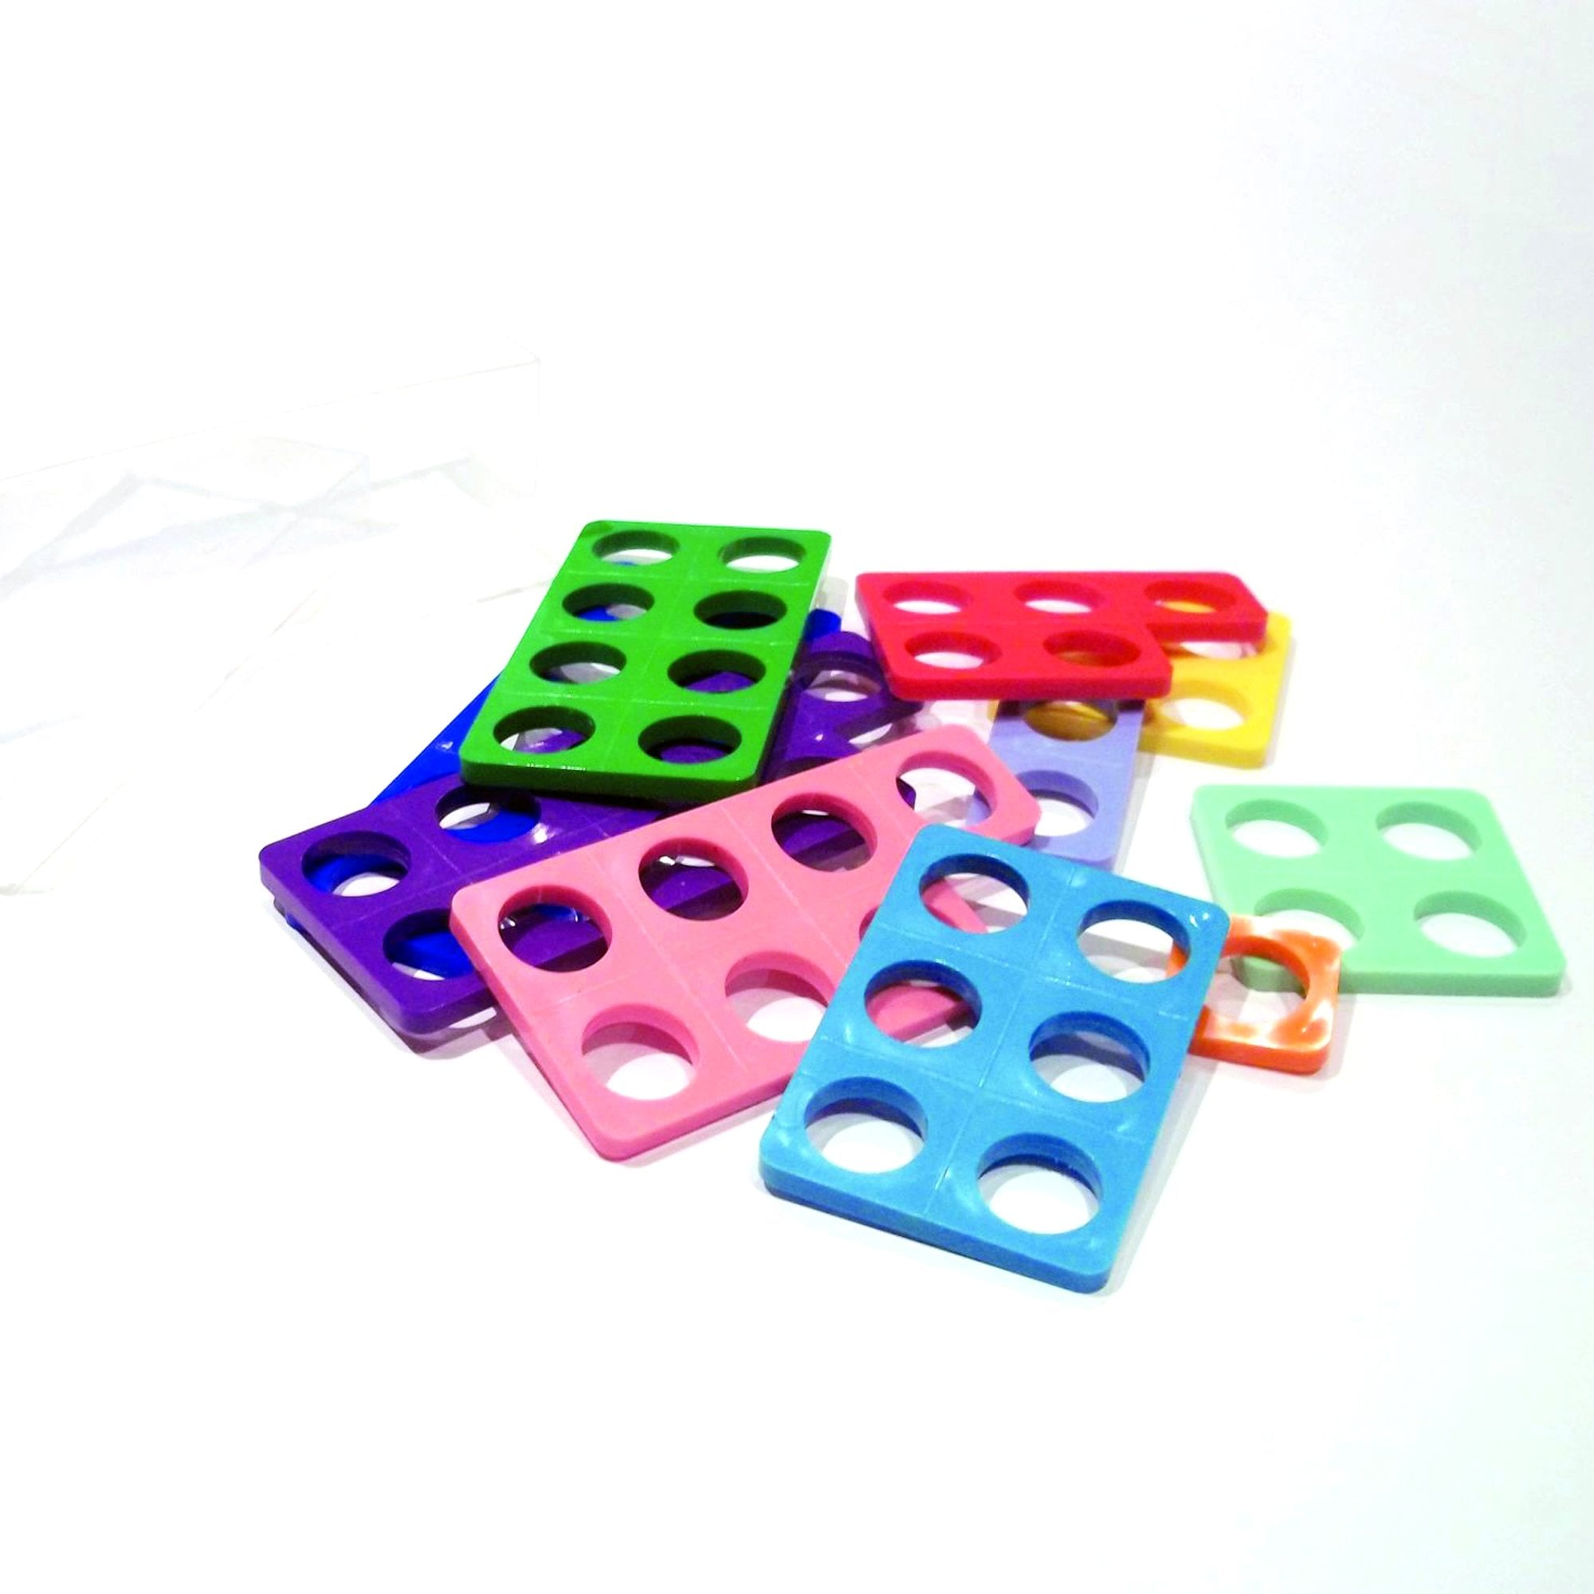
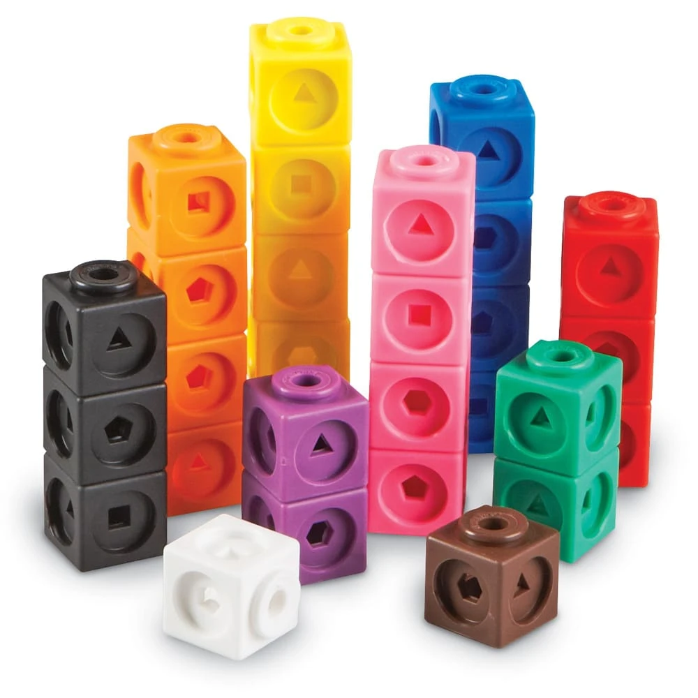
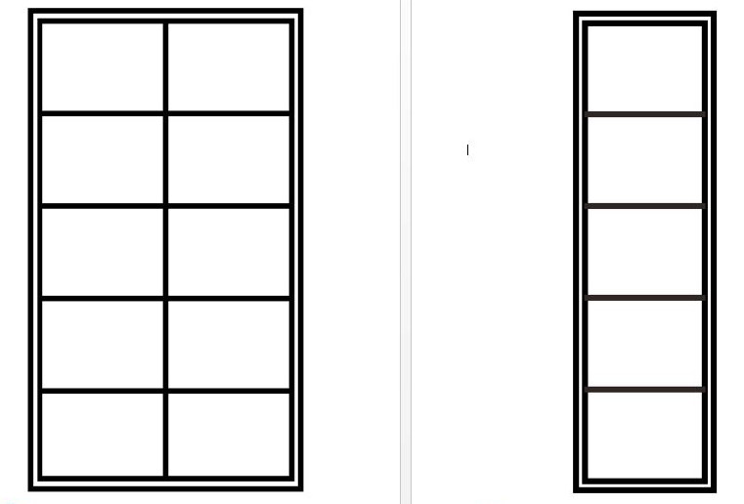
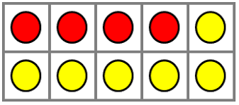
Our Maths area

Slide 11
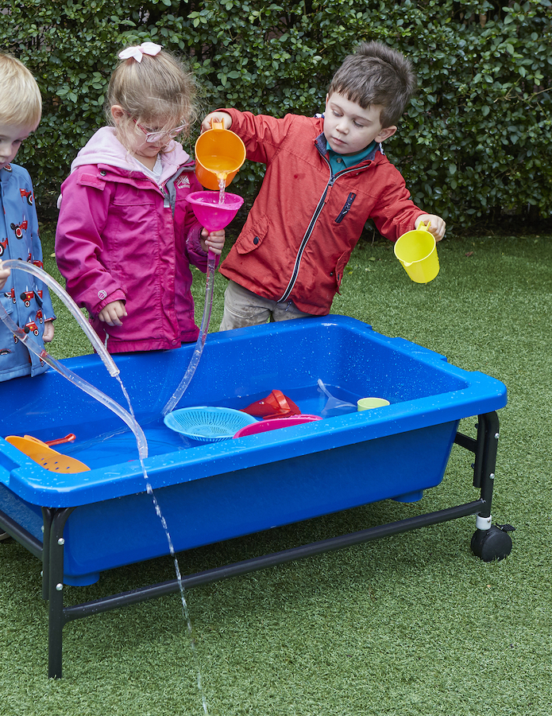
Maths in continuous provision
Each week there is a math activity set up in the maths area for the children to practice what they have been taught in adult led sessions.
There are various maths resources for them to create their own maths activities.
The children are always using their Maths skills during play without realising e.g. counting the strawberries, one more tyre, how many cups of water to fill the bucket, making a taller/shorter tower etc.
We move their learning on with questioning, modelling and making new discoveries together.

Slide 12
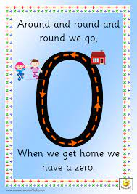
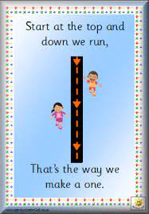
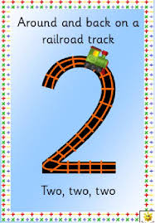
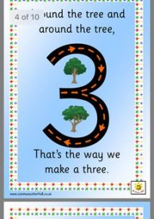
Forming numbers correctly
As we teach numbers we are teaching the children number rhymes to help them with the formation.
http://www.communication4all.co.uk/Numeracy/Number%20Formation%20Rhyme%20Cards.pdf

Slide 13
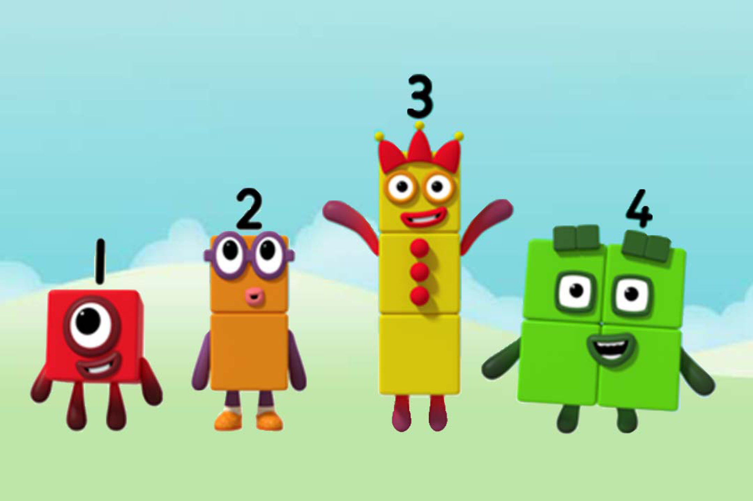
How can I help my child at home?
Noticing numbers around you e.g. I can see four sheep in the field.
Noticing shapes in your house
Counting steps on a walk
Make comparisons by talking about who has more and who has fewer
Ask your child to explain how they know what they know.
Mathletics
We encourage you to use our online resource Mathletics where there are more resources to support your child further.
​Numberblocks on BBC is a great way for children to learn about numbers in their down time. ​
Check out websites like: www.ictgames.co.uk
http://nrich.maths.org/early-years

Slide 14
Thank you for listening.
Any questions?

