Slide 1
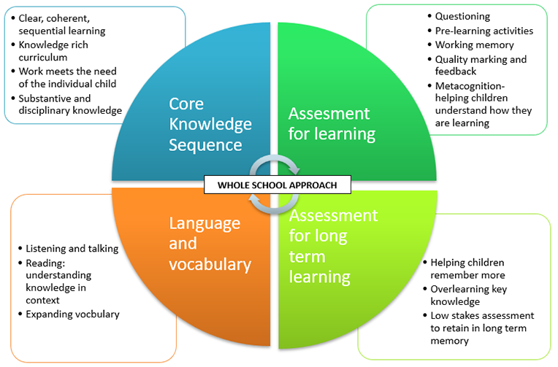
How is our curriculum organised?

Slide 2
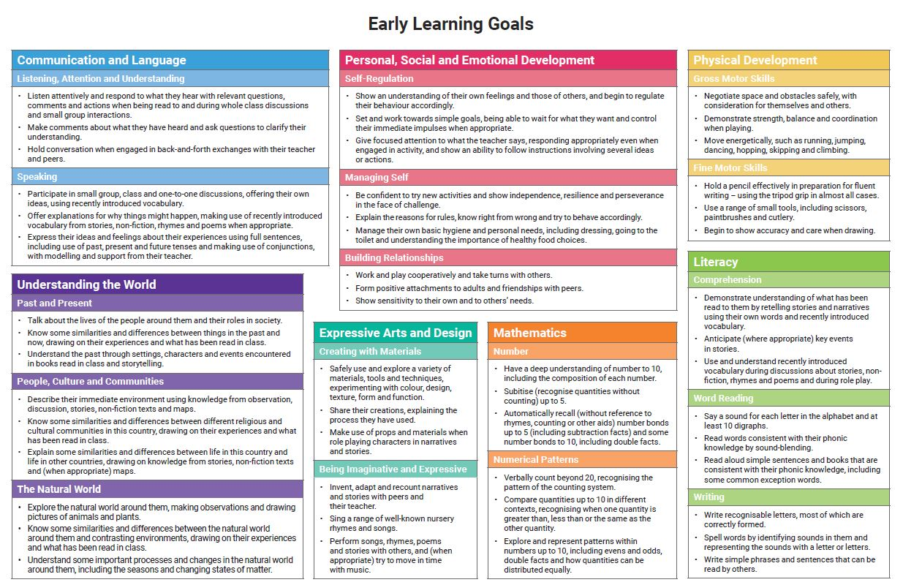

Slide 3
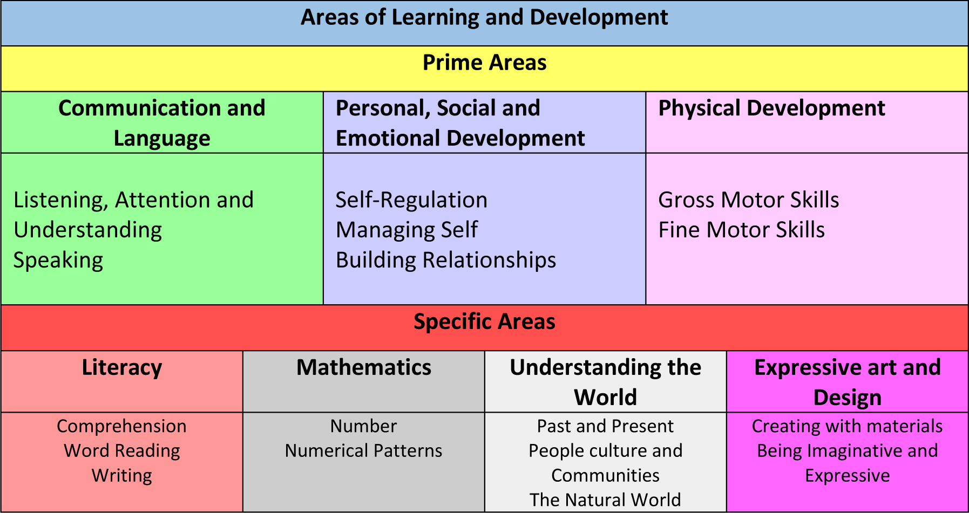

Slide 4
Curriculum Years 1-6
National Curriculum
Statutory document set out by the Department for Education.
Sets out the programmes of study and attainment targets for all subjects at all 4 key stages (primary and secondary).
Long Term Plans
Maps out the learning across the school for each subject.
Knowledge Overviews
Clear sequence of learning through a subject from Reception to Year 6.
Short term plans
Used where appropriate to detail specific elements of the lesson
All local-authority-maintained schools in England must teach these programmes of study. Academies can choose to adopt the national curriculum.
Contains clear end points for each year group.
Provides a detailed map of what units will be taught including when and how they will be taught.
Progression of knowledge and skills for each subject.

Slide 5
Which subjects are taught at Bramhope?
Mathematics
Science
Computing
English:
Phonics
Reading
Writing
History
Geography
Spanish
RE
Personal, Social, Health Education (PSHE)
Art and Design
Design and Technology
Music
Physical Education

Slide 6

Bramhope Primary School
Writing

Slide 7
In this session we will be covering:
Developing gross and fine motor skills ready for writing
Pencil grip and seating position
The importance of reading for writing
Parent support

Slide 8
Gross motor skills (Physical development)
The ability to write is very complex. Not only do children need to have the confidence to pick up a pencil and make marks on paper, they also need to be developmentally ready to write with strong core and hand muscles.
To get the children ready for writing, we need to develop their gross motor skills first. (focus for Autumn term)

Slide 9
How do we develop gross motor skills?
Sweeping
Climbing
Running
Rolling tyres
Our outdoor area!
Painting
Lifting
Digging
Mixing

Slide 10

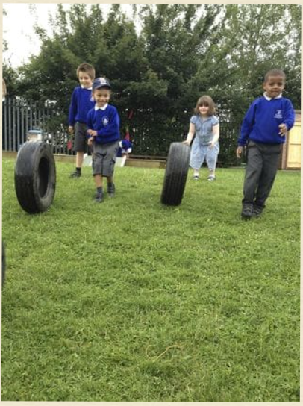
An example….
Tyres
The children love to create obstacle courses, trains, pirate ships and many other games with the tyres.
During this play, they are lifting, pushing, twisting and rolling the tyres.
This is strengthening their shoulder, elbow and wrist muscles.
Strengthening these muscles is essential for writing.

Slide 11
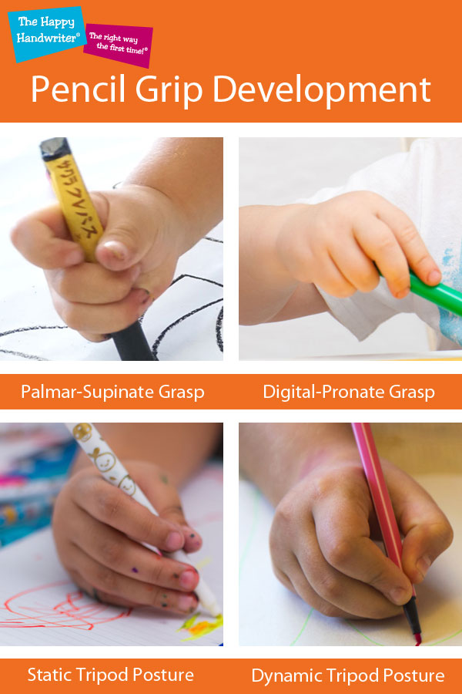
Gross motor physical development progression
Shoulder pivot
Elbow pivot
Wrist pivot
Fine motor triangulators

Slide 12
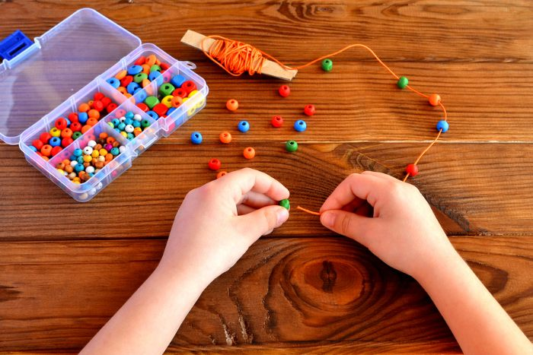
Fine motor skills
ELG Children at the expected level of development will: - Hold a pencil effectively in preparation for fluent writing – using the tripod grip in almost all cases; - Use a range of small tools, including scissors, paint brushes and cutlery; - Begin to show accuracy and care when drawing
Morning activities
During soft start, fine motor activities are put out for children to develop their fine motor skills including; threading, hama beads, tweezers, multi-link, various construction materials, cutting, colouring, drawing, multisensory mark making (sand trays) etc..
Using tools (school or home)
Scissors, paint brushes, cutlery, garden tools, hammers, screwdrivers, saws, cooking utensils.
Handwriting

Slide 13
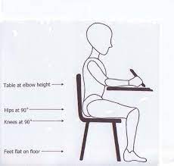
Best seating position
Bottom right back on the chair with no gaps; feet flat on the floor; chair tucked into the table; ... table and chair are a comfortable size for the child.

Slide 14
How will writing be taught?
It is progressive across the year
Autumn
Through RWI phonics sessions, the children will be taught to form the letters using RWI rhymes. For example, a is round the apple and down the leaf, m is maisy mountain mountain
The children practice writing the sound in a book and sat at a table.
They are taught to use their phonetic knowledge to begin to segment sounds for writing words and when they are ready to write phrases and sentences.
Spring
Additional adult led small groups are introduced during provision time and each child will work with the teacher once a week.
Specific handwriting sessions are introduced using Nelson handwriting programme, which links to Read write inc
Summer
Adult led groups and handwriting lessons continue
Writing challenges will be given in provision.

Slide 15
How will writing be taught during provision?
Children will be encouraged to write for a purpose during their learning through play. Initially they will need adult support but as the year progresses their independence will grow.
Autumn
Label models and pictures with their name.
Mark make with chalk, paint, pencils, crayons etc..
With adult support make signs for their construction or in role play e.g open or closed sign for a shop
Spring
Label models and pictures with their name and begin to add labels.
With increasing independence, make signs for their construction or in role play.
Have a go at the writing activity set up in the writing area.
Summer
Make their own story and non-fiction books
Write their own cards to send to people.
Write lists in the role play.
Write a plan for their construction, what they will need and how to make it.

Slide 16
What role does reading play in developing writers?
It provides rich language and vocabulary
It exposes children to different genres
It shows that we can write for different purposes

Slide 17
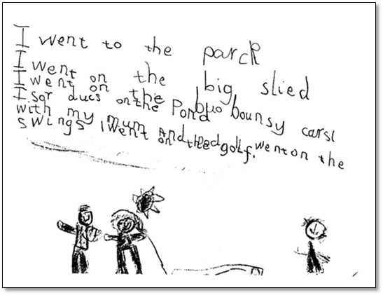
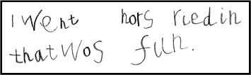
Writing ELG
Children at the expected level of development will: Write recognisable letters, most of which are correctly formed. Spell words by identifying sounds in them and representing the sounds with a letter or letters. Write simple phrases and sentences that can be read by others.
Independent writing towards the end of the first year: Children have made phonically plausible attempts.

Slide 18
What are phonically plausible attempts?
The teechir was eeting a cayk.
The bird floo away.

Slide 19
Parent support
Your support in your child’s learning is invaluable.
Help your child to write their name and form the letters in their name correctly. (Autumn term)
Ask your child about the sounds they have been learning. Encourage your child to have a go and use phonically plausible attempts when writing words.
Encourage your children to watch you write for reason, e.g. write a shopping list, write letters/cards etc... Don't always use your phone!

Slide 20
Breaking it down with your child
Listen to the word e.g. cat.
Segment the sounds in a word e.g. c-a-t (Fred fingers)
Remember the letter for each sound
Use the correct pencil grip to form the letters
Remember to write from left to right
Check you have written the word correctly

Slide 21
Thank you for listening.
Any questions?

