Slide 1
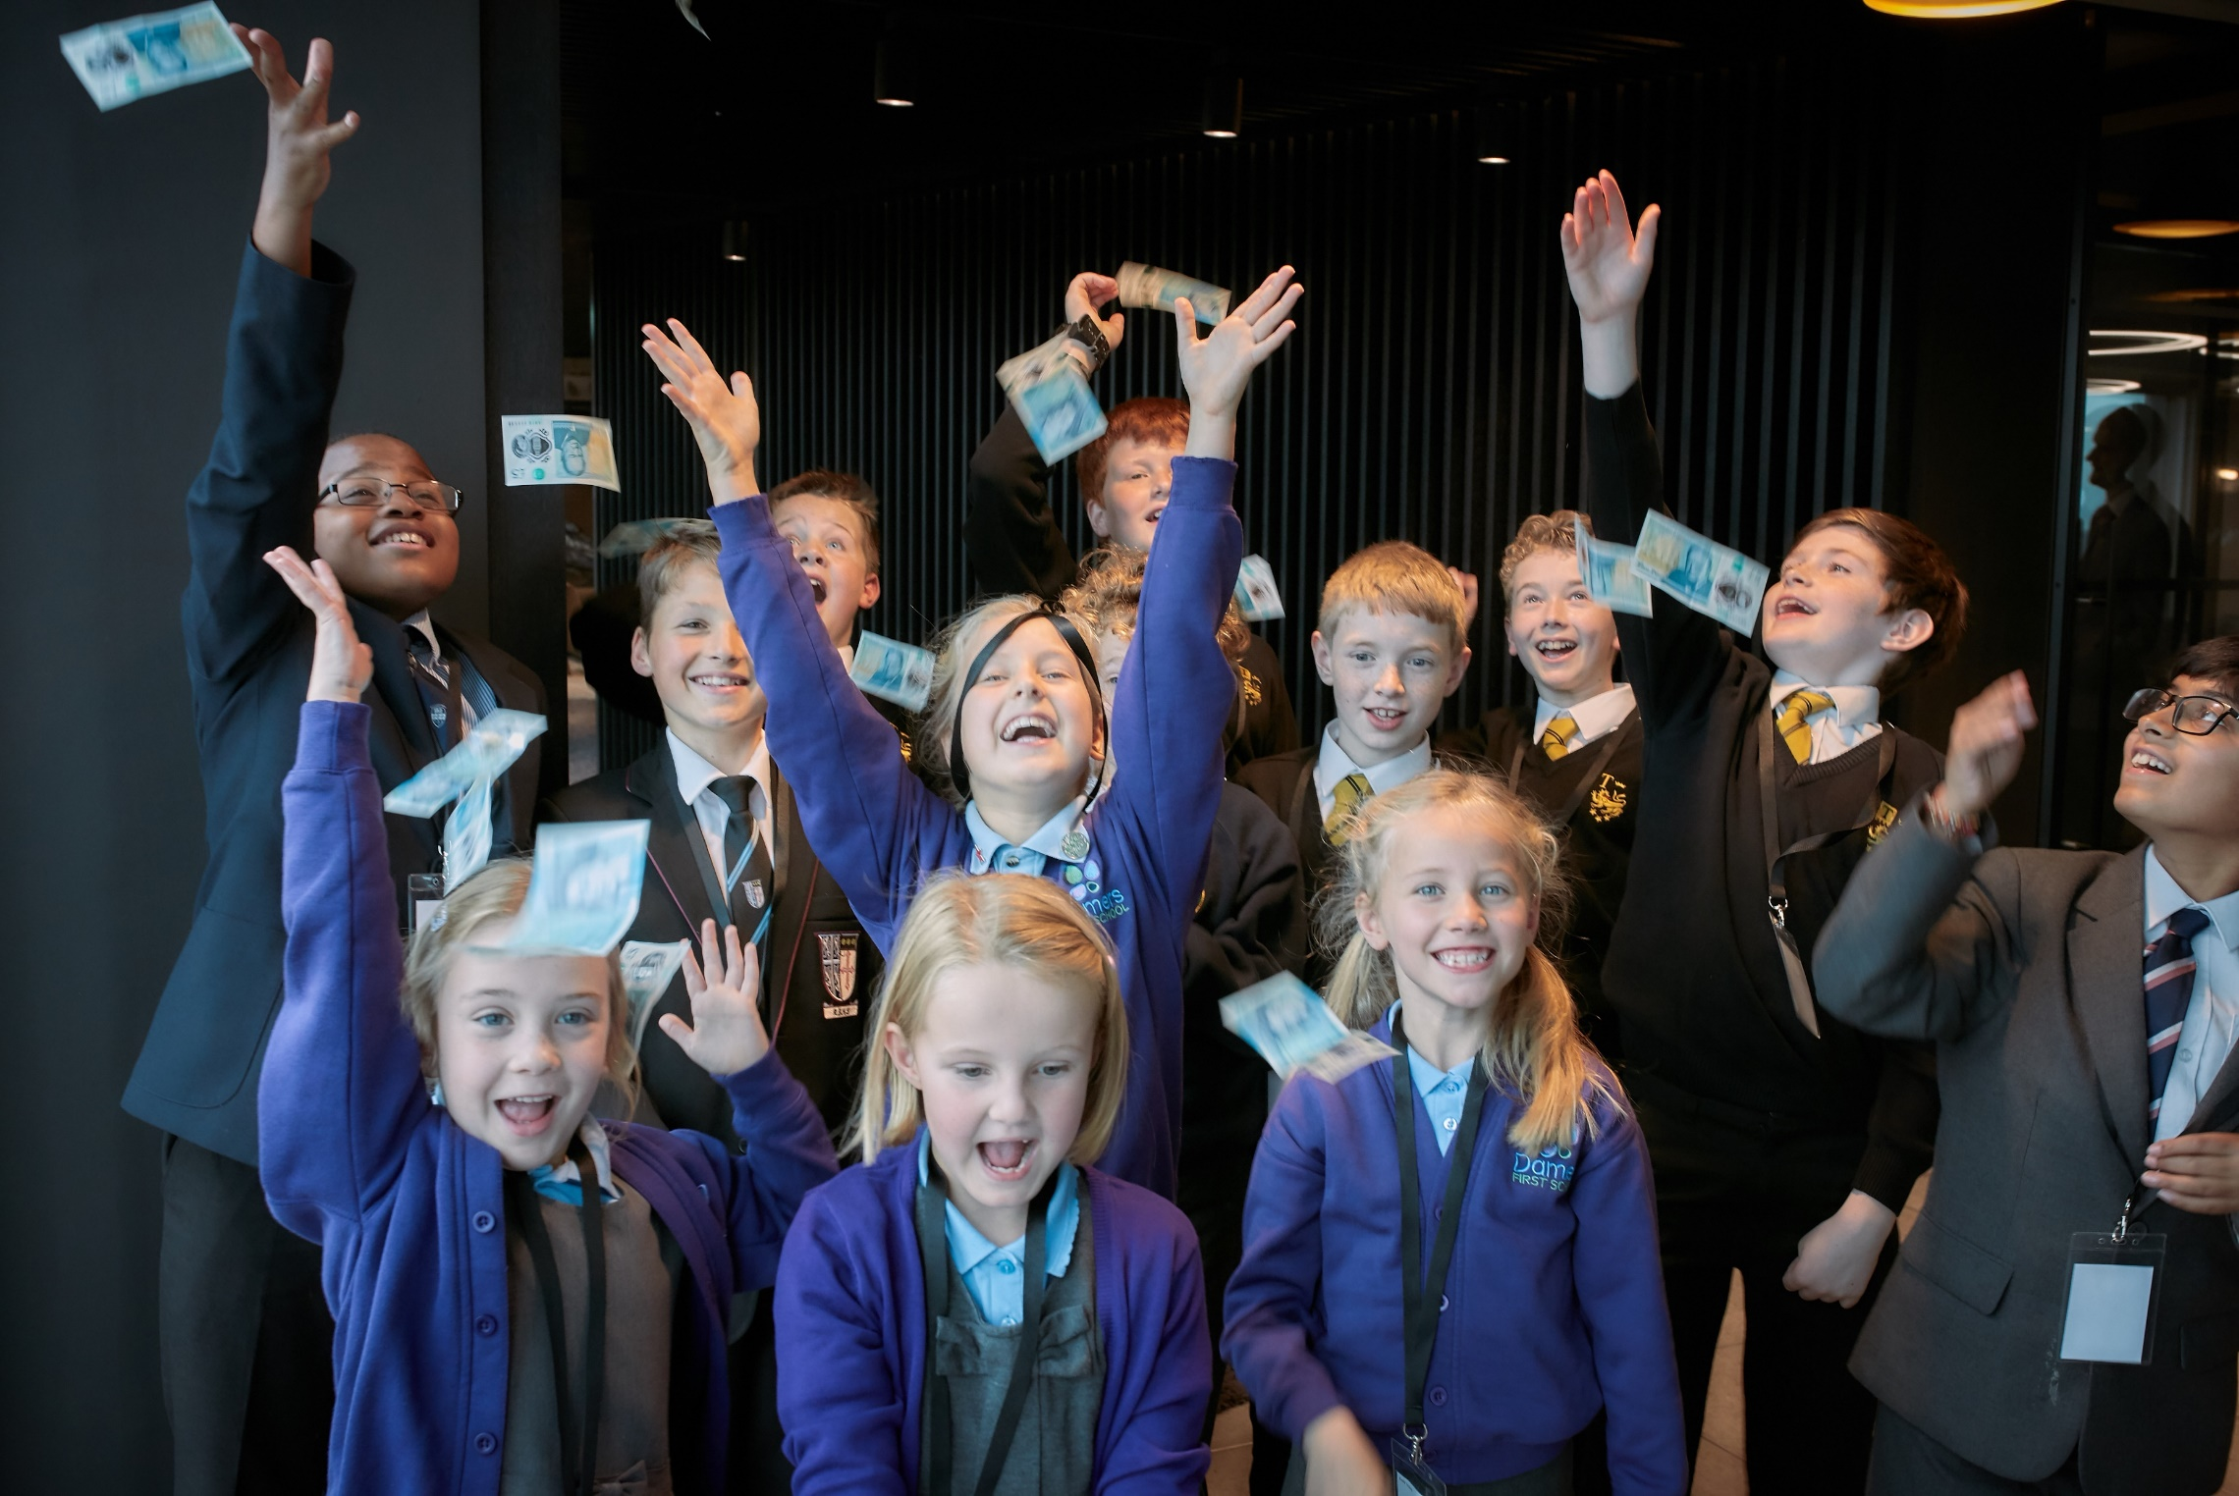


Your chance to be
an entrepreneur
Notes:
Teacher notes
Introduction
The PowerPoint presentation provides:
An introduction to the Fiver challenge and how it will work across the 4 weeks.
An activity to encourage pupils to think about what it means to be an entrepreneur.
The opportunity to listen to other young entrepreneurs and learn from their experience.
Guiding you through the 4 week challenge
We have also provided weekly slides corresponding with the 4 weeks of the Fiver challenge.
Each of the further 4 presentations can be found on the fiver website, within the weekly sections and contain:
A reminder of the tasks the pupils will need to think about and complete that week together with a list of resources that will help them.
An activity that is linked to the tasks for that week to help them to succeed.
Note: Depending on how much time you have in advance of the challenge you may want to do some of the introductory activities earlier.

Slide 2





Fiver Introduction
Who are Young Enterprise and what is their mission?
Young Enterprise is a charity that works with young people, like you, to help them to develop great personal, financial and business skills to use in life and work in the future.
Their mission is to empower young people to discover, develop and celebrate their skills and potential.
One way to help you to find out what you are good at is by doing the Fiver Challenge. So, shall we start the journey?
Notes:
Teacher notes
Young Enterprise mission.
On the slide the mission of Young Enterprise is presented in language more accessible to the pupils. The official YE mission and vision are below:
Young Enterprise (part of Junior Achievement Europe) is the UK’s leading charity that empowers young people to harness their personal, financial and business skills and has been running since 1963.
We run a range of enterprise and financial education programmes for young people aged 4 – 25.
Our Mission - To empower young people to discover, develop and celebrate their skills and potential.
Our Vision - Every young person has the opportunity to learn the vital skills and enterprising mindset needed to earn and look after their money and make a positive contribution to their community.

Slide 3
What is the Fiver Challenge?
Have you got an idea that you could turn into a business?
The Fiver Challenge will help put your idea into action and turn it into a business.
You will work in a team or independently
You will get £5 to start you off with your idea
There will be lots of support to help you to make it happen
If you make a profit from selling your products or service you get to decide what to do with it
This year’s challenge is taking place from the 5th – 30th June!
Notes:
Teacher Notes
This slide provides an overview of the Fiver Challenge.
This is intended to excite the pupils about exploring their ideas and putting them into practice.
Note: Use the word guide throughout the presentations to provide pupils with explanations all of term used across the programme such as 'profit'.

Slide 4
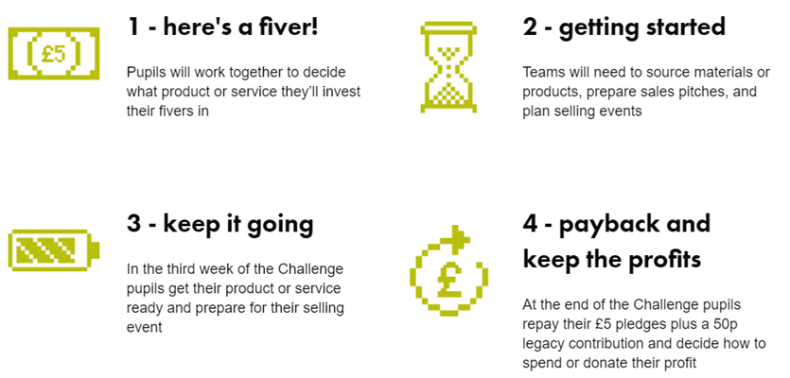
The Four Week Plan
You will be following the four week plan below, with lots of fun activities and competitions along the way, to help you start your business!
Week 1: Logo Competition
Week 2: Prepare for the Sales Pitch Competition
Week 3: Sales Pitch Competition
Week 4: National Competition
Notes:
Teacher Notes – The Fiver Challenge
This slide provide an overview of the 4 week plan which explains in detail what the pupils will be doing and when the competitions are taking place.
The logo competition closes on the Friday of the first week.
The sales pitch competition closes on the Friday of the third week.
The national competition closes a week after the challenge ends.
Competition dates and closing times can be found on the fiver website at www.fiverchallenge.org.uk - mark them in your calendars to ensure you don’t miss out!

Slide 5
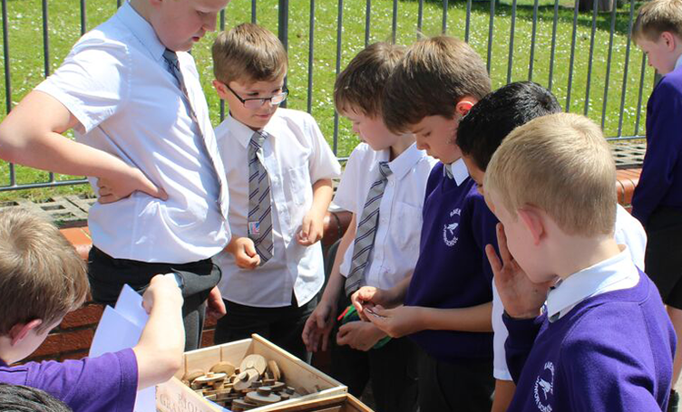
Introductory activity
What is an entrepreneur?
Notes:
Teacher Notes
The Fiver Challenge is aimed at encouraging pupils to develop their confidence, creativity, communication and problem-solving skills. These are some skills identified in entrepreneurs.
This activity is designed to help them to recognise people they are familiar with and perhaps less so – and to think about what makes these people entrepreneurs.
Ask the pupils do they understand the word?
Explain to them what it means.
Definition: someone who starts their own company or business, seeking to make a profit and/or a difference in the world.
Do they know any entrepreneurs? You can then show them the next slide.

Slide 6


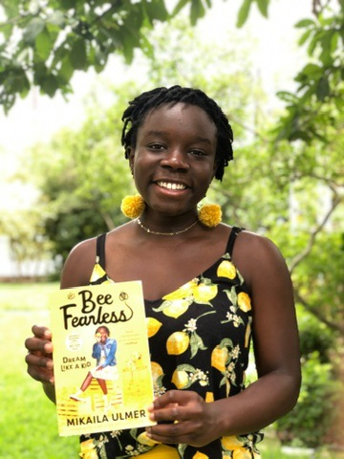

Who am I?
Omari McQueen
Harpreet Kaur
Makaila Ulmer
Steven Bartlett
Notes:
Teacher Notes
Ask your pupils if they recognise any of the entrepreneurs in this slide. Their names will appear on a mouse click for you to reveal.
Do they know who these people are?
Where have they seen them?
What makes them entrepreneurs?
Omari McQueen – an 11-year old entrepreneur from London, England, is considered to be the youngest award-winning vegan chef in the country. He is also one of the youngest restaurateurs in the world, as he has recently become the founder and CEO of his own plant-based restaurant called Dipalicious.
Harpreet Kaur – a dessert parlour owner and businesswoman from Birmingham, England, who won the Apprentice UK 2022 and Lord Sugar’s investment to expand her business.
Makaila Ulmer – a young entrepreneur, bee ambassador, social entrepreneur and author from America, who started her journey with a lemonade business in kindergarten for a children's business competition and as she continued beyond the competition, her lemonade is now sold in over 1500 stores. Makaila donates a portion of sales to bee conservation and has written a business memoir from a 15-year old entrepreneur.
Steven Bartlett - a British businessman, entrepreneur and television personality. He is the co-founder of Social Chain. He created a podcast series called The Diary of a CEO and began appearing as an investor on the BBC One show Dragons’ Den in 2022.
Highlight that anybody can become an entrepreneur, regardless of their age, gender and background!

Slide 7
What is an Entrepreneur?
An entrepreneur is a person who has an idea and they set up a business to make their idea real and sell it to people.
If it is a good idea, they can sell it for enough money to pay their costs and make a profit. They can use that profit for all sorts of things.
What do you think makes a good business-person or entrepreneur?
Notes:
Teacher Notes
Ask the pupils what kind of things/characteristics would make someone a good entrepreneur?
Use the next slide to summarise their ideas of what an entrepreneur is. Some ideas include: great communicator, problem-solver, risk-taker, open to learn, ambitious, creative, motivated
Note: Don’t forget to use the word guide throughout the presentations to provide pupils with explanations all of term used such as ‘cost’ and 'profit’.

Slide 8
What is an Entrepreneur?
Ambitious
Passionate
Creative
Risk taker
Open to learn
Resilient
Motivated
Enthusiastic
Team worker
Passionate
Notes:
Teacher Notes
You can summarise all the pupils ideas of enterprising attributes

Slide 9

Young Entrepreneur –
Treandos Thornton
Notes:
Teacher notes
Treandos started his own bow tie company after he was inspired by seeing his dad wearing them. The business wasn’t just about fashion though, it was about making people feel good and confident.
You can now show the pupils the short video so that they can learn a bit more about Treandos and his business.
Now that we know what an entrepreneur is and some of their characteristics let’s look at a real-life example of a successful entrepreneur who is making a difference in his hometown at the age of 8 years old.
He also made a social difference – helped the community!

Slide 10
A Fiver for Good…
You have just listened to Treandos.
You will need to think about:
How can the product you make or the service you offer be of benefit to your community or the wider community?
Who you involve? Will it provide work for them?
Will you plan to give back to the community from your profit?
Notes:
Teacher notes
Fiver for Good is one of the awards from the National Competition that recognises positive contributions and/or impact to the wider community. Here are some examples you can feed in to help pupils to think about community involvement for their ideas.
It might be because the service they are offering is of direct benefit to local people
e.g. Doing shopping for older people, or the local environment i.e. recycling local waste and re-using the materials for your product.
You can tell the pupils that they will need to think about all these things once they start to plan in week 1. You can direct them towards the Communities Top Tips sheet.
N.B. Pupil’s will have the opportunity to enter the National Competition once the Fiver Challenge ends.

Slide 11
Sustainability…
Your Fiver business is sustainable if it is:
Protects the planet e.g. reduces air miles by using local resources
Or cares for communities e.g. pays a fair price to suppliers
Profitable and aims to satisfy a need
“A business which operates today in a way that values and protects the people, planet and resources it relies on for the future’’
Notes:
Teacher notes
All businesses big and small have to think about the way they make a product or sell a service and if it is sustainable. It is not just about profit – how much money they can make.
Whilst profit is an important aspect of running a business as it will allow you to grow if you invest the money properly there are other key aspects.
In the mid-1990s, John Elkington produced a new way of measuring business results--the 'triple bottom line'. Going beyond £££, this includes environmental and social impacts. It is sometimes known as "People, Planet, Profit".
Your Fiver business is sustainable if it is:
Protects the planet e.g. reduces air miles by using local resources
Or cares for communities e.g. pays a fair price to suppliers
Profitable and aims to satisfy a need
An example of one way a Fiver business can achieve this is to spend time researching suppliers who operate as sustainably as possible. One way to do this would be to make sure you use eco-friendly packaging to reduce plastic consumption.
You can tell the pupils that they will need to think about all these things once they start to plan in week 1. You can direct them towards the Sustainability Top Tips sheet
Are there any ways for your pupils to focus on sustainability with their Fiver business idea/service? If so, they could be in with a chance of winning the ‘Best in sustainability’ prize in the National Competition.

Slide 12
United Nations
Sustainable Development Goals
Notes:
Teacher Notes
Extension for older and/or more able pupils
The Sustainable Development Goals (SDGs) also known as The Global Goals are a shared agenda to end poverty, fight inequality & injustice and protect the planet. Agreed in 2015 by all countries within UN and set to be completed by 2030.

Slide 13
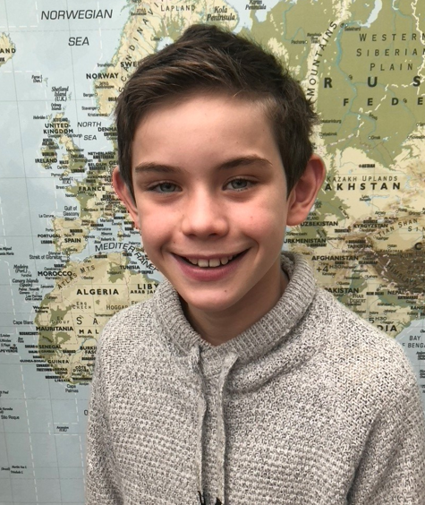
Young Enterprise Entrepreneurs
As part of his Fiver Challenge, Sam (left) decided to create personalised recyclable masks for the VE day celebration to ensure that his community could celebrate together safely, aged just 10 years old.
Sam’s idea was a good example of social good and sustainability.
Notes:
Teacher notes
Give them one example from a previous YE Fiver Challenge that involved social good and sustainability as well as making a profit.

Slide 14
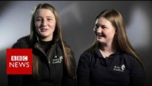
Top tips from young entrepreneurs
Notes:
Teacher notes
Before we finish the session let’s hear some more advice and top tips from some young entrepreneurs that you will be able to use in your Fiver Challenge once you get started.

Slide 15
Now it’s your chance to create and share your idea and become the next entrepreneur!
WE HOPE YOU’RE EXCITED TO GET STARTED
Notes:
Teacher notes
We look forward to having you on board with the Fiver Challenge!
If you haven’t already registered to access the free resources to deliver the programme, visit www.fiverchallenge.org.uk.
Key dates to run the challenge can be found on the website – save them in your calendar so you don’t miss out.

