Slide 1
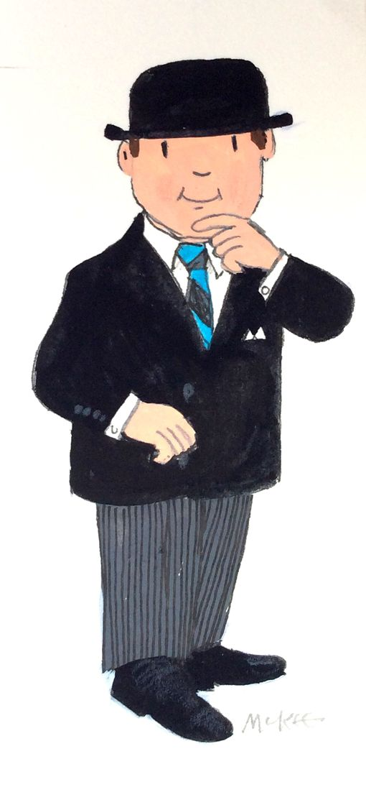
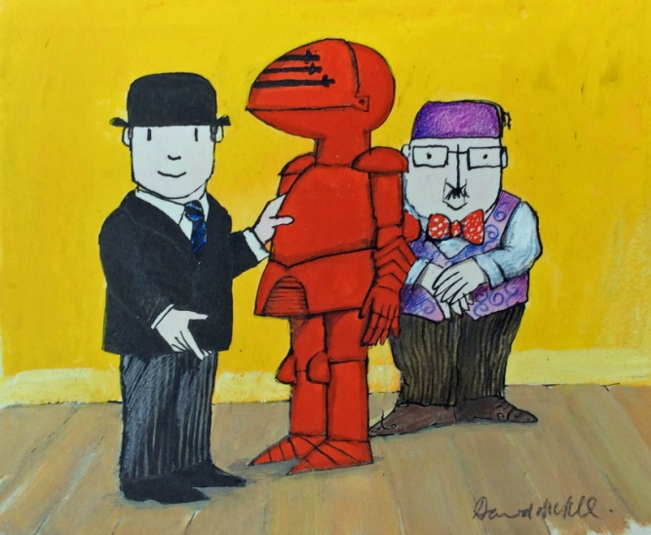
Lesson 6a :
Mr Benn:Red Knight
LC. Can you sequence the main events of
Mr Benn: The Red Knight in the correct order?

Slide 2
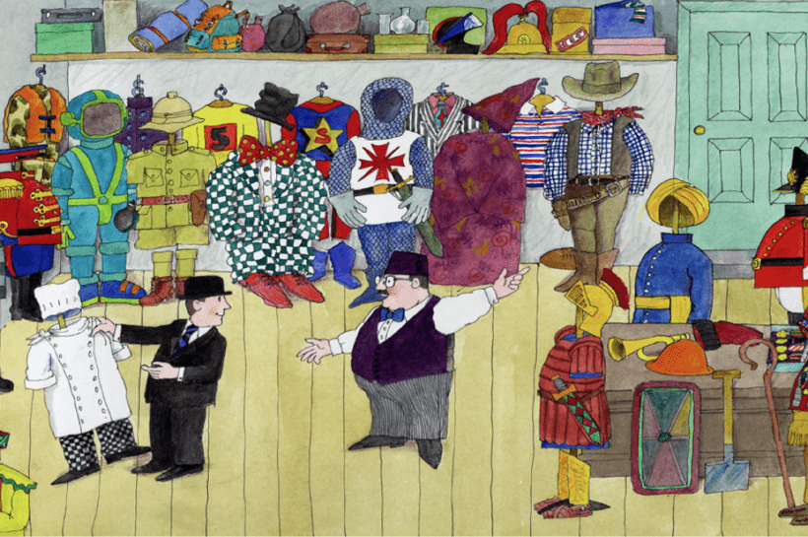
Mr Benn: Red Knight
As you already know, Mr Benn regularly visits the Fancy Dress Shop where he selects a costume.
The first costume he selected was a Red Knight.

Slide 3
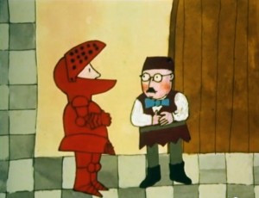
Can you recall the main events of the
Mr Benn:Red Knight story?
Let’s have a quick recap...
https://www.youtube.com/watch?v=KJuj_ZT8pjU

Slide 4
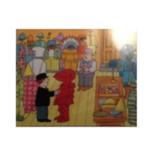
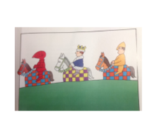
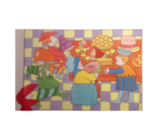
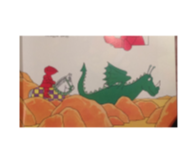
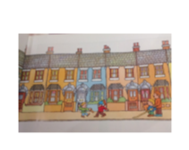
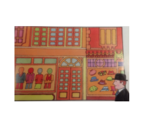
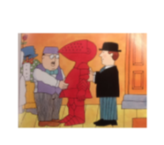
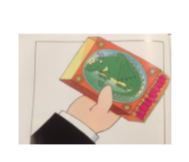
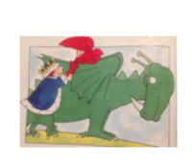
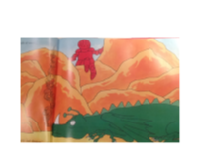
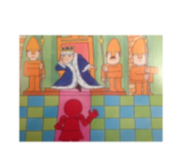
Below are all the key events but they have become muddled. Can you sequence them in the correct order?

Slide 5
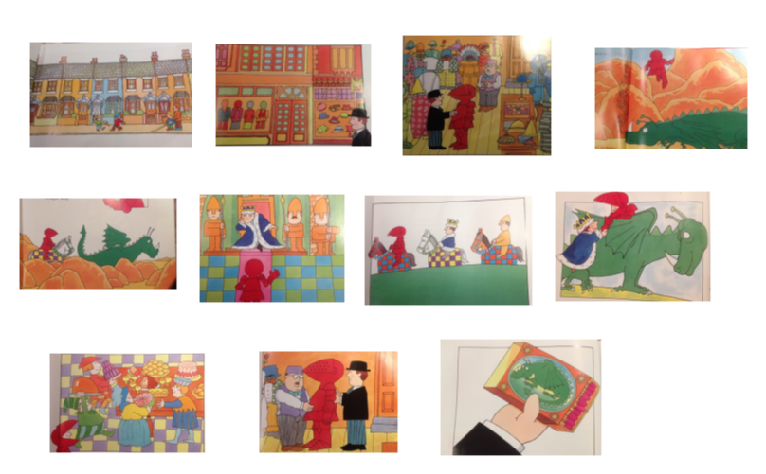
Did you sequence your pictures in the correct order? Let’s check...

Slide 6
Can you write the key words for each picture/event?
Try to think of just 3 main words for each picture.

Slide 7
Lesson 6b :
Mr Benn:Red Knight
LC. Can you write a short paragraph to summarise the story of Mr Benn: Red Knight?

Slide 8
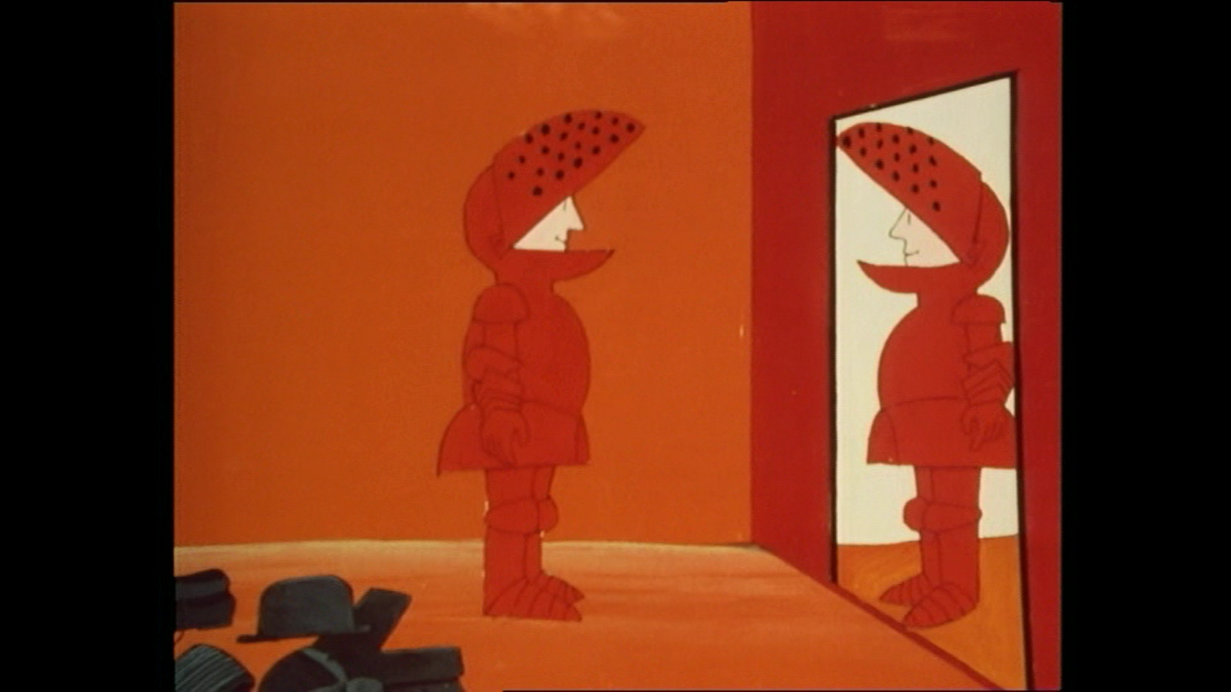
In the last lesson, we sequenced the main events of Mr Ben: red Knight.
Let’s share some of the key words you chose to write under each picture.

Slide 10
Today’s task:
Unlike when we normal re-write a story at length and include lots of descriptive vocabulary, conjunctions and a paragraph for each main events...
...today we are going to write one summary paragraph to include all the key events of the story.
This means, you do need to include all the main things that happened and in the correct order BUT just not in great detail.
It’s a little bit like a blurb however you do also give away the main part of the story and the ending!

Slide 11
Today’s task:
Unlike when we normal re-write a story, today’s success criteria will not be as big or complicated. However, the core skills and basics are especially important today.
- clear statement sentences.
- Capital letters and full stops to demarcate each sentence.
- Capital letters for Mr Benn and other names of people and places.
- Neat presentation – handwriting, finger spaces, pencil grip.
- Spellings – use the word bank to help, sound-out carefully, read back to check
- Take the time to re-read, check and edit your own work.

