Slide 1

Bramhope Primary School
Writing Workshop

Slide 2
In this session we will be covering:
Developing gross and fine motor skills ready for writing
Pencil grip and seating position
The importance of reading for writing
Parent support
Further resources

Slide 3
Gross motor skills (Physical development)
The ability to write is very complex. Not only do children need to have the confidence to pick up a pencil and make marks on paper, they also need to be developmentally ready to write with strong core and hand muscles.
To get the children ready for writing, we need to develop their gross motor skills first.

Slide 4

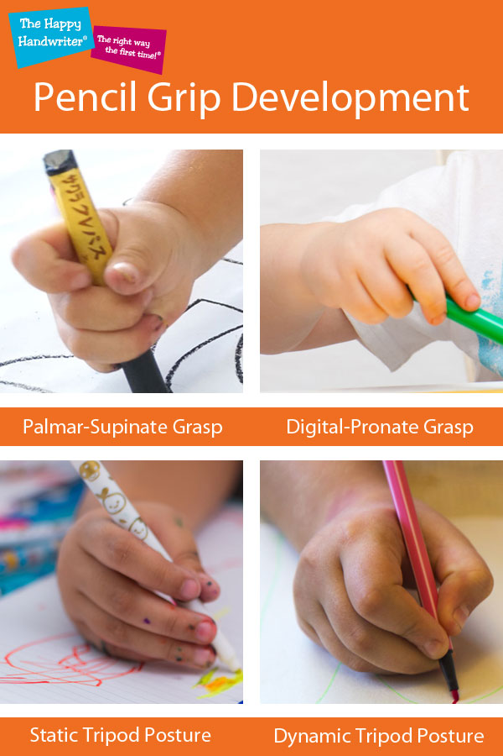
Gross motor physical development progression
Shoulder pivot
Elbow pivot
Wrist pivot
Fine motor triangulators

Slide 5
How do we develop gross motor skills?
Scrubbing
Climbing
Bike riding
Rolling tyres
Our outdoor area!
Running
Painting
Lifting
Digging
Mixing

Slide 6
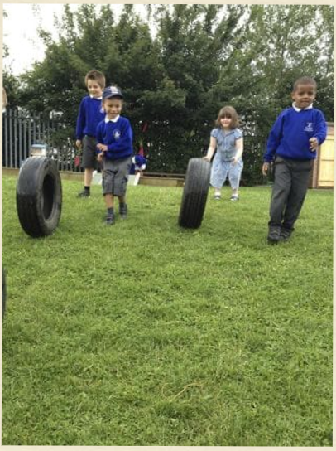
An example….
Tyres
The children love to create obstacle courses, trains, pirate ships and many other games with the tyres.
During this play, they are lifting, pushing, twisting and rolling the tyres.
This is strengthening their shoulder, elbow and wrist muscles.
Strengthening these muscles is essential for writing.

Slide 7

Dough disco
Dough disco is a fun dance workout for your hands.
It involves squeezing, rolling, pinching and splatting the dough as well as concentrating on each finger to prod shapes in the dough.
This is developing their gross and fine motor skills ready for writing.
We do this during our phonics sessions to strengthen and warm up their fingers ready for writing.

Slide 8
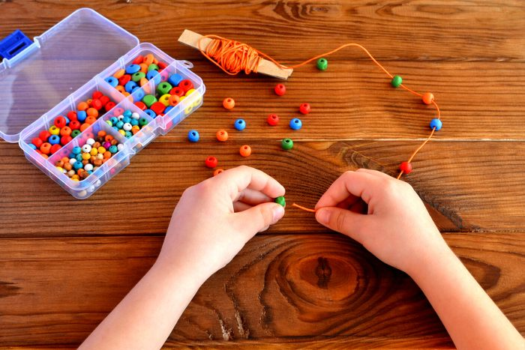
Fine motor skills
ELG Children at the expected level of development will: - Hold a pencil effectively in preparation for fluent writing – using the tripod grip in almost all cases; - Use a range of small tools, including scissors, paint brushes and cutlery; - Begin to show accuracy and care when drawing
Morning activities
During soft start, fine motor activities are put out for children to develop their fine motor skills; threading, hama beads, tweezers, multi-link, pattern making, colouring, multisensory mark making (sand trays) etc..
Using tools (school or home)
Scissors, paint brushes, cutlery, garden tools, hammers, screwdrivers, saws, cooking utensils.
Handwriting

Slide 9
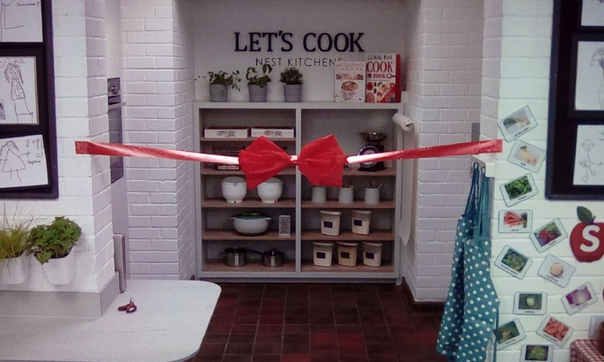
Cooking
The cooking sessions will develop a variety of skills including: chopping, slicing, spreading, mixing, grating and rolling.
As well as enabling discussion about healthy eating, the cooking sessions will further develop shoulder, elbow, wrist and finger strength that will develop their writing.

Slide 10
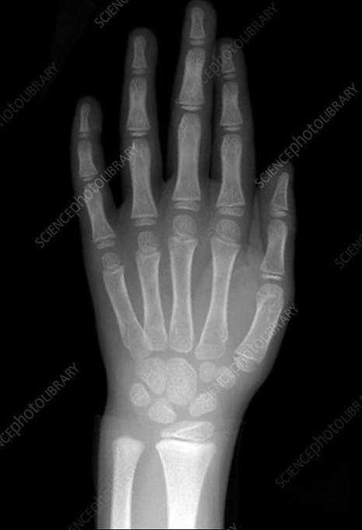
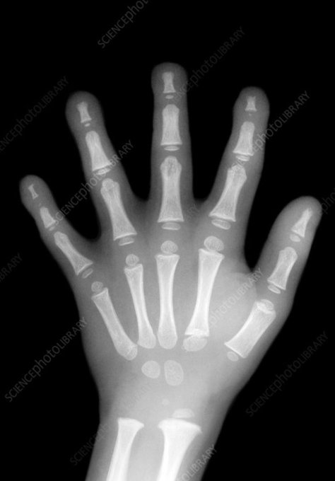
An x ray of a developed hand (around the age of 7) compared to an EYFS age child’s hand.
“It’s worth noting that it’s not just the size of the child’s hand which changes. The younger child has cartilage which will eventually become bone through the process of endocrinal ossification. This occurs around the ages of 6-8yrs.” This can explain why some children find writing difficult.

Slide 11
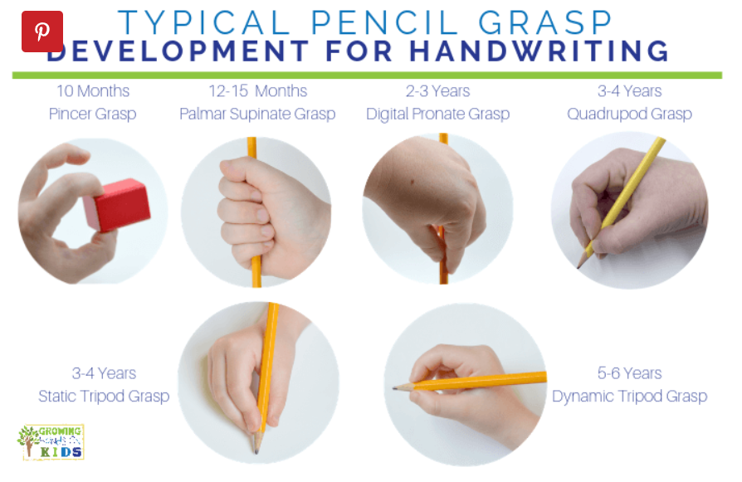
Pencil Grip

Slide 12
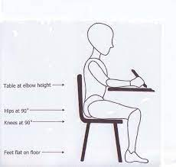
Best seating position
Bottom right back on the chair with no gaps; feet flat on the floor; chair tucked into the table; ... table and chair are a comfortable size for the child.

Slide 13
How will writing be taught?
Through phonics sessions, which are daily, and last for around 20 minutes.
The children will be taught to use their phonetic knowledge to segment words for writing.
Literacy lessons.
Handwriting sessions.

Slide 14
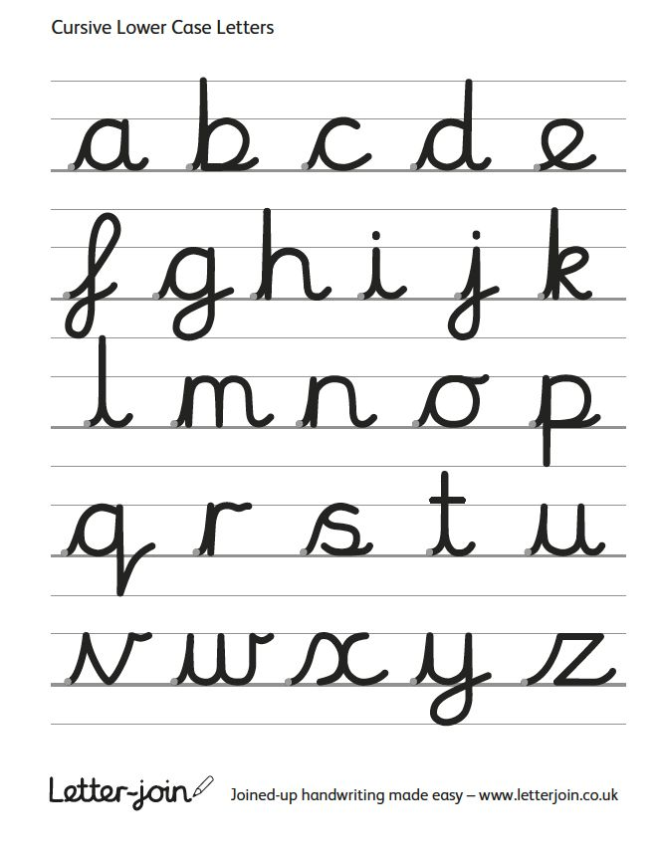
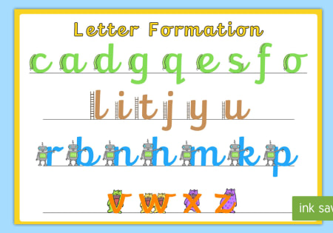
How do we teach the children to form letters?
We are no longer teaching pre-cursive letters in reception but we are still encouraging the lead out at the end of letters to help with cursive writing later on.

Slide 15
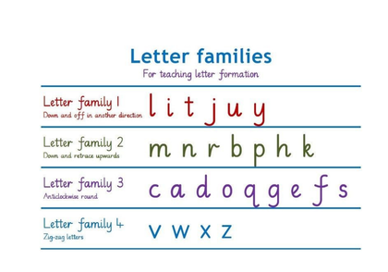
Letter families

Slide 16
Vocabulary used in phonics will be used to support writing.
Phoneme - a single unit of sound, a or ai
Digraph (2 letters that make 1 sound) ai, sh, ch chips
Trigraph ( 3 letters that make 1 sound) igh ear air chair
Segmenting for writing cat = c-a-t shop = sh-o-p

Slide 17
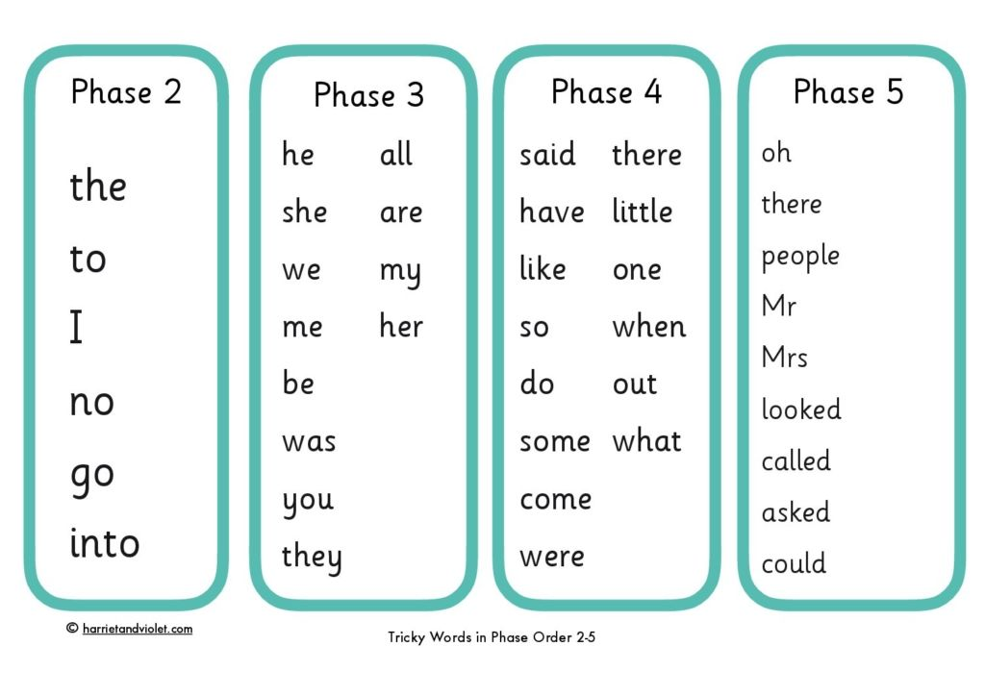
Tricky words
These words can't be sounded out using phonics skills.
The children also practice spelling ‘tricky words’, such as;
I, to, the, he, she, have, said and was .
In reception we will be aiming for children to be secure to phase 3 and some children will be working within phase 4.

Slide 18
What role does reading play in developing writers?
A well-chosen text provides rich language models and structures from which children can learn how writing works and the effect it can have on a reader.
If you want confident young writers, read aloud and share high quality texts across a range of genres, reflecting a range of writing styles.
Choose texts that are rich in vocabulary and enable children to comprehend beyond their own reading fluency level.
Create a rich reading environment that demonstrates the written word in all its forms and shares how writing can be used for thinking, for communication and as a means of expression. With a rich diet of quality texts and enriching experiences children will be able to find their own reasons to write and develop a style that fits the purpose, audience and form intended.

Slide 19
Supported Writing
•Letter sounds
•Simple CVC words
•Regular words with consonant blends (clusters) and digraphs
•Labels and Lists
•Phrases and sentences
•Capital letters, full stops
•Dictation practice prepares the children for independent writing:
Once the children are able to hear the sounds in words and know how to write them, they are ready for some simple dictation.
•First of all, letter sounds are dictated, followed by simple CVC words (consonant-vowel-consonant words eg ‘cat’, ‘hop’, ‘tin’.)
•When the children can do this, they are ready for longer, more complicated words (such as compound words or words with digraphs and consonant blends).
•Then they can move on to short phrases and eventually sentences, where they need to know that a sentence starts with a capital letter and ends with a full stop, and that the letters in the words should not bump up too close together but that there should be a gap between each word.
•By this stage it is a good idea to give some regular dictation on capital letters. The children find it quite easy to recognise them, but also need to know how to write them.
•It works well to give dictation as it prepares the children for the harder task of independent writing.
•It is also an opportunity to check that children are forming their letters correctly.

Slide 20
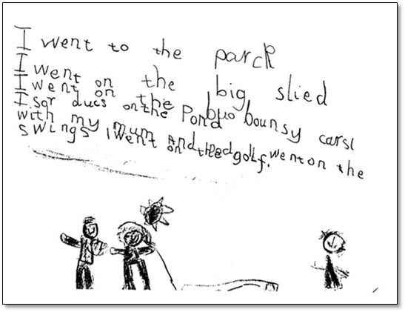
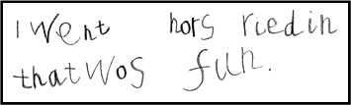
Writing ELG
Children at the expected level of development will: Write recognisable letters, most of which are correctly formed. Spell words by identifying sounds in them and representing the sounds with a letter or letters. Write simple phrases and sentences that can be read by others.
Independent writing towards the end of the first year: Children have made phonically plausible attempts.

Slide 21
What are phonically plausible attempts?
The teechur was eeting a caik.
The burd floo awai.
The bair was kighnd to the sneekee snaik.

Slide 22

The teaching of writing is effective when children see the use in it; when there is real, authentic purpose.
One of the ways we will be doing this at Bramhope is through helicopter stories. As the children develop their phonics and writing skills, we will encourage them to write their own helicopter story to act out in the class.
What is Helicopter Stories? ... In its simplest form, Helicopter Stories lets children dictate their stories which are written down, exactly as they are told, by a teacher. The children then gather around a taped out stage and the stories are acted out.

Slide 23
Parent support
Your support in your child’s learning is invaluable.
Ask your child about the sounds they have been learning. We will put these on the Reception learning page for you. Encourage your child to have a go and use phonically plausible attempts.
Encourage your children to watch you write for reason, e.g. write a shopping list, write letters/cards etc... Don't always use your phone!

Slide 24
Breaking it down with your child
Listening to the word e.g. cat.
Segmenting the word e.g. c-a-t
Remembering the grapheme for each phoneme
Correct pencil grip to form the letters
Remembering to write left to right
Checking your writing

Slide 25
My child doesn’t like writing. What can I do?
Try these strategies to help:
Ask your child to write for real purposes. For example, write a card to someone, write invitations, write postcards to special people etc...
Ask your child to be the teacher and ‘teach’ you to write.
Make the activity special – use special pens or make books.

Slide 26
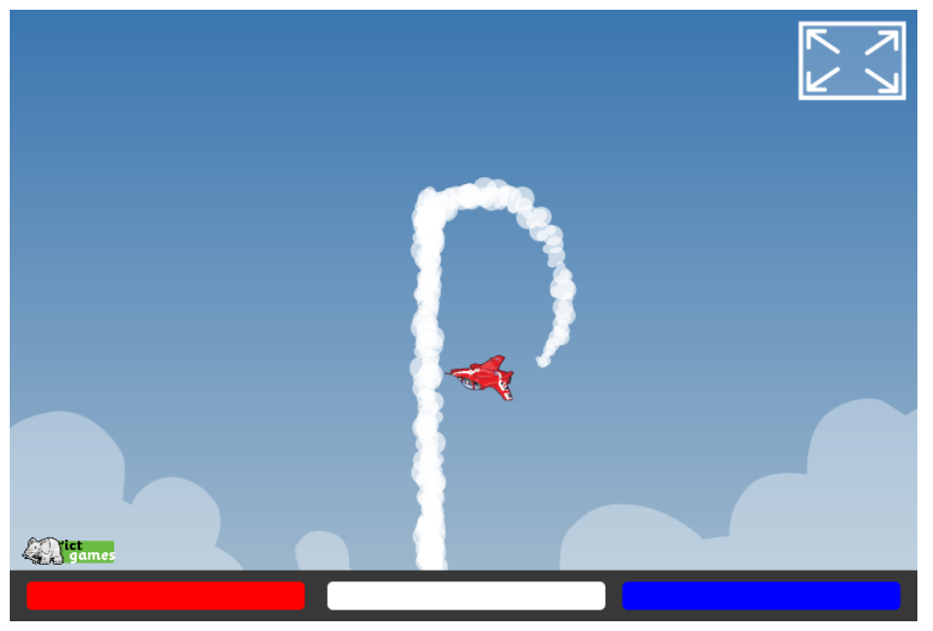
Where to go for more support?
Letters and Sounds website
https://letters-and-sounds.com/index.php/phase-2-introduction/
Skywriter
https://www.ictgames.com/mobilePage/skyWriter/index.html

Slide 27
Thank you for listening.
Any questions?

