Slide 1
Parenting in a Digital World
February 9th 2022
Notes:
Thank you for coming tonight.
Computing Lead at BPS.
That means I look after the computing curriculum which covers 3 strands: programming, use of software and digital literacy or online safety.

Slide 2

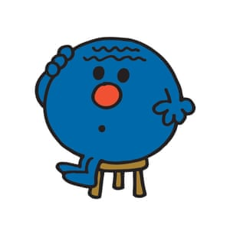

Agenda
Notes:
Share – digital landscape for our children.
Recognise some of the opportunities and the challenges we face collectively.

Slide 3
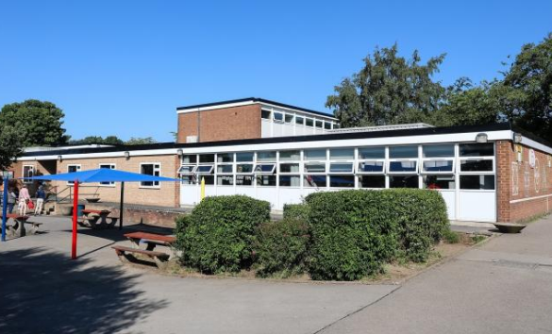
Agenda
Notes:
We will be looking specifically at our school context. – referring to some of their specific concerns both children and parents have raised to us.
Our digital leaders do research and regularly share online safety tips within classes and sometimes across the school.
They have been working hard to gather some of the concerns children have mentioned.

Slide 4

Agenda
Notes:
We will hope to share with you the key principles and advice for navigating the online world as a parent.
And sharing the ways in which we work to build good online safety awareness in school.

Slide 5

Notes:
All of our children are digital native (born after the widespread adoption of digital technology. Our children who have grown up using technology like the Internet, computers and mobile devices context as an intergral part of their lives. Many of us in this room in contrast are digital migrants, born before the widespread use of technology.
I thought it might be interesting to start with a short advert run by a mobile company. It brings to life the this notion that our children are met with technology from the very moment that they are born.

Slide 6

Notes:
And technology is everywhere.
Great opportunities. And challenges.
Key principle – We will not avoid children’s exposure but we can manage when we grant access and give them the skills to work in ever changing digital world.

Slide 7

Notes:
I wonder how many of these icons you recognise and use.
We know from our class surveys that children are using a wide range of these.
We also know that each year the ages accessing these apps becomes younger.
Importantly, we know that while some of these may look like games/apps have specific age limits and look like they may only be suitable for old children, we do know some of our pupils are accessing them.

Slide 8
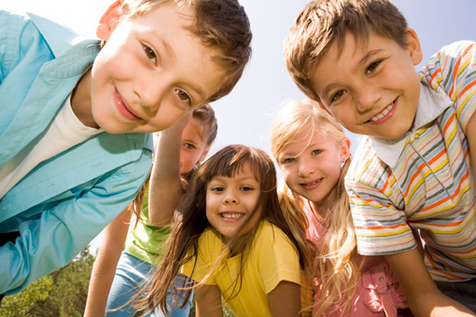
Giving children the skills to be happy and thrive in our connected world.
Notes:
But it need not be a source of worry.
Parenting in a digital world.
obviously offers many opportunities as well as challenges.
not different to parenting in other aspects of their lives – discussion, and mutually agreed boundaries.
Our job as teachers and as parents is to help them to develop positive online behaviours. We are looking for them to thrive and be happy.

Slide 9

Discussion
Notes:
Discussion in groups – What do your children use, What worries you, What would you like to learn more about?

Slide 10


Is this the full picture?
Notes:
Historically, people have seen e-safety risks centred stranger danger.
These are of course still important concern.
We will talk about this later.
First want to talk about something we know affects many children in our school

Slide 11
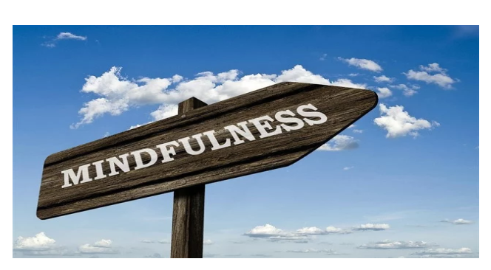

Notes:
It can be hard in a digital world to ensure quality time together. Digital devices are all around us and can become a barrier to other family opportunities.
Recent studies have shown that children are spending an average of 23 hours a week on smartphones and other gadgets - twice as much time as they spend conversing with their parents, polling suggests.
We know many of the games can be difficult to come off and so usage can become a real problem.

Slide 12
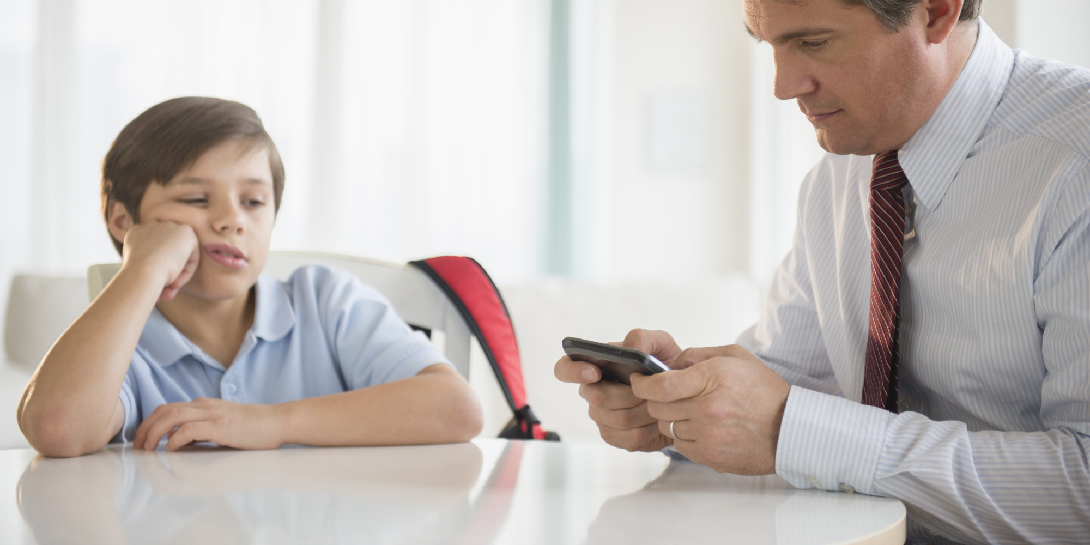
Techno-ference.
Notes:
In a 24 hour working world, it can also be hard for all of us to lead by example.
A recent study looking at families in the UK showed that 40 per cent of the mothers and 32% fathers feeling they used it too much.
“technoference” happening at least three times a day during interactions with their children.

Slide 13

68% of KS1 children and
95% Year 5/6 children
have their own devices
Notes:
“ Sometimes different videos come up on you tube that frighten me”
“I don’t like it if I get an unkind message”
“ I have some social media but didn’t know that there are settings that mean I’m giving away my location”

Slide 14
75% Year 5/6 children
use their devices for at least an hour a day.
39% of KS1 children use their devices for at least an hour a day.
Notes:
“ Sometimes different videos come up on you tube that frighten me”
“I don’t like it if I get an unkind message”
“ I have some social media but didn’t know that there are settings that mean I’m giving away my location”

Slide 15
70% of Bramhope Primary School families have some rules about the use of digital devices at home.
Notes:
“ Sometimes different videos come up on you tube that frighten me”
“I don’t like it if I get an unkind message”
“ I have some social media but didn’t know that there are settings that mean I’m giving away my location”

Slide 16

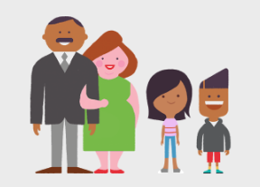
Create a family agreement
Notes:
Creating a family agreement is a great way to start talking about online safety.
It'll help your child understand what behaviour is appropriate when they're online. And they'll know who they can turn to if they are ever worried about anything they see or do.

Slide 17

Parental Controls
Notes:
Parental controls can be used to block upsetting or harmful content, control in-app purchases or manage how long your child spends online. And the good news is parental controls are really easy to set up.
Parental controls are software and tools which you can install on phones or tablets, games consoles or laptops – and even your home broadband.
You can also use them to help you block or filter the content your child sees when searching online. And family-friendly public WiFi can help when you’re out and about.
Parental controls are also available to help you to:
plan what time of day your child can go online and how long for
stop them from downloading apps they're too young for
manage the content different members of the family can see.
So whatever your child is doing online, there’s a way that you can help keep them safe.

Slide 18
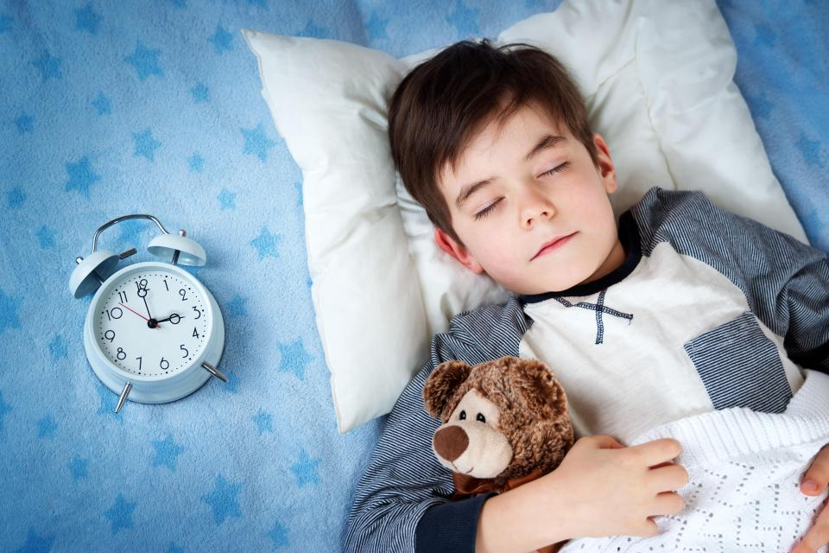
Sleep
Notes:
Where are your devices kept? Recommend downstairs.
Importance of sleep.

Slide 19
Discussion
Notes:
Discussion in groups – What do your children use, What worries you, What would you like to learn more about?

Slide 20
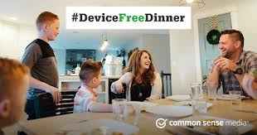
Device Free Mealtimes
Notes:
Device Free Dinner is a campaign launched by Common Sense Media.
Another good site offering advice.
It links to the idea of having times where none of the family are using their screens.
In this advert, Grandma and Grandpa go to extremes to ensure a good family weekend.

Slide 21


Weekend of 5/6 February.
Here are some of the ideas which we've been talking about.

Slide 22


Slide 23


Slide 24


Slide 25
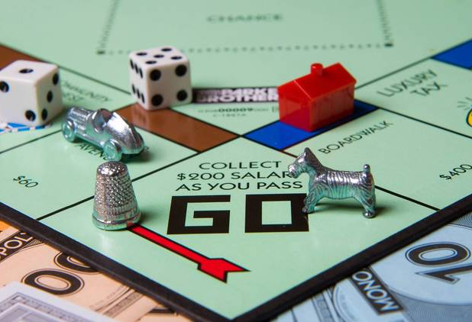
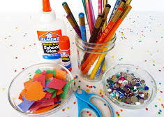
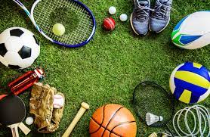
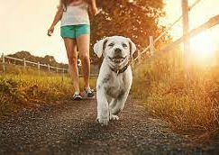

Slide 26
Discussion
Notes:
Before we move onto next part of presentation – time to discuss any rules you have.
Any ideas you have collectively.

Slide 27

Gaming.
Notes:
One of the key things children talk to our digital leaders about is gaming.
This obviously links well to the rules you introduce into your homes and you can use some of the technical solutions we mentioned to help you with these.
Gaming like all online activities does also offer opportunities. Friends can play together which can be good for social skills.

Slide 28
42% KS1 children play Roadblox.
11% KS1 children playing Among Us
10% of Year 5/6 children play Call of Duty
Notes:
“ Sometimes different videos come up on you tube that frighten me”
“I don’t like it if I get an unkind message”
“ I have some social media but didn’t know that there are settings that mean I’m giving away my location”

Slide 29
Many children recognise feeling angry when they have to come off a game.
Notes:
“ Sometimes different videos come up on you tube that frighten me”
“I don’t like it if I get an unkind message”
“ I have some social media but didn’t know that there are settings that mean I’m giving away my location”

Slide 30



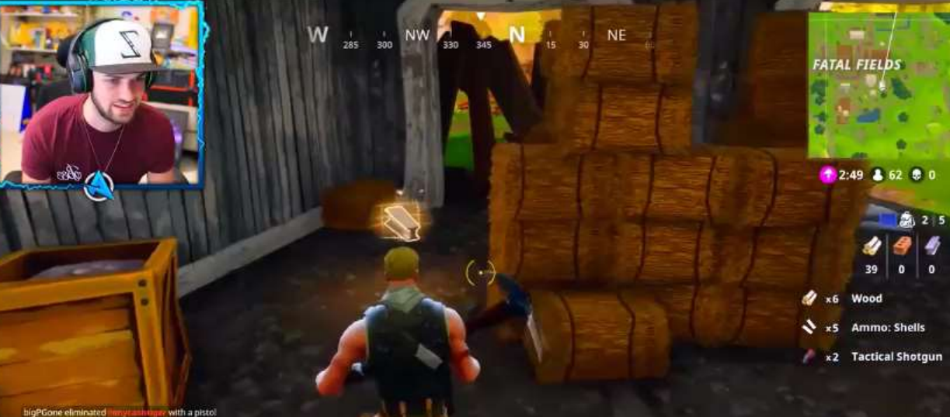
Damaging Content
Notes:
Consider suitability of game
Can be a huge amount of peer pressure.
Some content is unsuitable and certainly for all primary age children, with for eg a rape scene in grand theft auto.

Slide 31
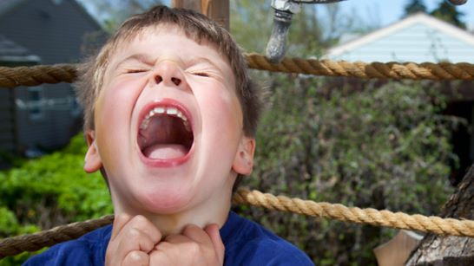
Anger and aggression.

Slide 32
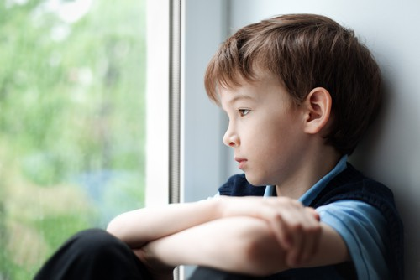
Other Gamers/Contact
Notes:
Know who they are playing with – backfilling teams on Fortnite.
Can you set setting to private.
Establish what to do if they are uncomfortable with anything

Slide 33

Gambling and advertising.
Notes:
Many children see a range of different features in games which are similar to online gambling world.
We have had children in school who have built large bills in in app purchases.
Discussions with classes have shown that children have a limited understanding of the fact that their information is being mined to sell them a service.

Slide 34
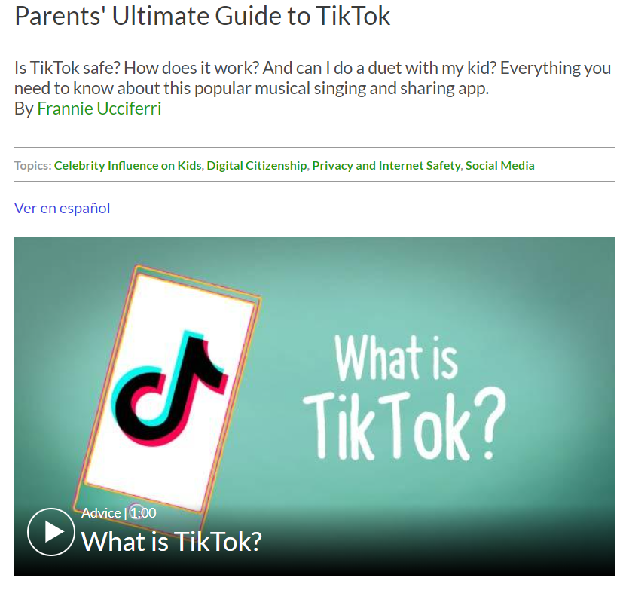

Gaming Review Sites for Parents
Notes:
Pegi offers official age ratino. Is a European agency.

Slide 35

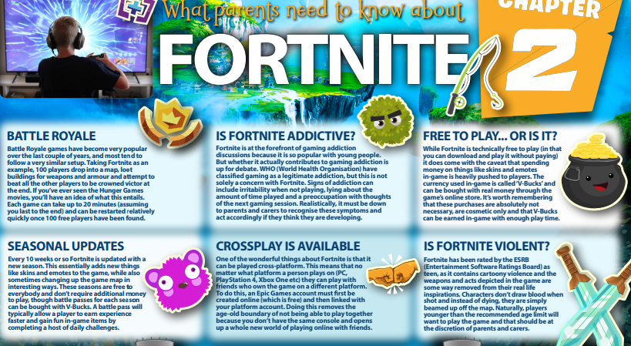
National Online Safety
Notes:
Easy to read format
Discuss with your child.
Points out how you might turn off communications for bad language

Slide 36
Parental Controls
Notes:
Turning off in app purchases.
Talking to children about nature of online advertising.
Openly discussing gambling.

Slide 37




Social Media
Notes:
Snapchat:
Thinking about streaks.
Instagram:
Damage to self esteem – but it can give you confidence. – can follow things you are interested in. Lots of climate change.
Unreal view of the world
An addictive feature
Competitive cultur

Slide 38
38 % of UKS2 children use Tik Tok
23% use Snapchat
KS1 60% using You Tube
Notes:
“ Sometimes different videos come up on you tube that frighten me”
“I don’t like it if I get an unkind message”
“ I have some social media but didn’t know that there are settings that mean I’m giving away my location”

Slide 39
18% of KS1 children have received a message which has worried them.
Notes:
“ Sometimes different videos come up on you tube that frighten me”
“I don’t like it if I get an unkind message”
“ I have some social media but didn’t know that there are settings that mean I’m giving away my location”

Slide 40
1/3 of children in school have seen a message from a stranger that made them uncomfortable.
Notes:
“ Sometimes different videos come up on you tube that frighten me”
“I don’t like it if I get an unkind message”
“ I have some social media but didn’t know that there are settings that mean I’m giving away my location”

Slide 41

Harmful Content
Notes:
You may have heard about or seen some videos that look like they're for kids but are clearly not. These videos may use familiar characters from kids' TV shows, such as Caillou or Peppa Pig, or they may use cartoon graphics such as cars and trucks. The videos have seemingly kid-friendly titles and begin normally, but then become strange and even extremely disturbing.
It is also worth looking at the auto play feature which leads one video onto the next.
If your child posts something, users can privately contact your child
Think about: restrictive mode and customised playlists.

Slide 42

Self Esteem/Peer Pressure
Notes:
Snapchat:
Thinking about streaks.
Instagram:
Damage to self esteem – but it can give you confidence. – can follow things you are interested in. Lots of climate change.
Unreal view of the world
An addictive feature
Competitive cultur

Slide 43
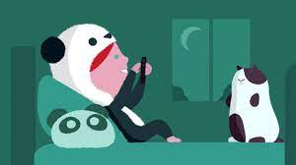
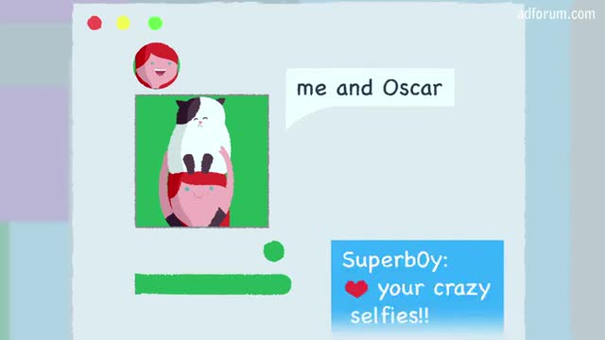

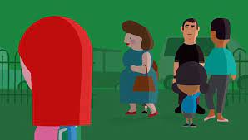

Social Media -Sharing personal information.
Notes:
Show NSPCC 2 videos in KS2

Slide 44

Privacy Settings/Sharing personal information.

Slide 45
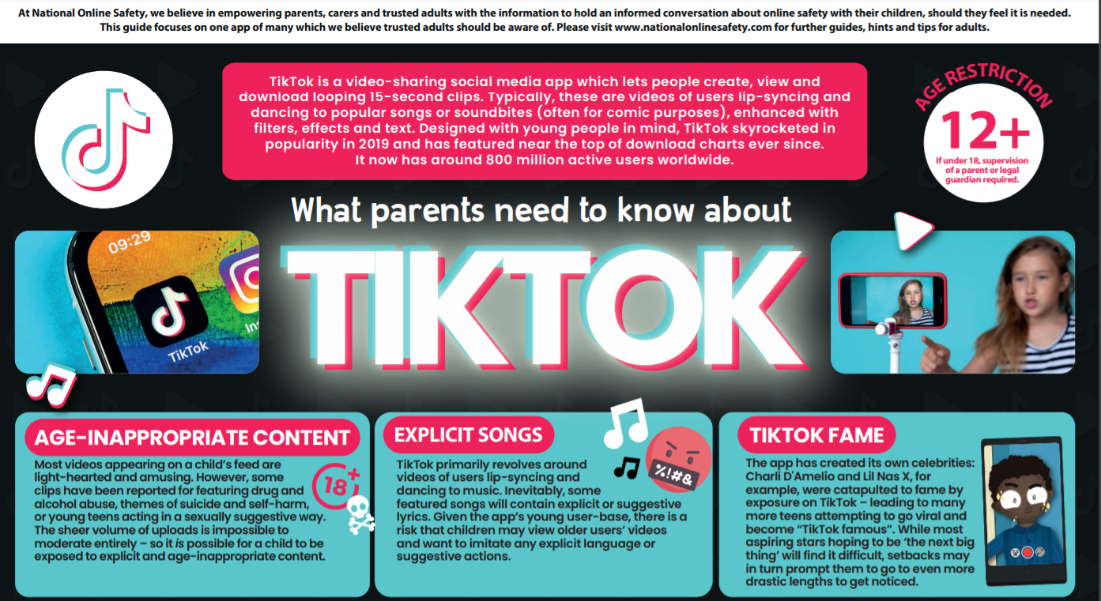


Useful Resources. National Online Safety
Notes:
Setting up of device:
Location settings
Password controls.
Hyperlink

Slide 46
Useful Resources. National Online Safety
You Tube Guide
Tik Tok Guide
Notes:
Setting up of device:
Location settings
Password controls.
Hyperlink

Slide 47






Resources – Time to Browse.

Slide 48

E Safety Curriculum
Notes:
At BPS, we follow the “Education for a connected world” framework, which covers a wide variety of e-safety issues such as online reputation and privacy and security.

Slide 49
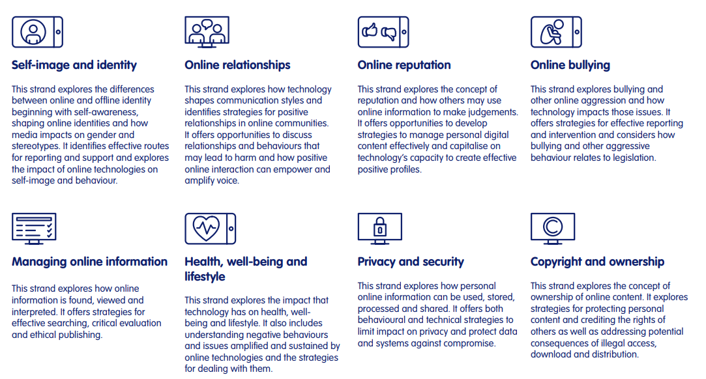

Slide 50
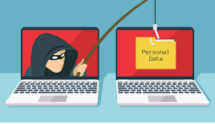

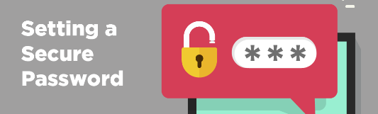
E Safety Warm Ups

Slide 51


E Safety Warm Ups KS2
Notes:
Show gambling video
Also woven throughout lesson. KS2 are currently researching WW2 and as well as offering specific websites to use, we offer advice on what makes a sensible search, how trustworthy is a source.

Slide 52
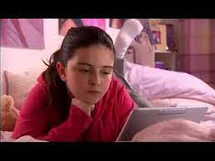
Stand-alone lessons
Notes:
Show NSPCC 2 videos in KS2

Slide 53

Digital Leaders
Notes:
Assemblies
On hand every Monday during coding club to offer any advice.

