Slide 1


Area and Perimeter
Annie is designing her dream home.
Here is a floor plan for downstairs.
6 m
3 m
Dining room
2 m
Kitchen
3 m
10 m
Living room
Utility
1 m
Work out the area of each room.
Have a go
What is the total area?

Slide 2



Annie is designing her dream home.
Here is a floor plan for downstairs.
6 m
3 m
12 m²
9 m²
Dining room
2 m
Kitchen
3 m
10 m
7 m²
Living room
48 m²
8 m
7m
Utility
1 m
Work out the area of each room.
48 $+$ 12 $=$ 60
What is the total area?
7 $+$ 9 $=$ 16
60 $+$ 16 $=$ 76 m²

Slide 3


Annie is designing her dream home.
Here is a floor plan for downstairs.
6 m
3 m
12 m²
9 m²
Dining room
2 m
Kitchen
3 m
10 m
7 m²
Living room
48 m²
14 m²
7 m
Utility
9 m
1 m
2 m
Work out the area of each room.
Total area $=$ 90 m²
90 $−$ 14 $=$ 76 m²
What is the total area?

Slide 4

Jack is redecorating his living room.
He is getting new skirting boards around the base of each wall.
180 cm
Have a go
4.8 m
3.4 m
5.5 m
How many metres of skirting board does Jack need to buy?

Slide 5


Jack is redecorating his living room.
He is getting new skirting boards around the base of each wall.
1.8 $+$ 1.4 $+$ 3.7 $+$ 3.4 $+$ 5.5 $+$ 4.8
$=$20.6 m
180 cm
What do you notice?
1.4 m
1.8 m
3.7 m
4.8 m
3.4 m
5.5 m
How many metres of skirting board does Jack need to buy?
20.6 m

Slide 6


Jack is redecorating his living room.
He is getting new skirting boards around the base of each wall.
1.8 $+$ 1.4 $+$ 3.7 $+$ 3.4 $+$ 5.5 $+$ 4.8
$=$20.6 m
180 cm
What do you notice?
1.4 m
3.7 m
5.5 $+$ 4.8 $=$ 10.3
10.3 $×$ 2 $=$ 20.6
4.8 m
3.4 m
5.5 m
How many metres of skirting board does Jack need to buy?
20.6 m

Slide 7





How many metres of skirting board does Jack need to buy?
20.6 m
Skirting boards can only be bought in lengths of 2 metres.
They cost £11.40
How many lengths will Jack need to buy and how much will it cost him?
20.6 $÷$ 2 $=$ 10.3
He will need to buy 11 lengths of skirting.
11 $×$ £11.40
$=$ £125.40
10 $×$ £11.40
1 $×$ £11.40
Have a go

Slide 8





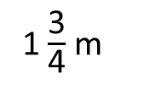
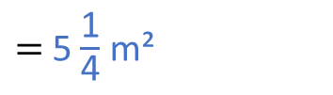







Amir is painting one of his living room walls.
Each tin of paint can cover 2.5 m² and costs £6.50
3 m
3 m $×$1 $\frac{\text{3}}{\text{4}}$ m
$=$ 5$\frac{\text{1}}{\text{4}}$ m²
1 $\frac{\text{3}}{\text{4}}$ m
5 $\frac{\text{1}}{\text{4}}$ m²
3 $×$1 $=$ 3
3 $×\frac{\text{3}}{\text{4}}$
$= \frac{\text{9}}{\text{4}}$ or 2$\frac{\text{1}}{\text{4}}$
Work out the cost of painting the wall.
$=$ £19.50
£6.50 $×$ 3
1 tin $=$ 2.5m²
2 tins $=$ 5m²
3 tins $=$ 7.5m²

Slide 9


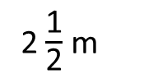



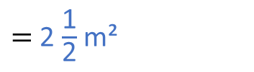
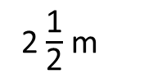

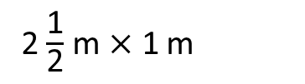


Eva is painting two of her dining room walls.
Each tin of paint can cover 2 m² and costs £5.75
4 m
4 m $×$ 2 $\frac{\text{1}}{\text{2}}$ m
$=$ 10 m²
2 $\frac{\text{1}}{\text{2}}$ m
10 m²
4 $×$ 2 $=$ 8
4 $×\frac{\text{1}}{\text{2}}$
$=$ 2
2 $\frac{\text{1}}{\text{2}}$ m $×$ 1 m
$=$ 2 $\frac{\text{1}}{\text{2}}$ m²
2 $\frac{\text{1}}{\text{2}}$ m
2 $\frac{\text{1}}{\text{2}}$ m²
Total area to paint is 12 $\frac{\text{1}}{\text{2}}$ m²
1 m
Have a go
Work out the cost of painting the walls.

Slide 10



Each tin of paint can cover 2 m² and costs £5.75
Total area to paint is 12 $\frac{\text{1}}{\text{2}}$ m²
1 tin $=$ 2 m²
6 tins $=$ 12 m²
7 tins $=$ 14 m²
 | 5 | 7 | 5
 |  |  | 7
$$×$$
4
0
2
5
5
3
It will cost £40.25 to buy 7 tins of paint.

Slide 11




Algebra
A painter charges £14.50 an hour.
In addition they charge £45 for the paint.
Write an algebraic formula to show the cost ($C$) for hours ($h$).
(14.50$h$)
$C$ $=$
$+$ 45
It takes 8 hours to paint the house.
How much will the painter charge?
Have a go

Slide 12








(14.50$h$)
$C$ $=$
$+$ 45
It takes 8 hours to paint the house.
How much will the painter charge?
£161
$C$ $=$
(14.50 $×$ 8)
$+$ 45
 | 1 | 4 | 5
 |  |  | 8
£116.00 $+$ £45
$$×$$
1
1
6
0
3
4

Slide 13
(14.50$h$)
$C$ $=$
$+$ 45
How much will the painter charge if it takes
6 hours?
15 hours?
2.5 hours?
£132
£262.50
£81.25
Have a go

Slide 14




(14.50$h$)
$C$ $=$
$+$ 45
If a painter charged
how long did it take to complete each job?
£190
190 $−$ 45 $=$ 145
145 $÷$ 14.5 $=$ 10 hours
£117.50
117.50 $−$ 45 $=$ 72.50
72.50 $÷$ 14.5 $=$
5 hours
Have a go

Slide 15
House worksheet

Slide 16
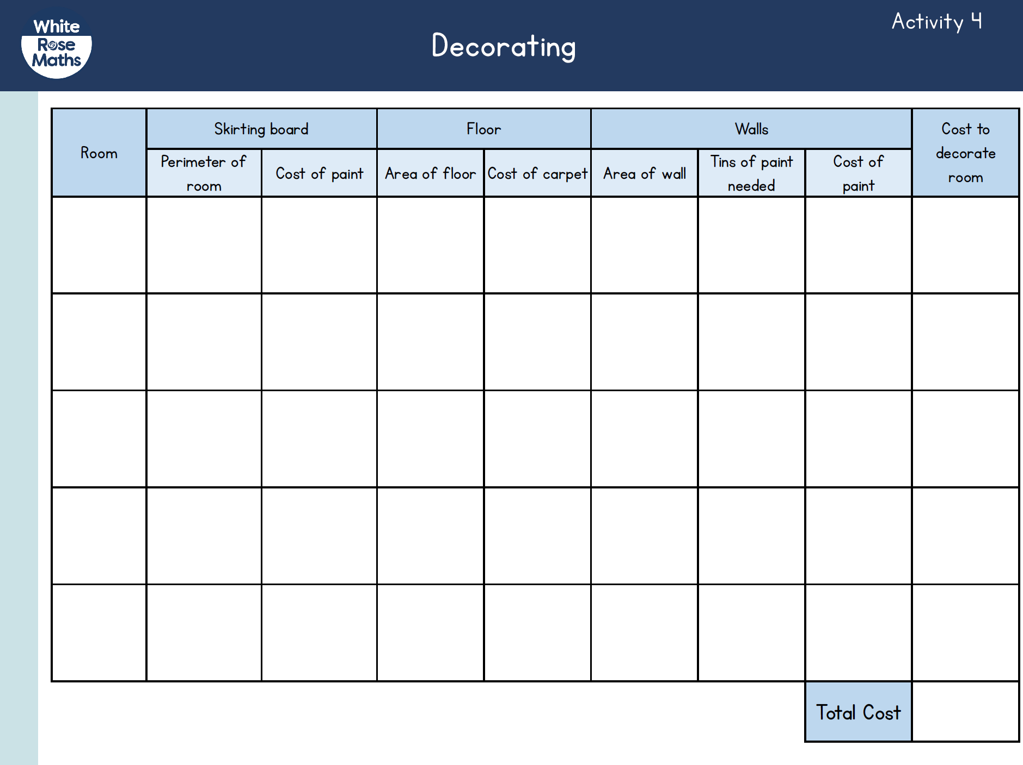
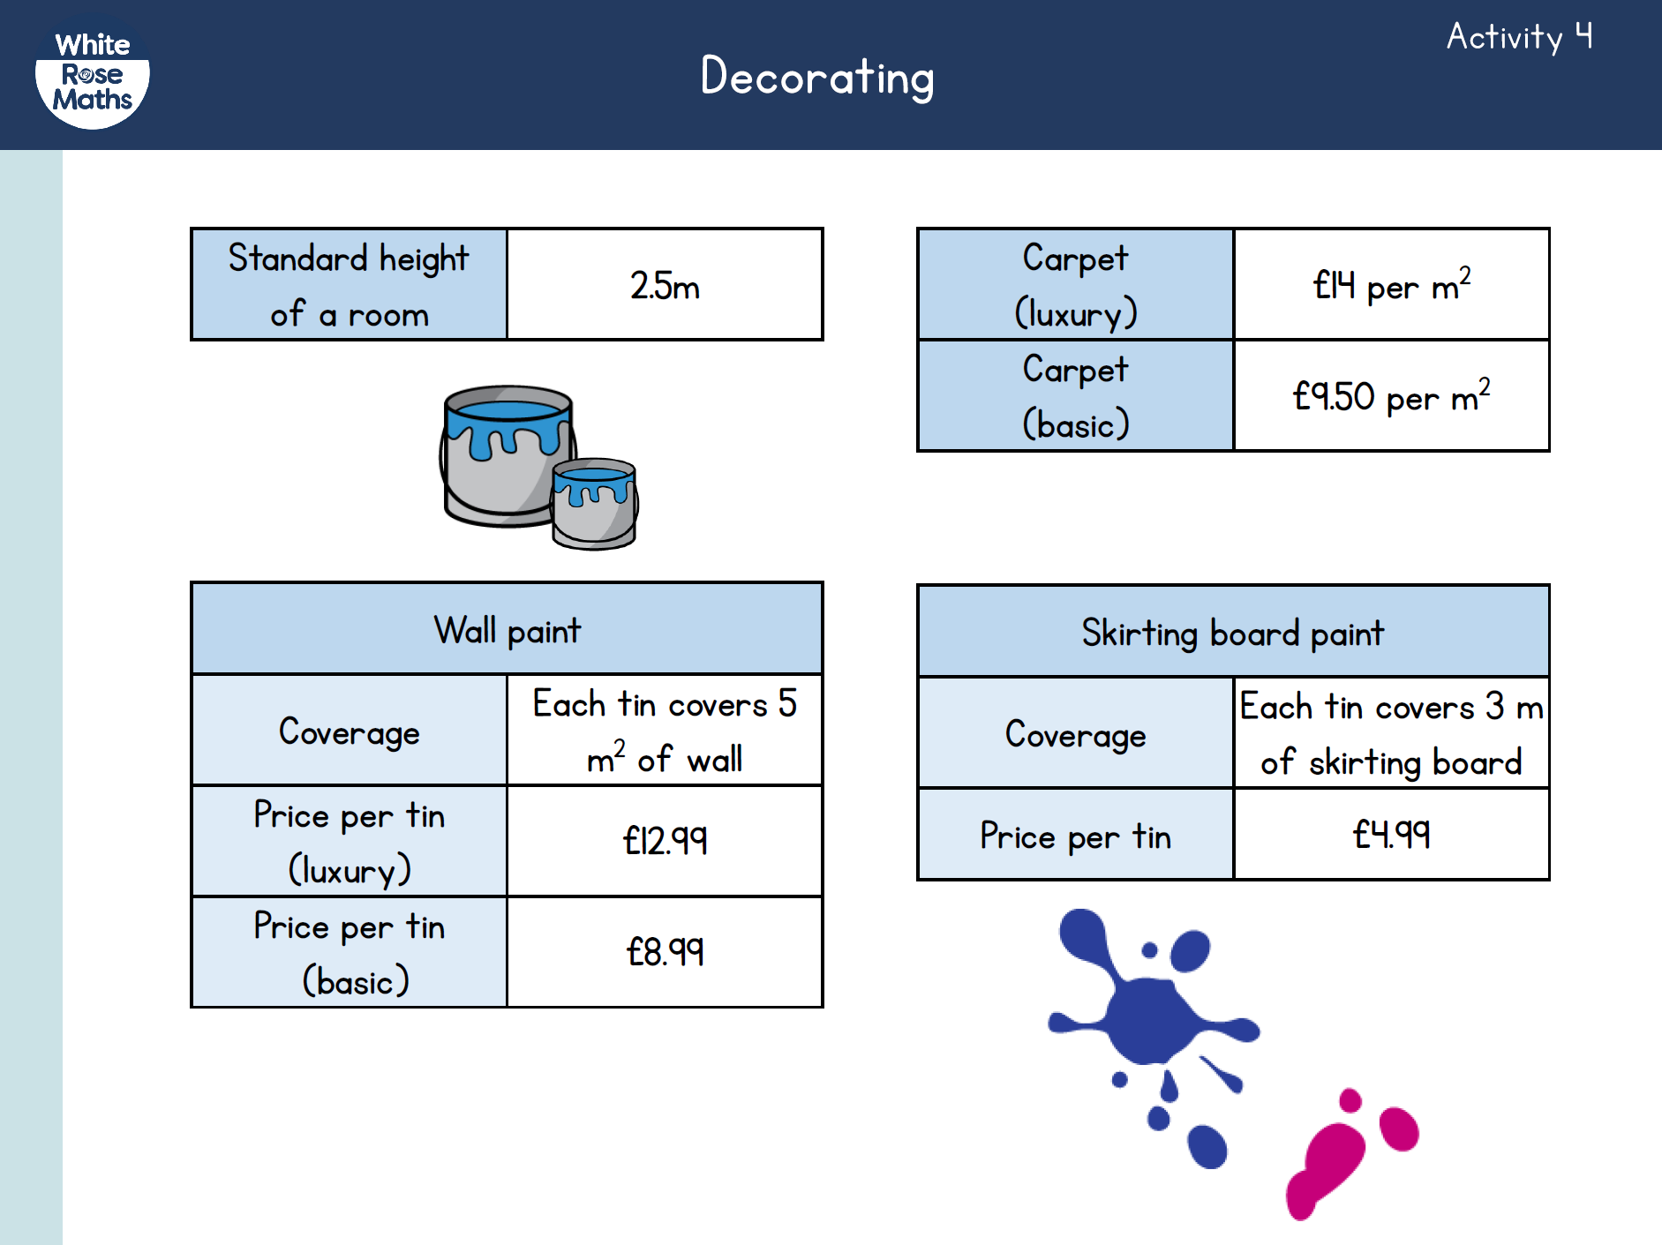
Activity 4
Sketch a floor plan for your dream home.
Work out the area and perimeter of each room.
Use the price template provided to work out how much it will cost for carpet and paint in each of your rooms.

Slide 17
Activity 5
Other possible tasks
Create a biography or ‘Day in the life of’ piece of writing about your dream future.
Using an ICT program create your dream home.
Build a scale model of your dream home.

