Slide 1

LC: CAN I Recognise vocabulary and structures for formal writing?

Slide 2
https://www.bbc.co.uk/programmes/p05qcb0h/player
Of the world’s seven different sea turtle species, leatherbacks are the largest. Fully grown adults can weigh as much as 900 Kilograms – a weight equivalent to eleven men! These giants of the ocean are so named because of their leathery shells, which are soft and flexible.
In this fascinating clip, we are transported to the Caribbean island of Trinidad, where we meet Len Peters. Len has dedicated his life to helping this vulnerable species. From patrolling the beaches at night (in an attempt to stop poachers killing the turtles for their meat) to educating children in local schools about the importance of the turtles, Len has worked tirelessly to help the leatherbacks. Do you think his hard work has paid off? Watch the clip to find out.

Slide 3
Extra challenge
How many different words ending in ‘cious’ or ‘tious’ can you list that relate in some way to the leatherback film clip? Once you have made your list, share it with your talk partner and explain each word’s connection to the clip.
e.g. malicious (the poachers’ threatening actions towards Len), ambitious (Len’s hope of safeguarding the leatherbacks’ future), …

Slide 4
The Grammar Bit!
When you interact with your family and friends you will most likely be using an informal speaking (or writing) style. However, there will be times in your life when you will need to adopt a more formal style in the way that you communicate your thoughts and ideas. With your talk partner, discuss when you might need to use a formal writing style.
The letters opposite (by Poppy and Leo) were written in response to an advert that appeared in the National Geographic magazine. The advert sought to attract dedicated volunteers, who would be tasked with helping to protect leatherback turtles on the tiny island of Tobago.
Poppy chose to write her response using an informal writing style, whilst Leo chose a more formal style. With your talk partner, compare and contrast the language used. Whose letter stands the best chance of success and why?

Slide 5
Informal Writing Style
Hi,
I’d love to help the turtles out as they’re such cool critters.
You’d be a fool not to choose me, as I’ve got a degree and have written a whole heap of stuff on the leathery monsters.
I love all of the fab animals in the sea, and I hope that my kids (and their kids too) will be able to see what I’ve seen. Please don’t forget to write back!
Speak soon,
Poppy
Formal Writing Style
Dear Sir/Madam,
I am writing to express my interest in the Leatherback Turtle Conservation Project on the island of Tobago.
I feel that I am well-placed to become a volunteer, as I have a degree in Marine Biology. Furthermore, I have written several essays on the many threats leatherbacks face in their fragile marine environment.
I am deeply passionate about safeguarding the world’s oceans, and their incredible biodiversity, for future generations. I look forward to hearing back from you,
Yours faithfully,
Leo Masters

Slide 6
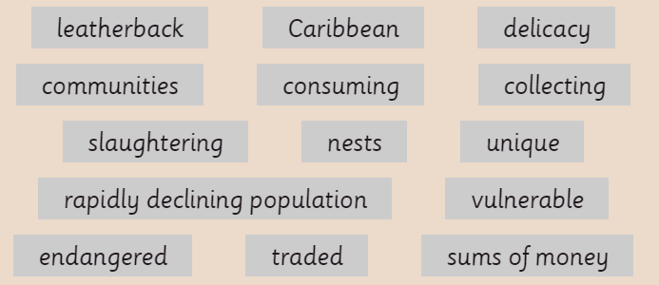
Challenge 1
Rewrite the first sentence so that it is in a formal style, using some of the words from the Word Wall.
Challenge 2
Rewrite the second sentence so that it is in a formal style, using some of the words from the Word Wall. Make sure that there are no abbreviations or contractions in your writing.
Challenge 3
Write a short paragraph for Leo’s letter that explains why leatherbacks should be protected. Try to include some of the technical words from the Word Wall and use a formal writing style.
1) Loads of bad things are still happening to leatherbacks with some people eating their eggs and others ‘doing them over’ for their meat.
2) I’ve known for a while that, in the Carib, turtle eggs (considered yummy by some folk around the world) are dug up and sold for loads of cash.

