Slide 1
L.C. Can I calculate mortgage payments?
Toolkit

Slide 2
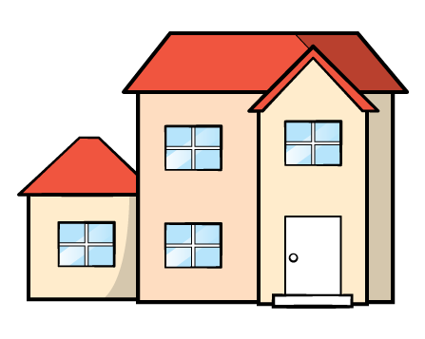
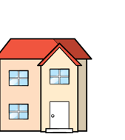
Ordering
Write the house prices in order starting with the most expensive.
£296,730
£365,570
£269,730
£365,750

Slide 3

Write the house prices in order starting with the least expensive.
£257,500
£249,999
£250,000
A quarter of a million
£350,000
Have a go

Slide 4

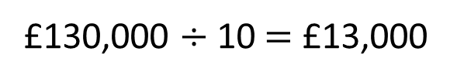
The deposit is 10% of the total cost.
Percentages
Ron can save £500 a month.
How long will it take him to save the money for the deposit?
£130,000
10% of £130,000
£130,000 $÷$ 10 $=$ £13,000

Slide 5






10% $=$ £13,000
Savings (£) | Months
500 | 1 month
$×$ 2
$×$ 2
1,000
2 months
$×$ 13
$×$ 13
13,000
26 months
26 months $=$ 2 years and 2 months
It will take Ron 2 years and 2 months to save enough money for the deposit on the house.

Slide 6

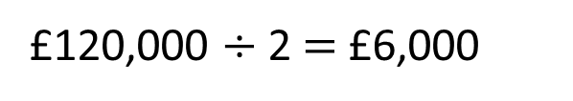
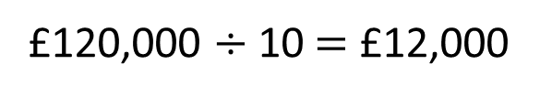
The deposit is 5% of the total cost.
Dexter can save £400 a month.
How long will it take him to save the money for the deposit?
£120,000
5% of £120,000
£120,000 $÷$ 10 $=$ £12,000
£120,000 $÷$ 2 $=$ £6,000
Have a go

Slide 7






5% $=$ £6,000
Savings (£) | Months
400 | 1 month
$×$ 5
$×$ 5
2,000
5 months
$×$ 3
6,000
15 months
$×$ 3
15 months $=$ 1 year and 3 months
It will take Dexter 1 year and 3 months to save enough money for the deposit on the house.

Slide 8

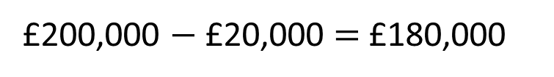
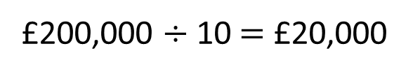
Mo has paid a 10% deposit.
His mortgage repayments are £500 a month.
£200,000
How long will it take Mo to pay off his mortgage?
£200,000 $÷$ 10 $=$ £20,000
£200,000 $−$ £20,000 $=$ £180,000
Mo has £180,000 left to pay.
Have a go

Slide 9






Mo has £180,000 left to pay.
Mortgage repayments (£) | Months
500 | 1 month
$×$ 100
$×$ 100
$×$ 60
50,000
100 months
$×$ 60
$×$ 3
150,000
300 months
$×$ 3
30,000
60 months
It will take Mo 360 months to pay back £180,000 to the mortgage company.

Slide 10




Mo has £180,000 left to pay.
Mortgage repayments (£) | Months
500 | 1 month
$×$ 2
$×$ 2
1,000
2 months
$×$ 180
180,000
360 months
$×$ 180

Slide 11




Mo has £180,000 left to pay.
Mortgage repayments (£) | Months
500 | 1 month
1,000
2 months
180,000
360 months
It will take Mo 360 months to pay back £180,000 to the mortgage company.
12 months $=$ 1 year
36 months $=$ 3 years
120 months $=$ 10 years
360 months $=$ 30 years
It will take Mo 30 years to pay back £180,000 to the mortgage company.

Slide 12

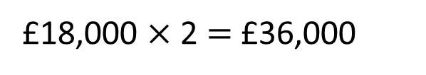
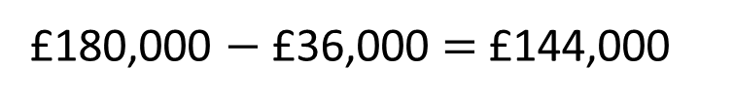
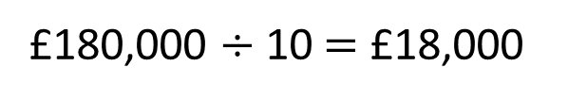

Dora has paid a 20% deposit.
Her mortgage repayments are £600 a month.
£180,000
How long will it take Dora to pay off her mortgage?
£180,000 $÷$ 10 $=$ £18,000
£18,000 $×$2 $=$ £36,000
20% $=$ £36,000
£180,000 $−$ £36,000 $=$ £144,000
Dora has £144,000 left to pay.
Have a go

Slide 13






Dora has £144,000 left to pay.
144,000 $÷$ 600
144 $÷$ 6 $=$ 24
144,000 $÷$ 6 $=$ 24,000
144,000 $÷$ 600 $=$ 240
6 | 1 | 4 | 4
0
2
4
2
24 months $=$ 2 years
240 months $=$ 20 years
It will take Dora 20 years to pay back £144,000
to the mortgage company.

Slide 14



Fractions
Rosie earns £1,800 a month after tax and other deductions.
She spends $\frac{\text{1}}{\text{8}}$ of her wage on bills.
After that, she spends $\frac{\text{1}}{\text{5}}$ of what is left on paying back her mortgage.
She then spends $\frac{\text{1}}{\text{3}}$ of what is left on food and clothes.
With the remainder of her wage, she spends $\frac{\text{1}}{\text{4}}$ on hobbies.
How much does Rosie have left?
Have a go

Slide 15








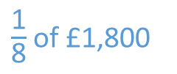
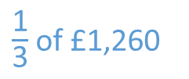
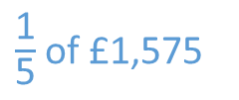

Rosie earns £1,800 a month after tax and other deductions.
She spends $\frac{\text{1}}{\text{8}}$ of her wage on bills.
$\frac{\text{1}}{\text{8}}$ of £1,800
$=$ £225
After that, she spends $\frac{\text{1}}{\text{5}}$ of what is left on paying back her mortgage.
£1,800 $−$ £225
$=$ £1,575
$\frac{\text{1}}{\text{5}}$ of £1,575
$=$ £315
She then spends $\frac{\text{1}}{\text{3}}$ of what is left on food and clothes.
£1,575 $−$ £315
$=$ £1,260
$\frac{\text{1}}{\text{3}}$ of £1,260
$=$ £420

Slide 16



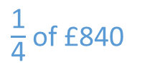



With the wage that is left, she spends $\frac{\text{1}}{\text{4}}$ on hobbies.
£1,260 $−$ £420
$=$ £840
$\frac{\text{1}}{\text{4}}$ of £840
$=$ £210
How much does Rosie have left?
Rosie has £630 left.
£840 $−$ £210
$=$ £630

Slide 17
Mortgage worksheet

Slide 18
Activity 3
Research the price of houses in your local area or use the template provided.
Find a house you would like to possibly live in.
Using the take-home pay from Activity 2, work out how long it would take to save a
5% deposit 10% deposit
20% deposit 25% deposit
What monthly mortgage repayments could you afford?
How long will it take to fully pay off the mortgage?

