Slide 1
L.C. Can I recall decimal equivalents for common fractions?

Slide 2
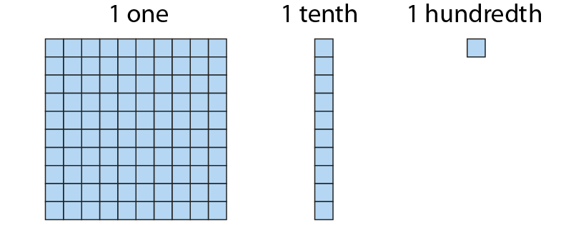
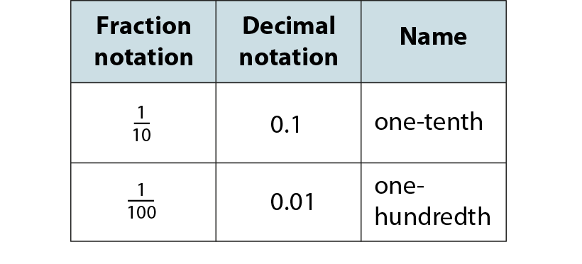
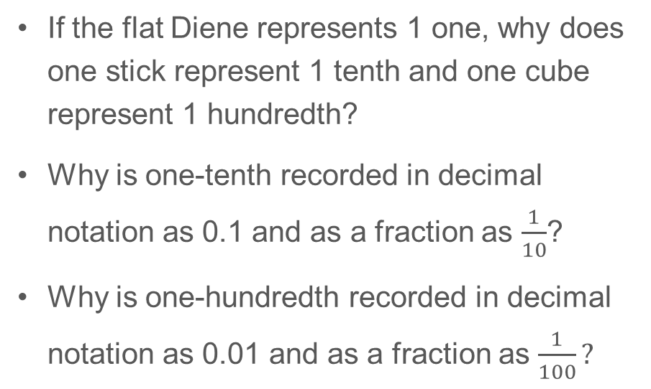
5F-3 Recall decimal equivalents for common fractions
If the flat Diene represents 1 one, why does one stick represent 1 tenth and one cube represent 1 hundredth?
Why is one-tenth recorded in decimal notation as 0.1 and as a fraction as $\frac{1}{10}$?
Why is one-hundredth recorded in decimal notation as 0.01 and as a fraction as $\frac{1}{100}?$

Slide 3
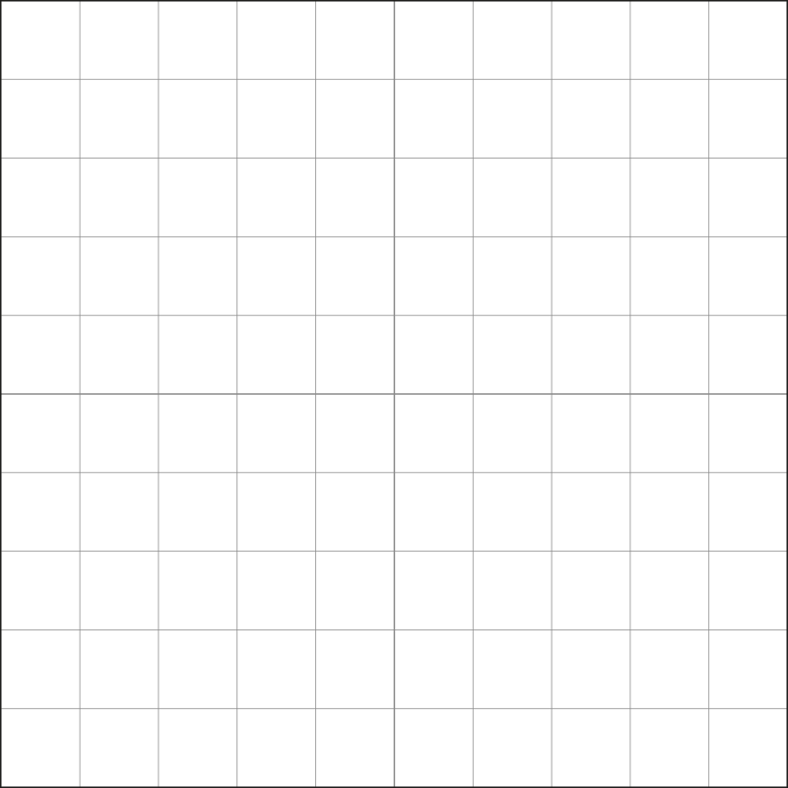
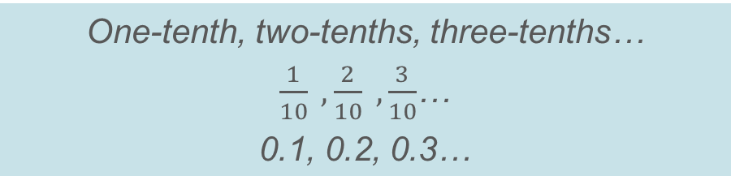
5F-3 Recall decimal equivalents for common fractions
Represent each image shown to identify the fraction of the hundred grid that is shaded.
Skip count in tenths as a new part is added each time using the fraction name, fractional notation and decimal notation.
One-tenth, two-tenths, three-tenths…
$\frac{1}{10} ,\frac{2}{10} ,\frac{3}{10}$…
0.1, 0.2, 0.3…

Slide 4
5F-3 Recall decimal equivalents for common fractions
How many equal parts has the hundred grid been divided into?
What fraction of the whole does each part represent?
How many hundredths are found within each shaded part?
What decimal notation can be used to describe each shaded part?

Slide 5
5F-3 Recall decimal equivalents for common fractions
How many equal parts has the hundred grid been divided into?
What fraction of the whole does each part represent?
How many hundredths are found within each shaded part?
What decimal notation can be used to describe each shaded part?

Slide 6
5F-3 Recall decimal equivalents for common fractions
How many equal parts has the hundred grid been divided into?
What fraction of the whole does each part represent?
How many hundredths are found within each shaded part?
What decimal notation can be used to describe each shaded part?

Slide 7
5F-3 Recall decimal equivalents for common fractions
Unit fraction
Decimal fraction
True or false? 0.5, 0.2 and 0.1 could also be written as 0.50, 0.20 and 0.10
How do you know each unit and decimal fraction are equivalent to each other? The Dienes could be used to help children’s explanations.
1
0.5
2
1
0.25
4
1
0.2
5
1
I know __ and __ are equivalent because if the hundred grid is split into __ equal parts there would be __ hundredths in each part.
0.1
10

Slide 8
5F-3 Recall decimal equivalents for common fractions
10
2
4
5
5
10
2
1
1
1
4
1
1
1
10
1
1
2
4
5
5
10
2
4
Count up and back along each vertical number line in decimal and fractional notation.
Why are different fractions shown on the different number lines? What is the link between the denominator of each fraction and the number of intervals on each number line?
0.9
9
0.9
9
10
10
8
0.8
4
0.8
4
8
0.8
10
0.8
3
5
5
10
0.75
0.75
3
4
4
0.7
7
0.7
7
10
10
0, 0.5, 1 1, 0.5, 0
Zero, one-half, two-halves.
Two-halves, one-half, zero.
6
0.6
3
3
6
0.6
10
0.6
0.6
5
5
10
1
2
1
2
0.5
0.5
0.5
5
5
0.5
2
0.5
0.5
4
2
4
10
10
4
0.4
2
2
4
0.4
10
0.4
0.4
5
5
10
0.3
3
0.3
3
1
10
10
0.25
0.25
1
4
4
2
0.2
1
1
2
0.2
10
0.2
0.2
5
5
10
0.1
1
0.1
1
10
10
0
0
0
0
0
0
0
0
0
0
0
0
0
0
0
0

Slide 9
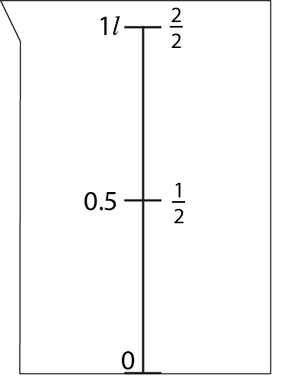
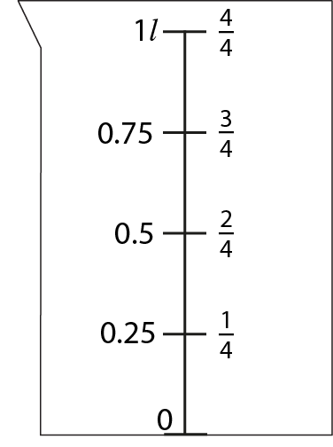
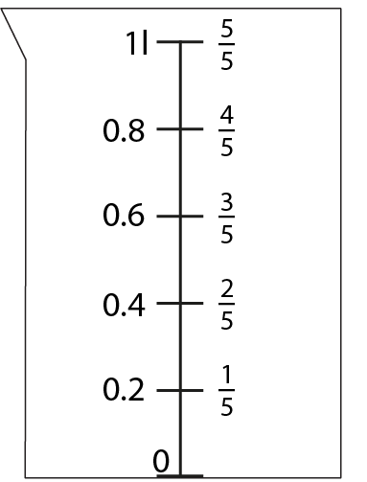
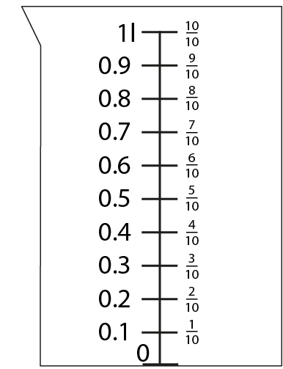
5F-3 Recall decimal equivalents for common fractions
How many parts has each container been split into between 0 and 1 litre?
Complete the missing fractional notations using the decimal notations to help you.
Complete the missing decimal notations using the fractional notations to help you.
Count forwards and backwards on each number line in fractional and decimal notations.

Slide 10
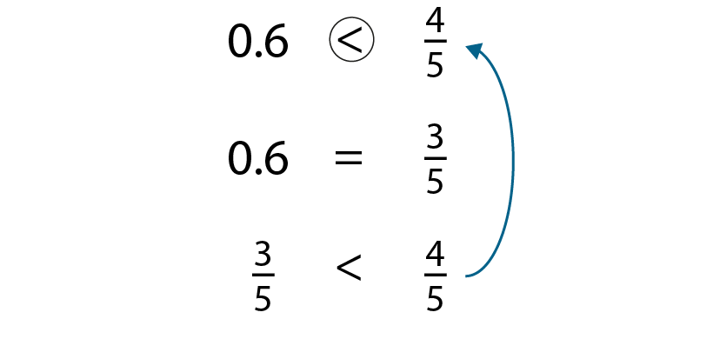
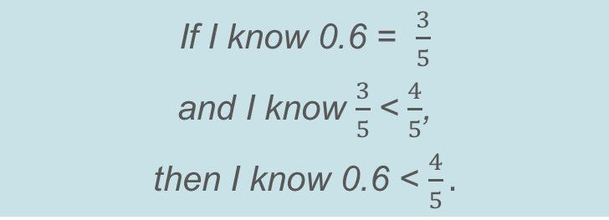
5F-3 Recall decimal equivalents for common fractions
Should the expression given be completed with <, > or =?
How does the given equality help us to complete the original expression?
If I know 0.6 = $\frac{3}{5}$
and I know $\frac{3}{5}$< $\frac{4}{5}$,
then I know 0.6 < $\frac{4}{5}.$

Slide 11
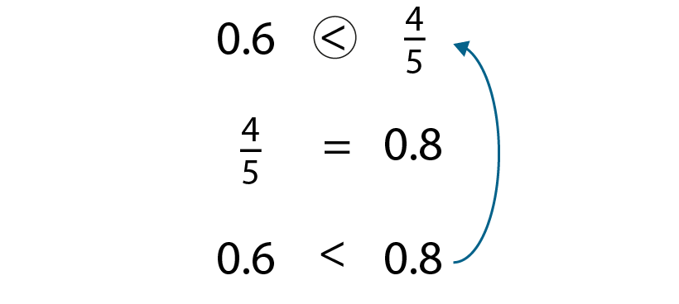
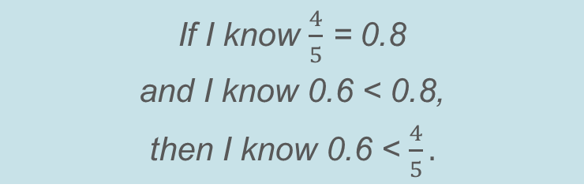
5F-3 Recall decimal equivalents for common fractions
Should the expression given be completed with <, > or =?
How does the given equality help us to complete the original expression?
If I know $\frac{4}{5}$ = 0.8
and I know 0.6 < 0.8,
then I know 0.6 < $\frac{4}{5}.$

Slide 12
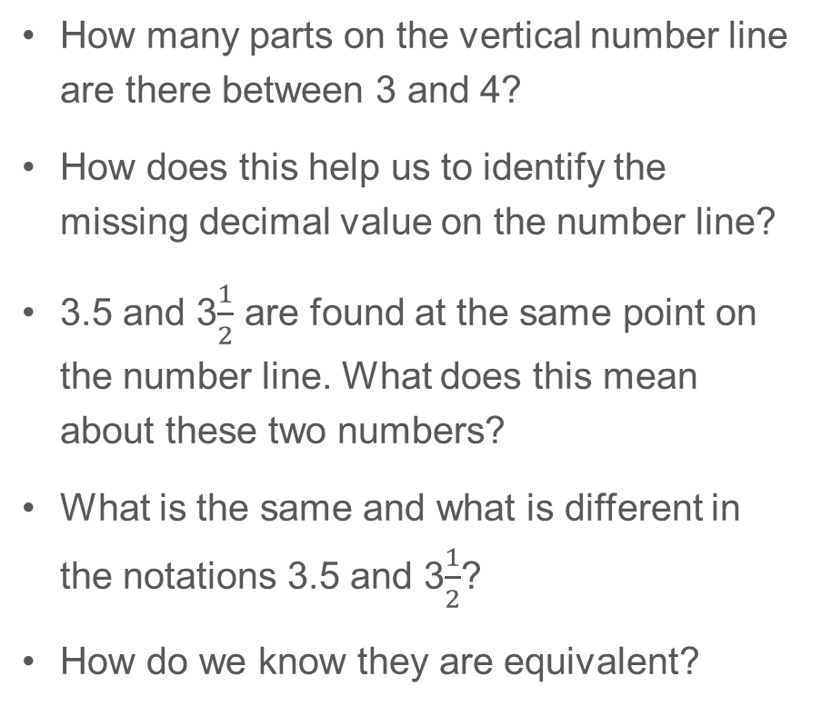
5F-3 Recall decimal equivalents for common fractions
4
4
How many parts on the vertical number line are there between 3 and 4?
How does this help us to identify the missing decimal value on the number line?
3.5 and 3$\frac{1}{2}$ are found at the same point on the number line. What does this mean about these two numbers?
What is the same and what is different in the notations 3.5 and 3$\frac{1}{2}$?
How do we know they are equivalent?
1
3.5
3
2
3

Slide 13
5F-3 Recall decimal equivalents for common fractions
10
10
How many parts on the vertical number line are there between 9 and 10?
How does this help us to identify the missing decimal values on the number line?
Identify the decimal and fractional notations that are equivalent to each other. How do you know these numbers are equivalent?
3
9.75
9
4
2
9.5
9
4
1
9.25
9
4
9
9

Slide 14
5F-3 Recall decimal equivalents for common fractions
7
7
How many parts in the vertical number line are there between 6 and 7?
How does this help us to identify the missing decimal values on the number line?
Identify the decimal and fractional notations that are equivalent to each other. How do you know these numbers are equivalent?
4
6.8
6
5
3
6.6
6
5
2
6.4
6
5
1
6.2
6
5
6
6

Slide 15
5F-3 Recall decimal equivalents for common fractions
2
2
How many parts in the vertical number line are there between 1 and 2?
How does this help us to identify the missing decimal values on the number line?
Identify the decimal and fractional notations that are equivalent to each other. How do you know these numbers are equivalent?
9
1.9
1
10
8
1.8
1
10
7
1.7
1
10
6
1.6
1
10
5
1.5
1
10
4
1.4
1
10
3
1.3
1
10
2
1.2
1
10
1.1
1
1
10
1
1

Slide 16
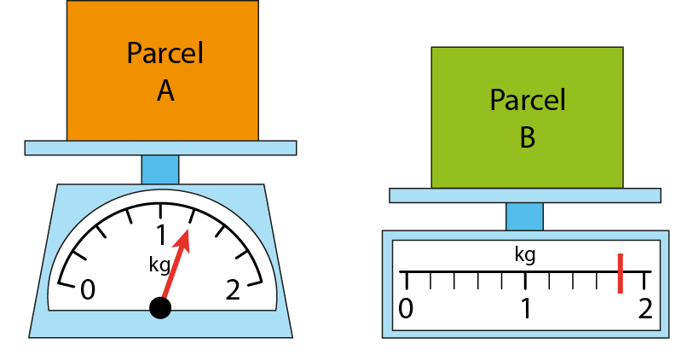
5F-3 Recall decimal equivalents for common fractions
What is different about the two scales shown?
How many intervals are there between zero and one for each scale? So, what interval do we need to count up in for each scale?
Do we need to start at zero on each scale when we count up? Why/why not?
What is the mass of Parcel A and Parcel B? Give your answers in fractional and decimal notations.
Which parcel is heavier? How do you know?

Slide 17
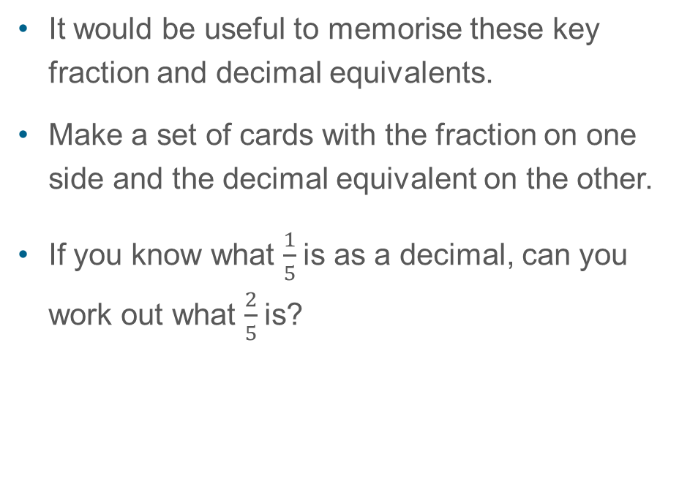
5F-3 Recall decimal equivalents for common fractions
Unit fraction
Decimal fraction
It would be useful to memorise these key fraction and decimal equivalents.
Make a set of cards with the fraction on one side and the decimal equivalent on the other.
If you know what $\frac{1}{5}$is as a decimal, can you work out what $\frac{2}{5}$is?
1
0.5
2
1
0.25
4
1
0.2
5
1
0.1
$\frac{1}{5 }$is equivalent to 0.2,so $\frac{2}{5}$ is equivalent to 0.4
10

