Slide 1
Malamander Chapter 29 and 30
https://www.youtube.com/watch?v=H3XxYjxV1lE chapter 29 and 30
Why does Violet call Eels the monster?
Why does Eels find the malamander’s weakness pathetic?
Predict if Eels will kill the malamander?
How does the author make us feel about Eels in this chapter?
What does Eels do straight away?
Who tries to protect Violet?
What is the malamander’s Achilles spot?

Slide 2
L.C. Can I write the opening of a chapter?
Toolkit

Slide 3
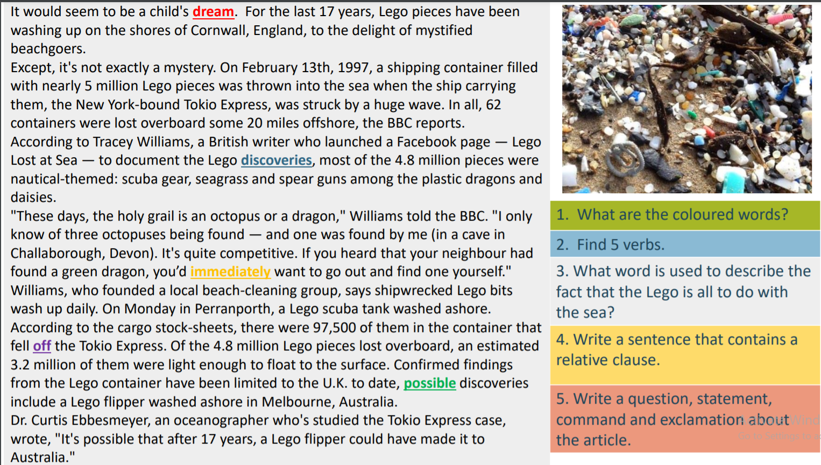

Slide 4
Summarise
What are the main plot points from chapters 29 and 30?
How does Violet feel:
When se is about to find the malamander’s weakness
When Sebastian appears snatching the book

Slide 5
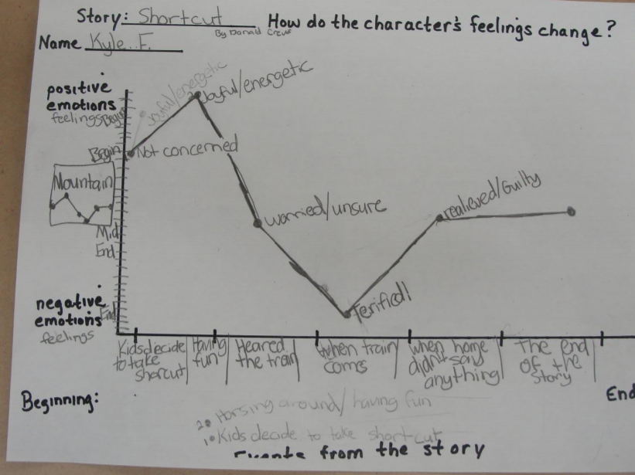
Mini task
Create an emotion graph to show the changes in the paragraph.

Slide 6
Task
Using the book as a template write the beginning of the next chapter.
  Who might be involved where might the story be set?
  Crucially, what happens next?

