Slide 1
Malamander Chapter 25 and 26
https://www.youtube.com/watch?v=BtqS2NxkUx8 chapter 25
https://www.youtube.com/watch?v=ozaaLGRRFOs chapter 26
Why does Herbie nearly cry out when he sees the wetsuit?
Why does the noise jolt Herbie?
Why does Herbie leave the door open a sliver?
Why does Herbie assume that Violet would know who the voices belong to?
Why does the Captain long to be free?
Why is the Captain dubious about facing the malamander?

Slide 2
L.C. Can I create a piece of malamander artwork?
Toolkit

Slide 3
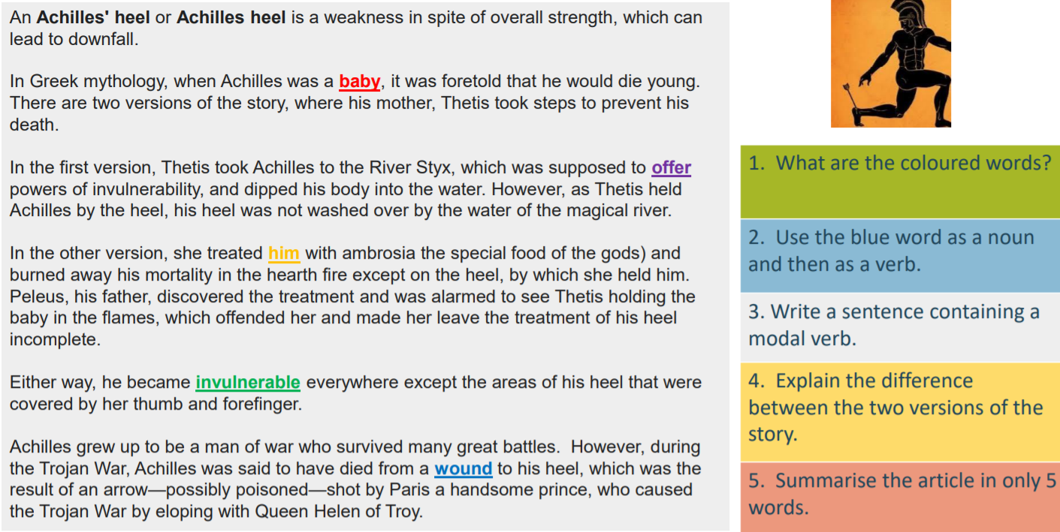

Slide 4
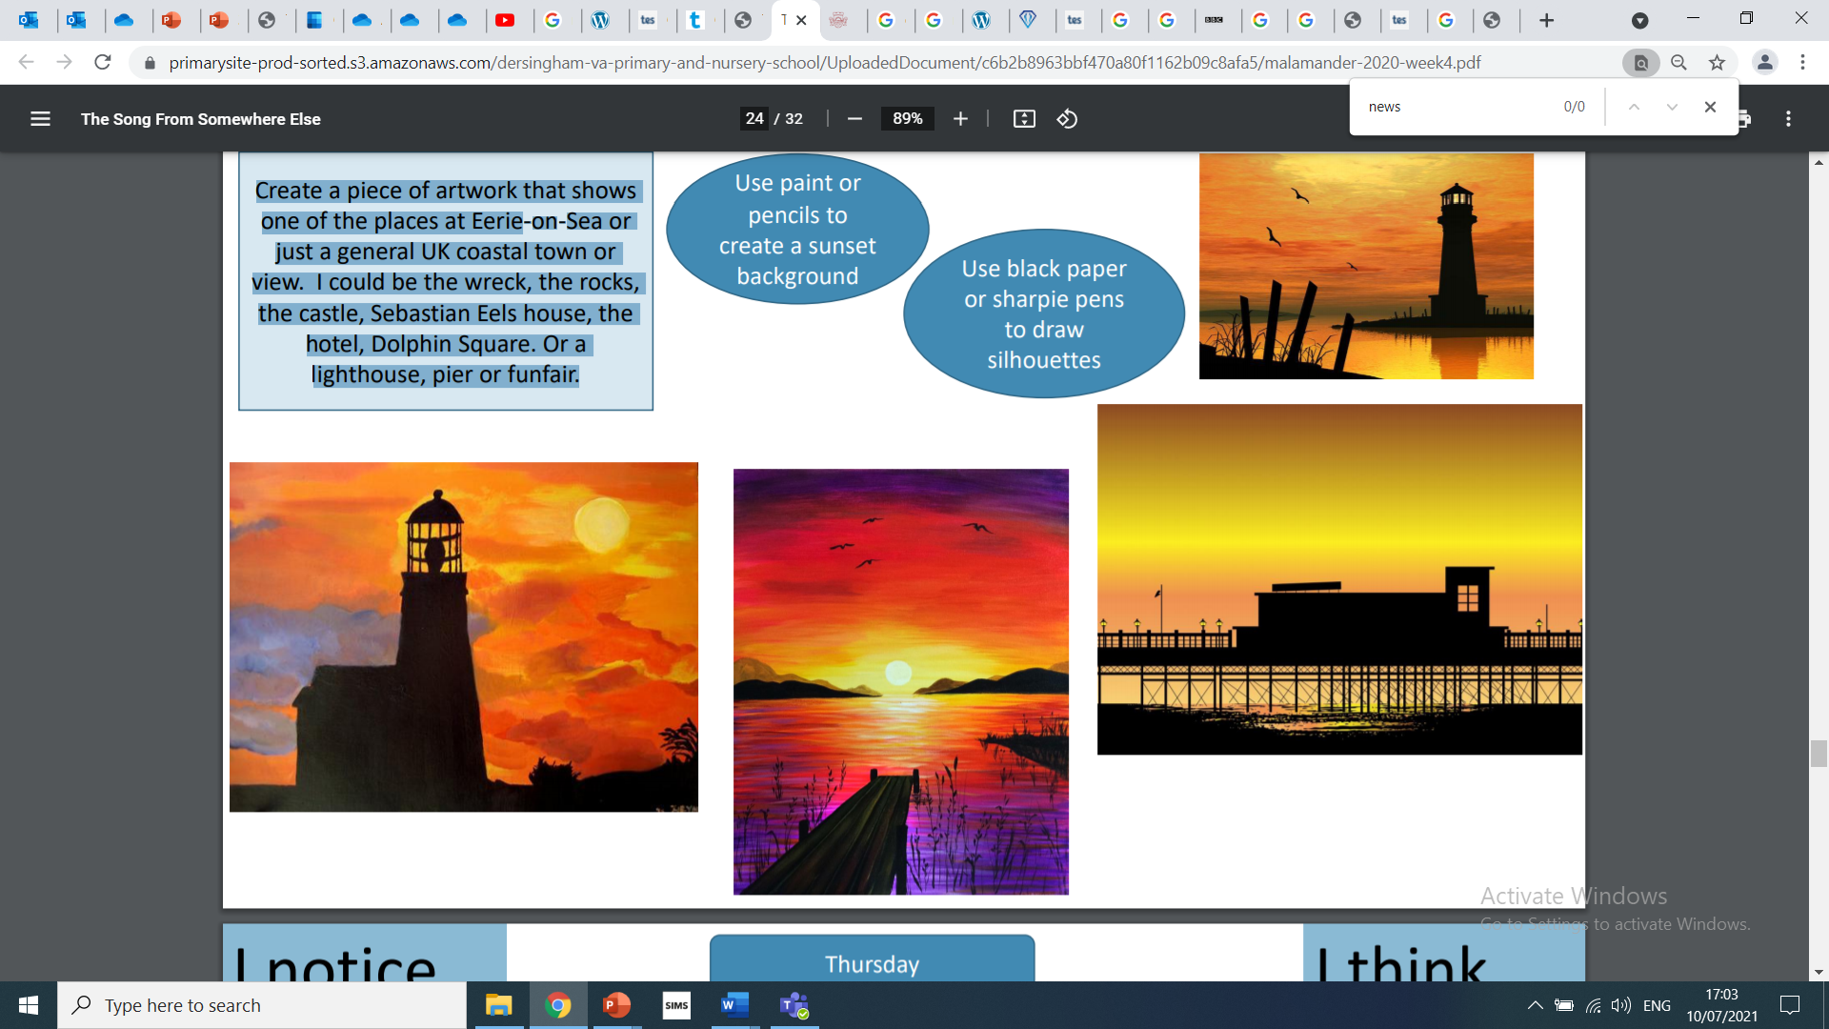
Task
Create a piece of artwork that shows one of the places at Eerie-on-Sea or just a general UK coastal town or view. I could be the wreck, the rocks, the castle, Sebastian Eels house, the hotel, Dolphin Square. Or a lighthouse, pier or funfair.

Slide 5
Malamander Chapter 27 and 28
https://www.youtube.com/watch?v=7uB8uoD20bk chapter 27
https://www.youtube.com/watch?v=EDuGOYcKjRs chapter 28
What comes out of the tap?
What does Herbie use as a shield?
Who protects Herbie from Boathook Man?
What flashes above Herbie’s head?
What can Erwin do that most cats can’t do?
Why had Violet gone to see Sebastian Eels?
Who found Violet in Sebastian Eels’ house?

