Slide 1
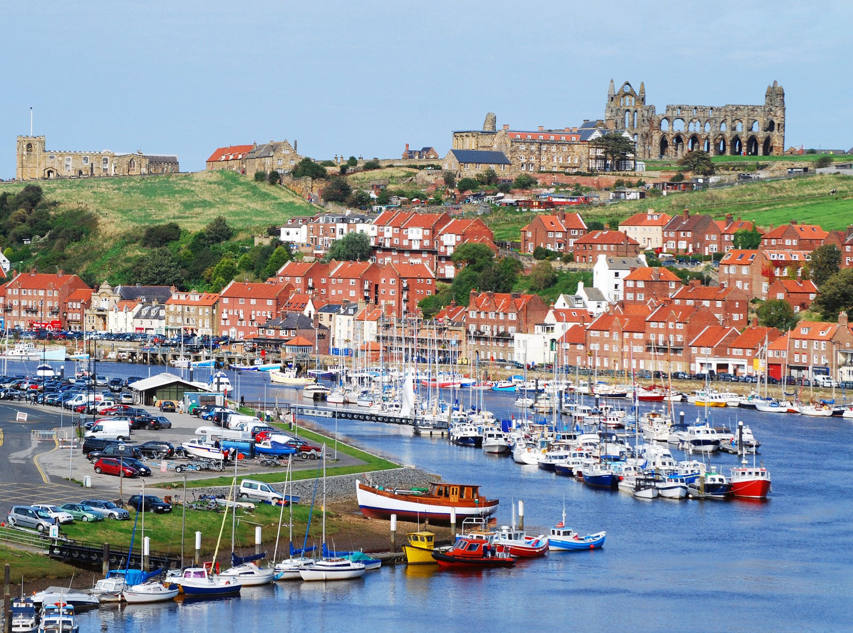
Geography – Whitby – Week 5

Slide 2
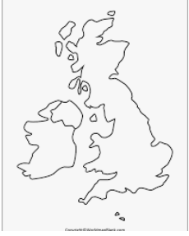
Revision of the geography of the UK – I know this is repetitive but.......!!!
Name the countries and capital cities of the four countries of the United Kingdom.
Which countries make up Great Britain?
What are the seas/oceans surrounding the UK?

Slide 3
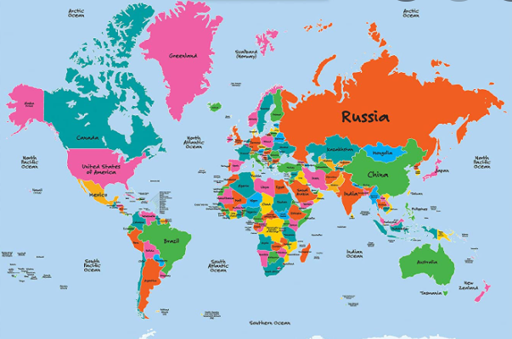
Locational knowledge (for house points)
Can you name:
2 cities in Europe?
2 cities in Asia?
2 cities in Africa?
2 cities in North America?
2 cities in South America?
2 cities in Oceania?

Slide 4
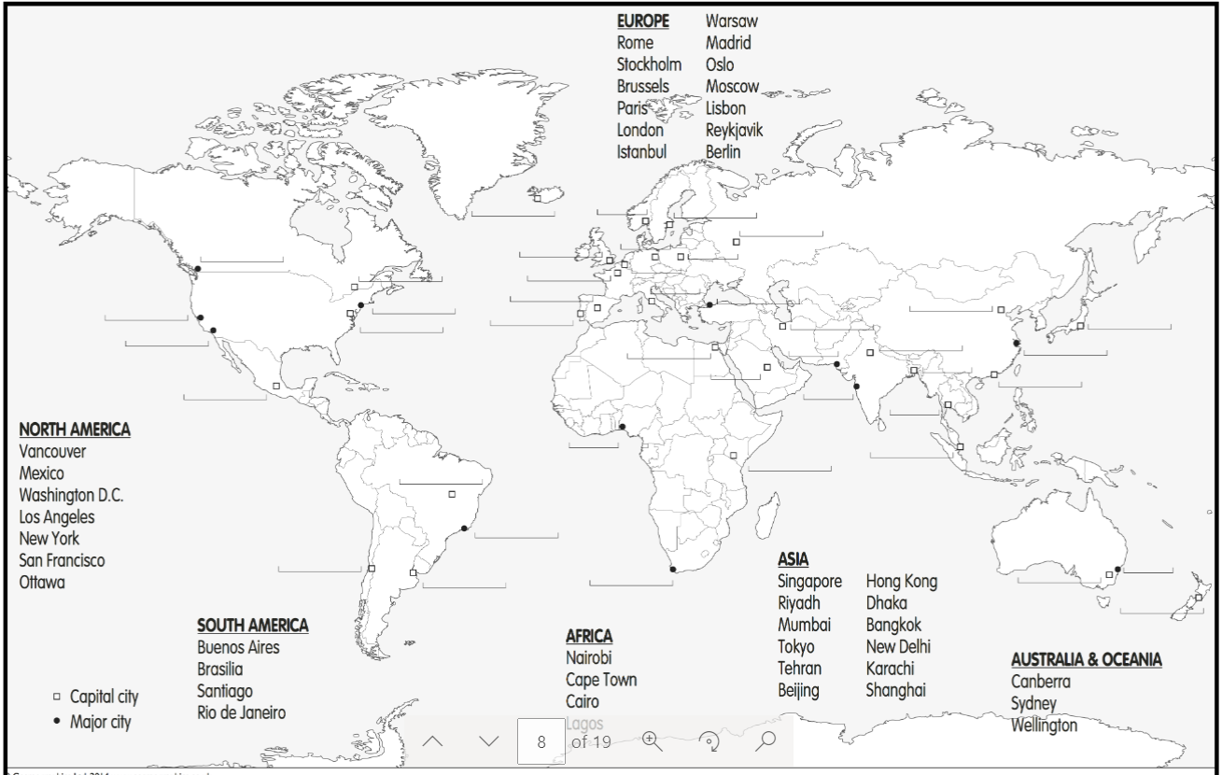

Slide 5

LC: Can I create a travel guide for a trip to Whitby?
Think about:
Location
How to get there
Accommodation
Things to do

Slide 6
Think about a trip you've been on...
A holiday
A day trip
A school trip (pre-Covid!!)
What did you need to do before your trip?
What did you take with you?
How did you travel there?
What did you do when you got there?

Slide 7
Think about a visitor coming to Bramhope or Leeds...
Where could they stay?
How could they travel to Bramhope or Leeds?
What is there to do there?
Explore these websites at home or in the classroom
.
www.thetrainline.com
www.expedia.co.uk/hotels

Slide 8
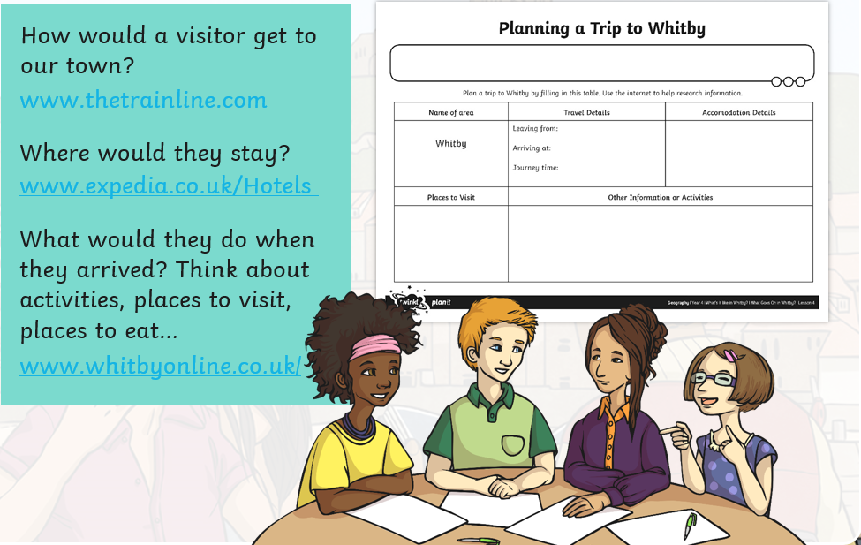
Planning a trip to Whitby
Explore these websites at home or in the classroom
.
www.thetrainline.com
www.expedia.co.uk/hotels
How much would it cost to travel by train from Leeds – Whitby?

Slide 9
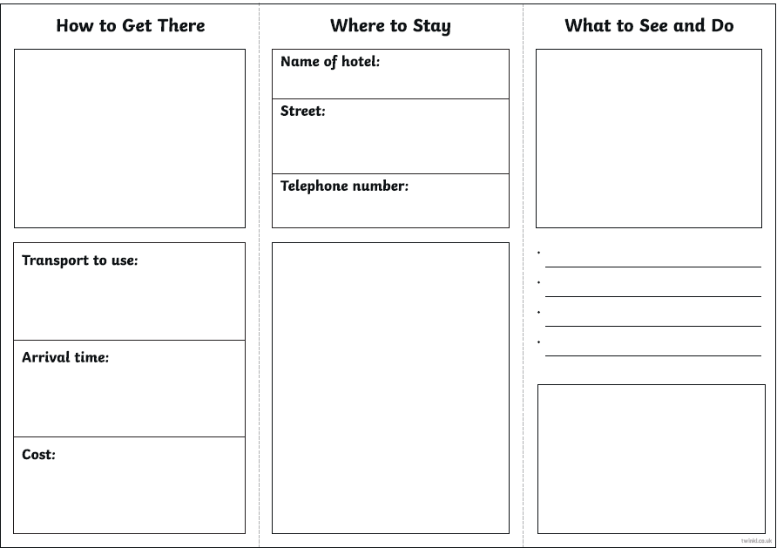
Presenting your work
Design a leaflet
Use the guide provided
Do a powerpoint
Create a poster
If you are at home with a sibling – work together to produce a travel documentary about Whitby and record it!

Slide 10
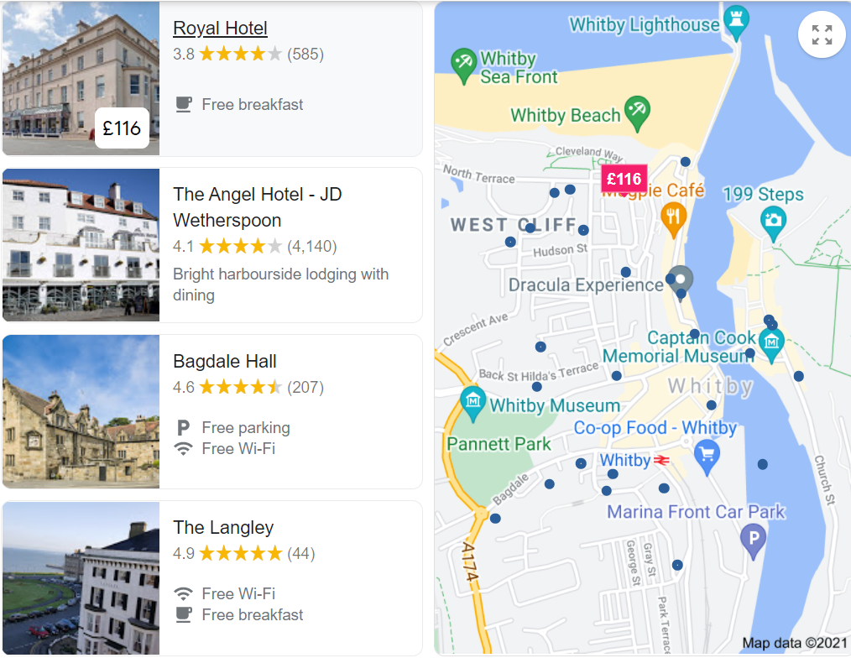

Slide 11


