Slide 1
L.C. Can I calculate bills?
Toolkit

Slide 2







4 Ops
Mr Rose is trying to work out how much money he has to spend each month.
After tax and other deductions, he earns £1,794 a month.
Mr Rose has bills to pay!
Gas and electricity costs £97 a month
Water costs £34 a month
How much does Mr Rose have to spend after he’s paid his bills?
£1,663
£97 $+$ £34
$=$ £131
£1,794 $−$ £131
£100 $+$ £34 $=$ £134
£134 $−$ £3 $=$ £131
Have a go

Slide 3





How much does Mr Rose have to spend after he’s paid his bills?
£1,663
He spends £55 a week on food.
One month, he does four weekly supermarket shops.
How much does Mr Rose have left?
£1,443
£55 $×$ 4
$=$£220
£1,663 $−$ £220
£50 $×$ 4 $=$ £200
£5 $×$ 4 $=$ £20
Have a think

Slide 4







Mrs Rose earns £1,204 a month after tax and other deductions.
Here are a list of bills she has to pay each month.
£104 for gas and electricity
£36 for water
£42 for the internet
She spends £288 on food each month.
What is Mrs Rose’s budget for the month after she has paid all her bills?
£734
£104$+$ £36 $+$ £42 $+$ £288
£1,204 $−$ £470
£140
$+$
£330
$=$£470
$+$ 30
$+$ 500
$+$ 204
Have a go
£470
£500
£1,000
£1,204

Slide 5


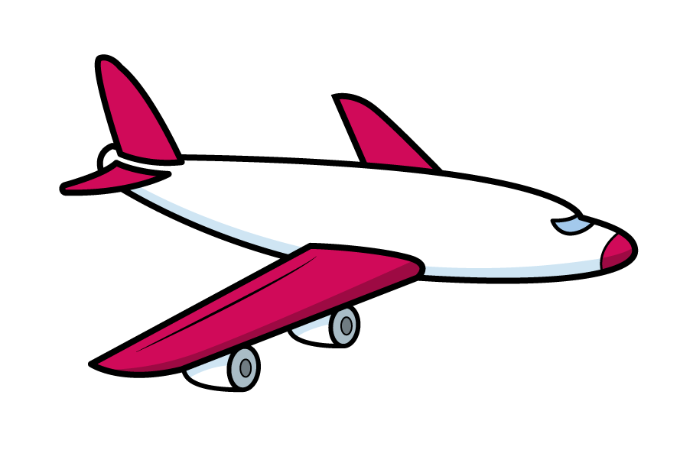

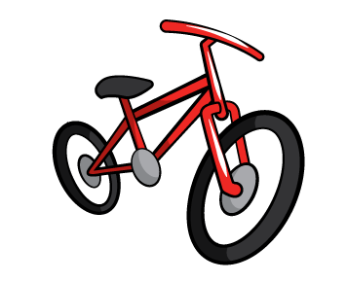
What is Mrs Rose’s budget for the month after
she has paid all her bills?
£734
Mrs Rose’s daughter has 8 football lessons a month.
Each lesson costs £30
Her son has 6 piano lessons a month.
Each lesson costs £40
Have a go
She has a dog walker 5 times a month.
Each walk costs £15
Mrs Rose is saving £100 a month for a
family holiday in the summer.
Can she afford to buy a new bike worth £90?

Slide 6








What is Mrs Rose’s budget for the month after
she has paid all her bills?
£734
Mrs Rose’s daughter has 8 football lessons a month.
Each lesson costs £30
£30 $×$ 8 $=$
£240
£240 $+$ £240 $=$ £480
£480 $+$ £100 $=$ £580
Her son has 6 piano lessons a month.
Each lesson costs £40
£40 $×$ 6 $=$
£240
£580 $+$ £75 $=$ £655
She has a dog walker 5 times a month.
Each walk costs £15
£15 $×$ 5 $=$
£75
Mrs Rose is saving £100 a month for a
family holiday in the summer.
Can she afford to buy a new bike worth £90?
£655 $+$ £90
No
$=$ £745

Slide 7




Fractions
Whitney earns £2,140 a month
She spends $\frac{\text{1}}{\text{5}}$ of her wage on bills.
She then spends $\frac{\text{3}}{\text{8}}$ of what is left on food and clothes.
With the wage that is left, she spends $\frac{\text{1}}{\text{2}}$ on hobbies.
How much does Whitney have left?
Have a go

Slide 8
Whitney earns £2,140 a month
She spends $\frac{\text{1}}{\text{5}}$ of her wage on bills.
She then spends $\frac{\text{3}}{\text{8}}$ of what is left on food and clothes.
£2,140
With the wage that is left, she spends $\frac{\text{1}}{\text{2}}$ on hobbies.
How much does Whitney have left?
?
5 | 2 | 1 | 4 | 0
0
4
2
8
1
4
Whitney spends £428 on bills.

Slide 9
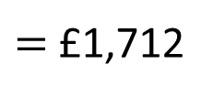
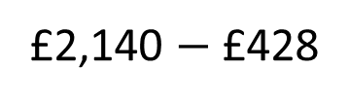
Whitney earns £2,140 a month
She spends $\frac{\text{1}}{\text{5}}$ of her wage on bills.
£428
She then spends $\frac{\text{3}}{\text{8}}$ of what is left on food and clothes.
8 | 1 | 7 | 1 | 2
£2,140 $−$ £428
$=$ £1,712
0
2
1
4
1
3
£1,712
£214
£214
£214
£642
?
Whitney spends £642 on food and clothes.

Slide 10
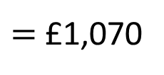
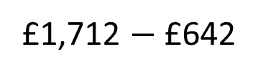
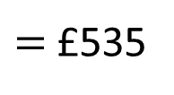
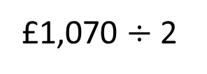
She spends $\frac{\text{1}}{\text{5}}$ of her wage on bills.
£428
She then spends $\frac{\text{3}}{\text{8}}$ of what is left on food and clothes.
£642
With the wage that is left, she spends $\frac{\text{1}}{\text{2}}$ on hobbies.
£1,712 $−$ £642
$=$ £1,070
£1,070 $÷$ 2
$=$ £535
How much does Whitney have left?
Whitney has £535 left.

Slide 11
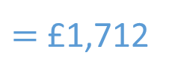
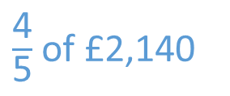
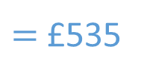

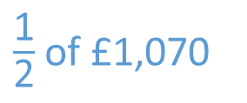

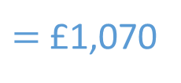
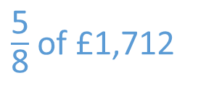
Whitney earns £2,140 a month
She spends $\frac{\text{1}}{\text{5}}$ of her wage on bills.
$\frac{\text{4}}{\text{5}}$ of £2,140
$=$ £1,712
She then spends $\frac{\text{3}}{\text{8}}$ of what is left on food and clothes.
$\frac{\text{5}}{\text{8}}$ of £1,712
$=$ £1,070
With the wage that is left, she spends $\frac{\text{1}}{\text{2}}$ on hobbies.
$\frac{\text{1}}{\text{2}}$ of £1,070
$=$ £535
How much does Whitney have left?
£535

Slide 12
Bills worksheet

Slide 13
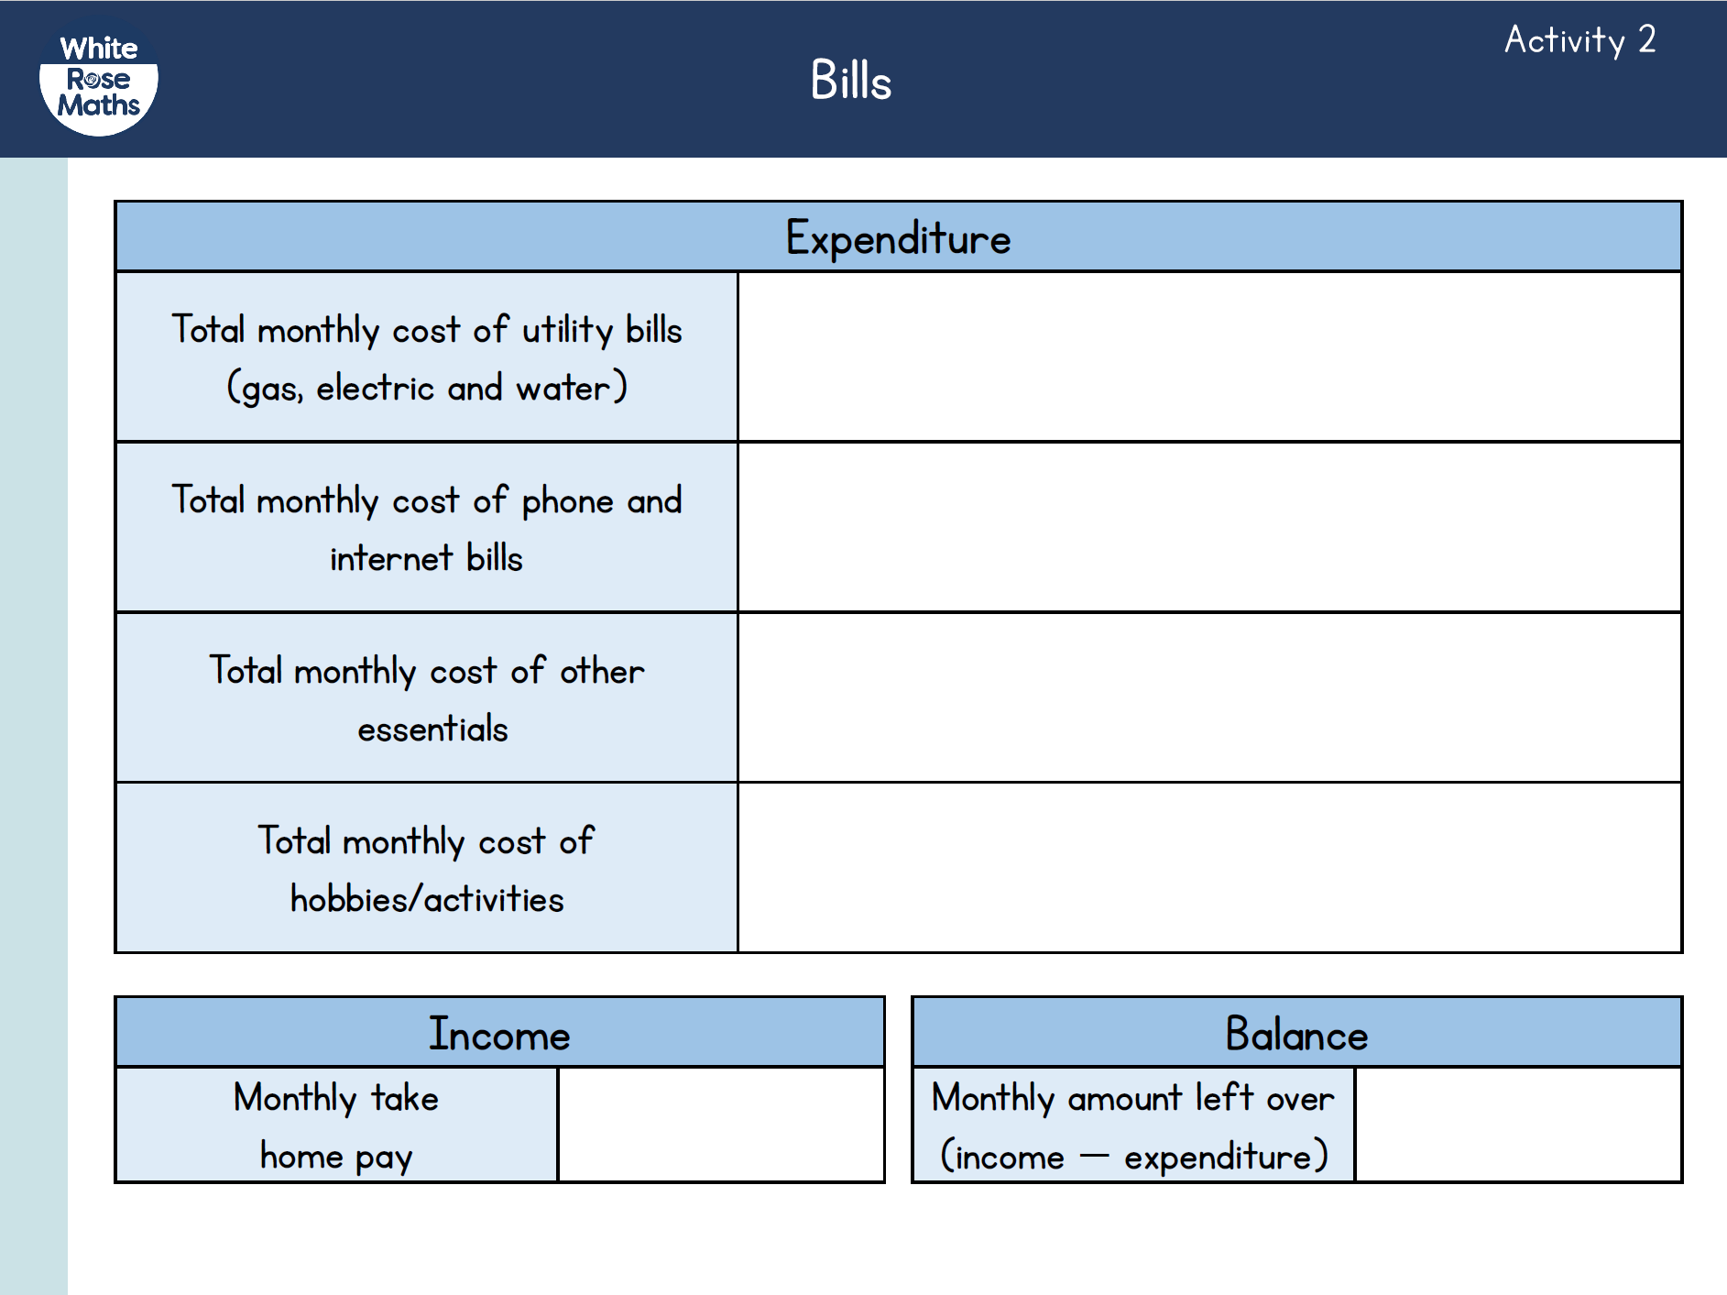
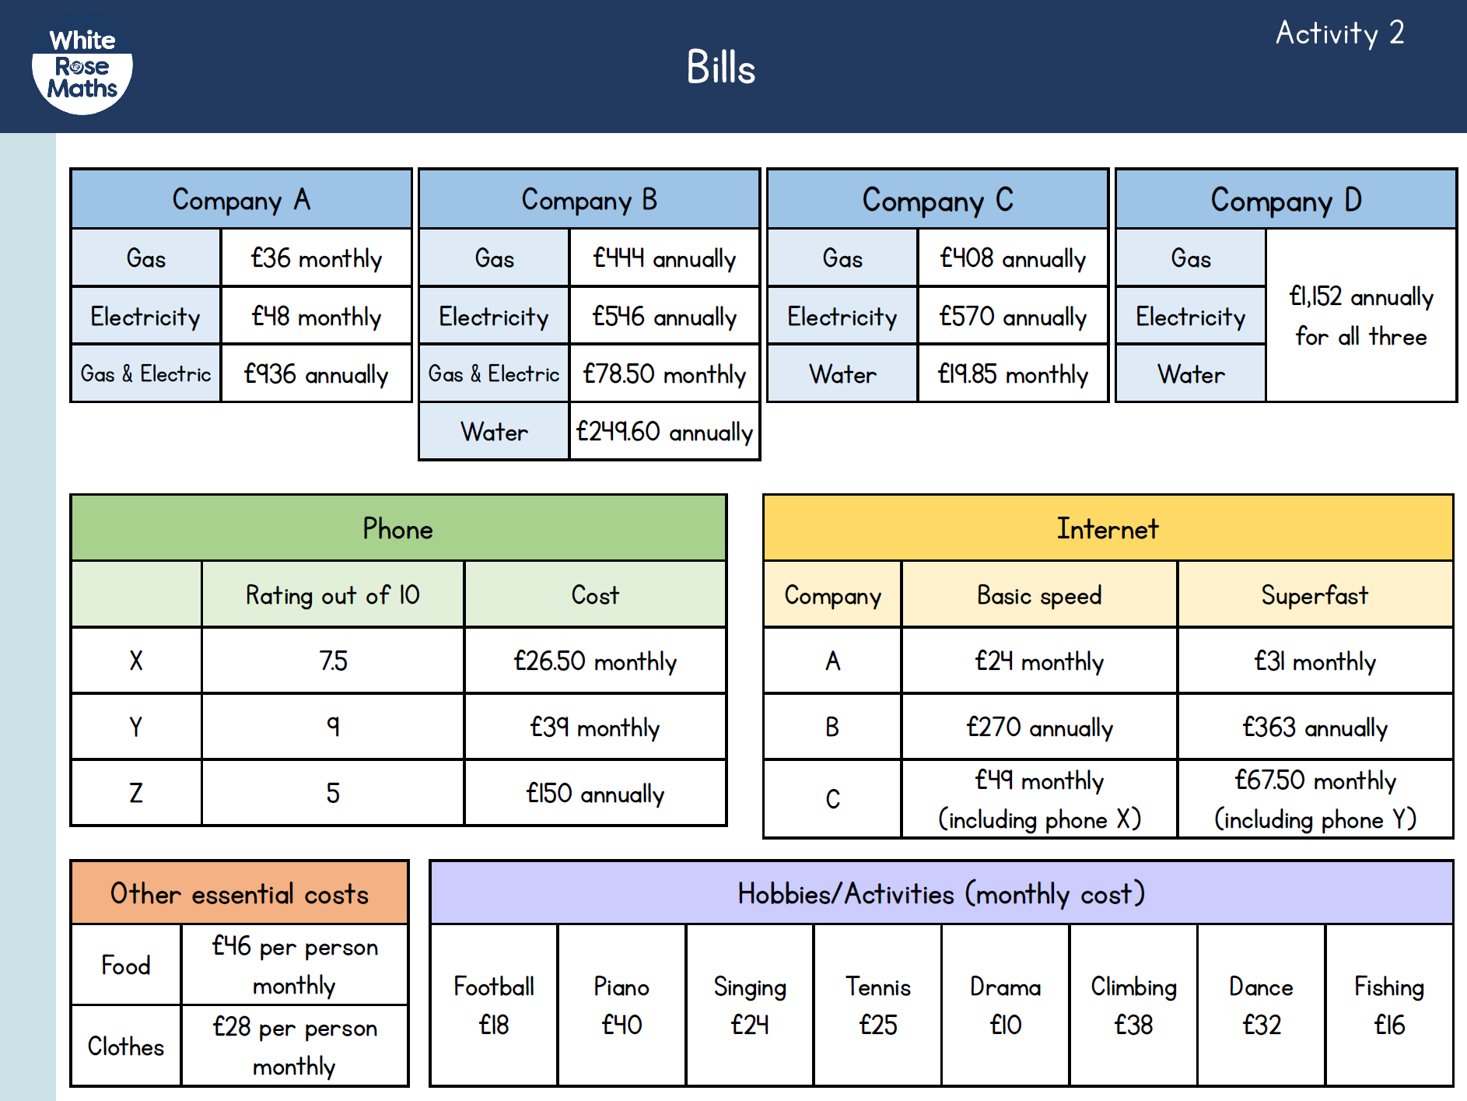
Activity 2
Use the bill template provided to work out the cost of bills per month.
What hobbies would you like to do?
Work out the cost of them per month.
Work out how much money you have left from your take-home pay after bills and extra activities.

