Slide 1
Malamander Chapter 23 and 24
https://www.youtube.com/watch?v=AHOoWjSh5ss chapter 23
https://www.youtube.com/watch?v=jhVqIpz81TA chapter 24
Why is Mr Mollusc suspicious about Herbie?
Who has written Herbie a letter?
How did Lady Kraken know what Herbie was up to?
Why doesn’t Lady K trust Violet?
Predict where Violet has gone.
Do you believe Violet is working with Sebastian Eels? Explain your answer.

Slide 2
L.C. Can I write a news article?
Toolkit

Slide 3
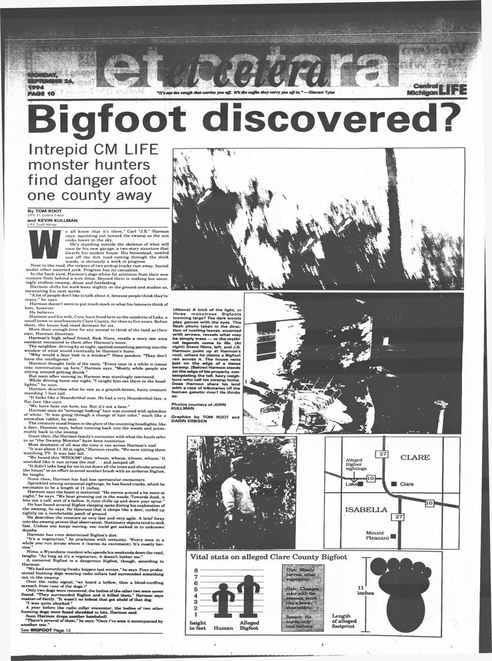
You’re hired
Following a sighting of the malamander the local newspaper ‘Eerie Times’ needs an article covering the story. It’s your job to write the story.

Slide 4
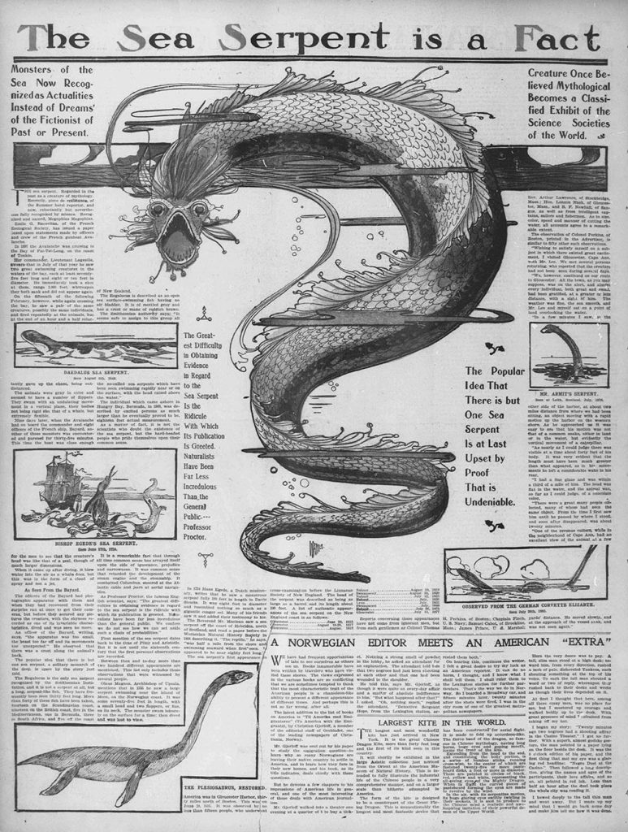
News article features
What features might we expect to find?
What can you see?

Slide 5
News article features
What features might we expect to find?
What can you see?

Slide 6
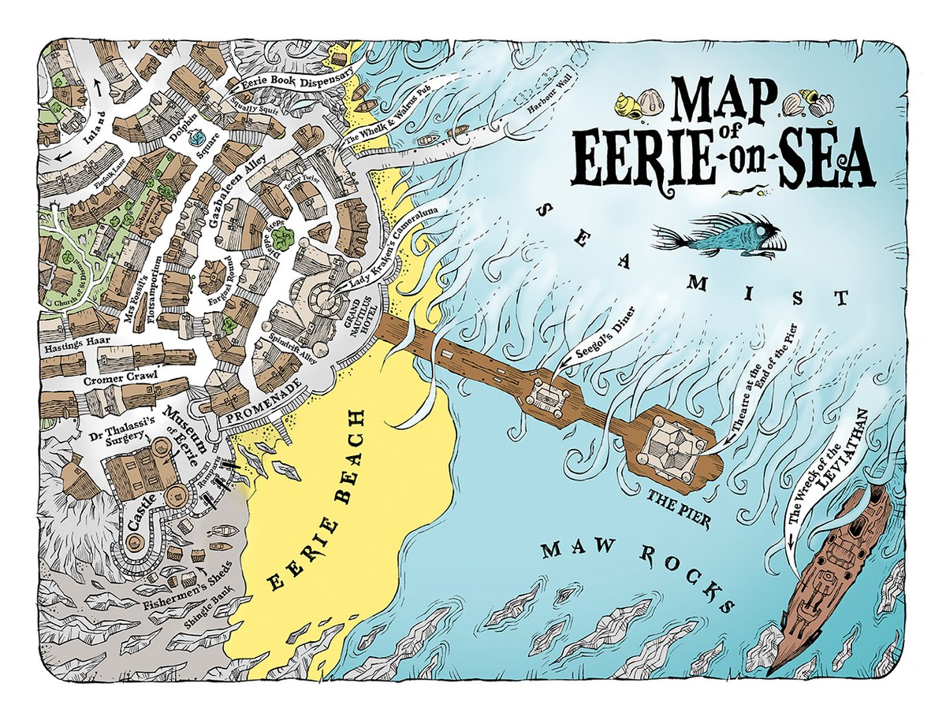
The facts you’ve been given:
The creature was spotted by several people (including Mrs Forester, Mr Thompson and Stuart Knowles, an expert in marine biology). Mrs Forster first spotted the creature while having her chips at Seegol’s Diner.
It appeared to be hungry, based on its movements.
It moved north, appearing to leap out of the water at times.
No one was injured but many cryptologists have flocked to the area in the hope they will get to see the creature.

Slide 7
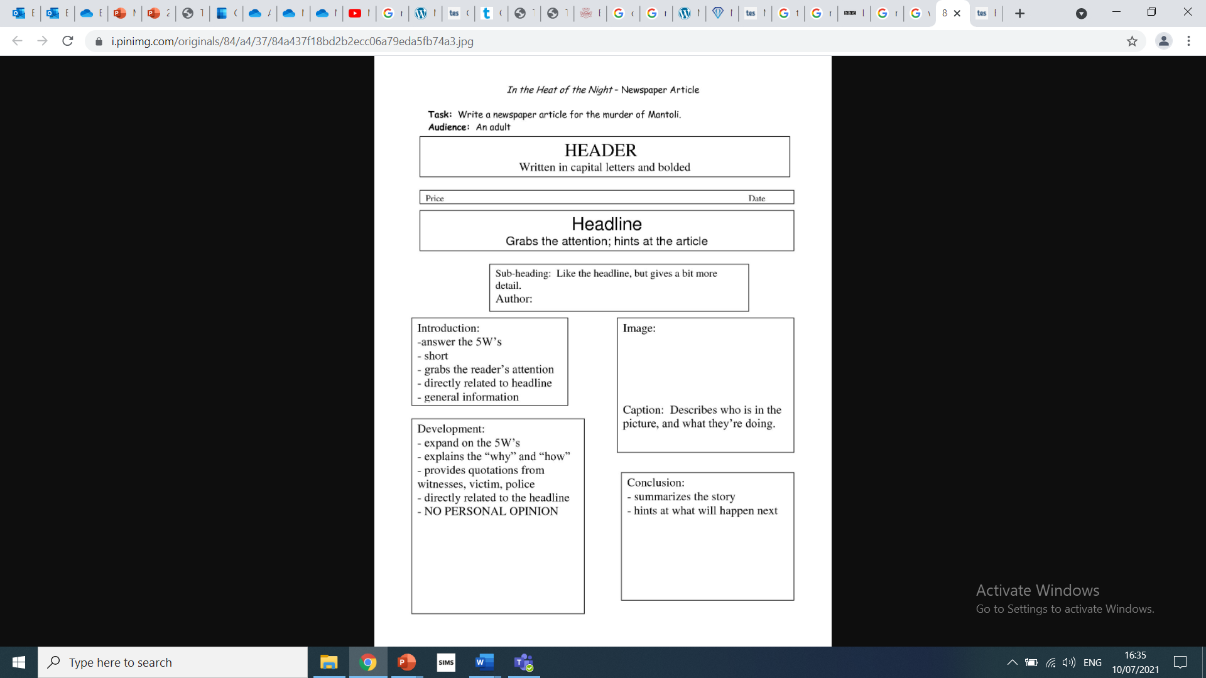
Task
Use the facts you’ve been given to plan and write your own news article.
You can make up quotes and draw your own images.

