Slide 1
L.C. Can I calculate hourly rates of pay?
Toolkit

Slide 2
Wages
Money people earn for doing a job
Hourly rate
The amount people earn for every hour worked

Slide 3


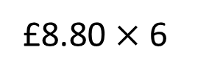
On Monday Amir works 6 hours.
Care worker
£8.80 an hour
How much money does he earn?
 | 8 | 8 | 0
 |  |  | 6
£8.80 $×$ 6
$$×$$
5
2
8
0
4
Amir earns £52.80

Slide 4

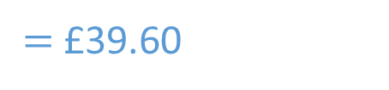



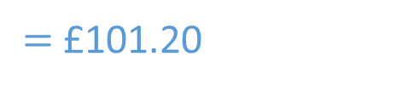

On Tuesday Amir works 7 hours.
£61.60
Care worker
£8.80 an hour
On Wednesday he works 4 and a half hours.
£39.60
How much money does Amir earn over the two days?
£61.60 $+$ £39.60
$=$ £101.20
 | 8 | 8 | 0
 |  |  | 7
 | 8 | 8 | 0
 |  |  | 4
$$×$$
Amir earns £101.20
$$×$$
6
1
6
0
3
5
2
0
5
3
Have a go
£35.20 $+$ £4.40
$=$ £39.60

Slide 5

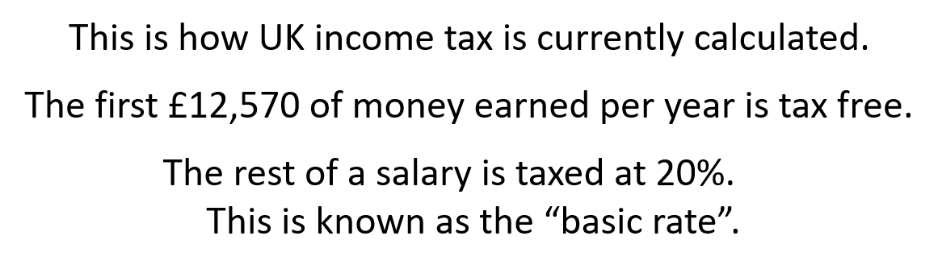
Eva works 30 hours a week.
Retail worker
£9.30 an hour
She works 45 weeks of the year.
How much does Eva earn per week?
How much does Eva earn in a year?
Will she have to pay tax?
Have a go

Slide 6
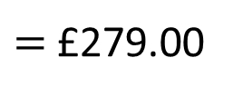
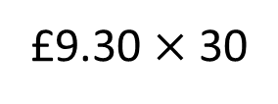
Eva works 30 hours a week.
Retail worker
£9.30 an hour
She works 45 weeks of the year.
How much does Eva earn per week?
£279.00
How much does Eva earn in a year?
Will she have to pay tax?
 | 9 | 3 | 0
 |  |  | 3
£9.30 $×$ 30
$=$ £279.00
2
7
9
0

Slide 7




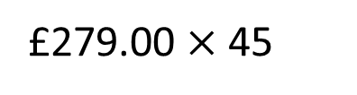
Eva works 30 hours a week.
Retail worker
£9.30 an hour
She works 45 weeks of the year.
How much does Eva earn per week?
Th | H | T | O
 | 2 | 7 | 9
 |  | 4 | 5
£279.00
How much does Eva earn in a year?
£12,555
Will she have to pay tax?
$$×$$
No
£279.00 $×$ 45
1
3
9
5
$($279 $×$ 5$)$
$$+$$
3
4
1
1
1
6
0
$($279 $×$ 40$)$
3
3
The first £12,570 of money earned per year is tax free.
1
2
5
5
5
1

Slide 8

Delivery driver
£10.20 an hour
Day | Shift start and end time
Monday | 7:30 am - 4:30 pm
Tuesday | 12 pm - 8 pm
Thursday | 1 pm - 10 pm
Friday | 8 am - 3:30 pm
Saturday | 10:30 am - 3:30 pm
Mo has a 1 hour break each day.
What is Mo’s wage this week before deductions?
Have a go

Slide 9







Delivery driver
£10.20 an hour
Day | Shift start and end time
Monday | 7:30 am - 4:30 pm
Tuesday | 12 pm - 8 pm
Thursday | 1 pm - 10 pm
Friday | 8 am - 3:30 pm
Saturday | 10:30 am - 3:30 pm
Hours
8
7
8
6.5
4
Mo has a 1 hour break each day.
What is Mo’s wage this week before deductions?
£341.70
Mo works 33.5 hours
£10.20 $×$33.5
£10.20 $×$30
$=$ £306
£10.20 $×$3
$=$ £30.60
£10.20 $×$ 0.5
$=$ £5.10

Slide 10
Hourly rates worksheet

Slide 11
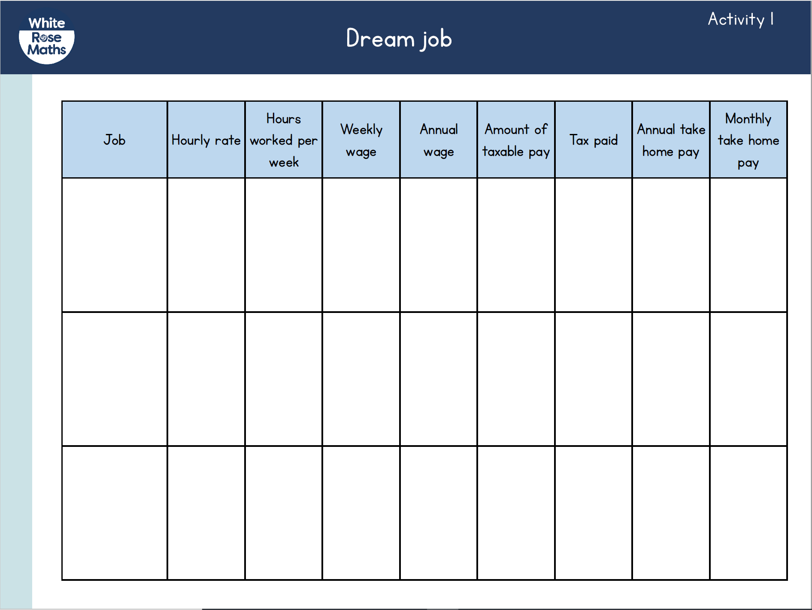
Activity 1
Research the salary of your dream job or choose from the jobs we have provided.
Complete the table.
Work out what your
gross pay would be
and your take-home
pay.

