Slide 1
L.C. Can I calculate salaries?
Toolkit

Slide 2















I want to be an astronaut!
I want to work with animals!
I want to help people!
I want to be a teacher!

Slide 3

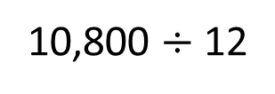
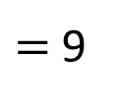
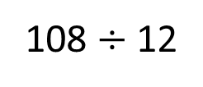
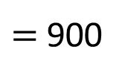
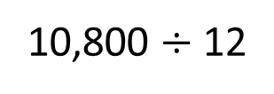
4 Ops
Money
Receptionist
£10,800 per year
How much is Tommy paid monthly?
£900 per month
10,800 $÷$ 12
108 $÷$ 12
$=$ 9
10,800 $÷$ 12
$=$ 900

Slide 4


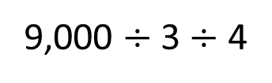
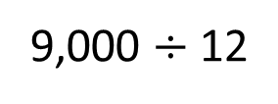
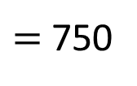
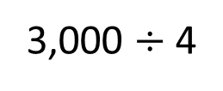
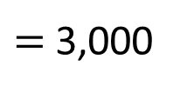
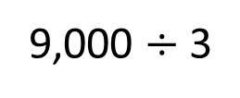
Bank cashier
£9,000 per year
How much is Dora paid per month?
£750 per month
9,000 $÷$ 12
3
4
9,000 $÷$ 3 $÷$ 4
9,000 $÷$ 3
$=$ 3,000
3,000 $÷$ 4
$=$ 750
Have a go

Slide 5
Salary
A fixed payment over a period of time
Gross pay
The total amount earned
Take-home pay
The amount you receive after taxes and other deductions

Slide 6

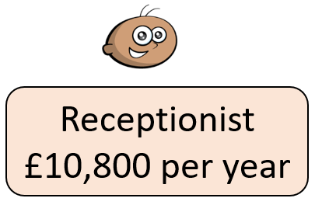
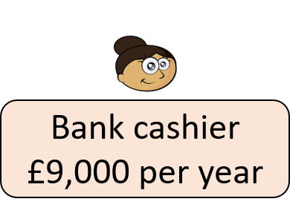
Police officer
£23,100 per year
This is how UK income tax is currently calculated.
The first £12,570 of money earned per year is tax free.
The rest of Rosie’s salary is taxed at 20%.
This is known as the “basic rate”.
Dora and Tommy do not have to pay income tax as their salary is less than £12,570
How much money will Rosie take home each month?

Slide 7
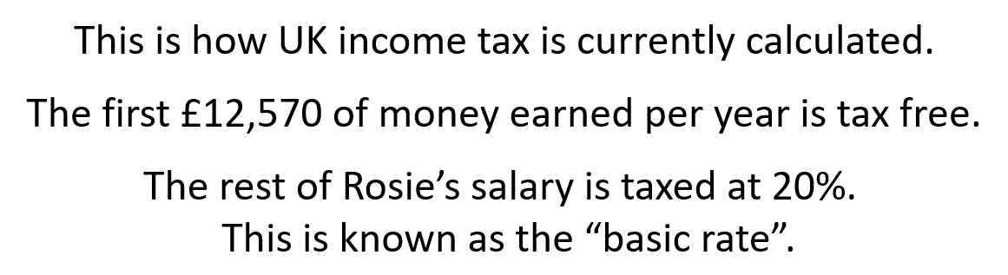




Police officer
£23,100 per year
How much money will Rosie take home each month?
Rosie will pay tax on £23,100 $−$ £12,570
$=$ £10,530
20% of £10,530
$=$ £2,106
£10,530
Rosie’s annual take-home pay $=$ £23,100 $−$ £2,106
$=$ £20,994
1,053
1,053
?

Slide 8
Rosie’s annual take-home pay $=$ £20,994
Rosie’s monthly take-home pay $=$ £20,994 $÷$ 12
1 | 2 | 3 | 4 | 5 | 6 | 7 | 8 | 9 | 10
12
24
36
48
60
72
84
96
108
120
12 | 2 | 0 | 9 | 9 | 4
0
1
7
4
9
5
.
2
8
5
11
6
0
.
Rosie takes home £1,749.50 every month.

Slide 9
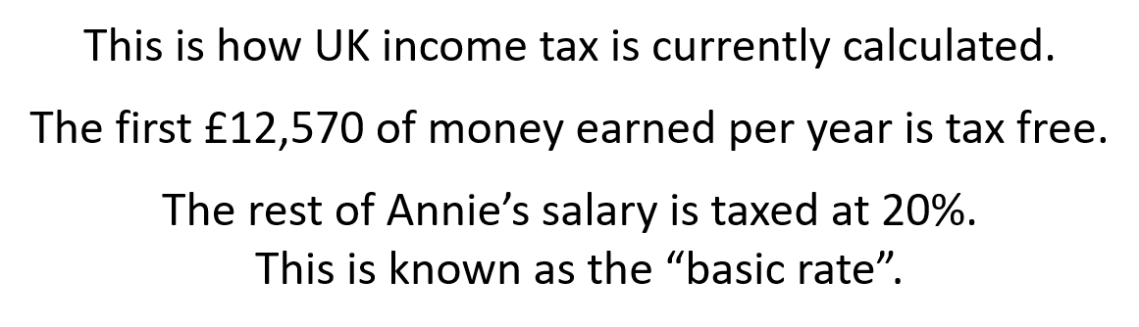
Doctor
£32,340 per year
How much money will Annie take home each month?
Have a go

Slide 10






Doctor
£32,340 per year
How much money will Annie take home each month?
Annie will pay tax on £32,340 $−$ £12,570
$=$ £19,770
20% of £19,770
$=$ £3,954
10% of £19,770 $=$ £1,977
£1,977 $×$ 2 $=$ £3,954
Annie’s annual take-home pay $=$ £32,340 $−$ £3,954
$=$ £28,386

Slide 11
Annie’s annual take-home pay $=$ £28,386
Annie’s monthly take-home pay $=$ £28,386 $÷$ 12
1 | 2 | 3 | 4 | 5 | 6 | 7 | 8 | 9 | 10
12
24
36
48
60
72
84
96
108
120
12 | 2 | 8 | 3 | 8 | 6
0
2
3
6
5
. 5
2
4
7
6
6
. 0
Annie takes home £2,365.50 every month.

Slide 12
Annual salary worksheet

