Slide 1
Malamander Chapter 21 and 22
https://www.youtube.com/watch?v=M3qDUWuR5fM chapter 21
https://www.youtube.com/watch?v=A38vEaiChNM chapter 22
What was the condition of Captain K’s wish?
What happened to the captain when the egg was gone?
Why is the museum cold?
What do they find in the hearth of the chimney?
What has Violet taken?
Summarise this chapter in fewer than thirty words.

Slide 2
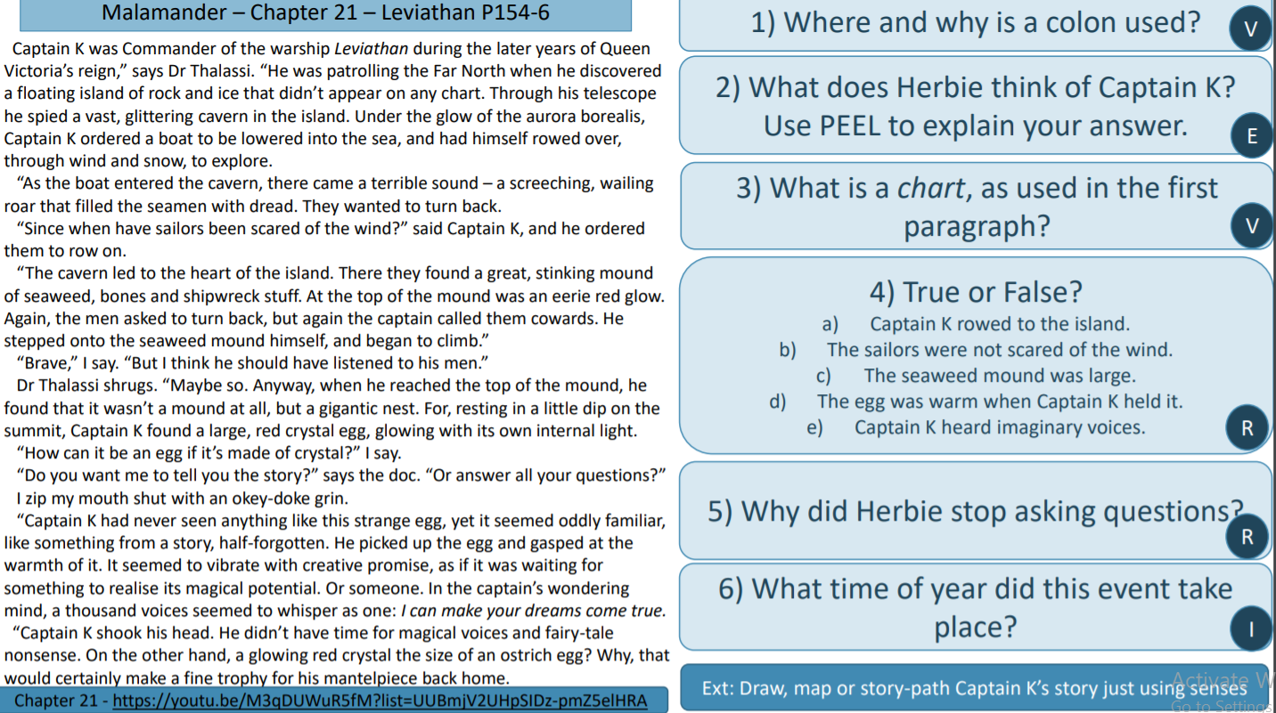

Slide 3
L.C. Can I structure a persuasive argument?
Toolkit

Slide 4
The three steps to persuade
Step 1: List all the reasons why having the malamander egg could be a problem (column 1 of the table on the next page)
Step 2: Explain or give examples for each reason (column 2 of the table on the next page)
Step 3: Write your persuasive argument following the OREO structure. Remember to use the language techniques you know from PURSUADE. If you cant think of your reasons, I’ve done some examples for you.

Slide 5
Reason it could cause problems | Evidence / Examples / Explanations / Facts (make up details if you need to)

Slide 6
Reason it could cause problems | Evidence / Examples / Explanations / Facts (make up details if you need to)
Something / someone who wants the egg might come to the hotel and try to get the egg back (the malamander / Boat Hook Man / Mr Eels / someone else) | • Herbie’s cubbyhole / cellar might get damaged in any attack, which would upset Lady Kraken / Mr Mollusc. The museum windows are already broken. The Leviathan was sunk. If this were to happen, then Herbie could lose his home and job. • The children might get physically hurt. Violet could have been in the trunk when BHM smashed it up (so we know he’s dangerous), she already has a twisted ankle from when he attacked them before. • Other people in the hotel might get hurt – Mrs Fossil is already injured (by something or someone, and probably because of the egg).
She stole from Dr Thalassi, which will have broken his trust. | • Dr Thalassi might tell Mr Mollusc / Lady Kraken / the police, and Herbie could lose his job and his home – a lost-and-founder needs to be trustworthy. • He will know that Violet and Herbie took it because there was no one else there. • He seems to care about the children – he walked them home, listened to them, gave them information. They might need him again. • He is the town’s doctor and they might need his help if they get injured or sick • If other people find out that they stole, then they might lose their trust too (Mrs Fossil / Jenny Haniver / Mr Eels / Amber Griss)

Slide 7
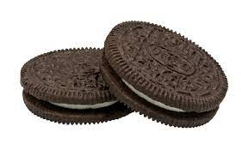
Oreo
Persuasive arguments are easier to write and to understand if you use a logical structure - OREO.
O = opinion (what do you think?)
R = reason (give a reason for your opinion)
E = explain / examples (explain the reason and give examples)
O = restate your opinion (use different words)

Slide 8

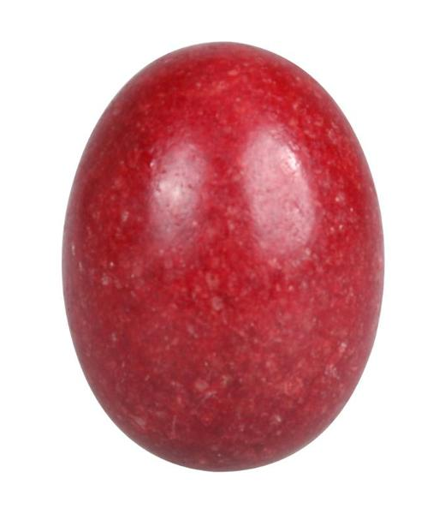
Task
You are going to write, using OREO, to persuade Violet that having the malamander egg is a BAD idea
You must:
• follow the OREO structure
• use personal pronouns and direct language
• include a rhetorical question you could:
• vary your openers
• use a colon

