Slide 1
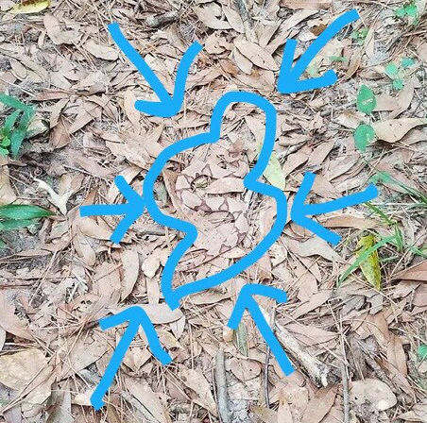
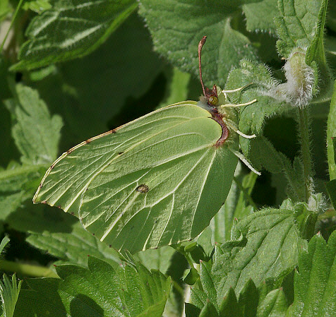
Camouflage Critters!

Slide 2
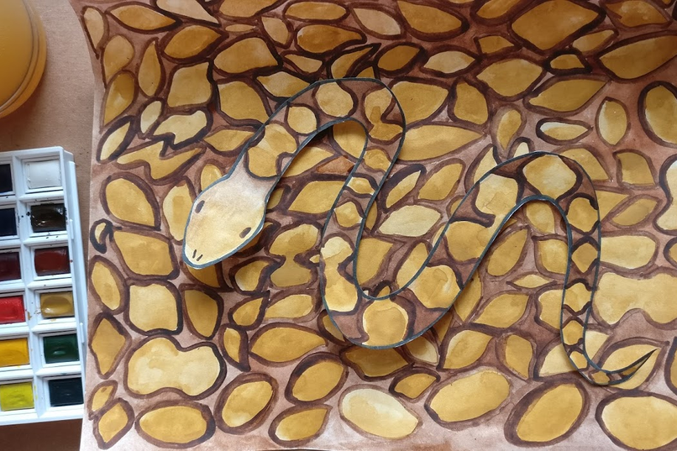

Slide 3
The Science of Camouflage
Have you ever wanted to make yourself disappear while playing a game of hide and seek? Some animals do this every day! Camouflage is a defence technique used by animals to avoid being seen or help them blend in with their environment. For example, many animals that live in places with lots of snow, like polar bears, have white fur. This helps them sneak up on their prey without being noticed! Prey animals can also use camouflage. The snowshoe hare has white fur like the polar bear, but it uses it to blend in with snow to hide from predators.
There are many other ways that camouflage is used in the animal kingdom. Some animals blend in by using multiple colours, designs or patterns on their bodies to make it harder to see the outline of the animal. This is called disruptive coloration. Examples of disruptive coloration include the way a tiger’s stripes mimic their environment to help them blend in, the way that a sea turtle’s shell patterns blend in with the ocean floor, and the way that some butterflies have spots that look like giant eyes on their wings, tricking predators into thinking they are much larger animals.

Slide 4
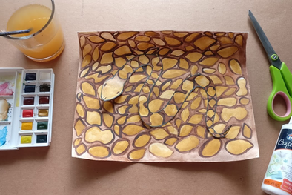
Your turn!
For this project you will be colouring an animal of your choice with a pattern to help it camouflage with a background
You will need:
paper
critter printout or a critter outline you drew yourself
scissors
glue
paint or something to colour with (pencil, crayons, paint, whatever you have)

Slide 5
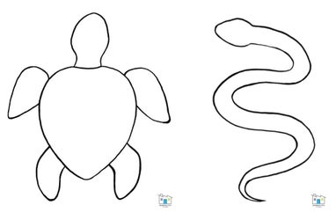

Step 1: Choose a Critter
For this step, you can choose one of the printable critter outlines provided in this post or draw your own critter outline!

Slide 6
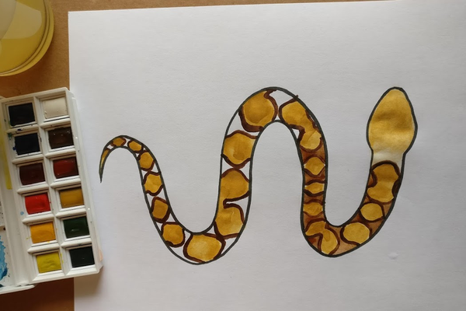
Step 2: Paint Your Critter!
Choose a pattern and paint your critter with the pattern. You can choose a colourful, fun pattern or a more realistic pattern. For my project, I looked up the colouring of a copperhead snake and used that as an inspiration. This is a very fun project to practice painting skills on but it can also be done with colouring supplies or other creative methods of pattern making (collage, printing, etc). Since you will be cutting your critter out later, you don’t need to worry about painting outside of the lines.

Slide 7
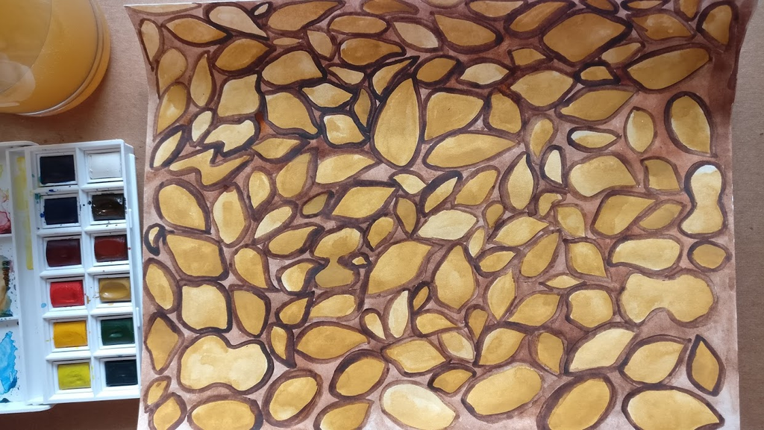
Step 3: Create a Background
Next, you will paint the same pattern you used on your critter on a full sheet of paper. This will be the background that your critter will blend into!

Slide 8
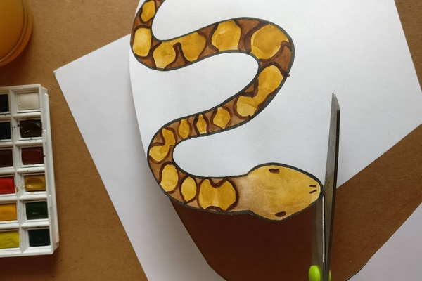

Step 4: Camouflage Your Critter!
Cut your critter out and position it on your background however you like. Glue the critter in place and show off your amazing camouflage art project!

