Slide 1
L.C. Can I identify tenths and hundredths?

Slide 2
5NPV-1 Tenths and hundredths
10 tenths are equivalent to one.
0.1
0.1
0.1
0.1
0.1
Count in steps of 0.1 to 1
How many steps did you count?
Why do we not record 10 tenths as 0.10?
1
0.1
0.1
0.1
0.1
0.1

Slide 3
5NPV-1 Tenths and hundredths
10 hundredths are equivalent to one-tenth.
0.01
0.01
0.01
0.01
0.01
Count in steps of 0.01 to 0.1
How many steps did you count?
0.1
0.01
0.01
0.01
0.01
0.01

Slide 4


5NPV-1 Tenths and hundredths
1 one
1 tenth
1 hundredth
Use Dienes blocks to show that 10 tenths are equivalent to one.
Also that 10 hundredths are equivalent to one tenth.

Slide 5
5NPV-1 Tenths and hundredths
0.1
0.1
0.1
0.1
10 tenths are equivalent to one.
18 tenths are equivalent to 1.8.
0.1
0.1
0.1
0.1
Take a handful of 0.1 counters and write and say the number you have. Say it two ways: saying the number of tenths you have, and saying the way the number is normally read.
Repeat the activity with a different number of counters.
1.8
0.1
0.1
0.1
0.1
0.1
0.1
0.1
0.1
0.1
0.1

Slide 6
5NPV-1 Tenths and hundredths
0.01
0.01
0.01
0.01
10 hundredths are equivalent to 0.1.
18 hundredths are equivalent to 0.18.
0.01
0.01
0.01
0.01
Take a handful of 0.01 counters, and write and say the number you have. Say it two ways: saying the number of hundredths you have, and saying the way the number is normally read.
Repeat the activity with a different number of counters.
0.18
0.01
0.01
0.01
0.01
0.01
0.01
0.01
0.01
0.01
0.01

Slide 7
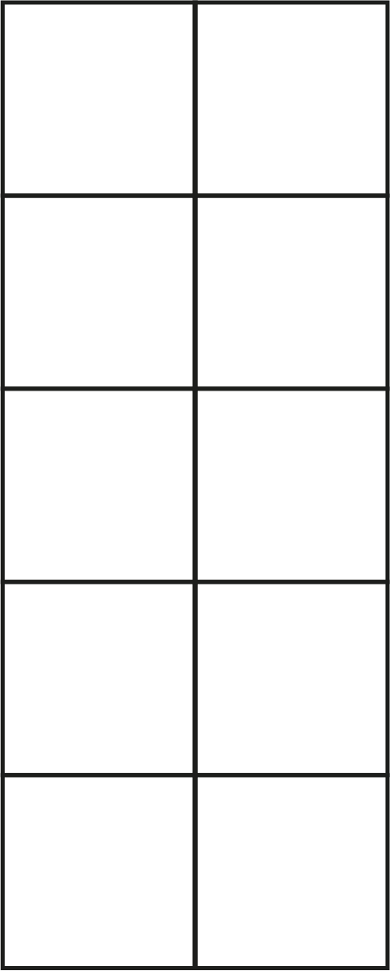
5NPV-1 Tenths and hundredths
0.1
0.1
0.1
0.1
0.1
0.1
0.1
0.1
0.1
0.1
0.1
0.1
0.1
0.1
0.1
0.1
0.1
0.1
0.1
0.1
0.1
0.1
0.1
0.1
0.1
0.1
0.1
0.1
0.1
0.1
0.1
0.1
0.1
0.1
0.1
0.1
0.1
0.1
0.1
0.1
0.1
0.1
0.1
0.1
0.1
0.1
0.1
0.1
0.1
0.1
Count up in 0.1s. Stop at a number. How many tenths do you have in total?
How would you normally say this number?

Slide 8
5NPV-1 Tenths and hundredths
0.01
0.01
0.01
0.01
0.01
0.01
0.01
0.01
0.01
0.01
0.01
0.01
0.01
0.01
0.01
0.01
0.01
0.01
0.01
0.01
0.01
0.01
0.01
0.01
0.01
0.01
0.01
0.01
0.01
0.01
0.01
0.01
0.01
0.01
0.01
0.01
0.01
0.01
0.01
0.01
0.01
0.01
0.01
0.01
0.01
0.01
0.01
0.01
0.01
0.01
Count up in 0.01s. Stop at a number. How many hundredths do you have in total?
How would you normally say this number?

Slide 9
5NPV-1 Tenths and hundredths
0.1
0.2
0.3
0.4
0.5
0.6
0.7
0.8
0.9
1
Count in tenths. What do you notice when you get to the end of each row?
Choose a number and say how many tenths it is made from.
1.1
1.2
1.3
1.4
1.5
1.6
1.7
1.8
1.9
2
2.1
2.2
2.3
2.4
2.5
2.6
2.7
2.8
2.9
3
3.1
3.2
3.3
3.4
3.5
3.6
3.7
3.8
3.9
4
4.1
4.2
4.3
4.4
4.5
4.6
4.7
4.8
4.9
5
5.1
5.2
5.3
5.4
5.5
5.6
5.7
5.8
5.9
6
6.1
6.2
6.3
6.4
6.5
6.6
6.7
6.8
6.9
7
7.1
7.2
7.3
7.4
7.5
7.6
7.7
7.8
7.9
8
8.1
8.2
8.3
8.4
8.5
8.6
8.7
8.8
8.9
9
9.1
9.2
9.3
9.4
9.5
9.6
9.7
9.8
9.9
10

Slide 10
5NPV-1 Tenths and hundredths
0.1
0.1
0.1
0.1
0.1
0.1
0.1
0.1
0.1
0.1
What do you notice about the value of the each row? And of the whole grid?
Click to reveal a number of tenths.
How many tenths are there? What is the total value of those tenths?
Highlight some of the tenths in a grid yourself. How many tenths are there? What is the number you have made?
0.1
0.1
0.1
0.1
0.1
0.1
0.1
0.1
0.1
0.1
0.1
0.1
0.1
0.1
0.1
0.1
0.1
0.1
0.1
0.1
0.1
0.1
0.1
0.1
0.1
0.1
0.1
0.1
0.1
0.1
0.1
0.1
0.1
0.1
0.1
0.1
0.1
0.1
0.1
0.1
0.1
0.1
0.1
0.1
0.1
0.1
0.1
0.1
0.1
0.1
0.1
0.1
0.1
0.1
0.1
0.1
0.1
0.1
0.1
0.1
0.1
0.1
0.1
0.1
0.1
0.1
0.1
0.1
0.1
0.1
0.1
0.1
0.1
0.1
0.1
0.1
0.1
0.1
0.1
0.1
0.1
0.1
0.1
0.1
0.1
0.1
0.1
0.1
0.1
0.1

Slide 11
5NPV-1 Tenths and hundredths
0.01
0.02
0.03
0.04
0.05
0.06
0.07
0.08
0.09
0.1
Count in hundredths. What do you notice when you get to the end of each row?
Choose a number and say how many hundredths it is made from.
0.11
0.12
0.13
0.14
0.15
0.16
0.17
0.18
0.19
0.2
0.21
0.22
0.23
0.24
0.25
0.26
0.27
0.28
0.29
0.3
0.31
0.32
0.33
0.34
0.35
0.36
0.37
0.38
0.39
0.4
0.41
0.42
0.43
0.44
0.45
0.46
0.47
0.48
0.49
0.5
0.51
0.52
0.53
0.54
0.55
0.56
0.57
0.58
0.59
0.6
0.61
0.62
0.63
0.64
0.65
0.66
0.67
0.68
0.69
0.7
0.61
0.72
0.73
0.74
0.75
0.76
0.77
0.78
0.79
0.8
0.81
0.82
0.83
0.84
0.85
0.86
0.87
0.88
0.89
0.9
0.91
0.92
0.93
0.94
0.95
0.96
0.97
0.98
0.99
1

Slide 12
5NPV-1 Tenths and hundredths
0.01
0.01
0.01
0.01
0.01
0.01
0.01
0.01
0.01
0.01
What do you notice about the value of the each row? And of the whole grid?
Click to reveal a number of hundredths.
How many hundredths are there? What is the total value of those hundredths?
Highlight some of the hundredths in a grid yourself. How many hundredths are there? What is the number you have made?
0.01
0.01
0.01
0.01
0.01
0.01
0.01
0.01
0.01
0.01
0.01
0.01
0.01
0.01
0.01
0.01
0.01
0.01
0.01
0.01
0.01
0.01
0.01
0.01
0.01
0.01
0.01
0.01
0.01
0.01
0.01
0.01
0.01
0.01
0.01
0.01
0.01
0.01
0.01
0.01
0.01
0.01
0.01
0.01
0.01
0.01
0.01
0.01
0.01
0.01
0.01
0.01
0.01
0.01
0.01
0.01
0.01
0.01
0.01
0.01
0.01
0.01
0.01
0.01
0.01
0.01
0.01
0.01
0.01
0.01
0.01
0.01
0.01
0.01
0.01
0.01
0.01
0.01
0.01
0.01
0.01
0.01
0.01
0.01
0.01
0.01
0.01
0.01
0.01
0.01

Slide 13
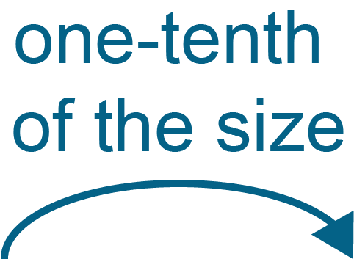
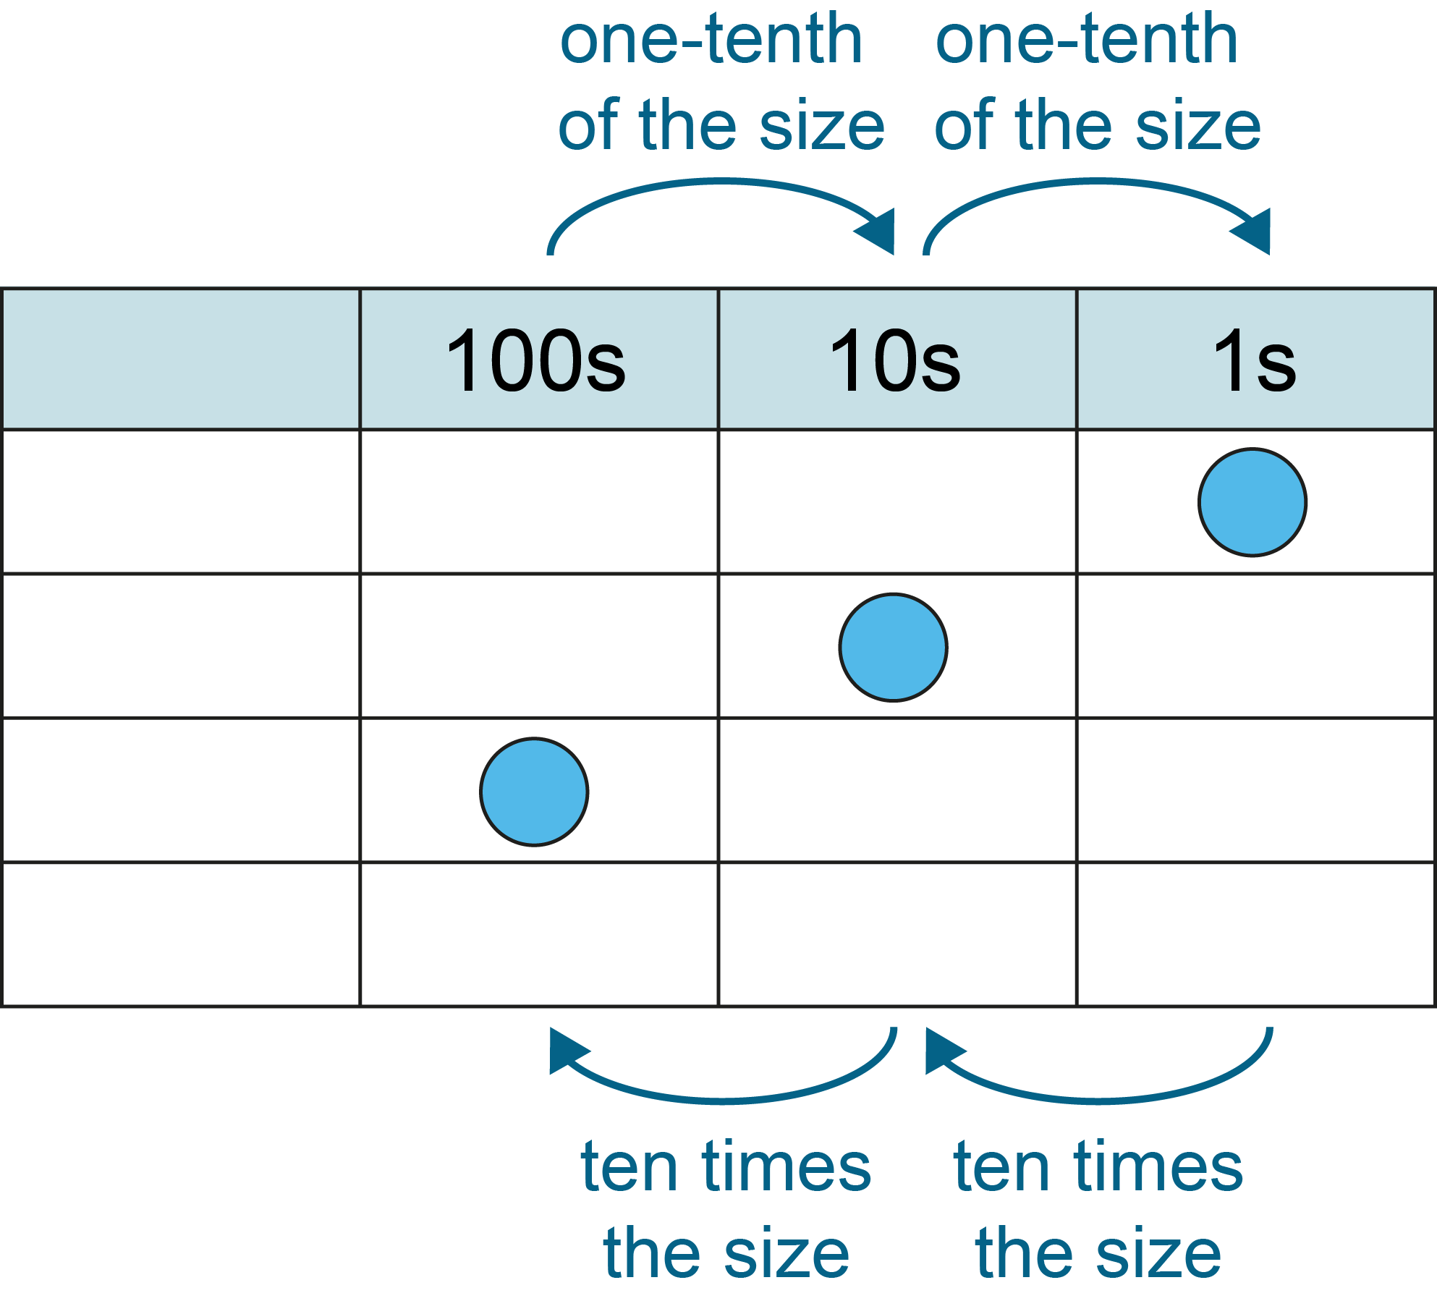

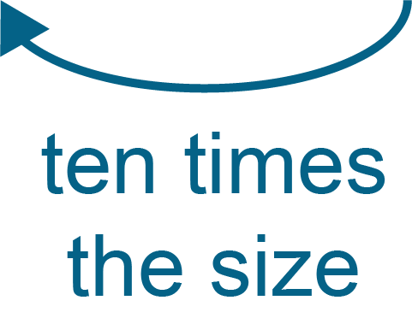
5NPV-1 Tenths and hundredths
If the blue counter has a value of 1, what happens to its value when it moves from the ones column to the tenths column? And from the tenths column to the hundredths column?
What happens to the counter’s value when you move it the other way?
1s
0.1s
0.01s

Slide 14
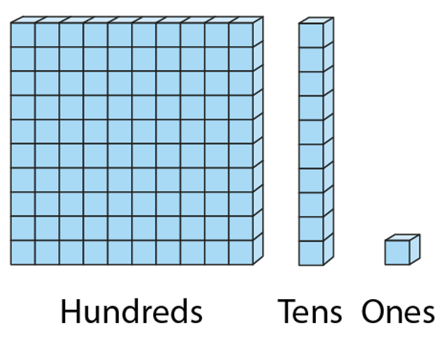
5NPV-1 Tenths and hundredths
Compare the value of the units. What do you notice?
1 one
1 tenth
1 hundredth

Slide 15
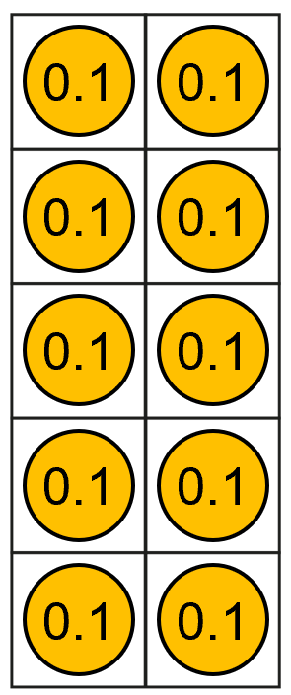
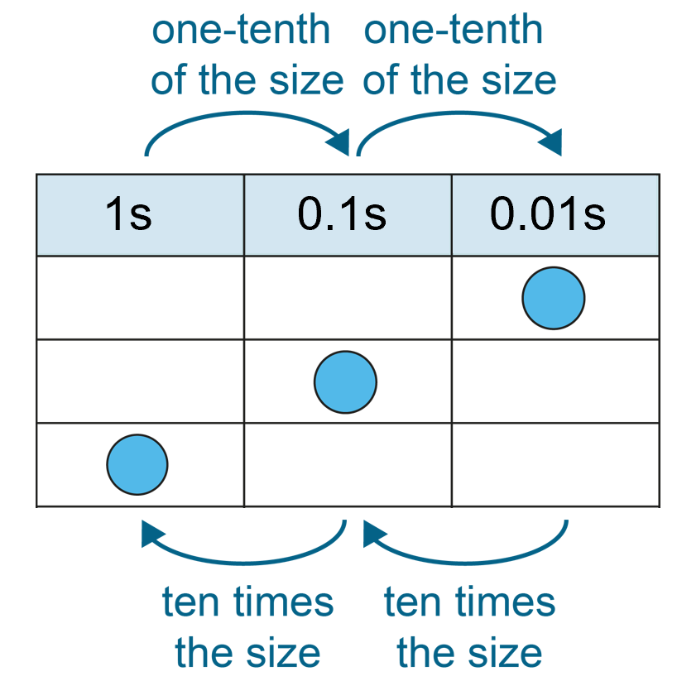
5NPV-1 Tenths and hundredths
Grouping and exchange model
Scaling model
10 tenths are equivalent
to one.
1 is ten times the size of 0.1.
0.1 is one-tenth the size of 1.
Practise describing the relationship between 0.1 and 1 in these two different ways.

Slide 16
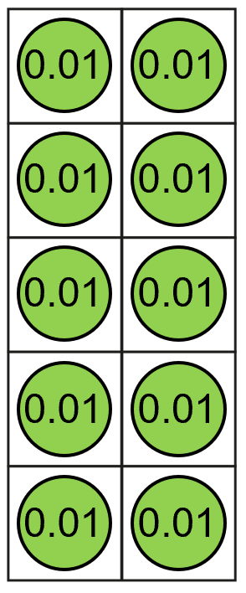
5NPV-1 Tenths and hundredths
Grouping and exchange model
Scaling model
10 hundredths are equivalent to
1 tenth
0.1 is ten times the size of 0.01
0.01 is one-tenth the size of 0.1
Practise describing the relationship between 0.1 and 0.01 in these two different ways.

