Slide 1
L.C. Can I subtract fractions?
Toolkit

Slide 2
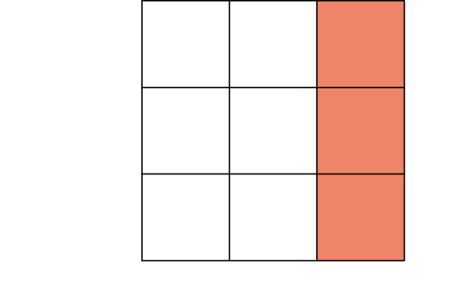
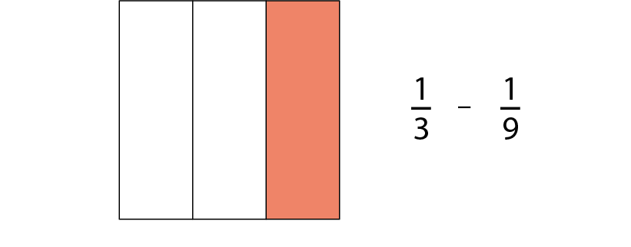
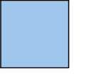
3.8 Common denomination
Step 2:2

Slide 3
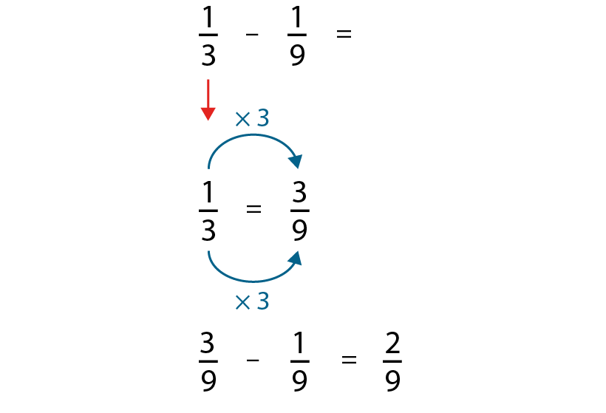
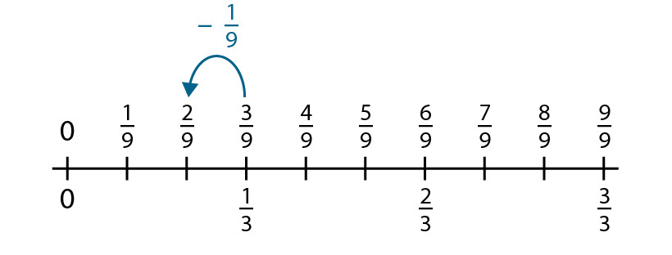
3.8 Common denomination
Step 2:2
Notes:
How could we rewrite one-third so that the denominators of both fractions in our calculation are the same?

Slide 4
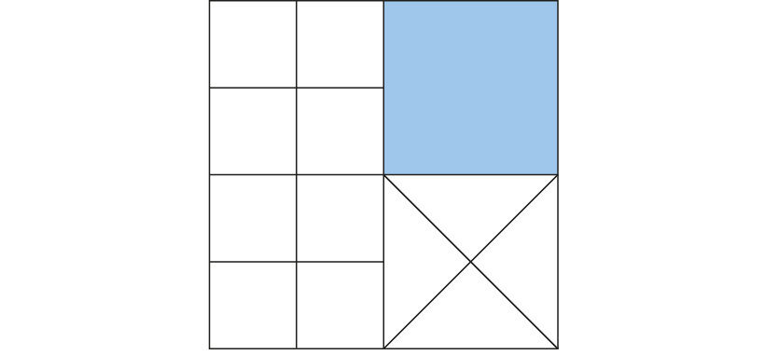
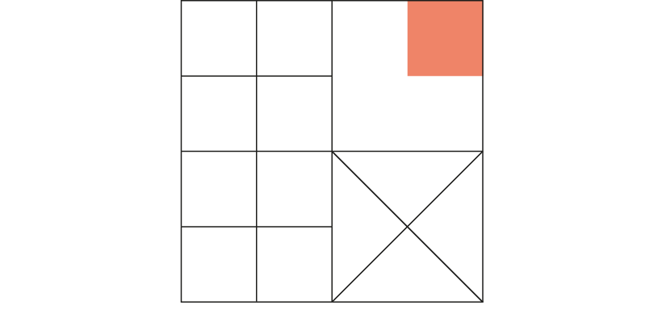
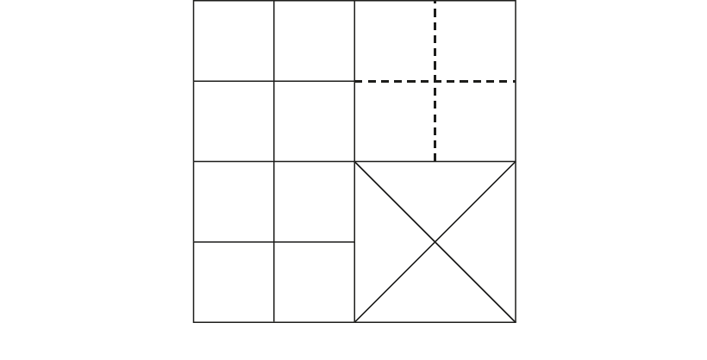
3.8 Common denomination
Step 2:4

Slide 5
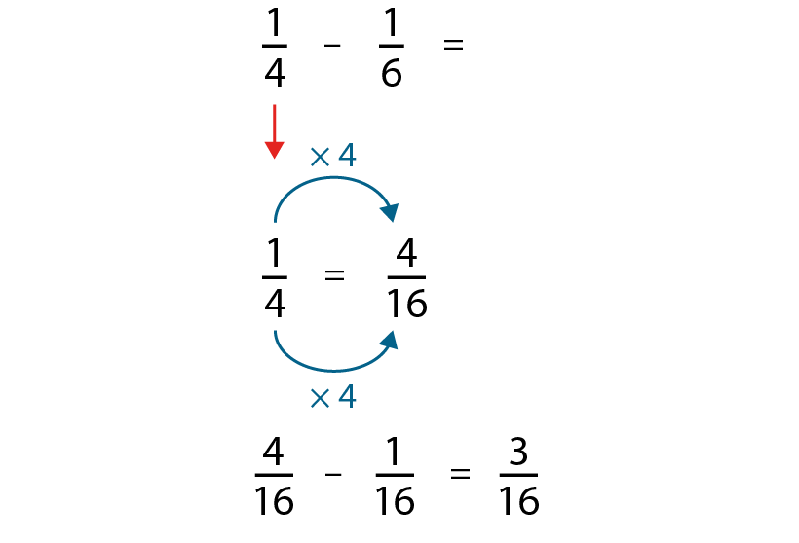


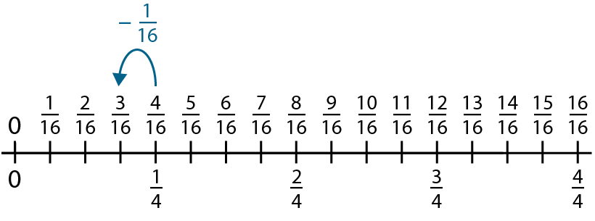
3.8 Common denomination
Step 2:4

Slide 6
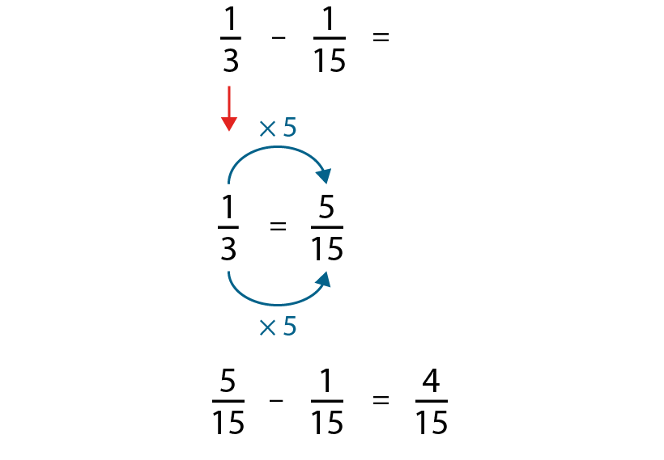
3.8 Common denomination
Step 2:5

Slide 7
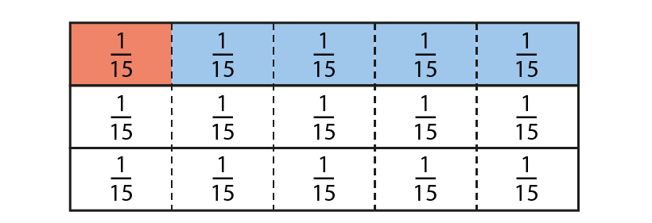
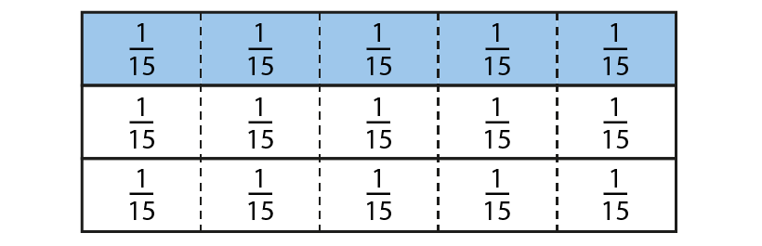
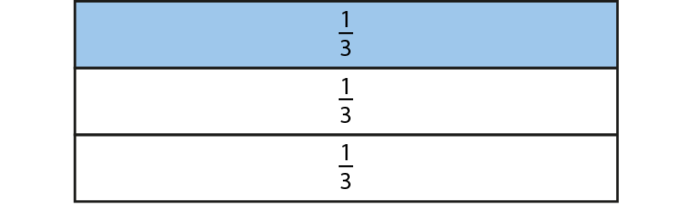
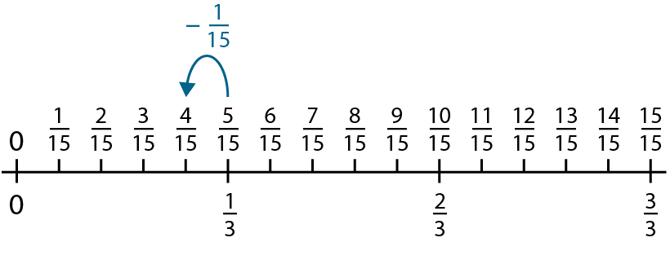
3.8 Common denomination
Step 2:6

Slide 8


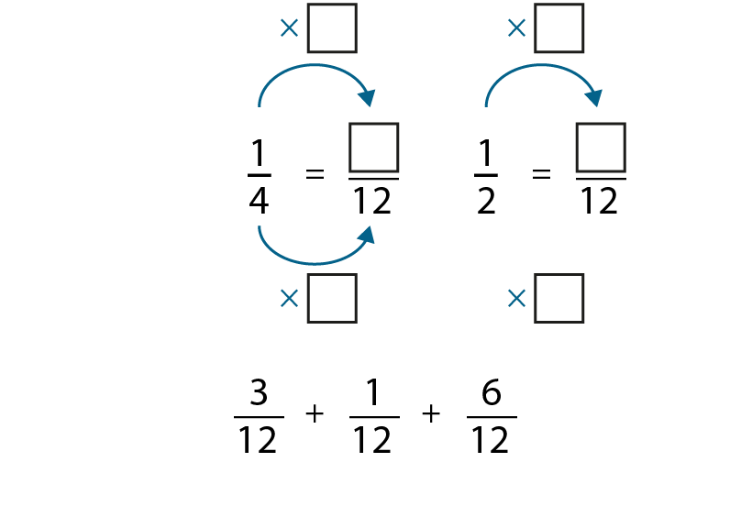


3.8 Common denomination
Step 2:7

Slide 9
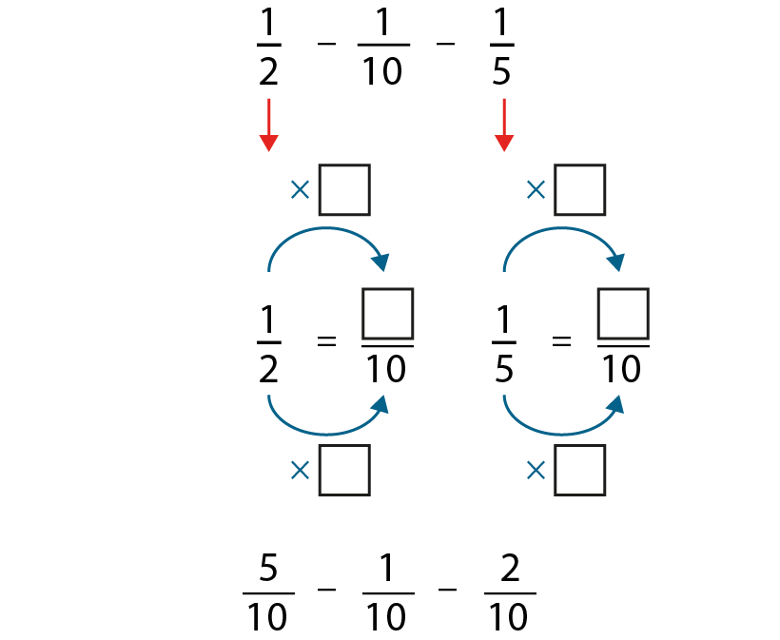

3.8 Common denomination
Step 2:7

Slide 10
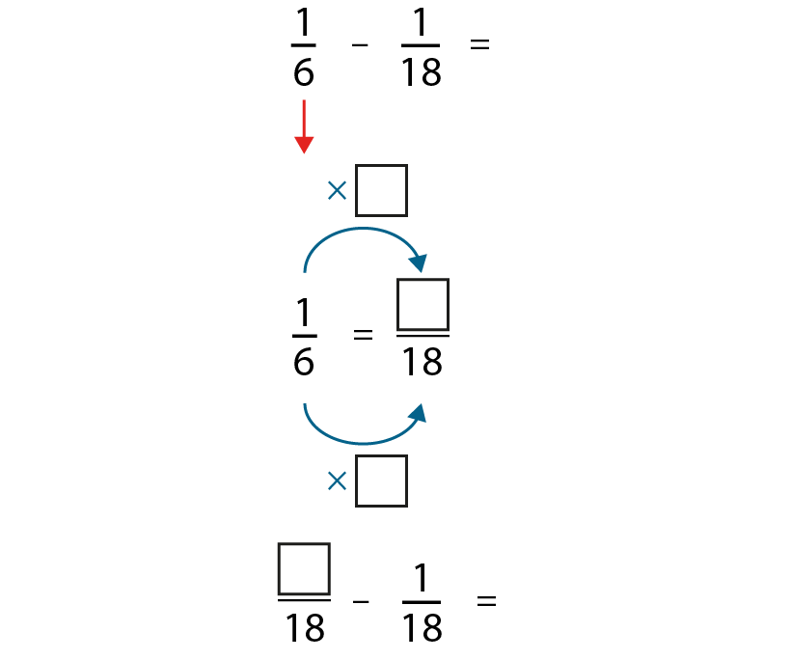
3.8 Common denomination
Step 2:8

Slide 11
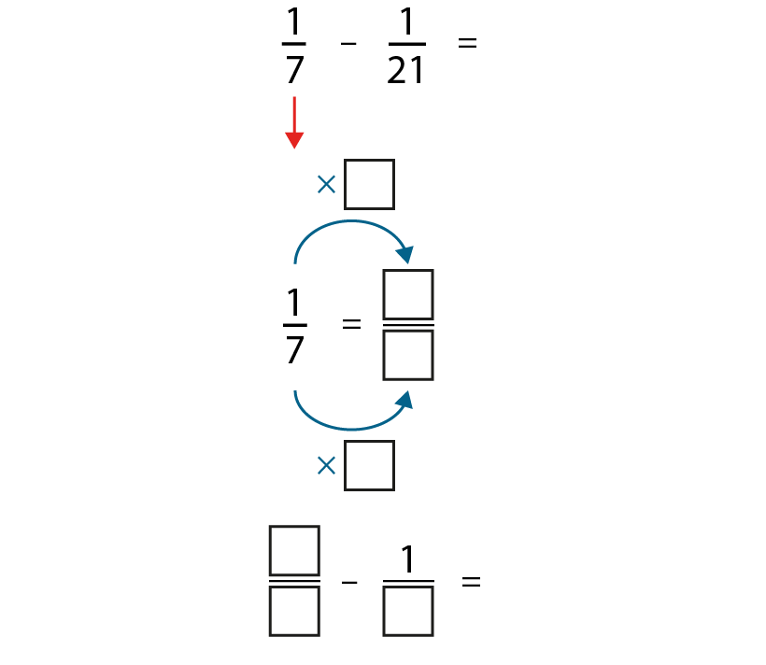
3.8 Common denomination
Step 2:8

Slide 12
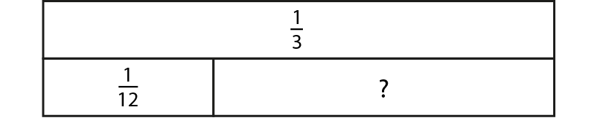
3.8 Common denomination
Step 2:8
Notes:
Write the calculation represented by the bar model.

Slide 13
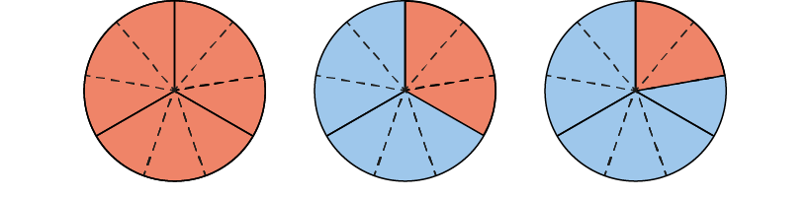
3.8 Common denomination
Step 2:10
Notes:
Dad makes a chocolate cake. When Sam gets home from school there is $\frac{1}{3}$ of the cake left. Sam eats a piece and there is $\frac{2}{9}$ left. How much has Sam eaten?

Slide 14
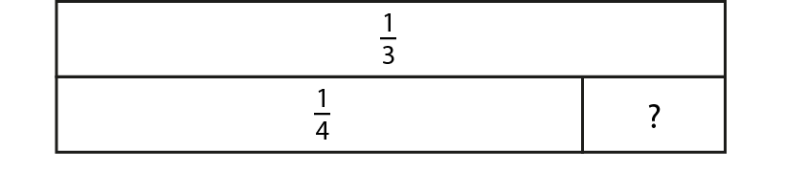
3.8 Common denomination
Step 2:10
Notes:
Find the value of the missing part.

Slide 15
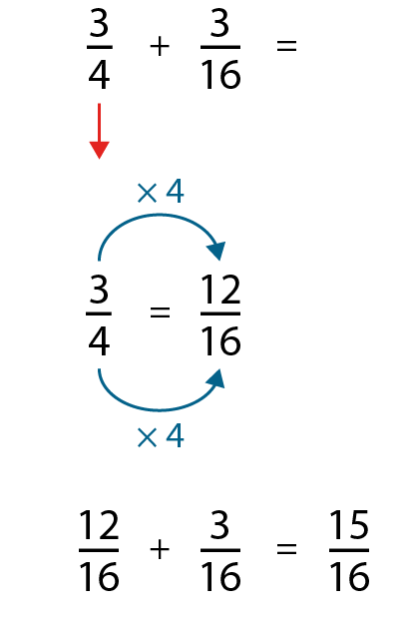
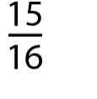
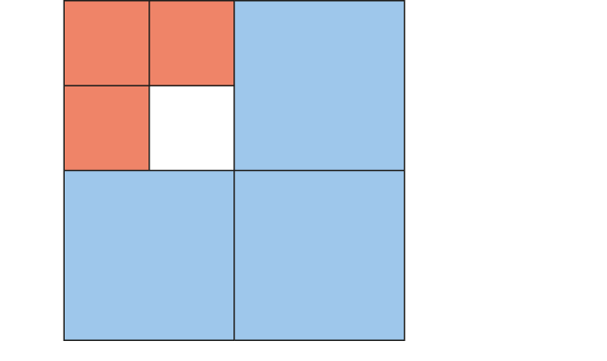
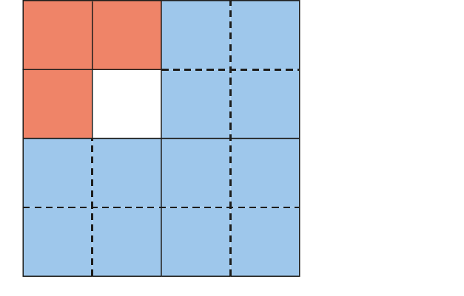
3.8 Common denomination
Step 3:1
Notes:
Can you see the $\frac{3}{4}$?
Can you see the $\frac{3}{16}?$
Do we have equal parts?

Slide 16
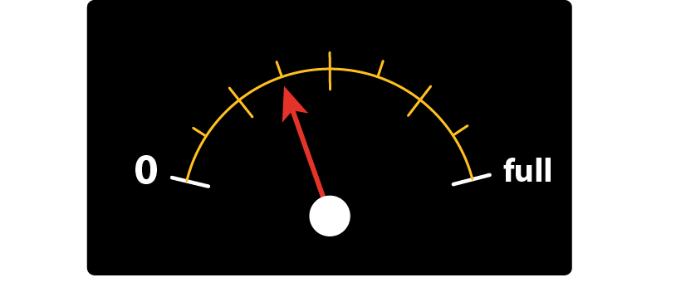
3.8 Common denomination
Step 4:11
Notes:
I have $\frac{3}{8}$ of a tank of petrol in my car. I use $\frac{1}{5}$ of a tank driving to see my friend. What fraction of a tank of petrol remains?

Slide 17
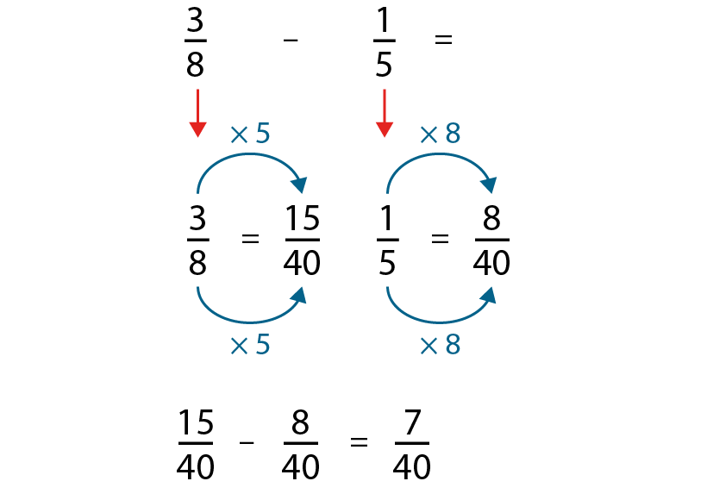
3.8 Common denomination
Step 4:11
Notes:
To add or subtract fractions with different denominators, first convert to fractions with a common denominator.

