Slide 1
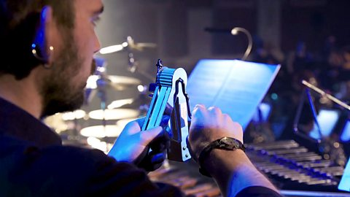
L.C. Can I create art-work inspired by a piece of orchestral music?
Toolkit

Slide 2
Anthology of Fantastic Zoology – Sprite;A Bao A Qu By Mason Bates

Slide 3
A Bao a Qu
It is pronounced: A Bao a Qu
aa BOW aa KOO
aa as in father
ow as in now
k as in king to reflect the original Spanish pronunciation

Slide 4

Mason Bates
The composer:
Mason BATES (born 1977)
American composer
Is becoming famous for mixing different styles of music together, for example – DJ-ing and orchestral music, jazz mixed with techno

Slide 5

Listen……………..
Listen to a recording of ‘A Bao A Qu’ without images.
Close your eyes as you listen.
What was the music describing?
http://downloads.bbc.co.uk/tv/tenpieces/BatesBao.mp3

Slide 6
Task
Draw the animal that you think is being portrayed by the music. It is an imaginary animal so you are free to invent something new. However, the ‘A Bao A Qu’ is based on a real animal.
Can you guess which one?

Slide 7
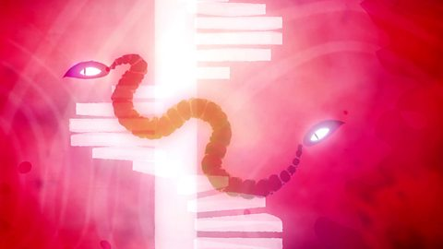
Ten Pieces
Watch the Mason Bates Ten Pieces film which reveals what the animal is and its actions.
Did you like the film?
Did anyone guess that the animal is a kind of snake slithering up and down a tower?
https://www.bbc.co.uk/programmes/articles/5t3vS7Bk966KKlJrGns66RP/sprite-and-a-bao-a-qu-from-anthology-of-fantastic-zoology-by-mason-bates

Slide 8
Book of Imaginary Beings’ (1957).
‘A Bao A Qu’ and ‘Sprite’ from ‘Anthology of Fantastic Zoology’ Written in 2015 is inspired by Jorge Luis Borges’s ‘Book of Imaginary Beings’ (1957).
‘A Bao A Qu’ is an imaginary breed of snake that slithers up and down the staircase of a famous tower in India
A ‘sprite’ is a fairy-like creature or elf that flies and flickers across water. This one jumps across the orchestra too!

