Slide 1
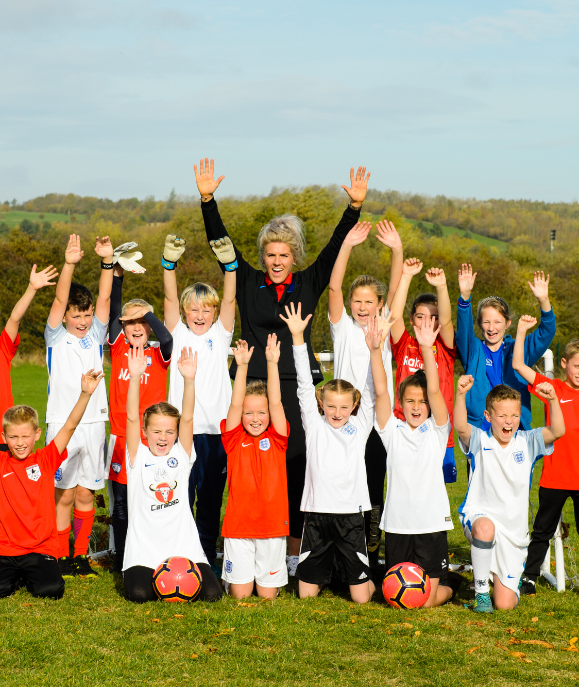

YOUR BIG QUESTION TO ANSWER IS:
L.C. Why do I need a positive mindset?
To understand what a positive mindset is.
To be able to change negative thoughts into positive thoughts.
To know why it is beneficial to have a positive mindset.
Notes:
Teacher Notes
The big question to answer is a key point of the lesson.

Slide 2

Player profile
“When you retire from professional football and you’re only 19 years old you lose your motivation and then you lose your focus”, he admitted.
Jack Rutter
Jack Rutter is 30 years old, and 12 years ago he was playing football for Birmingham City’s youth and reserve sides. During an evening out with friends, he sadly received a brain injury. At first, doctors weren’t sure how severe Jack’s injury was, but he became deaf in one ear, had trouble with his balance and co-ordination and even his memory and speech were affected.
Even though Jack made amazing progress with his recovery, he had to retire from professional football due to the lasting effects of his injury.
However, an opportunity arose for Jack in 2012 when he was introduced to Cerebral Palsy football, a 7-a-side game on a smaller pitch, open to those with disorders such as a traumatic brain injury.
“Eventually the opportunity did come along, and it was the best opportunity in the world,” said Jack. Within 12 months he was representing England. “It wasn’t a normal trajectory to playing for your country, so it made it extra special,” explained Jack. “Seeing your shirt hanging there for the first time with your name and number on the back, the three lions on the chest, it’s just an overwhelming feeling. You can’t quite believe it’s happened.”
Jack led England as captain at both the European and World Championships. He led Team GB’s CP football side at the 2016 Paralympic Games in Rio. Unfortunately, Jack faced another monumental setback at the beginning of 2018.
Notes:
Teacher Notes
Text adapted from:
https://sportsgazette.co.uk/facing-adversity-inspirational-story-former-england-team-gb-cerebral-palsy-football-captain-jack-rutter/
Read through the player profile. Pose the following questions:
What hardships has this person been through?
How do you think this person is still able to play for England even though they have been through a lot?
What has been difficult for you in the last year? (COVID-19)
How can we turn this around into something positive?
Why is a positive mindset important?
How do you think having a positive mindset helped Jack Rutter keep going?

Slide 3
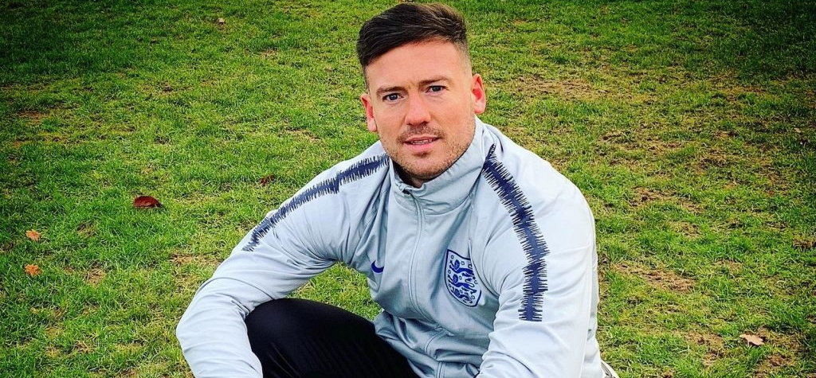
Following a change to the rules regarding the level of a player’s impairment, Jack was told he could not continue playing CP football.
In response, Jack looked to use his previous experiences to help manage the disappointment of another cruel setback.
However, it wasn’t long before he was presented with a fresh opportunity to get back into the sport.
After being approached by the FA, Jack decided to channel his energy and passion for football into a new discipline – coaching. Remarkably, not only has he now progressed to head coach of England’s Under 21’s CP team, he has also recently completed his UEFA A coaching license.
“I didn’t think I’d enjoy coaching as much as I do now. Playing is unbelievable, it’s very difficult to rival that feeling, but when you put on a good training session and the lads learn something from it and then they do it in a game, it’s a very rewarding feeling,” said Jack.
“I’m 29 years old but I’ve learned so much and been through so much in my life, experiencing some of the ultimate highs in life but also some of the ultimate lows. I just try and pass on my experience."
“It’s definitely given me a new focus, a new motivation.”
Notes:
Teacher Notes
See notes on previous slide.

Slide 4

A LETTER FROM JACK
Hi Kids,
When things don’t go well, you can feel a bit down but as you see from my story, NOT giving up is what saved me.
Feeling down for a short time is helpful and normal. It gives you time to think about what you want and need, and when you feel happier, which you will, you appreciate your happy times.
Think of it this way, when it's raining outside and then the sun comes out, you feel more positive! 😀 You enjoy it more because it was raining before☔️☀️.
In my story, I am feeling down but then get offered new opportunities. I took them! I could have said, ‘No’, because I was fearful of failure but instead, I talked it through with my friends and family and gave it a go.
It stopped me thinking about the sad things, and that helped me to remain positive about the future.
So, here’s a few tips if you’re feeling down:
Talk to someone about how you are feeling. They may have a helpful suggestion.
Try something new; it could be a new sport or hobby. Just give it a go. Focusing on something new can lift your mood and you never know, you may like it!
Do something that does not require thinking too much. Run around the garden or up and down the stairs, help your mum or dad with a job around the house.
Remember we are all good at something. We just have to keep an open mind and find it. Best of all, there is only one YOU!”
Many thanks,
Jack Rutter

Slide 5
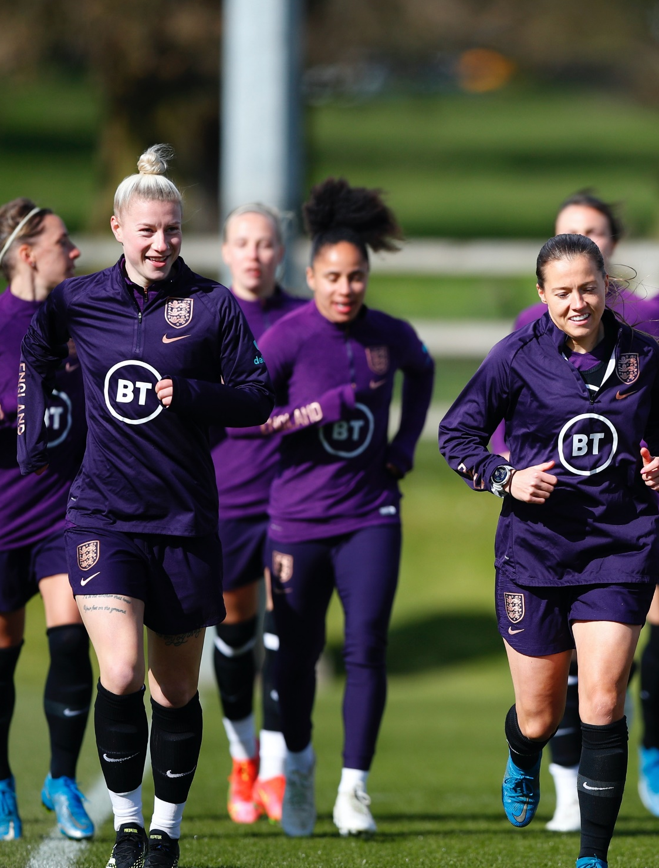
Positive thinking
We are going to practise turning negative thoughts into positive thoughts.
How could you turn this statement from a negative into positive?
I can’t do long division.
Notes:
Teacher Notes
Explain that pupils are going to practice turning their negative thoughts into positive ones.
I can’t do long division becomes I can’t do long division yet.
Ask pupils to pose some negative thoughts e.g.
I’m rubbish at writing stories.
I don’t like games lessons.
As a class, practice turning them into positive thoughts.

Slide 6

Positive thinking
Work through the statements on the Negative to Positive activity sheet. Change the negative statements into positive statements.
Notes:
Teacher Notes
Hand out copies of the Negative to Positive activity sheet.

Slide 7

Negative to positive
NEGATIVE | POSITIVE
I forgot to do my maths homework. | I’ll set a reminder so I remember next time.
Don’t run in the corridors! | Walk sensibly in the corridors so everyone is safe.
I missed school so much during lockdown. | I am really happy to be back in the classroom with my friends.
It’s too hard! | This may take some time and effort.
She/he is so clever, I’ll never be that clever. | I’m going to find out my targets so I can make progress.
I’m not good at this. | What am I missing to be able to improve?
I never win at tennis. | How can I improve my game?
I don’t have many friends to play with. | I have a really close friend who I can rely on.
I only have 10 minutes to finish - I’ll never get it done! | How much can I get done in the time I have?
Write your own.
Write your own.

Slide 8

Why is positive thinking important?
Improves self-esteem.
Helps build your resilience.
Reduces stress.
Improves mental-health.
Notes:
Teacher Notes
Recap on the benefits of positive thinking.

Slide 9
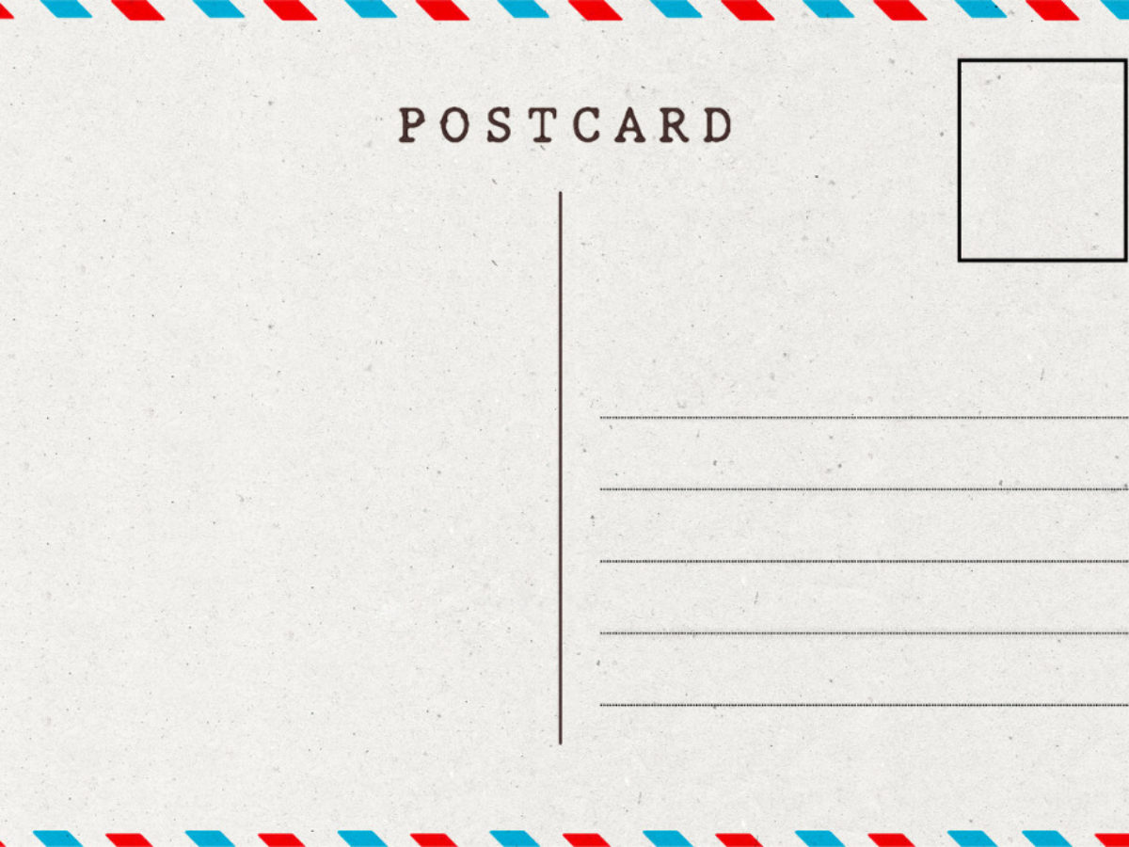
Let’s write home
Write a postcard home saying what you have learnt about positive mindsets.
Can you include:
Why a positive mindset is important.
How being positive can help you.
Notes:
Teacher Notes
Students to consolidate their learning within this section.
Linking back to the big question.

