Slide 1
L.C. Can I calculate budgets?
Toolkit

Slide 2







I’ve chosen to go to Lanzarote for a week.
Self-catering
Half-board
All inclusive
Breakfast and dinner included
£313 pp
£437 pp
£531 pp
£533.50
Which is better value for money?
Breakfast
£5.00
Lunch
£7.50
Dinner
£19.00
£7.50 $×$ 7 $=$ £52.50
£437 $+$ £52.50 $=$
£489.50

Slide 3
I’ve chosen to go to Lanzarote for a week.
Self-catering
Half-board
All inclusive
Breakfast and dinner included
£313 pp
£437 pp
£531 pp
£533.50
£489.50
£531
Which is better value for money?
Half-board is the best value for money.

Slide 4



I’ve chosen to go to Corfu for 5 days.
20% off!
Self-catering
Half-board
All inclusive
Breakfast and dinner included
£239 pp
£387 pp
£430 pp
Which is better value for money?
Breakfast
£4.50
Lunch
£16.50
Dinner
£9
Have a go

Slide 5



I’ve chosen to go to Corfu for 5 days.
20% off!
Self-catering
Half-board
All inclusive
Breakfast and dinner included
£150
£239 pp
£387 pp
£430 pp
£389
Which is better value for money?
Breakfast
£4.50
Lunch
£16.50
Dinner
£9
$$+$$
$$+$$
£30 $×$ 5 $=$
£30 a day
£150

Slide 6
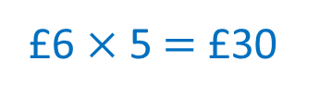
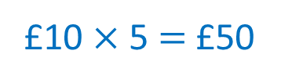
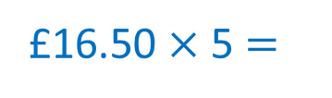
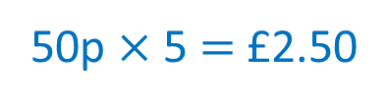
I’ve chosen to go to Corfu for 5 days.
20% off!
Self-catering
Half-board
All inclusive
Breakfast and dinner included
£239 pp
£387 pp
£430 pp
£469.50
Which is better value for money?
Breakfast
£4.50
Lunch
£16.50
Dinner
£9
£16.50 $×$ 5 $=$
£82.50
£10 $×$ 5 $=$ £50
£6 $×$ 5 $=$ £30
50p $×$ 5 $=$ £2.50

Slide 7
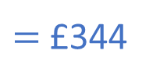





I’ve chosen to go to Corfu for 5 days.
20% off!
£430
Self-catering
Half-board
All inclusive
Breakfast and dinner included
43
43
£239 pp
£387 pp
20 % $=$ £86
£430 pp
?
430 $−$ 86 $=$ 344
$=$ £344
Which is better value for money?
£430
Breakfast
£4.50
Lunch
£16.50
Dinner
£9
43
80 % $=$
?
43 $×$ 8 $=$ 344
$=$ £344

Slide 8
I’ve chosen to go to Corfu for 5 days.
20% off!
Self-catering
Half-board
All inclusive
Breakfast and dinner included
£239 pp
£387 pp
£430 pp
£389
£469.50
£344
Which is better value for money?
All inclusive is the best value for money.

Slide 9
Accommodation worksheet

Slide 10
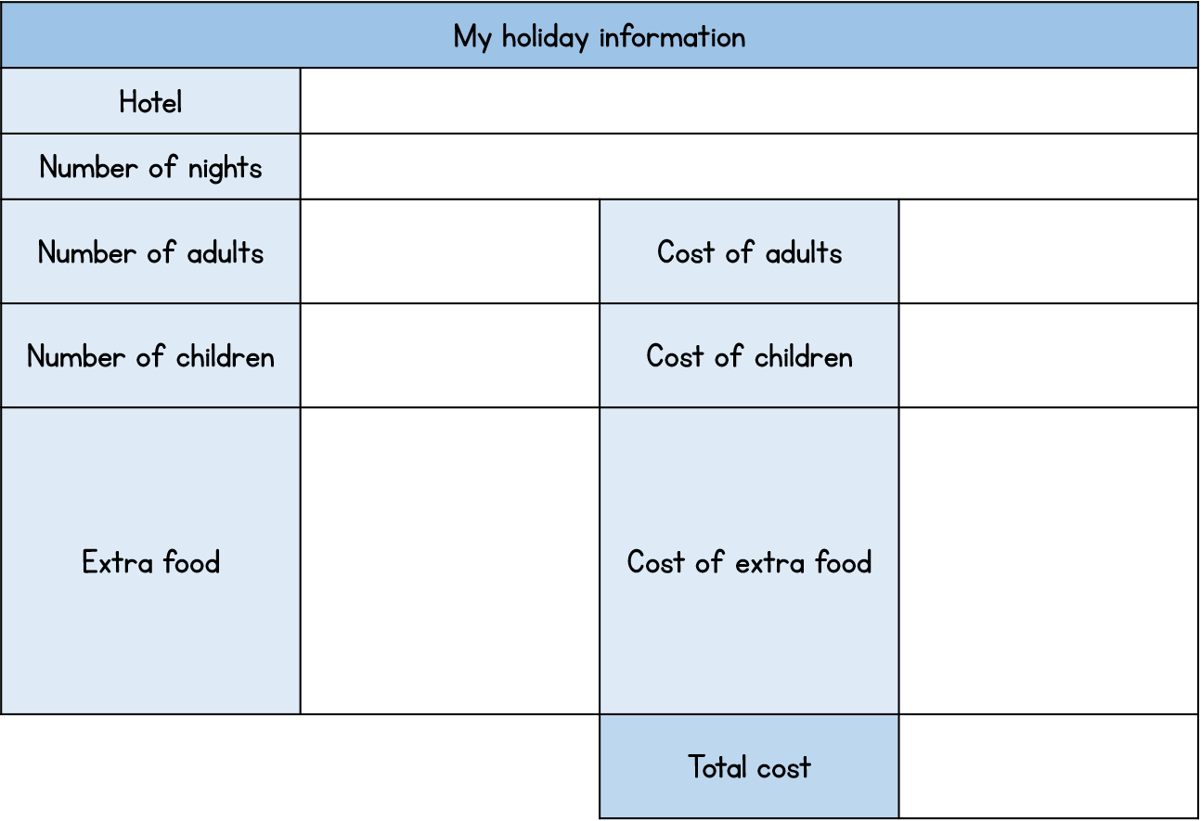
Activity 3
Research 3 types of accommodation at your chosen destination or use the accommodation template we have provided.
Work out the average cost of food per day.
Which accommodation is the best value for money?
Remember to include the cost of food and check if there are any deals on!

Slide 11

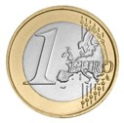




Exchange rates and budget
Decimals
£1.00
$$=$$
€1.16
$×$3
$×$3
£3.00
$$=$$
€3.48

Slide 12







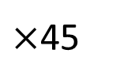
£1.00
$$=$$
€1.16
$×$45
Th | H | T | O
 | 1 | 1 | 6
 |  | 4 | 5
$×$45
£45.00
$$=$$
€52.20
$$×$$
5
8
0
$($116 $×$ 5$)$
3
4
6
4
0
$($116 $×$ 40$)$
$$+$$
2
5
2
2
0
1
1

Slide 13
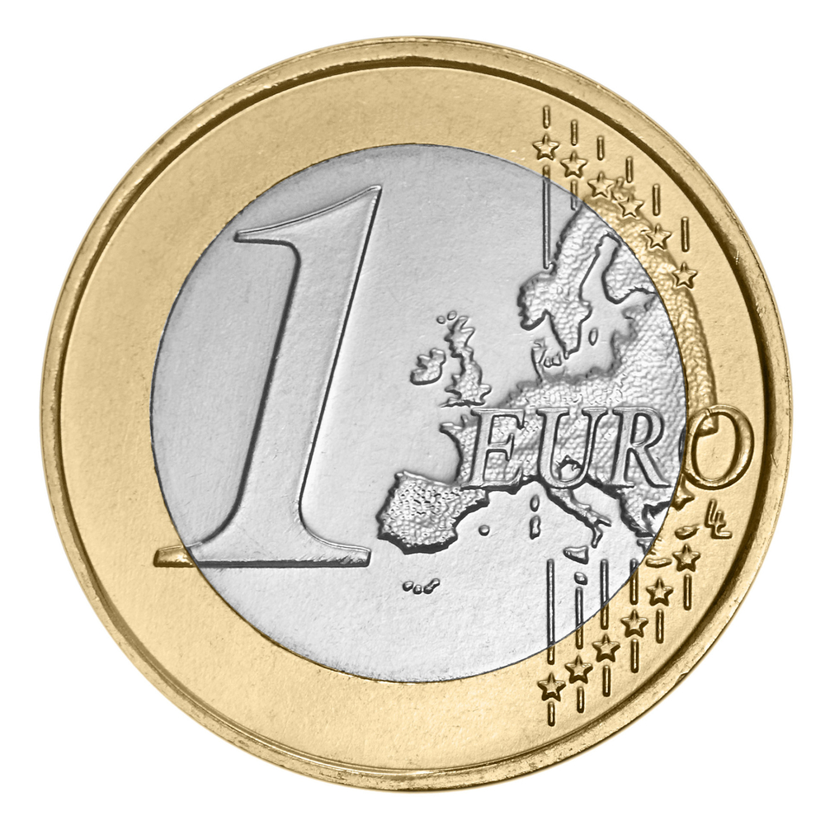
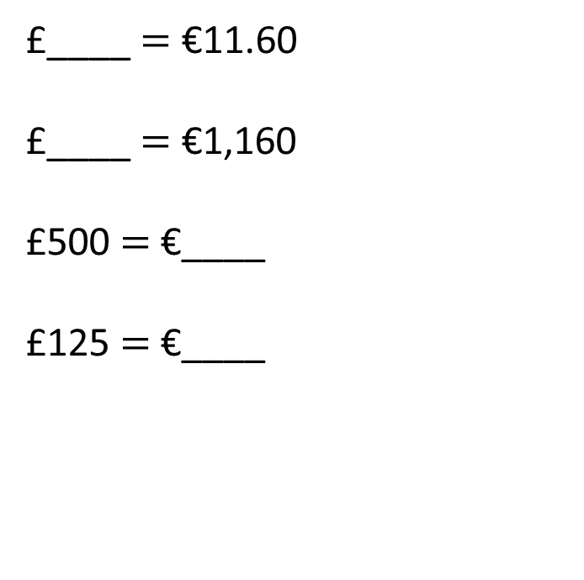

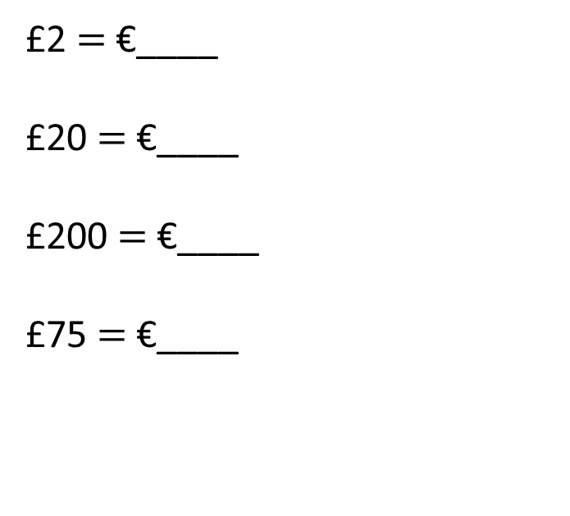
£1.00
$$=$$
€1.16
Complete the conversions.
2.32
10
£2 $=$ €____
£20 $=$ €____
£200 $=$ €____
£75 $=$ €____
£____ $=$ €11.60
£____ $=$ €1,160
£500 $=$ €____
£125 $=$ €____
23.20
1,000
232
580
87
145
Have a go

Slide 14



£1.00
$$=$$
$1.41
$×$3
$×$3
£3.00
$$=$$
$4.23
1 | . | 4 | 1
 |  |  | 3
$$×$$
4
.
2
3
1

Slide 15
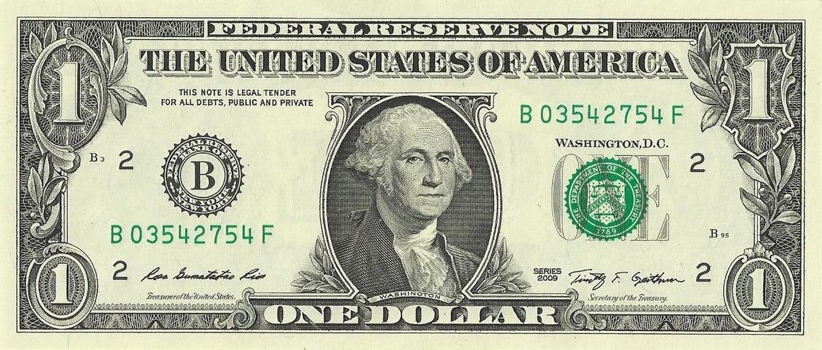



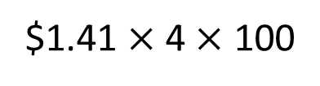
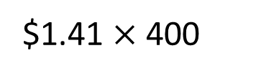

£1.00
$$=$$
$1.41
I want to take £400 worth of US dollars. How many US dollars will I get?
$1.41 $×$ 400
$1.41 $×$ 4 $×$ 100
1 | . | 4 | 1
 |  |  | 4
$5.64 $×$ 100
$$×$$
$564
5
.
6
4
1
Have a go

Slide 16

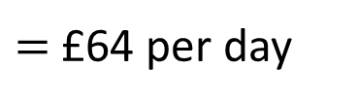

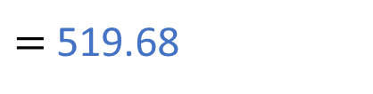
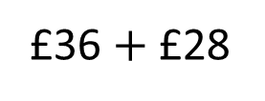
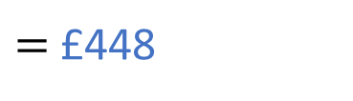
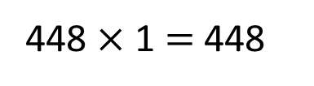





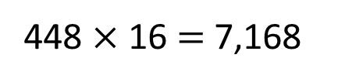


Teddy is going to Greece for a week.
He is working out his budget.
Teddy wants to have £36 per day for activities and £28 per
day for food.
How many euros does he need?
Teddy needs €519.68
£1.00
$$=$$
€1.16
£36 $+$ £28
$=$ £64 per day
£64 $×$ 7
60 $×$ 7 $=$ 420
$=$ £448
4 $×$ 7 $=$ 28
448 $×$ 1.16
$=$ 519.68
448 $×$ 1 $=$ 448
448 $×$ 0.16 $=$
71.68
450 $×$ 1.16 $=$ 522
448 $×$ 16 $=$ 7,168
448 $+$ 71.68 $=$
Have a go
519.68

Slide 17

Ron is going to the French Alps for 4 days.
He’s allowed to choose 2 of the following activities to try.
Skiing
Ice skating
Sledging
Snowboarding
How many different possible combinations are there?
Have a think

Slide 18
Skiing
Ice skating
Sledging
Snowboarding
✓
✓
✓
✓
✓
✓
✓
✓
✓
✓
✓
✓
There are 6 possible combinations.

Slide 19
Here are the prices of each activity per day.
Skiing
Ice skating
Sledging
Snowboarding
€30 per day
€15 per day
€12 per day
€19 per day
Ron chooses to ski for two days and snowboard for 2 days.
What is the total cost?
€98
Estimate how much that is in pounds.
€60 to ski
€38 to snowboard
Have a go

Slide 20

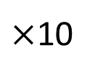
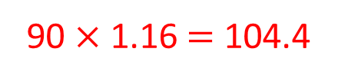


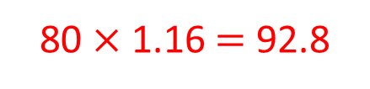


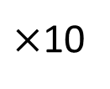

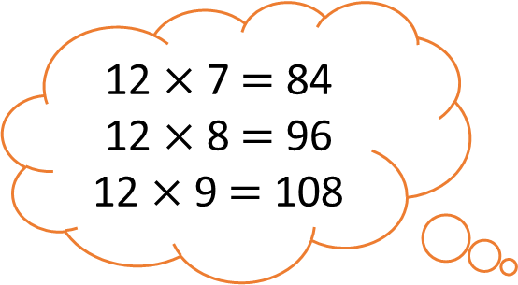
$≈$ €1.20
£1.00
$$=$$
€1.16
$×$10
$×$10
£10.00
$$≈$$
€12.00
$×$8
£80.00
€98
$$?$$
$$≈$$
12 $×$ 7 $=$ 84
12 $×$ 8 $=$ 96
12 $×$ 9 $=$ 108
80 $×$ 1.16 $=$ 92.8
90 $×$ 1.16 $=$ 104.4

Slide 21





Whitney is going to the USA for 5 days.
She is trying to work out how much money she needs.
Food per day
£35 if self-catering
£12 if half-board
Activities
Boat Trip
Sight-seeing
bus tour
Seaside trip
Theme park
£55
£45
£11.50
£58.50
How many US dollars will Whitney need if she chooses
half-board and does all the activities?
Have a go

Slide 22
Whitney is going to the USA for 5 days.
She is trying to work out how much money she needs.
Food per day
£60 for food
£35 if self-catering
£12 if half-board
Activities
£170 for activities
Boat Trip
Sight-seeing
bus tour
Seaside trip
Theme park
£55
£100
£45
£70
£11.50
£58.50
How many US dollars will Whitney need if she chooses half-board and does all the activities?
£230

Slide 23
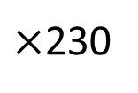

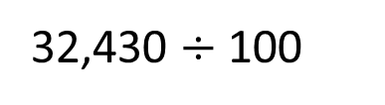

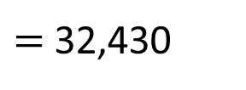
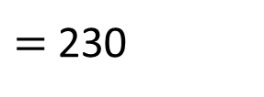

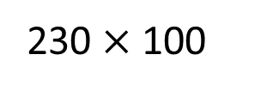
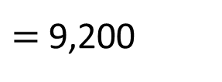
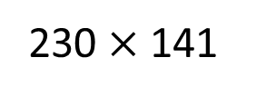
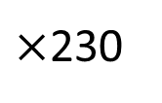
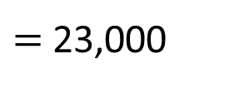
£1.00
$$=$$
$1.41
$×$230
$×$230
£230
$324.30
230 $×$ 141
$=$ 32,430
32,430 $÷$ 100
230 $×$ 100
$=$ 23,000
230 $×$ 40
$=$ 9,200
230 $×$ 1
$=$ 230

Slide 24

Mo is going to the Cornwall for 5 days.
He is staying in self-catering accommodation and has a budget of £250
Food per day
£35 if self-catering
£12 if half-board
Activities
Boat Trip
Sight-seeing
bus tour
Seaside trip
Theme park
£55
£45
£11.50
£58.50
Which activities can Mo afford to do?
Is there more than one answer?
Have a go

Slide 25



Mo is going to the Cornwall for 5 days.
He is staying in self-catering accommodation and has a budget of £250
35 $×$ 5 $=$ £175
Food per day
£250 $−$ £175
$=$ £75
£35 if self-catering
£12 if half-board
Activities
Boat Trip
Sight-seeing
bus tour
Seaside trip
Theme park
£55
£45
£11.50
£58.50
Which activities can Mo afford to do?
Is there more than one answer?

Slide 26
Mo has £75 to spend on activities.
A boat trip and a seaside trip.
A sight-seeing bus tour and a seaside trip.
A seaside trip every day!
A seaside trip and a visit to a theme park.
Activities
Boat Trip
Sight-seeing
bus tour
Seaside trip
Theme park
£55
£45
£11.50
£58.50
Which activities can Mo afford to do?
Is there more than one answer?

Slide 27
Budget worksheet

Slide 28
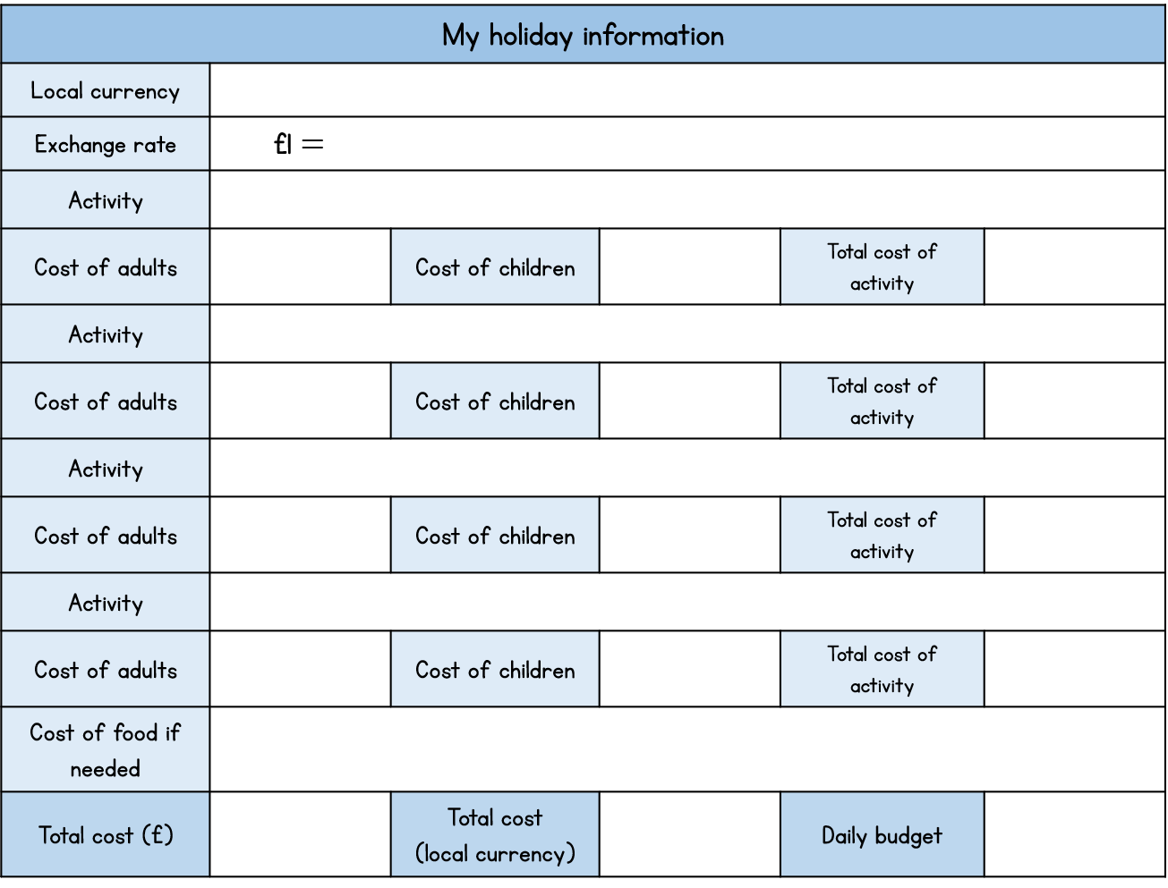
Activity 4
Research or use the template provided to choose which activities you would like to do on your holiday.
How many people are taking part in the activities?
Do you need to take into account money for food?
Work out how much your budget is in the currency of the place you’ve chosen to go.

