Slide 1
L.C. Can I add fractions?
Toolkit

Slide 2
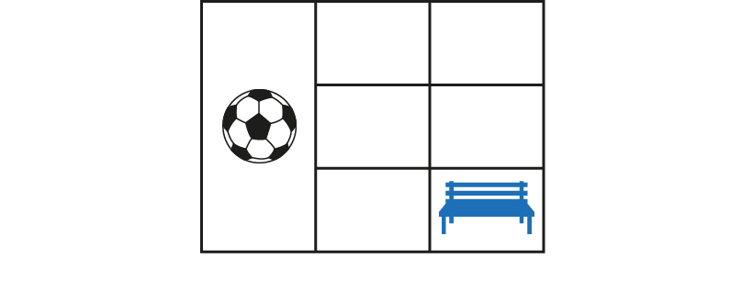
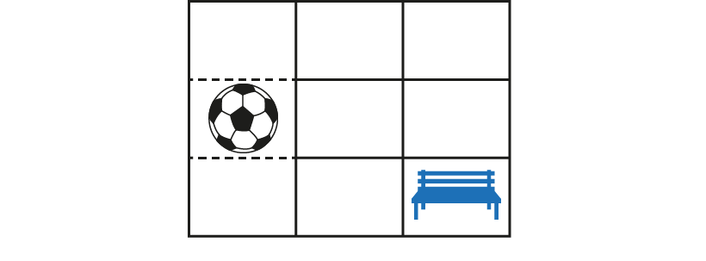
3.8 Common denomination
Step 1:1
Notes:
What fraction of the playground is the ball-game zone?
What fraction of the playground is the quiet zone?
Do we have equal parts?

Slide 3
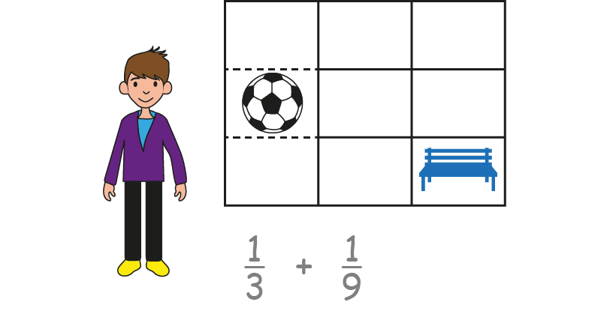
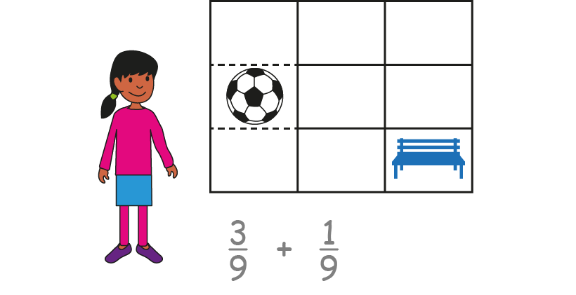
3.8 Common denomination
Step 1:2
Notes:
Will writes this calculation: $\frac{1}{3}+ \frac{1}{9}$
Ella writes this calculation: $\frac{3}{9}+ \frac{1}{9}$
Whose calculation is correct? Can you explain your thoughts, using the diagram to help you?

Slide 4
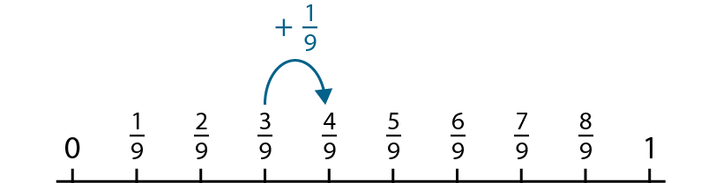
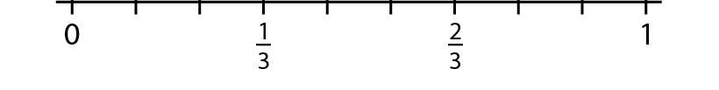
3.8 Common denomination
Step 1:3

Slide 5
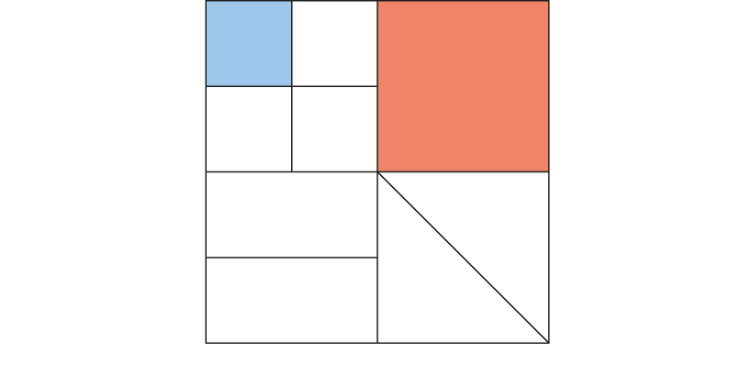
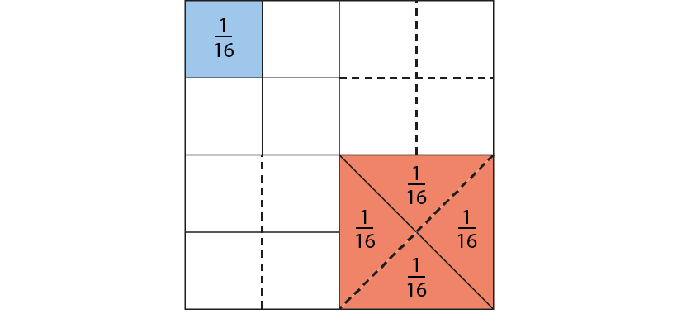
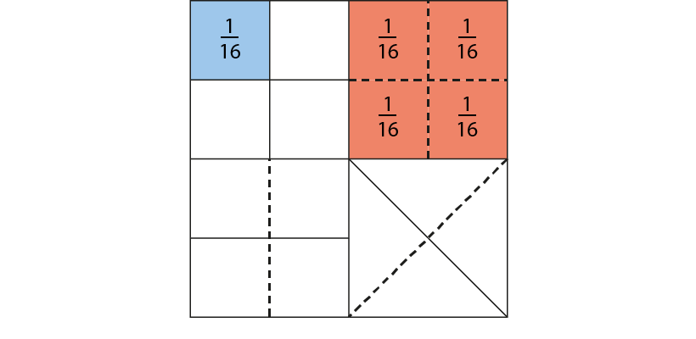
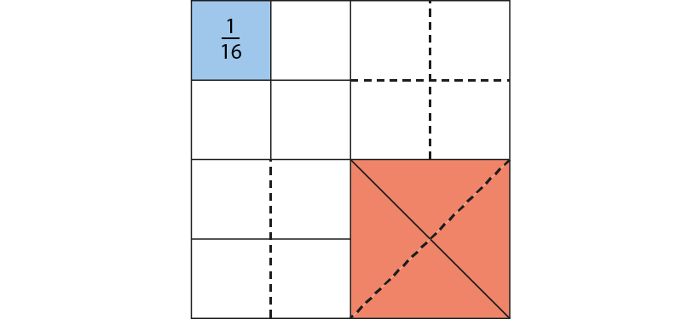

3.8 Common denomination
Step 1:4
Notes:
What fraction of the whole does each of the shaded parts represent?
Can we say what fraction of the whole is shaded altogether?
Can we also say that five-sixteenths of the first diagram is shaded?

Slide 6
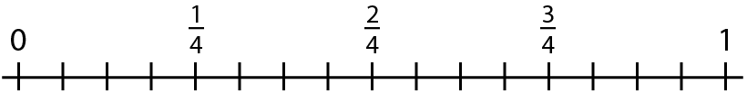


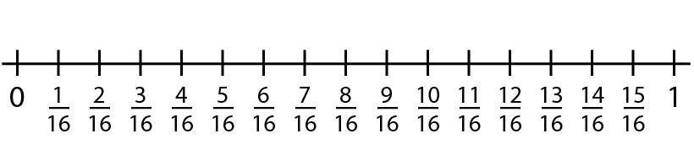
3.8 Common denomination
Step 1:5

Slide 7
3.8 Common denomination
Step 1:6
Notes:
Related fractions have denominators where one denominator is a multiple of the other.

Slide 8
3.8 Common denomination
Step 1:6
Notes:
Related fractions have denominators where one denominator is a multiple of the other.

Slide 9
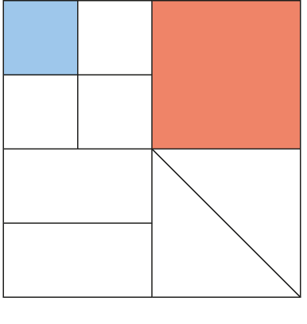
3.8 Common denomination
Step 1:8
Notes:
$\frac{1}{16}$ and $\frac{1}{4}$ are related fractions because the denominator, ’16’, is a multiple of the other denominator, ‘4.’

Slide 10
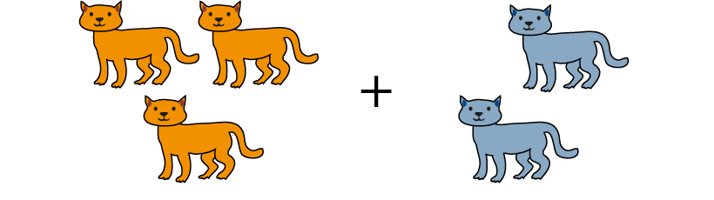
3.8 Common denomination
Step 1:9
Notes:
In order to add a number of things with different names together,
it is necessary to find a name that is common to both things.

Slide 11
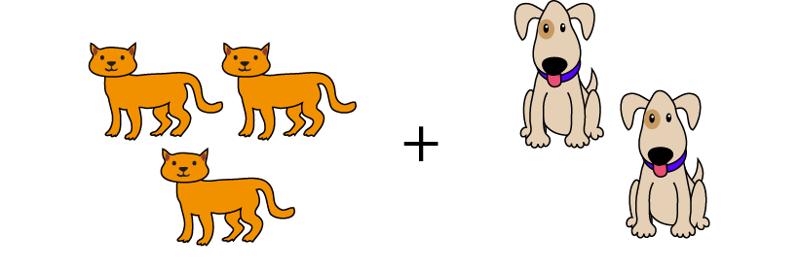
3.8 Common denomination
Step 1:9
Notes:
In order to add a number of things with different names together,
it is necessary to find a name that is common to both things.

Slide 12

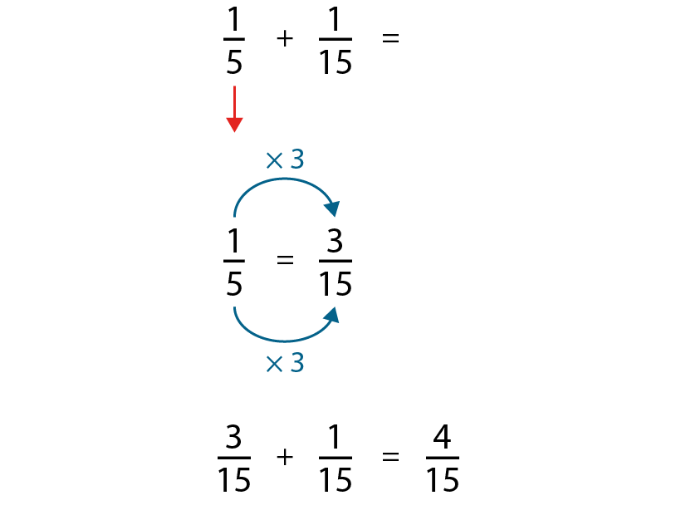
3.8 Common denomination
Step 1:12

Slide 13
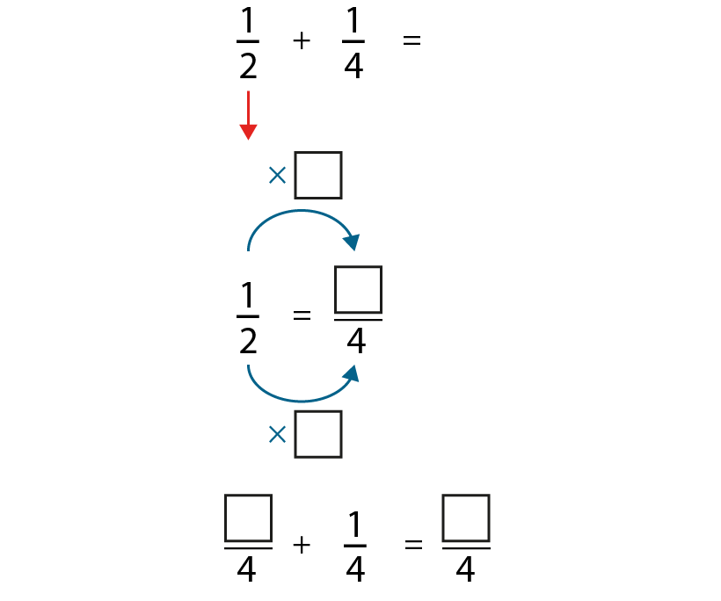
3.8 Common denomination
Step 1:13

Slide 14

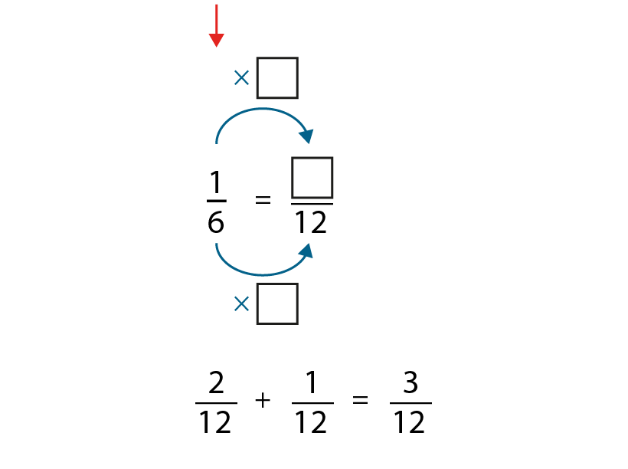
3.8 Common denomination
Step 1:13

Slide 15
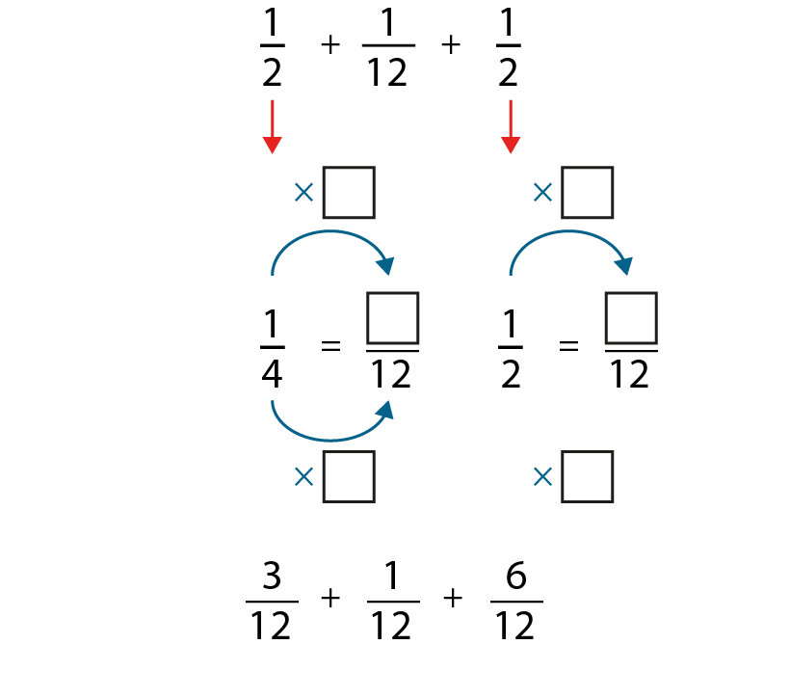



3.8 Common denomination
Step 1:13

Slide 16
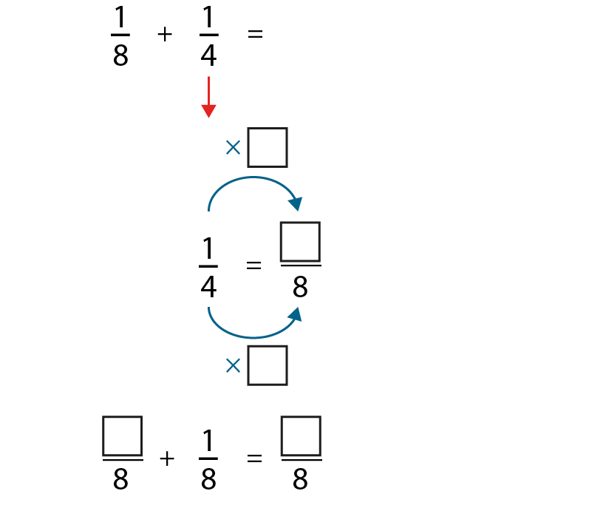


3.8 Common denomination
Step 1:14

Slide 17
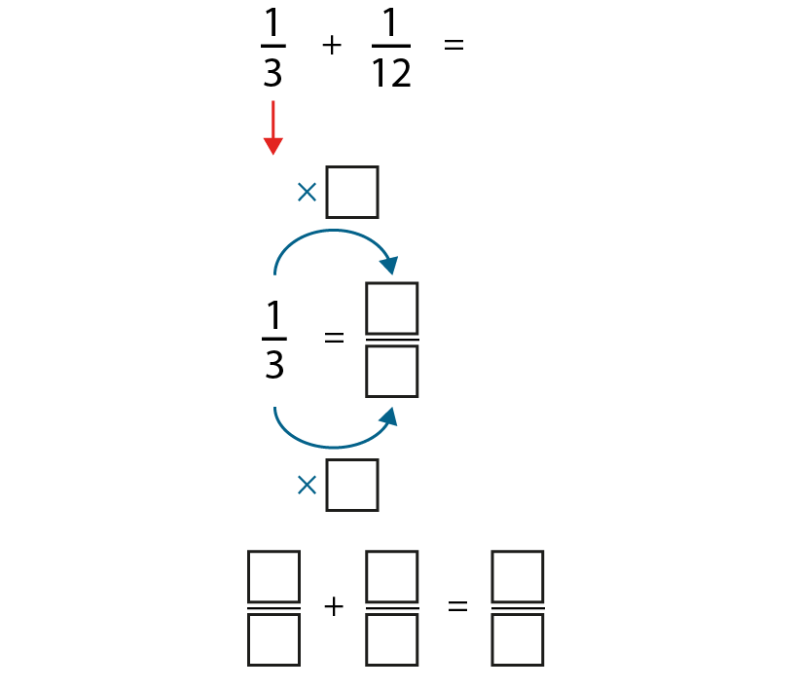
3.8 Common denomination
Step 1:14

Slide 18
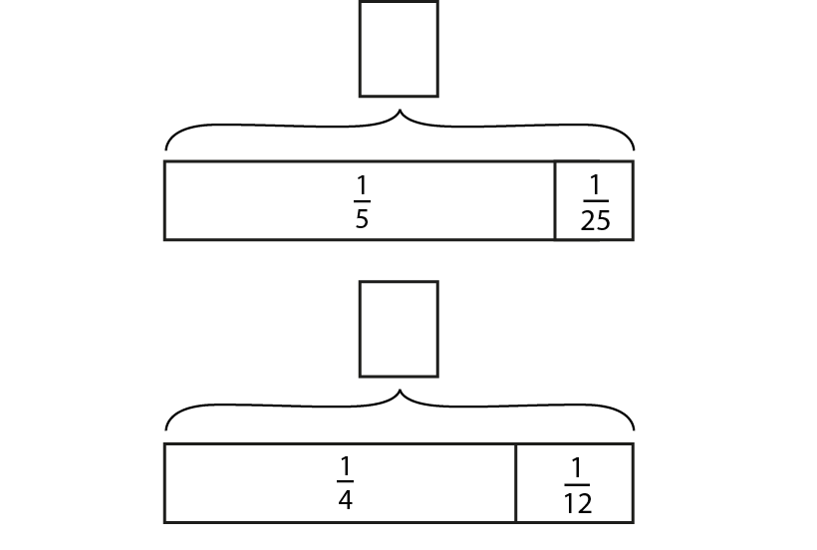
3.8 Common denomination
Step 1:14

Slide 19
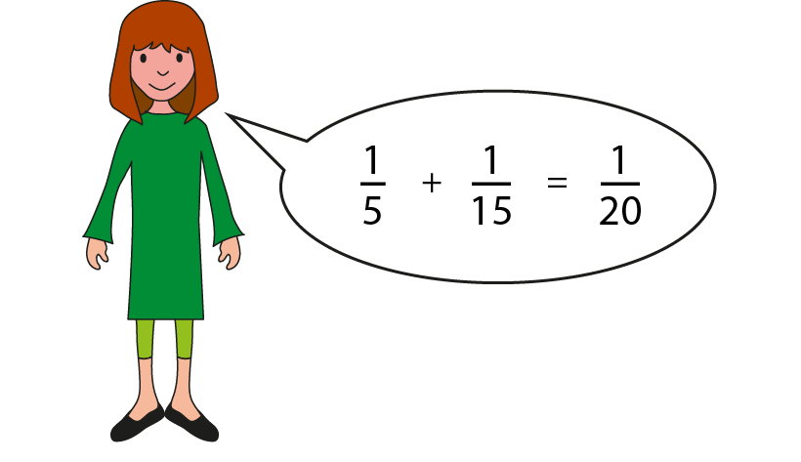
3.8 Common denomination
Step 1:14
Notes:
Can you explain Hannah’s mistake?

Slide 20
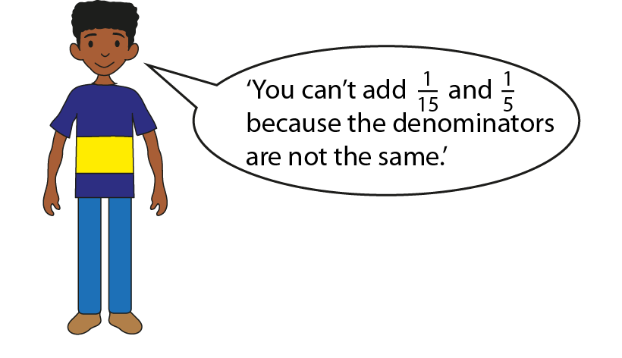
3.8 Common denomination
Step 1:14
Notes:
Complete the following sentences.
Ahmed is partly correct in that ___.
Ahmed is partly wrong in that____.

Slide 21
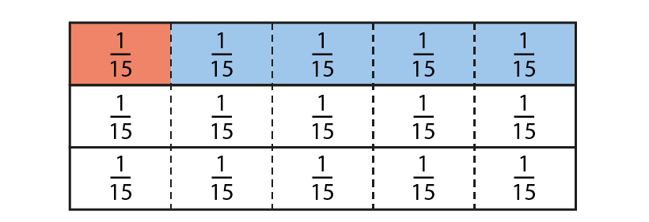
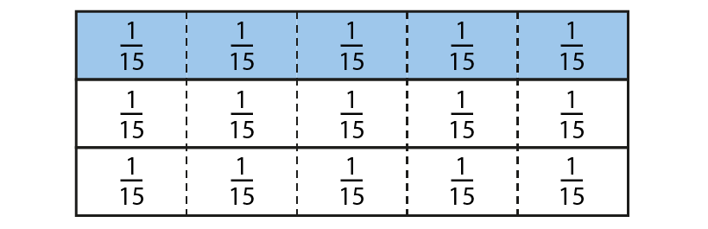
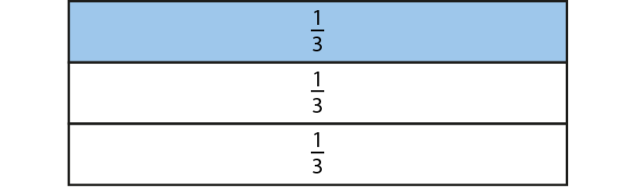
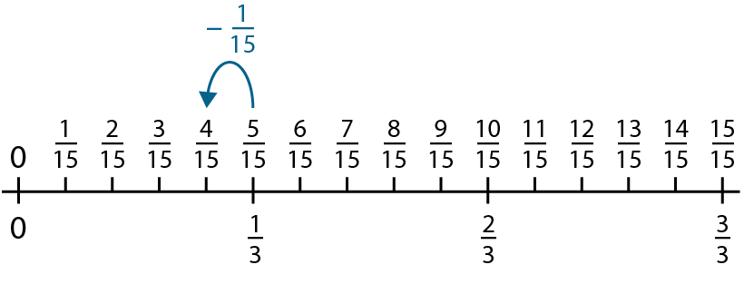
3.8 Common denomination
Step 2:6

Slide 22
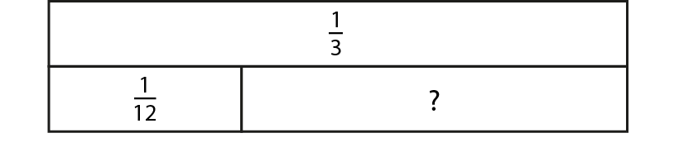
3.8 Common denomination
Step 2:8
Notes:
Write the calculation represented by the bar model.

Slide 23
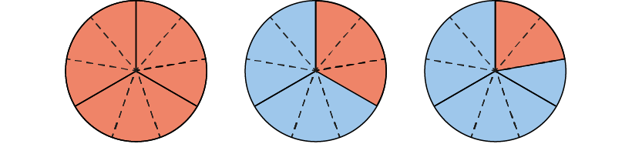
3.8 Common denomination
Step 2:10
Notes:
Dad makes a chocolate cake. When Sam gets home from school there is $\frac{1}{3}$ of the cake left. Sam eats a piece and there is $\frac{2}{9}$ left. How much has Sam eaten?

Slide 24
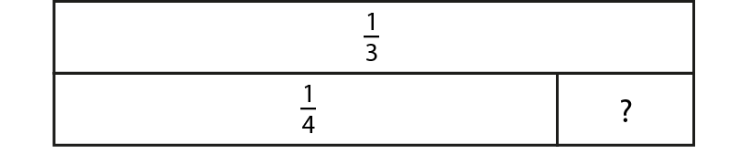
3.8 Common denomination
Step 2:10
Notes:
Find the value of the missing part.

Slide 25
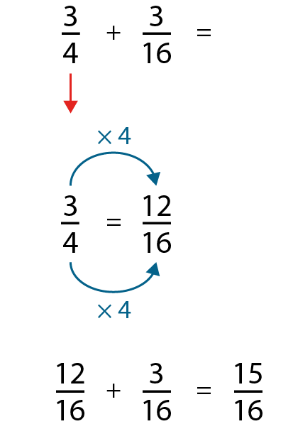
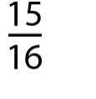
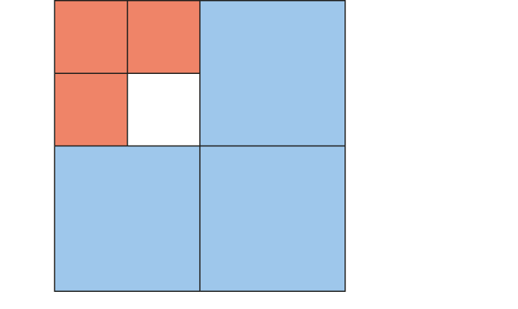
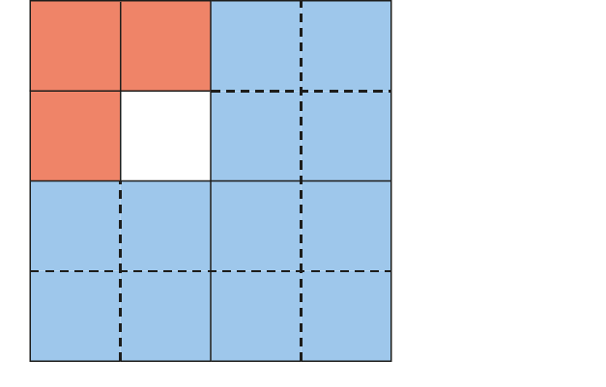
3.8 Common denomination
Step 3:1
Notes:
Can you see the $\frac{3}{4}$?
Can you see the $\frac{3}{16}?$
Do we have equal parts?

Slide 26
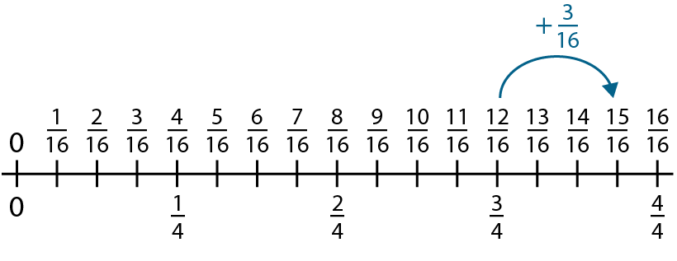
3.8 Common denomination
Step 3:2

Slide 27
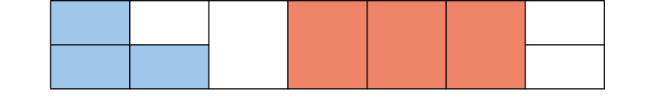

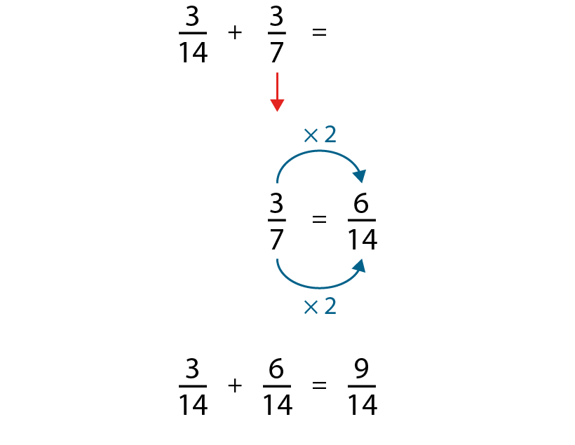
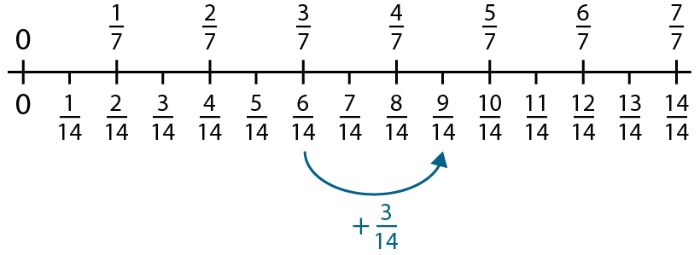
3.8 Common denomination
Step 3:3

Slide 28
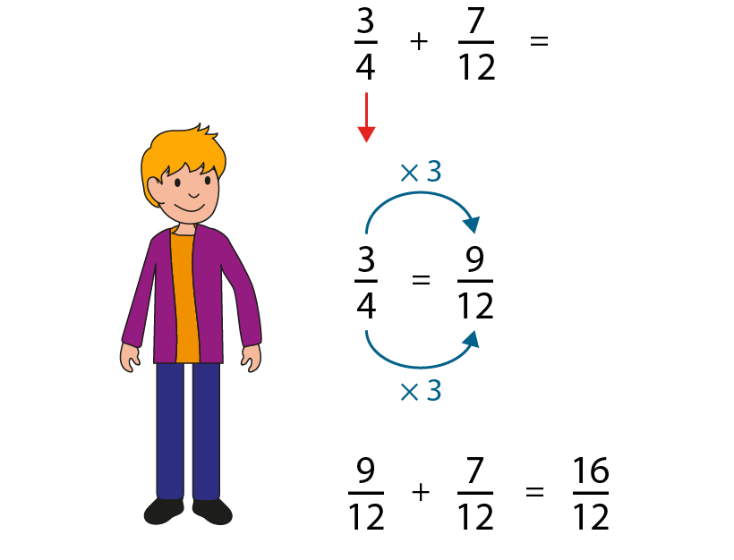
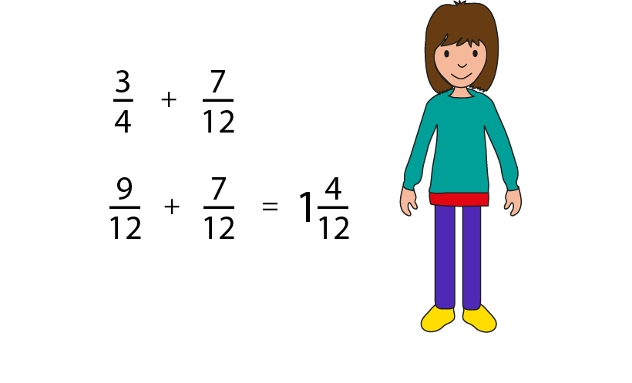
3.8 Common denomination
Step 3:6
Notes:
Sam calculated $\frac{3}{4}$ + $\frac{7}{12}$ and got $\frac{16}{12}$ as his answer.
Maisa calculated $\frac{3}{4}$ + $\frac{7}{12}$ and got $1\frac{4}{12}$ as her answer.
Whose answer is correct?
What is the same about both answers? What is different?
What has Maisa done to her answer?

Slide 29
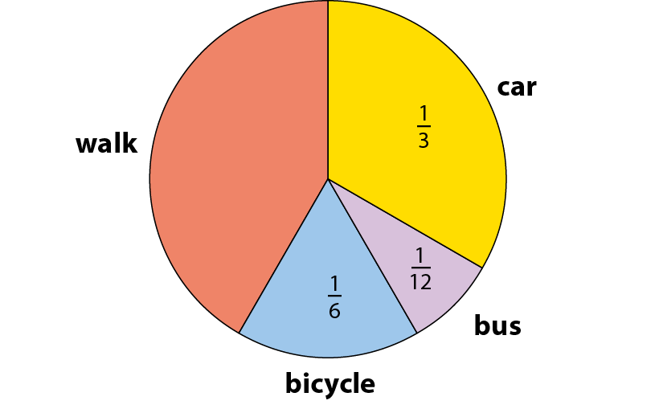
3.8 Common denomination
Step 3:8
Notes:
Class 5 conducted a survey to find out the different ways pupils travel to school. Here is a pie chart of their findings. What fraction of the children walk to school?

Slide 30
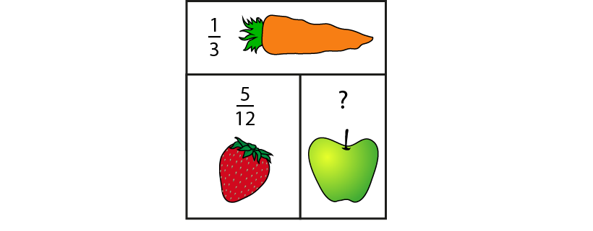
3.8 Common denomination
Step 3:8
Notes:
Farmer Nishi grows fruit and vegetables on her farm. What fraction of the farm is used to grow apples?

Slide 31
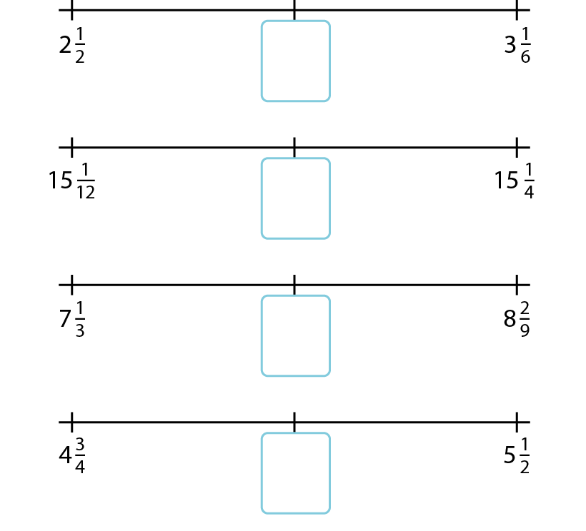
3.8 Common denomination
Step 3:8
Notes:
Find the mid-points of these pairs of numbers.

Slide 32
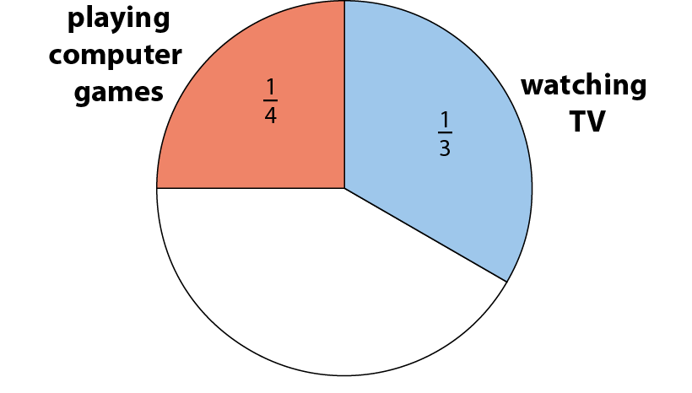

3.8 Common denomination
Step 4:1
Notes:
Will has made a pie chart to show how he spends his free time in a week. In total, what fraction of the week does Will spend playing computer games and watching TV?
What do you think of Will’s answer?
Can you convince me that Will’s answer is wrong?
What would a reasonable answer be?

Slide 33

3.8 Common denomination
Step 4:3

Slide 34
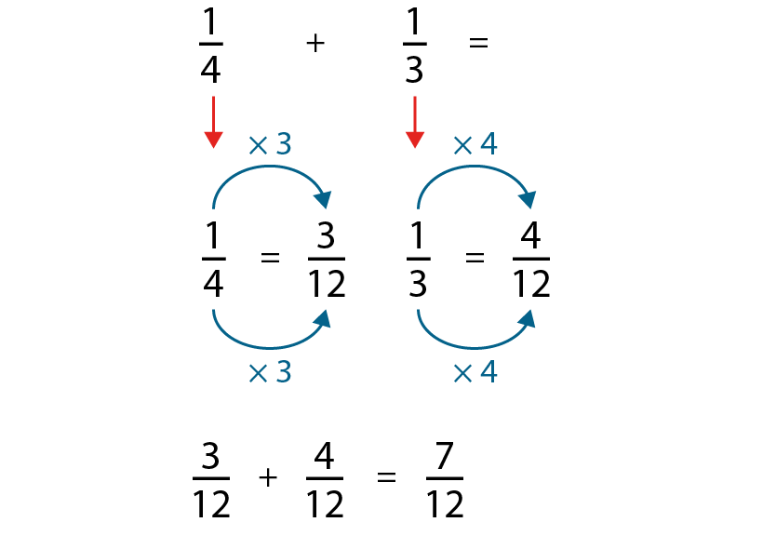
3.8 Common denomination
Step 4:5

Slide 35
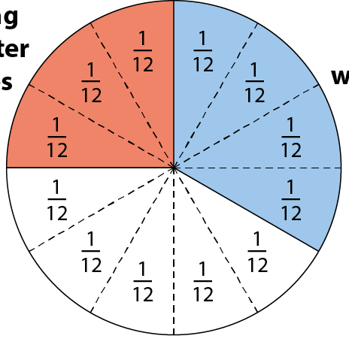
3.8 Common denomination
Step 4:6

Slide 36
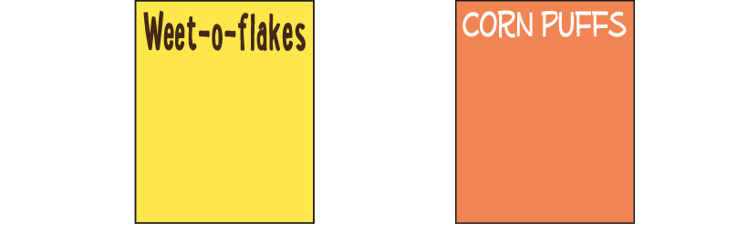
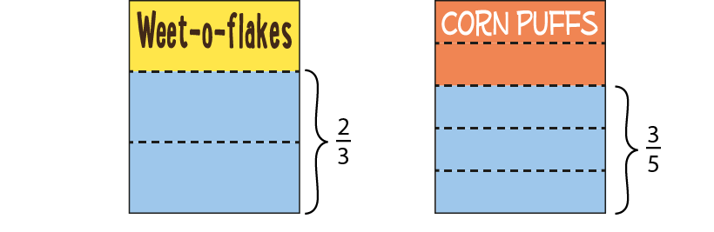
3.8 Common denomination
Step 4:7
Notes:
We buy two equal-sized boxes of cereal. In one week, my family eats $\frac{2}{3}$ of the box of Weet-o-flakes and $\frac{3}{5}$ of the box of Corn Puffs for breakfast. How many boxes of cereal do we eat in total in one week?
For additional support you can use the stem sentence:
The whole is divided into ___ equal parts, and we have eaten ___ of them.

Slide 37
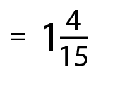

3.8 Common denomination
Step 4:9

Slide 38



3.8 Common denomination
Step 4:10
Notes:
You can’t add fractions with different denominators. Discuss whether you agree or disagree.
(You can add fractions with different denominators, but you need to convert to a common denominator in order to do this.)

