Slide 1
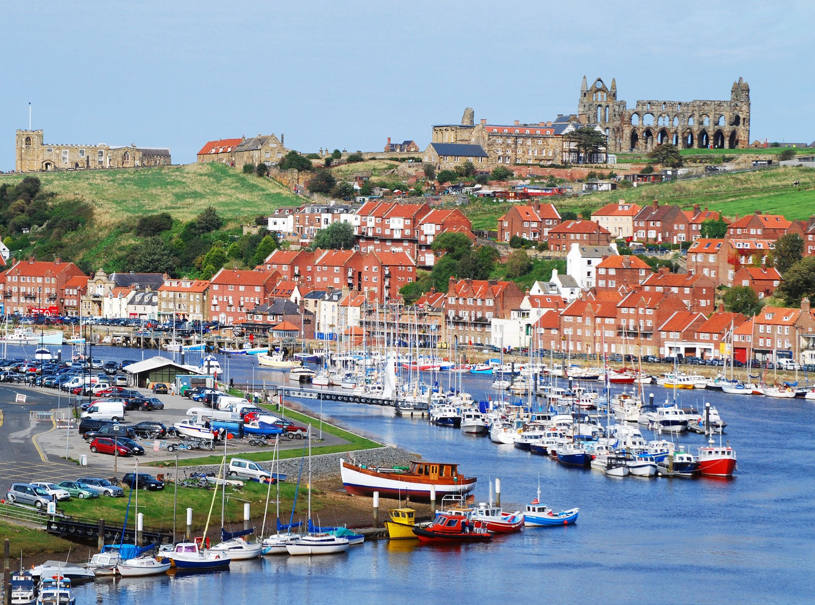
Geography – Whitby – Week 4

Slide 2
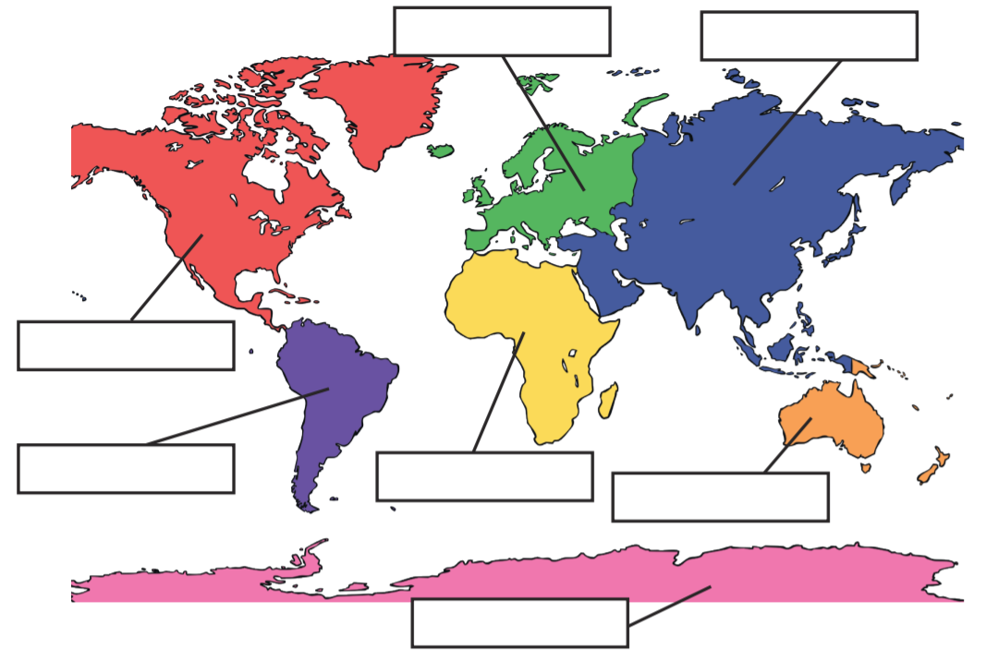
Revision – name the 7 continents of the world

Slide 3
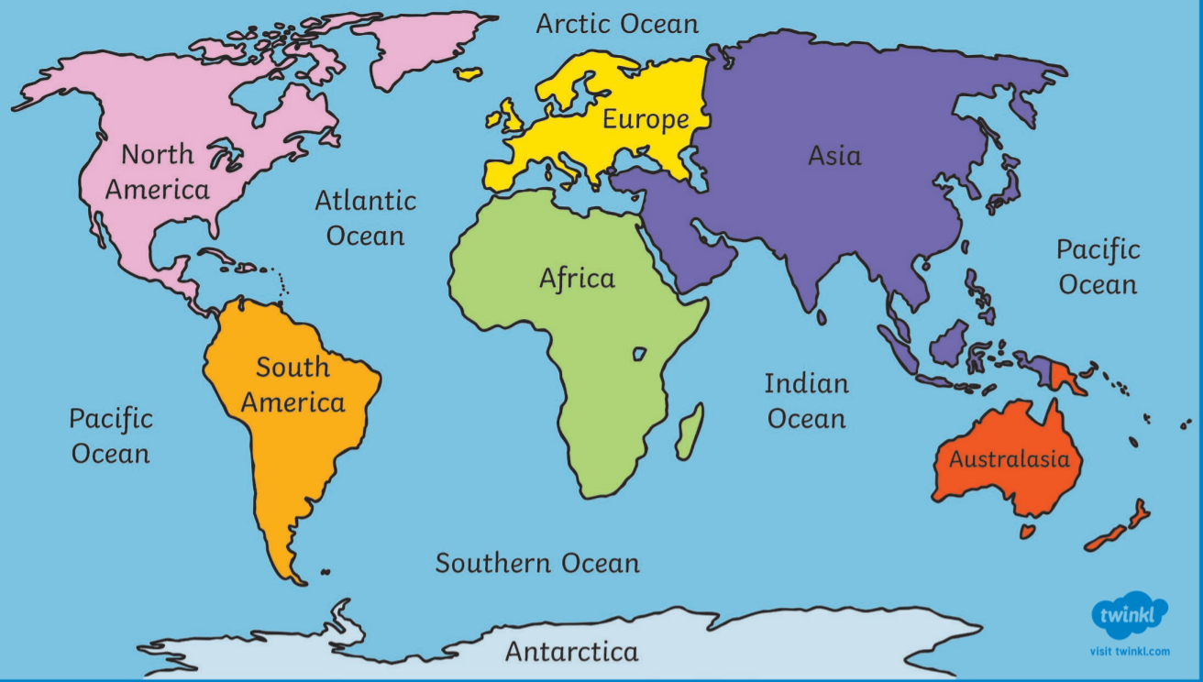
Revision – name the 5 oceans of the world

Slide 4
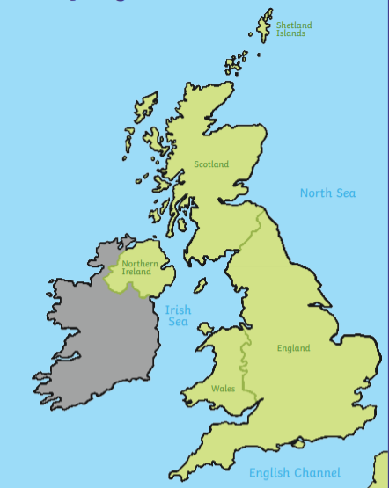
Revision of the geography of the UK
Name the countries and capital cities of the four countries of the United Kingdom.
Which countries make up Great Britain?
What are the seas/oceans surrounding the UK?
Atlantic Ocean
Celtic Sea
Atlantic Ocean

Slide 5
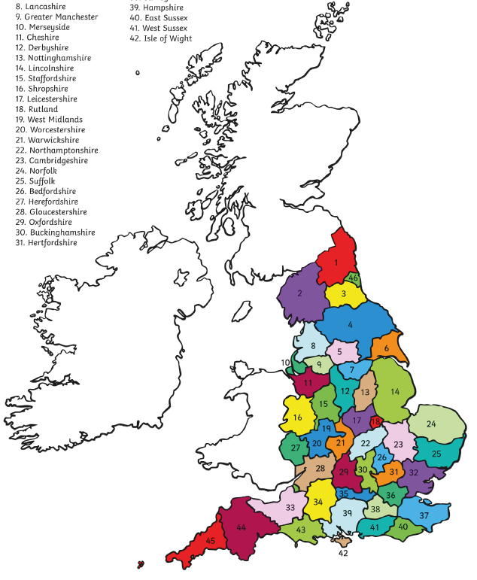
Revision – Counties of the UK
Can you identify the following:
North Yorkshire
West Yorkshire

Slide 6
Revision – Counties of the UK
Can you identify the following:
North Yorkshire – no 4
West Yorkshire – no 5

Slide 7
LC: Can I compare land use in Whitby and Bramhope?
Name different types of land use.
Identify how land is used from a digital map.
Use a key to record the different land use.
Identify similarities and differences between Whitby and Bramhope.

Slide 8
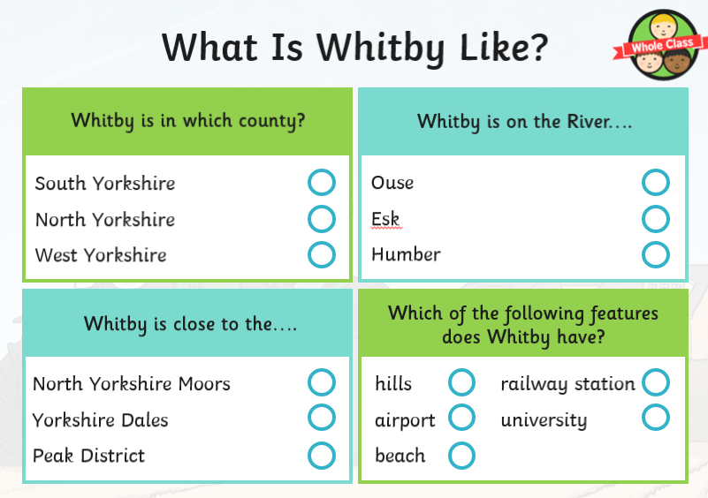

Slide 9
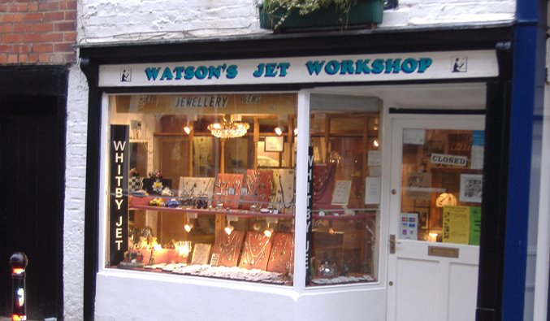
How is land being used in this picture?

Slide 10
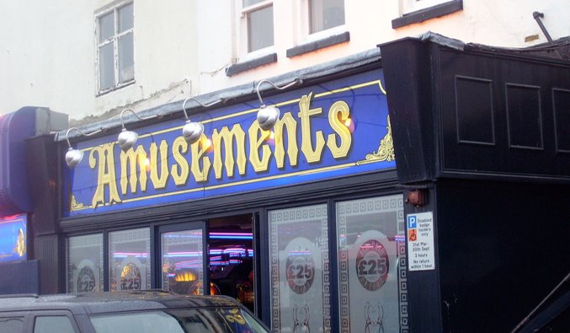
How is land being used in this picture?

Slide 11
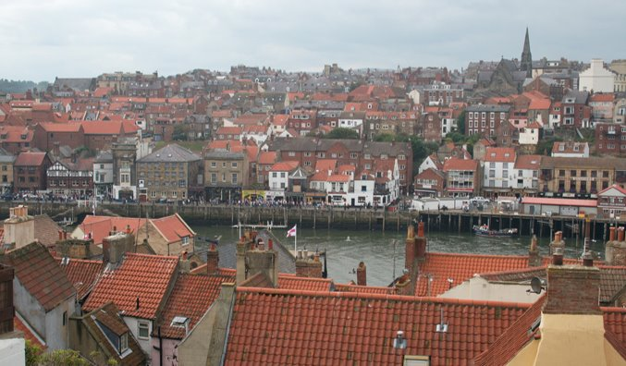
How is land being used in this picture?

Slide 12
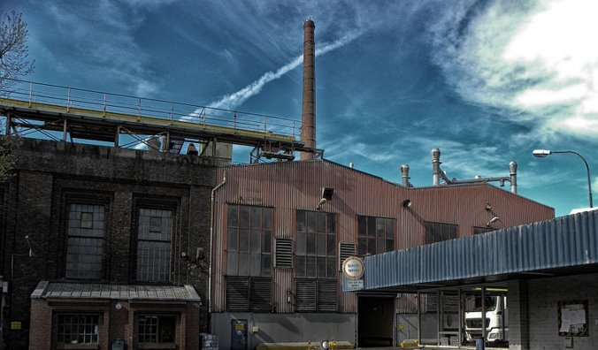
How is land being used in this picture?

Slide 13
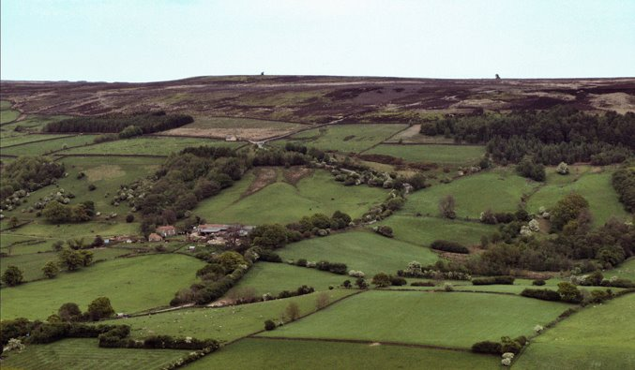
How is land being used in this picture?

Slide 14
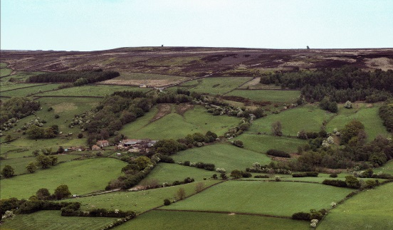
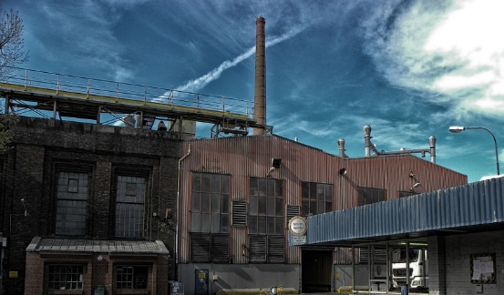
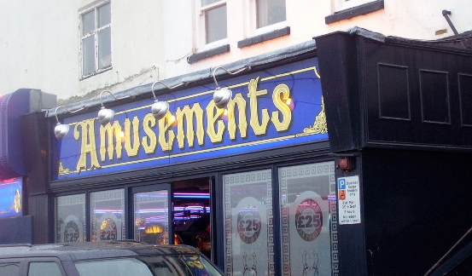
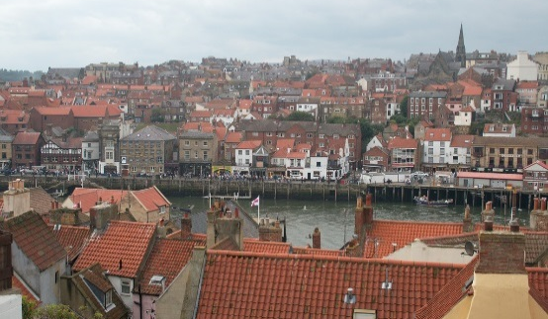
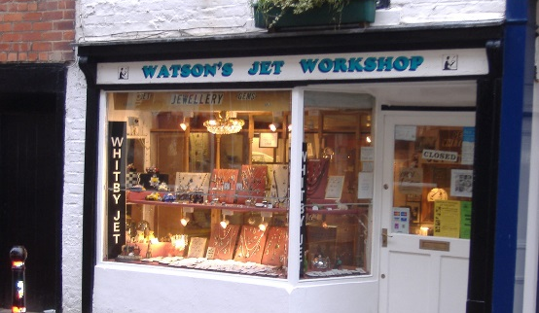
How is land being used in this picture?
agricultural
industrial
leisure
housing
retail

Slide 15
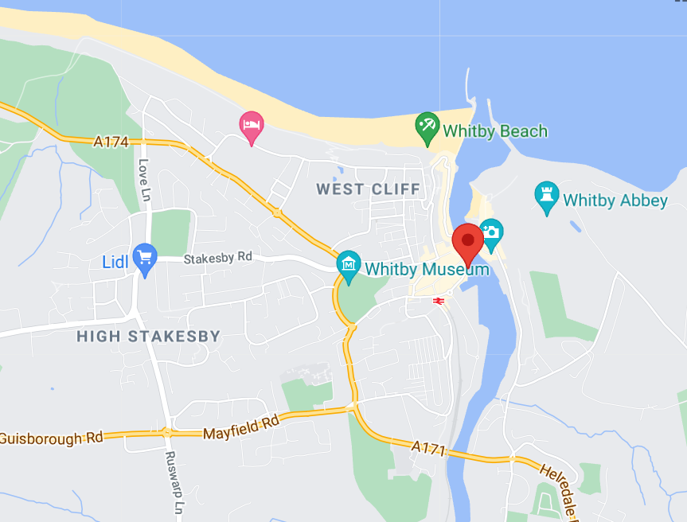
How is land used in Whitby?
Visit Google Maps.
Search for Whitby.
Use the information on the map and from the Earth view to annotate your map to show how areas of land are used.
Colour in your map and don't forget to add your key.

Slide 16
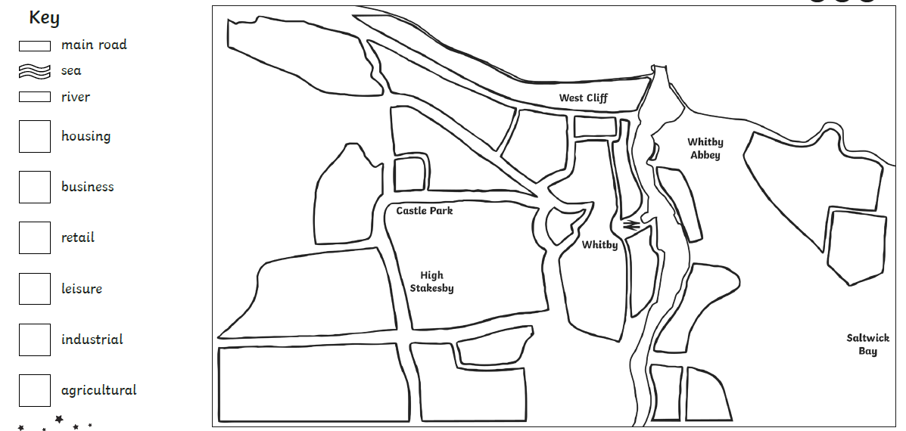
Complete the map and use a key

Slide 17
How is land used where you live? Can you draw a quick sketch map?
Open google maps on Bramhope.
Which are the main roads we need to draw on our sketch map?
Where are the main areas of green space – are they parks or farmland?
How is the land used in the centre of the village?
Where is most of the housing located?
Are there any retail areas we need to add?
What about businesses or industrial estates?

